Slide 1
My ways are not your ways
Isaiah 55:8
AM Sermon
Morningside Church of Christ
Sunday 27 January 2019
By John Staiger

Slide 2
My ways are not your ways
Isaiah 55:8

Slide 3
Isaiah 55:6-9 English Standard Version (ESV)
⁶ “Seek the Lord while he may be found;
call upon him while he is near;
⁷ let the wicked forsake his way,
and the unrighteous man his thoughts;
let him return to the Lord, that he may have compassion on him,
and to our God, for he will abundantly pardon.
⁸ For my thoughts are not your thoughts,
neither are your ways my ways, declares the Lord.
⁹ For as the heavens are higher than the earth,
so are my ways higher than your ways
and my thoughts than your thoughts.

Slide 4

Isaiah 55:6
⁶“Seek the Lord while he may be found;
call upon him while he is near; (ESV)
Man says:
“There’s plenty of time to worry about spiritual things.”
God says:

Slide 5
Isaiah 55:6
⁶“Seek the Lord while he may be found;
call upon him while he is near; (ESV)
Man says:
“There’s plenty of time to worry about spiritual things.”
God says:
Revelation 3:3
³ So remember what you have received and heard; and keep it, and repent. Therefore if you do not wake up, I will come like a thief, and you will not know at what hour I will come to you. (NASB)

Slide 6
Isaiah 55:7
⁷let the wicked forsake his way,
and the unrighteous man his thoughts;
let him return to the Lord, that he may have compassion on him,
and to our God, for he will abundantly pardon. (ESV)
Man says:
“I make mistakes, but what is this talk of wickedness?”
God says:

Slide 7
Isaiah 55:7
⁷let the wicked forsake his way,
and the unrighteous man his thoughts;
let him return to the Lord, that he may have compassion on him,
and to our God, for he will abundantly pardon. (ESV)
Man says:
“I make mistakes, but what is this talk of wickedness?”
God says:
Romans 3:23
All have sinned…
1 Peter 3:11
¹¹ “He must turn away from evil and do good;
He must seek peace and pursue it. (NASB)

Slide 8

Isaiah 55:7
⁷let the wicked forsake his way,
and the unrighteous man his thoughts;
let him return to the Lord, that he may have compassion on him,
and to our God, for he will abundantly pardon. (ESV)

Slide 9
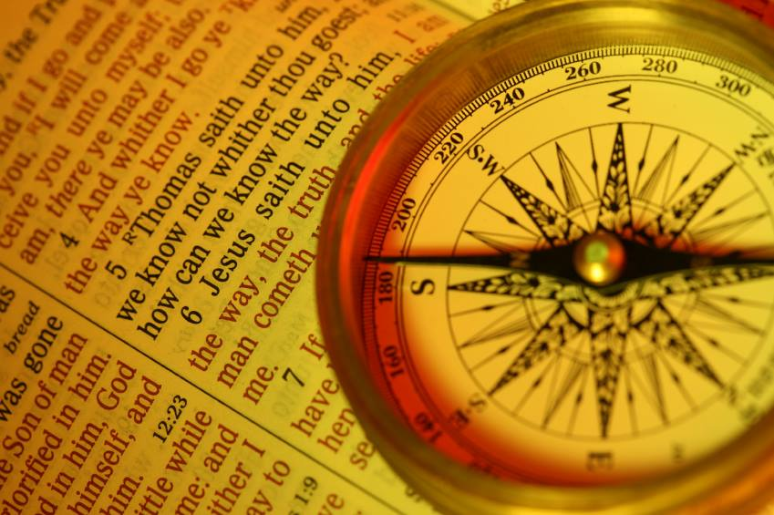
Isaiah 55:8
⁸For my thoughts are not your thoughts,
neither are your ways my ways, declares the Lord. (ESV)
Man says:
“Know thyself!”
“Follow your heart.”
“Let your conscience be your guide.”
God says:

Slide 10
Isaiah 55:8
⁸For my thoughts are not your thoughts,
neither are your ways my ways, declares the Lord. (ESV)
Man says:
“Know thyself!”
“Follow your heart.”
“Let your conscience be your guide.”
God says:
Jeremiah 17:9
⁹ “The heart is more deceitful than all else
And is desperately sick;
Who can understand it? (NASB)

Slide 11

Isaiah 55:9
⁹For as the heavens are higher than the earth,
so are my ways higher than your ways
and my thoughts than your thoughts. (ESV)

Slide 12

Man says:
Seek the good things of this life
God says:

Slide 13
Man says:
Seek the good things of this life
God says:
1 John 2:15
¹⁵ Do not love the world nor the things in the world. If anyone loves the world, the love of the Father is not in him. (NASB)

Slide 14

Man says:
I will control my fear, but
  Lives in fear of
  Scarcity
  Uncertainty
  Loss
  Separation
God says:

Slide 15
Man says:
I will control my fear, but
  Lives in fear of
  Scarcity
  Uncertainty
  Loss
  Separation
God says:
1 John 4:18
¹⁸There is no fear in love; but perfect love casts out fear, because fear involves punishment, and the one who fears is not perfected in love. (NASB)

Slide 16
Man says:
I will control my fear, but
  Death is inevitable
God says:

Slide 17
Man says:
I will control my fear, but
  Death is inevitable
God
Hebrews 2:14-15
¹⁴ Therefore, since the children share in flesh and blood, He Himself likewise also partook of the same, that through death He might render powerless him who had the power of death, that is, the devil, ¹⁵ and might free those who through fear of death were subject to slavery all their lives. (NASB)

Slide 18
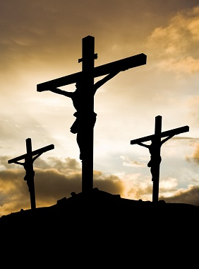
Man says:
The message of the cross is foolishness
God says:

Slide 19
Man says:
The message of the cross is foolishness
God says:
1 Corinthians 1:18
¹⁸For the message of the cross is foolishness to those who are perishing, but to us who are being saved it is the power of God. (NKJV)

Slide 20

Man says:
Dead men don’t rise
God says:

Slide 21
Man says:
Dead men don’t rise
God says:
Romans 1:4
Jesus, “⁴who was declared the Son of God with power by the resurrection from the dead, according to the Spirit of holiness, Jesus Christ our Lord,” (NASB)

Slide 22
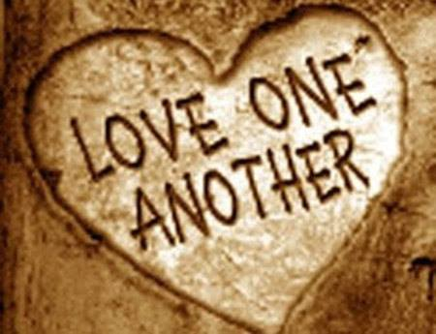
Man says:
Love those who love you
God says:

Slide 23
Man says:
Love those who love you
God says:
Matthew 5:44
⁴⁴ But I say to you, Love your enemies and pray for those who persecute you, (ESV)

Slide 24
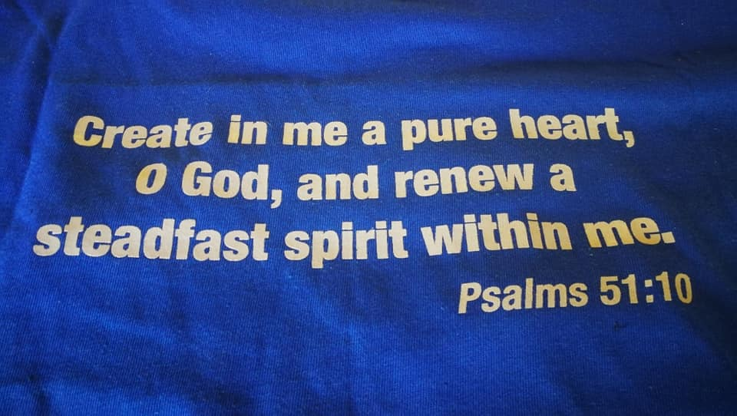

Slide 25

Deuteronomy 6:6-7
⁶ These words, which I am commanding you today, shall be on your heart. ⁷ You shall teach them diligently to your sons and shall talk of them when you sit in your house and when you walk by the way and when you lie down and when you rise up. (NASB)

Slide 26

John 3:5
⁵Jesus answered, “Truly, truly, I say to you, unless one is born of water and the Spirit, he cannot enter the kingdom of God. (ESV)

