Slide 1
Make me a servant
AM Sermon
Morningside Church of Christ
Sunday 24 February 2019
By John Staiger

Slide 2
Make me a Servant

Slide 3

A lot has been said about “Servant Leadership.”
I am not doubting anyone’s sincerity.
But I can’t help but wonder if the word, “Leadership” is the greater motivation.
Let’s face it—No one ever went out of their way to a attend a “Servant” seminar, unless they were absolutely desperate for a job.

Slide 4
What does a
“Servant” look like?

Slide 5
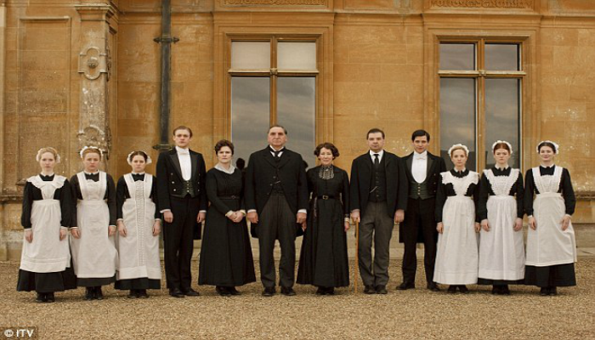

Slide 6

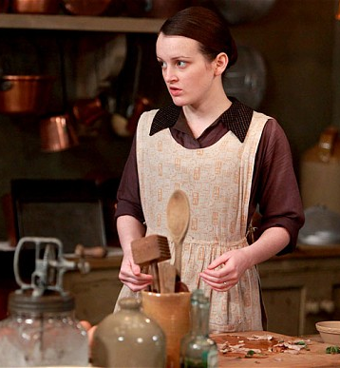
A wise man said, “No one minds being a servant, until you’re treated like one.”

Slide 7
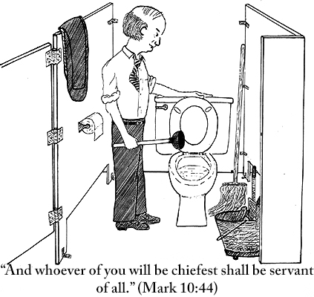

Slide 8

How
Jesus
saw himself

Slide 9
Matthew 12:18-21
¹⁸ “Behold, My Servant whom I have chosen;
My Beloved in whom My soul is well-pleased;
I will put My Spirit upon Him,
And He shall proclaim justice to the Gentiles.
¹⁹ “He will not quarrel, nor cry out;
Nor will anyone hear His voice in the streets.
²⁰ “A battered reed He will not break off,
And a smouldering wick He will not put out,
Until He leads justice to victory.
²¹ “And in His name the Gentiles will hope.” (NASB95)
Jesus is quoting Isaiah 42:1-4

Slide 10
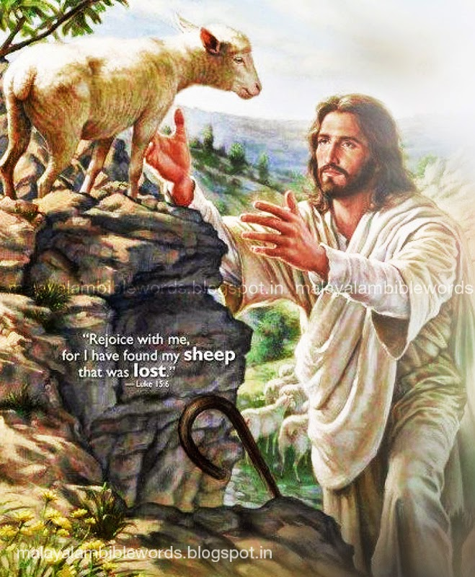
Luke 19:10—¹⁰ For the Son of Man has come to seek and to save
that which was lost.” (NASB95)

Slide 11
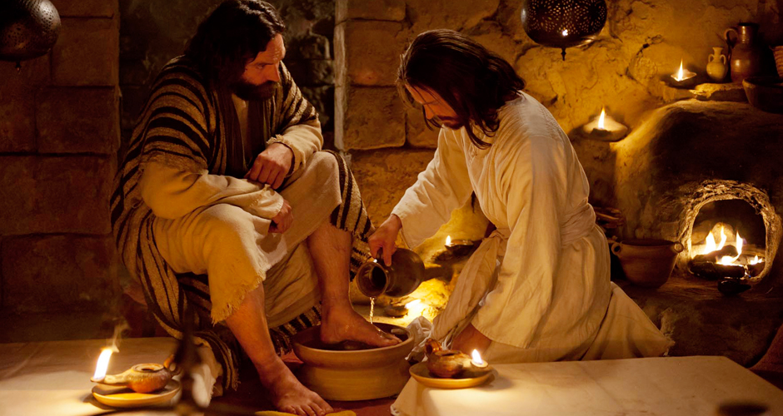
John 13:14-15—¹⁴If I then, the Lord and the Teacher, washed your feet, you also ought to wash one another’s feet. ¹⁵For I gave you an example that you also should do as I did to you. (NASB95)

Slide 12

How
do we
see ourselves?

Slide 13

How we see ourselves is everything

Slide 14
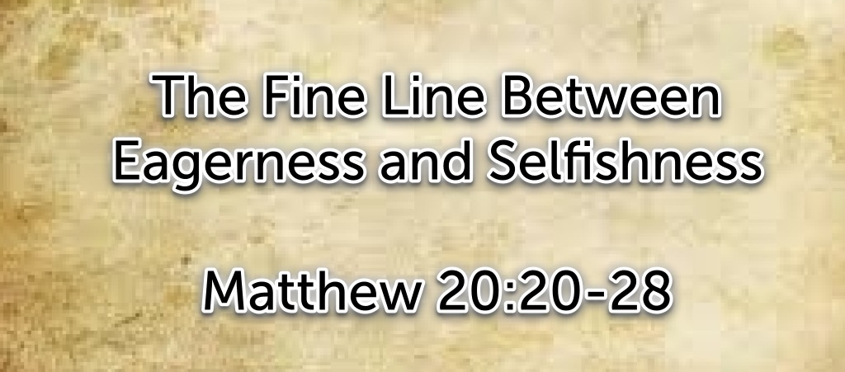
A mother seeing her boys right…!

Slide 15
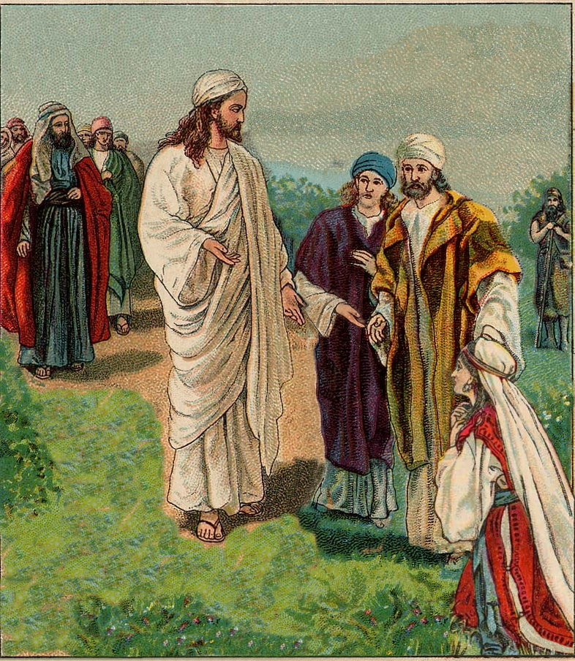

Slide 16
Matthew 20:20-28
²⁰Then the mother of the sons of Zebedee came to Jesus with her sons, bowing down and making a request of Him. ²¹And He said to her, “What do you wish? ”She *said to Him, “Command that in Your kingdom these two sons of mine may sit one on Your right and one on Your left.” ²²But Jesus answered, “You do not know what you are asking. Are you able to drink the cup that I am about to drink?” They *said to Him, “We are able.” ²³He *said to them, “My cup you shall drink; but to sit on My right and on My left, this is not Mine to give, but it is for those for whom it has been prepared by My Father.” (NASB95)

Slide 17
Matthew 20:20-28
²⁴And hearing this, the ten became indignant with the two brothers. ²⁵But Jesus called them to Himself and said, “You know that the rulers of the Gentiles lord it over them, and their great men exercise authority over them. ²⁶It is not this way among you, but whoever wishes to become great among you shall be your servant, ²⁷and whoever wishes to be first among you shall be your slave; ²⁸just as the Son of Man did not come to be served, but to serve, and to give His life a ransom for many.” (NASB95)

Slide 18
Your reactions will tell you everything…
What happens when no one notices?

Slide 19
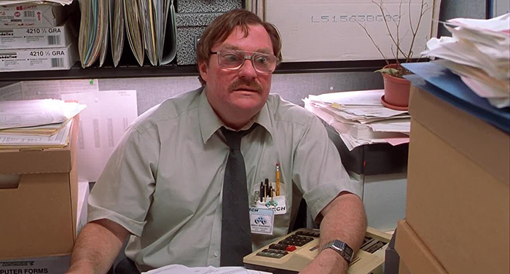
Your reactions will tell you everything…
What happens when no one notices?

Slide 20

Your reactions will tell you everything…
What happens when no one notices?
No one says, “Thank you”?
Someone redoes the job as if it has never been done?
When you are told, “It’s not good enough”?
When you are treated as if you are invisible?
When what you have done upsets others?

Slide 21

Your reactions will tell you everything…
What happens when no one notices?
No one says, “Thank you”?
Someone redoes the job as if it has never been done?

Slide 22

Your reactions will tell you everything…
What happens when no one notices?
No one says, “Thank you”?
Someone redoes the job as if it has never been done?
When you are told, “It’s not good enough”?

Slide 23
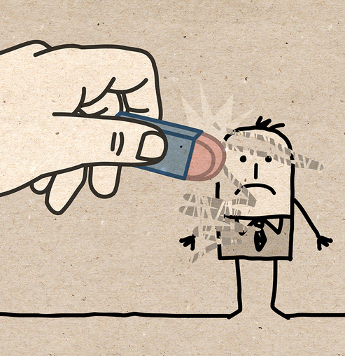
Your reactions will tell you everything…
What happens when no one notices?
No one says, “Thank you”?
Someone redoes the job as if it has never been done?
When you are told, “It’s not good enough”?
When you are treated as if you are invisible?

Slide 24
What to Do

Slide 25
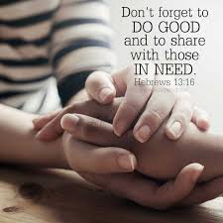
What a servant of Christ does…
Loves others as Christ loves them (Jn.13:34-35)
Puts the spiritual needs of others first
Does no harm
Happy to be last
Does not exalt themselves
Does not desire to be the ‘chief’ servant

Slide 26


Matthew 25:34-40
³⁴“Then the King will say to those on His right, ‘Come, you who are blessed of My Father, inherit the kingdom prepared for you from the foundation of the world. ³⁵For I was hungry, and you gave Me something to eat; I was thirsty, and you gave Me something to drink; I was a stranger, and you invited Me in; ³⁶ naked, and you clothed Me; I was sick, and you visited Me; I was in prison, and you came to Me.’ (NASB95)

Slide 27
Matthew 25:34-40
³⁷ Then the righteous will answer Him, ‘Lord, when did we see You hungry, and feed You, or thirsty, and give You something to drink? ³⁸And when did we see You a stranger, and invite You in, or naked, and clothe You? ³⁹ When did we see You sick, or in prison, and come to You?’ ⁴⁰ The King will answer and say to them, ‘Truly I say to you, to the extent that you did it to one of these brothers of Mine, even the least of them, you did it to Me.’ (NASB95)

Slide 28
Where do I begin?
Becoming a servant of Christ begins when we put on Christ in baptism…

Slide 29


Acts 22:16
¹⁶ Now why do you delay? Get up and be baptized, and wash away your sins, calling on His name.’ (NASB95)

