Slide 1
The Rich Man and Lazarus
Morningside Church of Christ
Sunday 31 March 2019 AM Worship
John Staiger

Slide 2
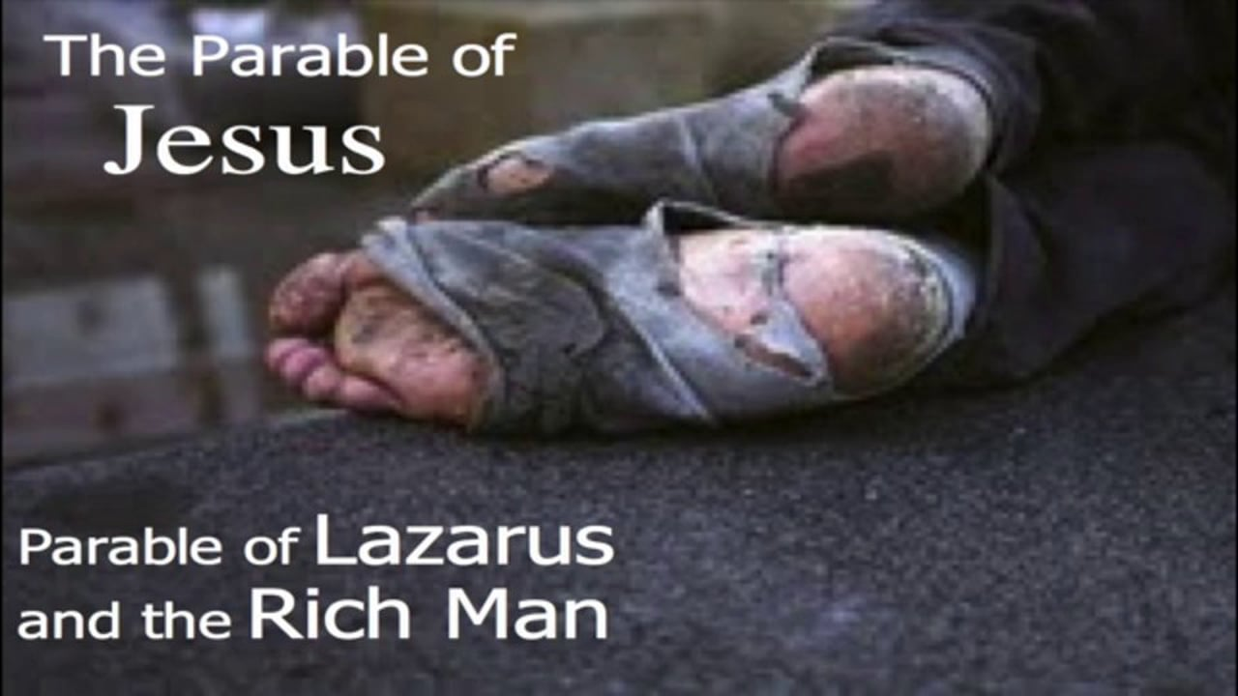
Lazarus And The Rich Man
(Luke 16:19-31)

Slide 3

Luke 16:19- "Now there was a rich man, and he habitually dressed in purple and fine linen, joyously living in splendor every day.

Slide 4
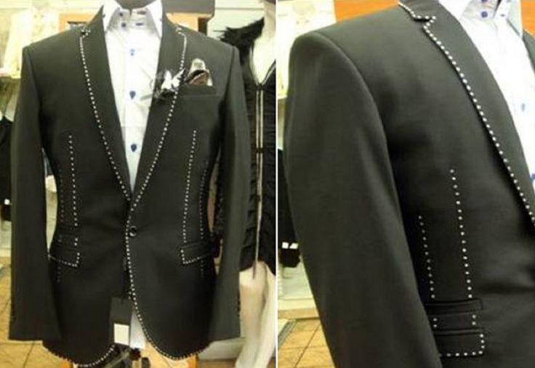
Stuart Hughes Diamond Edition – $892,500 (Not tailor marks – diamonds)

Slide 5

Alexander Amosu Vanquish II Bespoke – $101,860

Slide 6
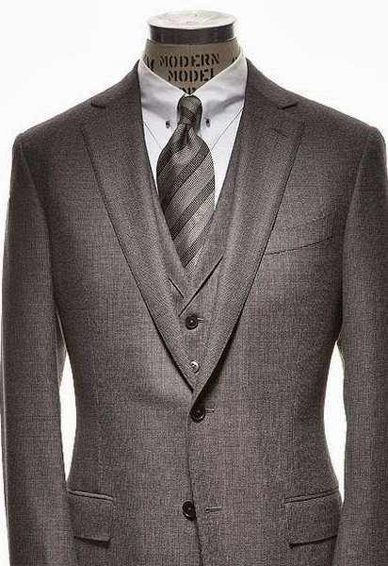
Dormeuil Vanquish II – $95,319

Slide 7
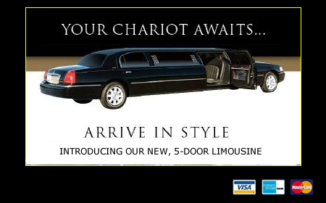
Fared sumptuously every day – joyously living in splendor every day

Slide 8
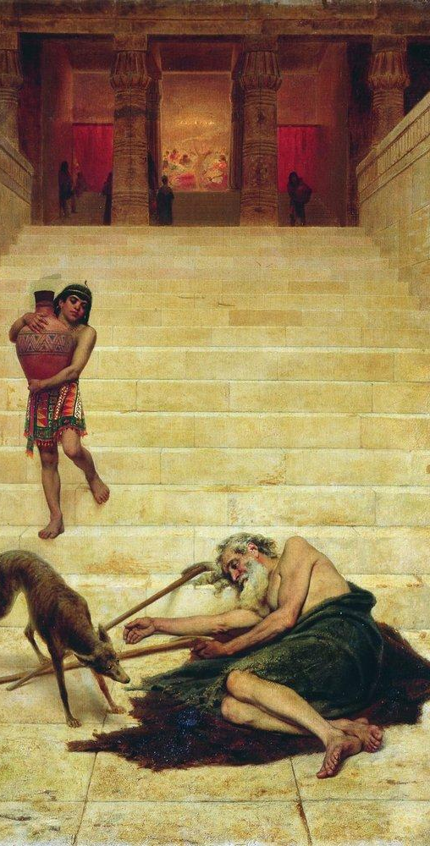
A certain beggar named Lazarus –
Luke 16:20-21 ²⁰ "And a poor man named Lazarus was laid at his gate, covered with sores, ²¹ and longing to be fed with the crumbs which were falling from the rich man's table; besides, even the dogs were coming and licking his sores. (NASB)

Slide 9
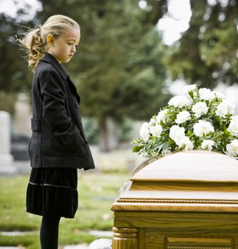
THE RICH MAN AND LAZARUS IN DEATH...
THEY BOTH DIE –
Luke 16:22
²² "Now the poor man died and was carried away by the angels to Abraham's bosom; and the rich man also died and was buried. (NASB)

Slide 10
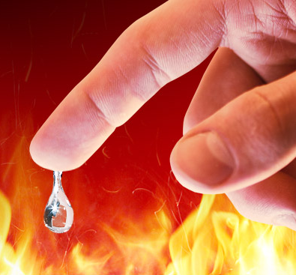
The rich man in torment
Luke 16:23-26
²³ "In Hades he lifted up his eyes, being in torment, and *saw Abraham far away and Lazarus in his bosom.
²⁴ "And he cried out and said, 'Father Abraham, have mercy on me, and send Lazarus so that he may dip the tip of his finger in water and cool off my tongue, for I am in agony in this flame.'
(NASB)

Slide 11
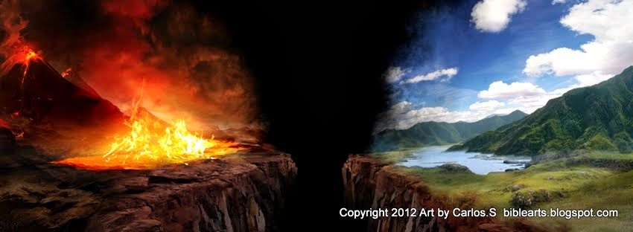
The rich man in torment
Luke 16:23-26—²⁵ "But Abraham said, 'Child, remember that during your life you received your good things, and likewise Lazarus bad things; but now he is being comforted here, and you are in agony. ²⁶ 'And besides all this, between us and you there is a great chasm fixed, so that those who wish to come over from here to you will not be able, and that none may cross over from there to us.’ (NASB)

Slide 12
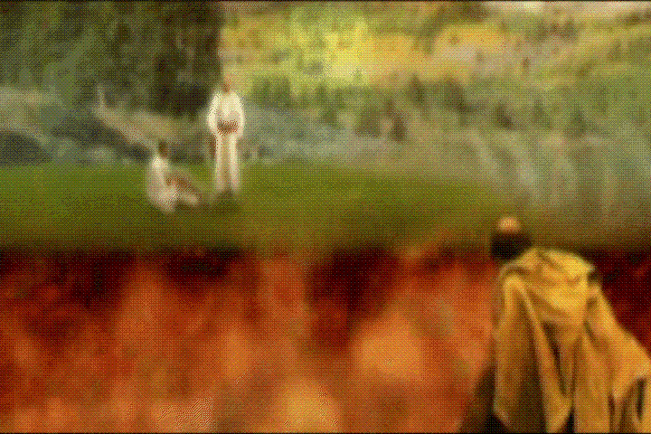

Slide 13
“Hades”
  The etymology of the word – it may be from IDEIN (seen) with a negative prefix A-, meaning “the unseen, invisible”
  Or from AIANES, meaning “gloomy, gruesome”

Slide 14
“Hades”
In Classical Greek...
  Homer used the word as a proper name for the “god of the underworld”
  In other literature, it stood for “the underworld” as the abode of all the dead
    Which was divided into two parts (similar to Luke 16) These two parts were:
      The “Elysian fields”, the abode of the good
      “Tartarus”, the place of punishment for the wicked

Slide 15
In the NT, “Hades” is found eleven times...
Ten times it is translated “hell” or “hades” (Mt 11:23; 16:18; Lk 10:15; 16:23; Ac 2:27, 31; Rev 1:18; 6:8; 20:13,14), and once it is the “grave” (1 Co 15:55)

Slide 16
Hades is used
As the place of the wicked - Lk 16:23
As a place where the wicked are in torment - Lk 16:23
As a temporary place—to be thrown into “the lake of fire” after the Judgment - Rev 20:13-14

Slide 17
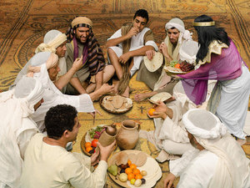
The rich man pleads with Abraham for his five brothers
Luke 16:27-31 (NASB)
²⁷ "And he said, 'Then I beg you, father, that you send him to my father's house—
²⁸ for I have five brothers—in order that he may warn them, so that they will not also come to this place of torment.'

Slide 18
The rich man pleads with Abraham for his five brothers
Luke 16:27-31 (NASB)
²⁹ "But Abraham *said, 'They have Moses and the Prophets; let them hear them.'
³⁰ "But he said, 'No, father Abraham, but if someone goes to them from the dead, they will repent!'
³¹ "But he said to him, 'If they do not listen to Moses and the Prophets, they will not be persuaded even if someone rises from the dead.'"

Slide 19
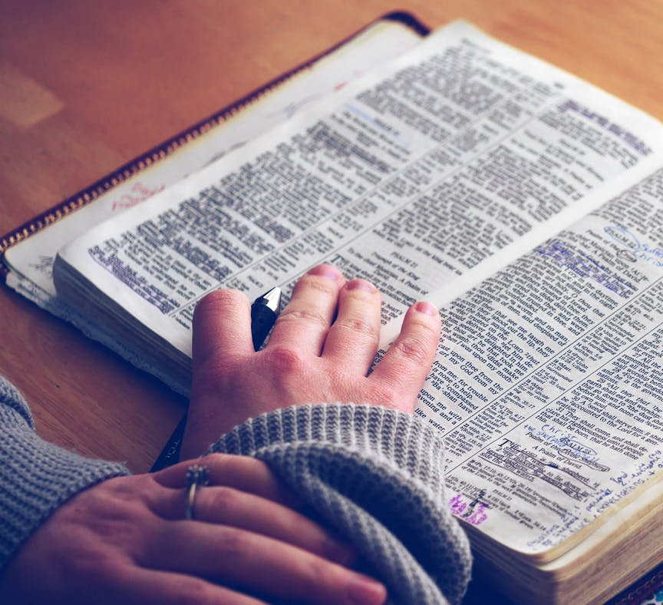
The importance of heeding the Word of God!
Luke 16:29 (NASB)
²⁹ "But Abraham *said, 'They have Moses and the Prophets; let them hear them.’
If God’s Word doesn’t move you to repentance, neither will a miracle! - Luke 16:31

Slide 20
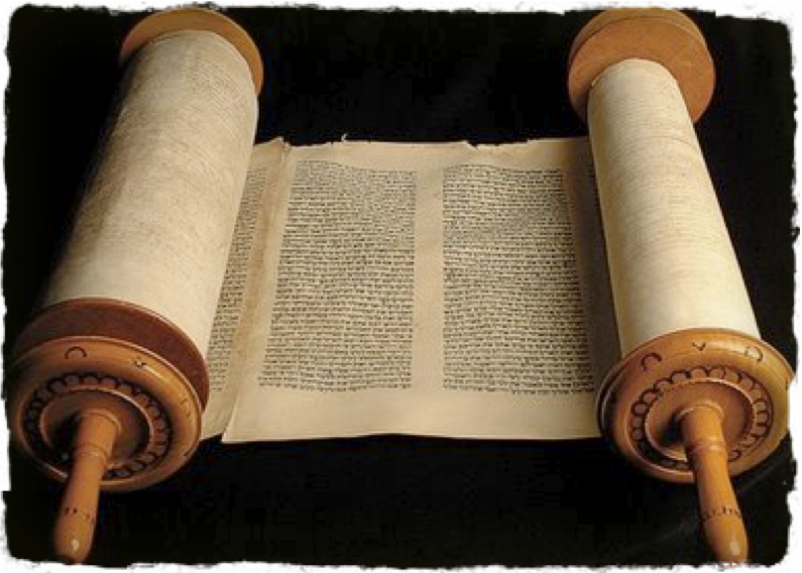
The importance of heeding the Word of God!
Acts 17:1-3 (NASB)
¹ Now when they had traveled through Amphipolis and Apollonia, they came to Thessalonica, where there was a synagogue of the Jews.
² And according to Paul's custom, he went to them, and for three Sabbaths reasoned with them from the Scriptures,
³ explaining and giving evidence that the Christ had to suffer and rise again from the dead, and saying, "This Jesus whom I am proclaiming to you is the Christ."

Slide 21
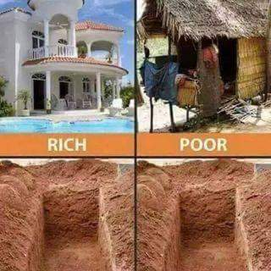
A man’s worldly wealth is no measure of his status in the sight of God
We all have an appointment with death.
Ecclesiastes 2:14 (GW) A wise person uses the eyes in his head, but a fool walks in the dark. But I have also come to realize that the same destiny waits for both of them.
Hebrews 9:27 (ESV) And just as it is appointed for man to die once, and after that comes judgment,

Slide 22
The souls of believers are specially cared for by God in the hour of death
“...carried by angels to Abraham’s bosom” - Luke 16:22
Psalm 116:15 (NASB) 15 Precious in the sight of the LORD Is the death of His godly ones.
Acts 7:55 (NASB) But being full of the Holy Spirit, he gazed intently into heaven and saw the glory of God, and Jesus standing at the right hand of God;

Slide 23
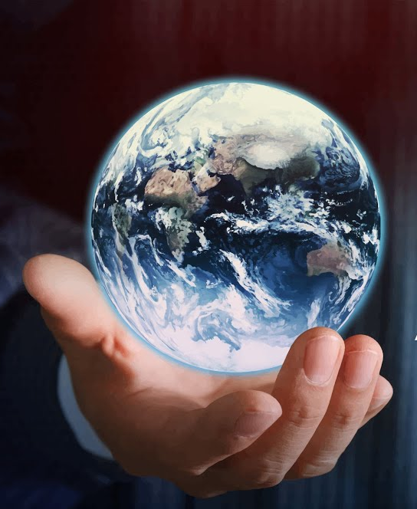
Unconverted souls realize the value of their soul, after death, when it is too late
Matthew 16:26 "For what will it profit a man if he gains the whole world and forfeits his soul? Or what will a man give in exchange for his soul?” (NASB)

Slide 24
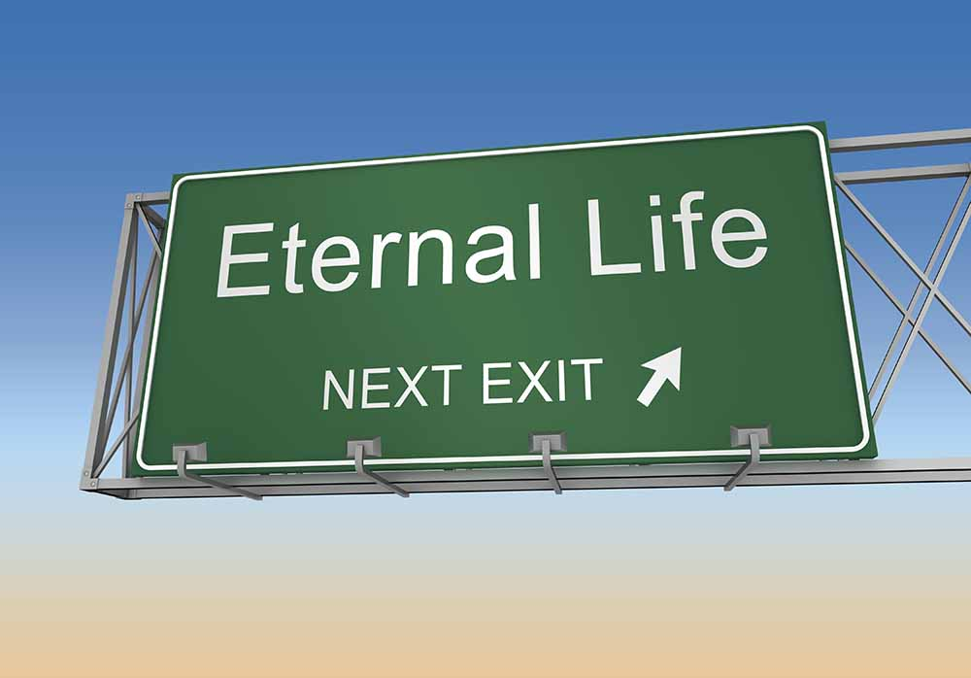
2 Corinthians 5:6-8 (NASB) Therefore, being always of good courage, and knowing that while we are at home in the body we are absent from the Lord— 7 for we walk by faith, not by sight— 8 we are of good courage, I say, and prefer rather to be absent from the body and to be at home with the Lord.

Slide 25
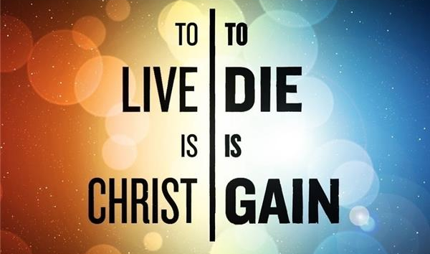
Philippians 1:21-24 (NASB) 21 For to me, to live is Christ and to die is gain. 22 But if I am to live on in the flesh, this will mean fruitful labour for me; and I do not know which to choose. 23 But I am hard-pressed from both directions, having the desire to depart and be with Christ, for that is very much better; 24 yet to remain on in the flesh is more necessary for your sake.

Slide 26

2 Corinthians 5:10-11 (NASB) For we must all appear before the judgment seat of Christ, so that each one may be recompensed for his deeds in the body, according to what he has done, whether good or bad. 11 Therefore, knowing the fear of the Lord, we persuade men…

Slide 27
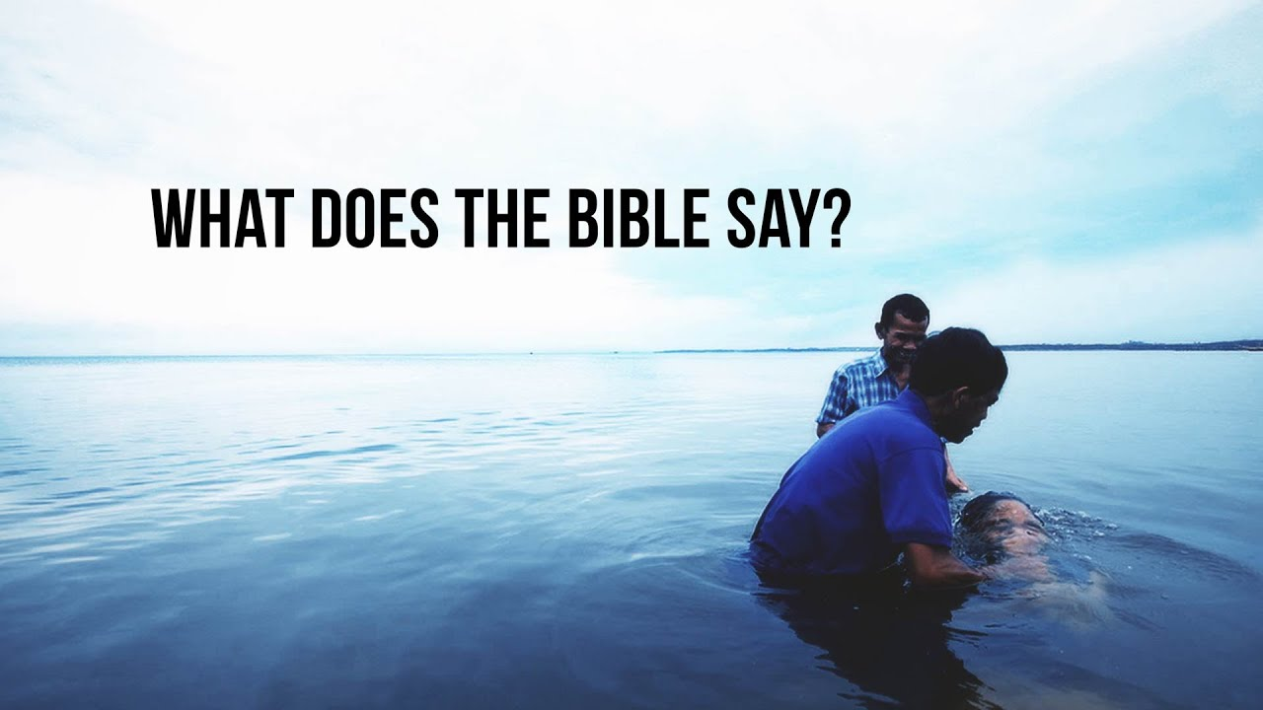
Acts 2:38—³⁸ And Peter said to them, “Repent and be baptized every one of you in the name of Jesus Christ for the forgiveness of your sins, and you will receive the gift of the Holy Spirit. (ESV)

