Slide 1
Love – Right where you are!
AM Sermon
Morningside Church of Christ
Sunday 3 March 2019
By John Staiger

Slide 2
Love – Right where you are!

Slide 3
1. Long term Investment

Slide 4
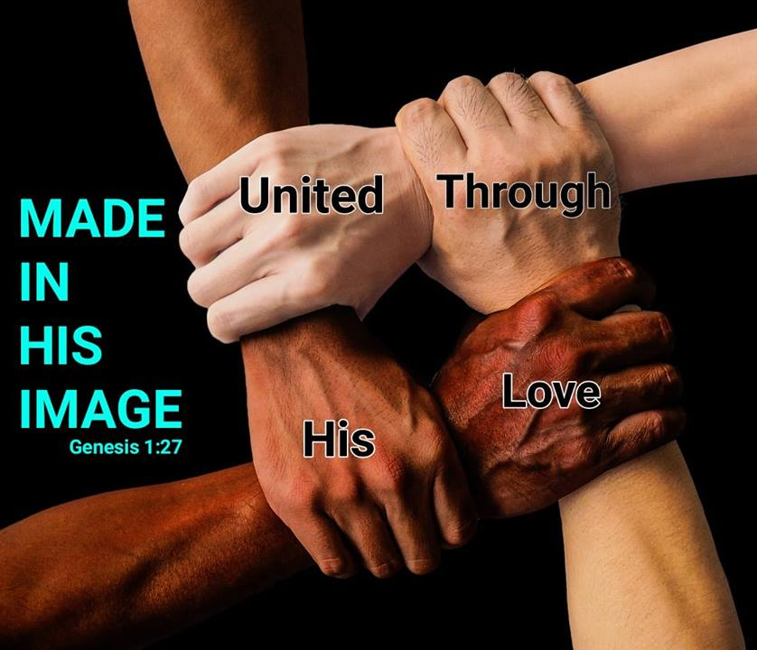

a. There is no lasting unity in the church without it

Slide 5
a. There is no lasting unity in the church without it!
Colossians 3:14—¹⁴And above all these put on love, which binds everything together in perfect harmony. (ESV)

Slide 6
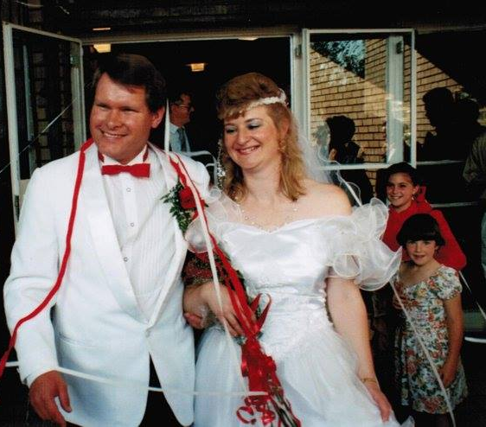
b. There is no lasting unity in marriage without it!

Slide 7
b. There is no lasting unity in marriage without it!
Ephesians 5:33—³³However, let each one of you love his wife as himself, and let the wife see that she respects her husband. (ESV)

Slide 8
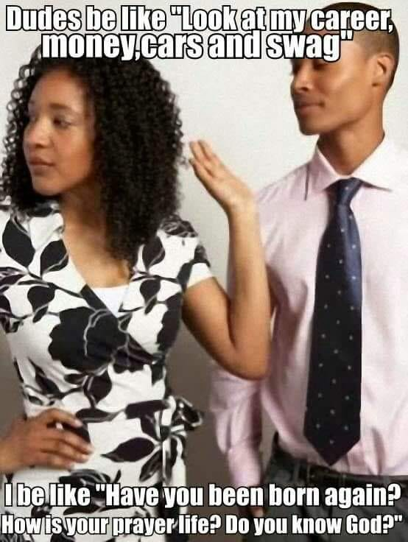

Slide 9
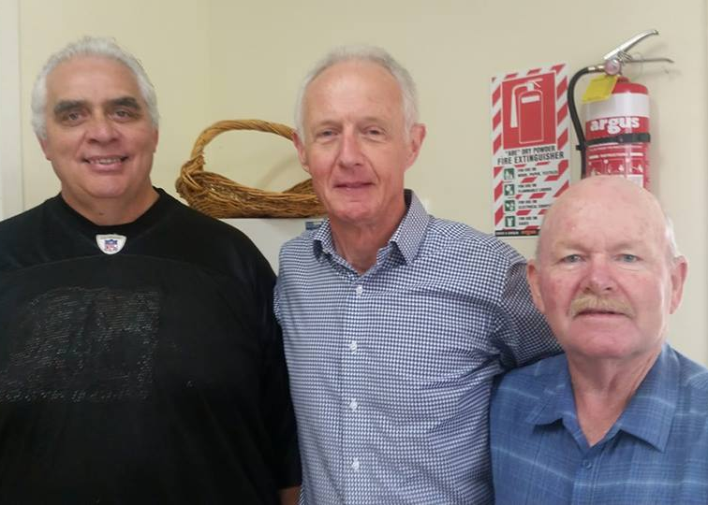
c. There is no lasting unity in brotherhood without it!

Slide 10
c. There is no lasting unity in brotherhood without it!
1 Peter 2:17^{—17}…Love the brotherhood. (ESV)
Proverbs 27:17—¹⁷ Iron sharpens iron,
So one man sharpens another. (NASB95)

Slide 11
2. Love them Anyway

Slide 12

BUT FIRST: Let’s keep it real…What about…?
The unlovable:
Not much in common / Unteachable / selfish / critical
Enemies:
Unforgiving / evil / set their face against you
The unbeliever:
Religiously confused / persecutors
These are real people who come into our lives—Some stay.

Slide 13

BE FIRST…
John 15:12-13—¹²“This is my commandment, that you love one another as I have loved you. ¹³Greater love has no one than this, that someone lay down his life for his friends. (ESV)

Slide 14

BE FIRST…To put in the Effort
1 Peter 4:8—⁸Above all, keep fervent in your love for one another,… (NASB95)
It’s up to you to fuel this fire—Keep it burning!

Slide 15
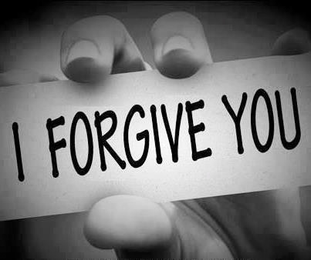
BE FIRST…To Forgive
Ephesians 4:32—³² Be kind to one another, tender-hearted, forgiving each other, just as God in Christ also has forgiven you. (NASB95)

Slide 16

BE FIRST…To get your prayer-life into gear
Matthew 5:44-45
⁴⁴ But I say to you, love your enemies and pray for those who persecute you, (NASB95)
Our enemies cause us to either withdraw in or strike out.
Romans 12:21—²¹ Do not be overcome by evil, but overcome evil with good. (NASB95)

Slide 17

3. A sense Urgency

Slide 18
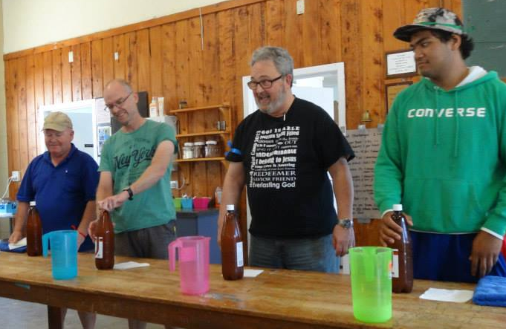

Randy Daw spoke at our camp in 2015.

Slide 19
Randy Daw spoke at our camp in 2015.
He died last Saturday (23-2-2109) at 64.

Slide 20
Randy Daw spoke at our camp in 2015.
He died last Saturday (23-2-2109) at 64.
Randy was ready to meet his God and ours!
He wasn’t sitting around waiting:
  He preached for churches big and small
  He went to Russia, Ukraine, NZ…to take Jesus to the lost.

Slide 21

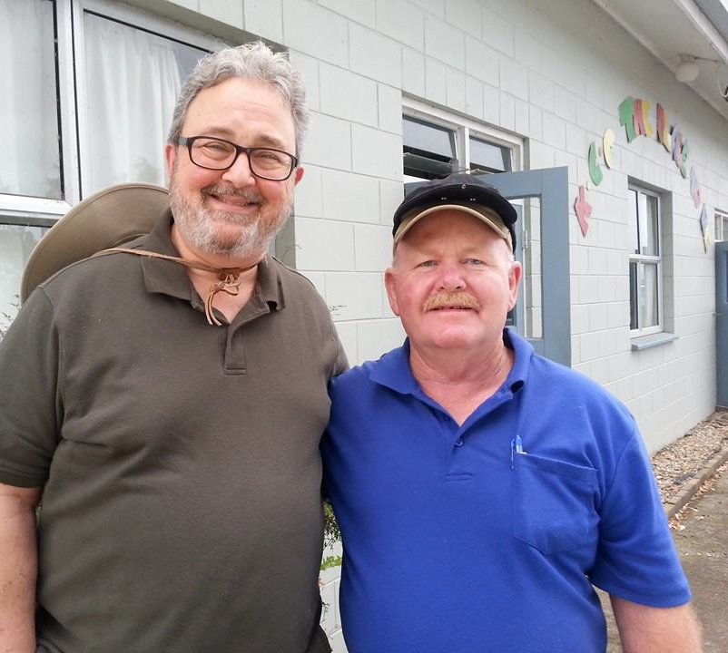
It’s love for
God
and it’s love
for the
souls of man
that makes
men and women
of God
sacrifice
for the
Kingdom of Christ

Slide 22

Our beginning—
In the spirit of Isaiah we respond to the call:
Isaiah 6:8—⁸And I heard the voice of the Lord saying, “Whom shall I send, and who will go for us?” Then I said, “Here I am! Send me.” (ESV)

Slide 23
Our end—
With the apostle Paul we see our end:
2 Timothy 4:7-8—⁷I have fought the good fight, I have finished the race, I have kept the faith. ⁸Henceforth there is laid up for me the crown of righteousness, which the Lord, the righteous judge, will award to me on that day, and not only to me but also to all who have loved his appearing. (ESV)

Slide 24
Our Today—
Paul exhorted Timothy to get on with the work of the day:
1 Timothy 6:12—¹² Fight the good fight of faith; take hold of the eternal life to which you were called, and you made the good confession in the presence of many witnesses. (NASB95)

Slide 25


Our Today—
Love does not shrink back from telling the truth
We speak the truth in love
Jesus is love in the flesh
Out of love we preach Christ and him crucified
1 John 3:16—¹⁶We know love by this, that He laid down His life for us; and we ought to lay down our lives for the brethren. (NASB95)

Slide 26
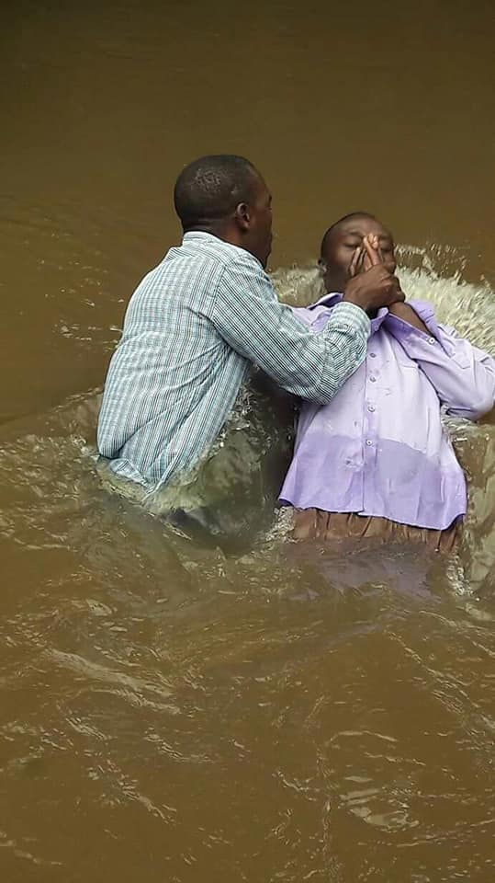
Romans 6:4—⁴ Therefore we have been buried with Him through baptism into death, so that as Christ was raised from the dead through the glory of the Father, so we too might walk in newness of life. (NASB95)

