Slide 1
Character
AM Sermon
Morningside Church of Christ
Sunday 21 April 2019
John Staiger

Slide 2

Character

Slide 3

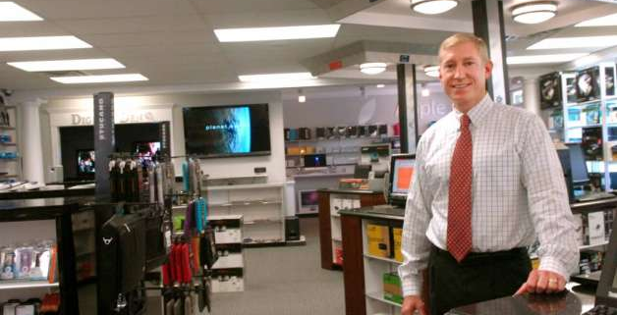
A store owner interviewed a young man for a job.
He asked, "If I hire you to work in my store, will you be honest and truthful?" The young man answered,…

Slide 4

…"I will be honest and truthful whether you hire me or not."

Slide 5

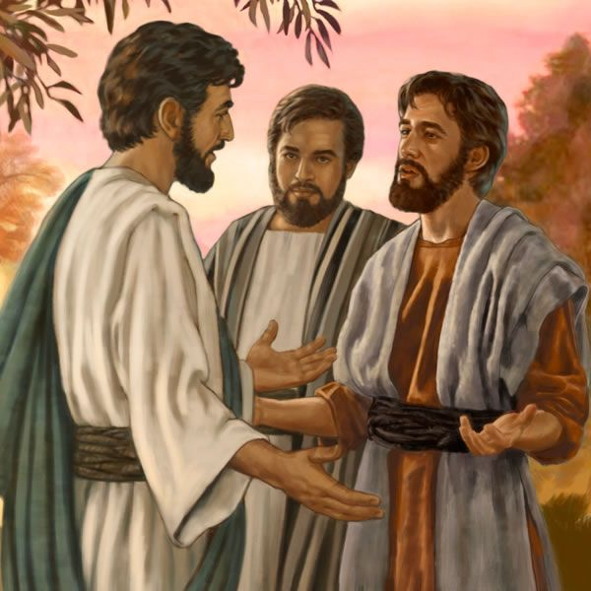
You are your character and your character is you.
John 1:47—⁴⁷Jesus saw Nathanael coming to Him, and *said of him, “Behold, an Israelite indeed, in whom there is no deceit!” (NASB95)

Slide 6
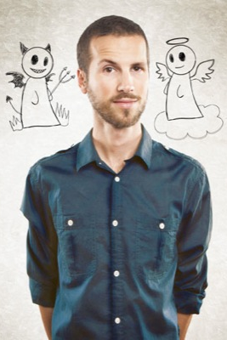
In any given situation

Slide 7

In any given situation
Nothing has changed since the Garden of Eden—The choice is still yours…

Slide 8
In any given situation
How do you see yourself in the daily struggle between right and wrong?
Reactions—

Slide 9
In any given situation
How do you react to:
  Temptation—Overcome or give in?
  Injustice—Ignore or speak up?
  Insult—Return or bless?

Slide 10

Character shown in two women

Slide 11

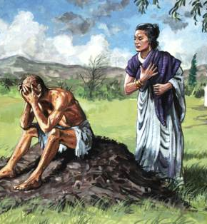
Job 2:9-10
⁹Then his wife said to him, “Do you still hold fast your integrity? Curse God and die!” ¹⁰But he said to her, “You speak as one of the foolish women speaks. Shall we indeed accept good from God and not accept adversity?” In all this Job did not sin with his lips. (NASB95)

Slide 12


Slide 13
Character shown in two groups of men

Slide 14
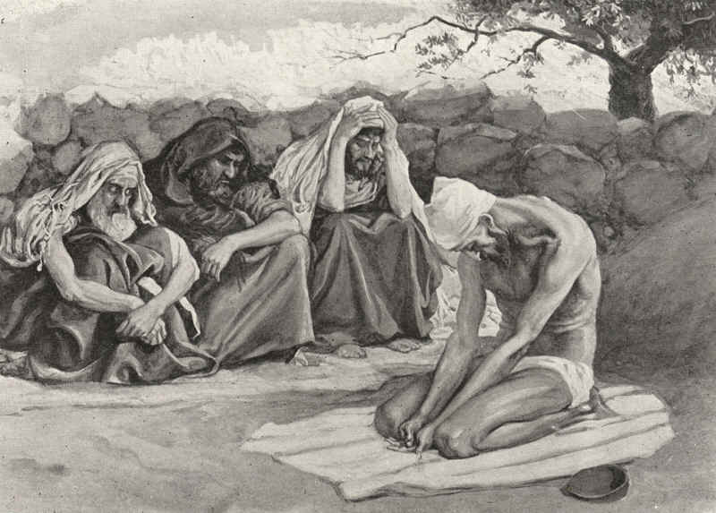
Job’s friends

Slide 15
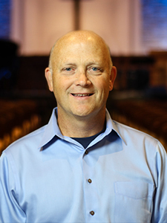
Elders—Qualifications Titus 1. (Appoint Elders v.5.) (Overseer v.7.)
⁶ namely, if any man is above reproach,
2. the husband of one wife,
3. having children who believe, not accused of dissipation or rebellion.
4. ⁷ For the ^{[a]}overseer must be above reproach as God’s steward,
5. not self-willed,
6. not quick-tempered,
7. not addicted to wine,
8. not pugnacious,
9. not fond of sordid gain,
10. ⁸ but hospitable,
11. loving what is good,
12. sensible,
13. just,
14. devout,
15. self-controlled,
16. ⁹ holding fast the faithful word which is in accordance with the teaching, so that he will be able both to exhort in sound doctrine and to refute those who contradict.
Elders
Shepherds
Overseers

Slide 16
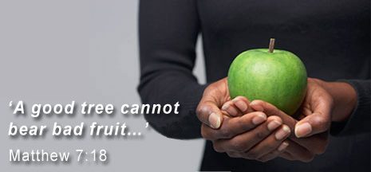
Character—Not just one virtue, or a few, but everything about you.
Not just having sincerity or honesty or doing the right thing:
  Matthew 7:20—²⁰ So then, you will know them by their fruits. (NASB95)

Slide 17
Character—Not just one virtue, or a few, but everything about you.
God knows the inside of the fruit, too:

Slide 18
Character—Not just one virtue, or a few, but everything about you.
God knows the inside of the fruit, too:
  Matthew 7:21-23—²¹ “Not everyone who says to Me, ‘Lord, Lord,’ will enter the kingdom of heaven, but he who does the will of My Father who is in heaven will enter. ²² Many will say to Me on that day, ‘Lord, Lord, did we not prophesy in Your name, and in Your name cast out demons, and in Your name perform many miracles?’ ²³ And then I will declare to them, ‘I never knew you; depart from Me, you who practice lawlessness. (NASB95)

Slide 19
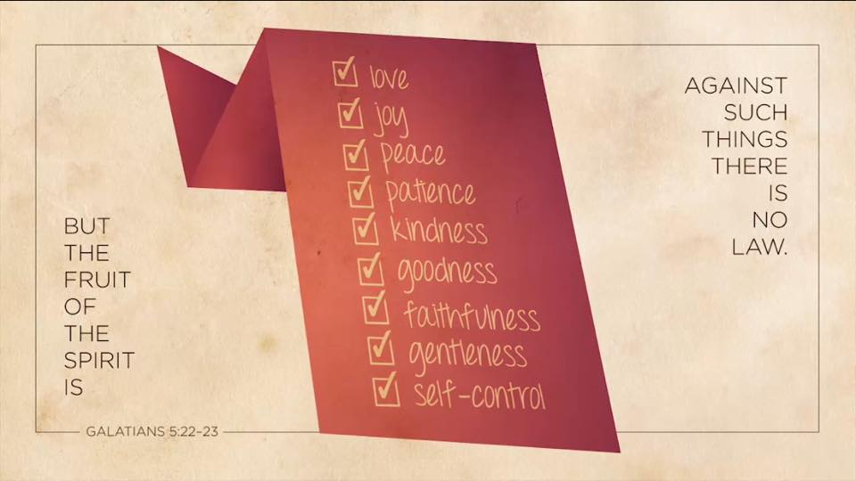
Character—Not just one virtue, or a few, but everything about you.

Slide 20


Slide 21

Christian Character is built on Christ

Slide 22
Christian Character is built on Christ
Man is concerned about built in comfort

Slide 23
Christian Character is built on Christ
Man is concerned about built in comfort
God is concerned about built in character.

Slide 24
Christian Character is built on Christ
Man is concerned about built in comfort
God is concerned about built in character.
Only God can make a man of God

Slide 25
Christian Character is built on Christ
Man is concerned about built in comfort
God is concerned about built in character.
Only God can make a man of God
2 Timothy 2:19
Nevertheless, the firm foundation of God stands, having this seal, “The Lord knows those who are His,” and, “Everyone who names the name of the Lord is to abstain from wickedness.” (NASB95)

Slide 26

Character—In you for others
Proverbs 20:6-7
⁶Many a man proclaims his own steadfast love,
but a faithful man who can find?
⁷The righteous who walks in his integrity—
blessed are his children after him! (ESV)

Slide 27
Character—In you for others
Titus 2:7-8
⁷in all things show yourself to be an
  example of good deeds,
  with purity in doctrine,
  dignified,
  ⁸sound in speech which is beyond reproach,
  so that the opponent will be put to shame,
  having nothing bad to say about us. (NASB95)

Slide 28
Where to Start

Slide 29

Step One—Surrender
    Body, soul and spirit to Jesus Christ and His Lordship of your life.

Slide 30
Step Two—Daily effort
    Work on your Faith
    Cultivate the Mind of Christ within you
    Give yourself to Good Works

Slide 31
Step Three—Let God be God
    ²⁸And we know that God causes all things to work together for good to those who love God, to those who are called according to His purpose. (Rom.8:28)
    ¹² So then, my beloved, just as you have always obeyed, not as in my presence only, but now much more in my absence, work out your salvation with fear and trembling; ¹³for it is God who is at work in you, both to will and to work for His good pleasure. (Phil.2:12-13)

Slide 32
If you haven’t started from the beginning
it time to act…

Slide 33
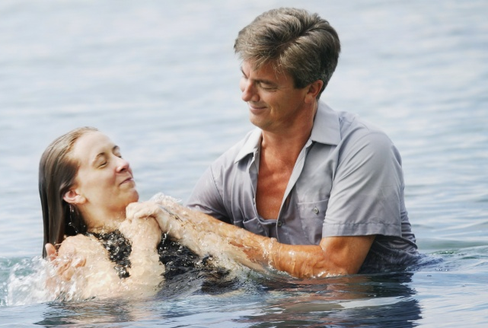
Acts 22:16—Now why do you delay? Get up and be baptized, and wash away your sins, calling on His name.’

