Slide 1
Gentleness of Spirit
AM Sermon
Morningside Church of Christ
Sunday 2 December 2018
By John Staiger

Slide 2
Gentleness of Spirit

Slide 3
Jesus presented Himself as the model of gentleness.

Slide 4
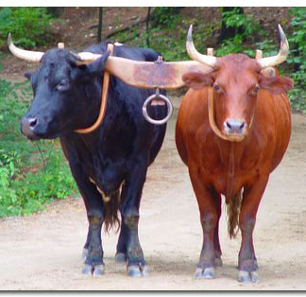
Matthew 11:29-30—²⁸ “Come to Me, all who are weary and heavy-laden, and I will give you rest.²⁹Take my yoke upon you, and learn from me, for I am gentle and lowly in heart, and you will find rest for your souls. ³⁰ For my yoke is easy, and my burden is light.” (ESV) (praus)

Slide 5
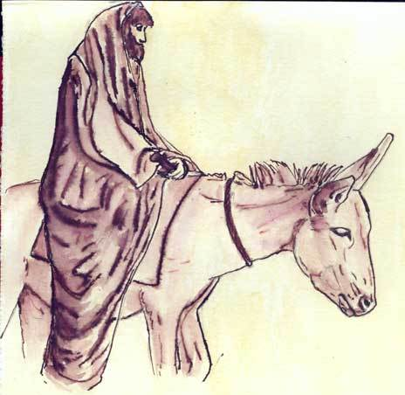
Matthew 21:5
“Say to the daughter of Zion, ‘Behold your King is coming to you, Gentle, and mounted on a donkey, Even on a colt, the foal of a beast of burden.’” (NASB95)
Zech.9:9; (gentle—praus)
The donkey was a symbol of a peace.
Jesus was fulfilling the prophecy of Zechariah 9:9.
The gentle king coming to establish peace.

Slide 6
Jesus’ gentleness of spirit wasn’t without displays of righteous anger.

Slide 7
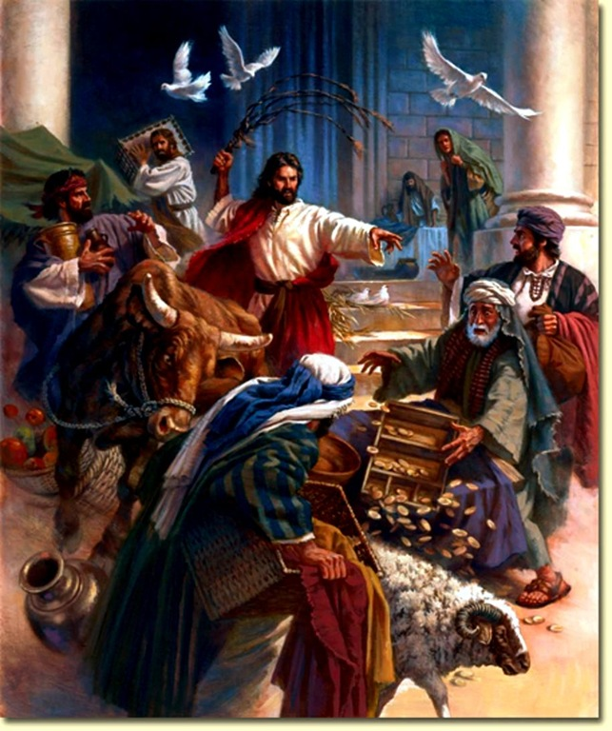
Jesus cleansed the temple
Matthew 21:12-13
¹²And Jesus entered the temple and drove out all those who were buying and selling in the temple, and overturned the tables of the money changers and the seats of those who were selling doves. ¹³ And He *said to them, “It is written, ‘My house shall be called a house of prayer’; but you are making it a robbers’ den.” (NASB95)
Jer.7:11

Slide 8
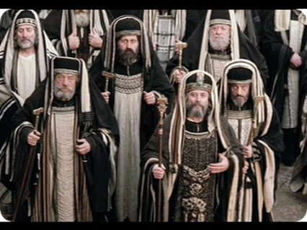
Matthew 23:27-28
²⁷“Woe to you, scribes and Pharisees, hypocrites! For you are like whitewashed tombs which on the outside appear beautiful, but inside they are full of dead men’s bones and all uncleanness. ²⁸So you, too, outwardly appear righteous to men, but inwardly you are full of hypocrisy and lawlessness. (NASB95)
In public Jesus condemned the scribes and pharisees for their hypocrisy (Mt.23).

Slide 9
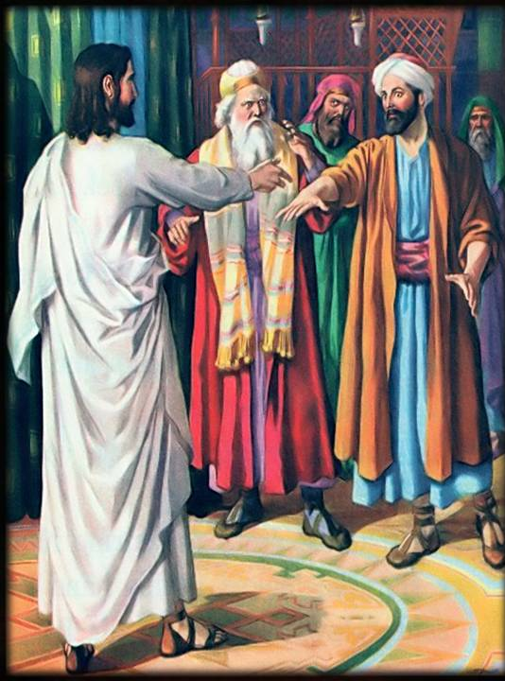
Jesus was being condemned in a synagogue for healing a man with the shrivelled hand on the Sabbath.
He showed his anger toward their stubborn hearts by doing the right thing
Mark 3:5
After looking around at them with anger, grieved at their hardness of heart, He *said to the man, “Stretch out your hand.” And he stretched it out, and his hand was restored. (NASB95)

Slide 10
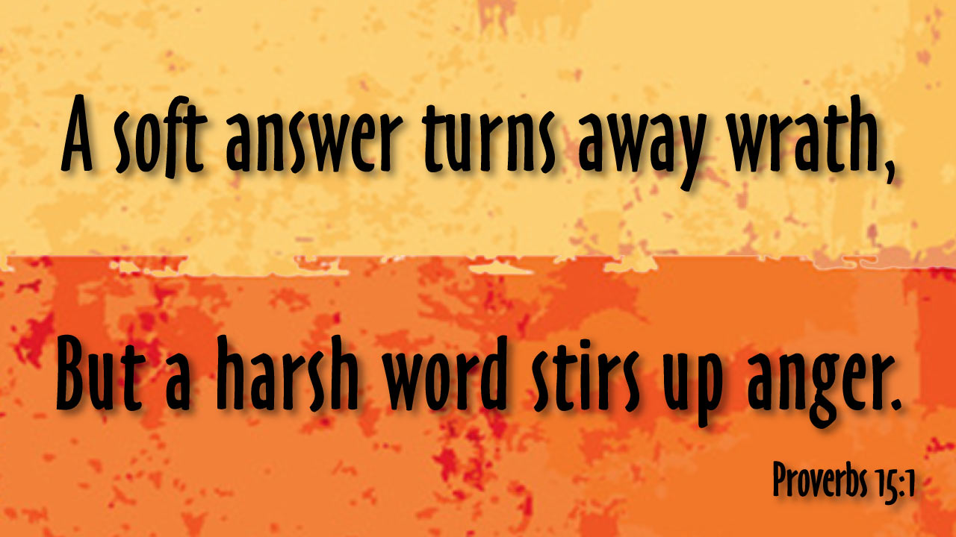
Jesus’ anger was always:
On the right grounds
Against the right person
In the right manner
At the right moment
For the right amount of time
To the desired end…

Slide 11
John 3:17
¹⁷For God did not send the Son into the world to judge the world, but that the world might be saved through Him. (NASB95)

Slide 12
Jesus had no interest in stirring up emotions of hatred.
He told Pilate:
John 18:36—³⁶ Jesus answered, “My kingdom is not of this world. If My kingdom were of this world, then My servants would be fighting so that I would not be handed over to the Jews; but as it is, My kingdom is not of this realm.” (NASB95)

Slide 13
Jesus presents the gentle in spirit as being blessed.

Slide 14

Matthew 5:5
“Blessed are the gentle, for they shall inherit the earth. (NASB95) praeis

Slide 15
Matthew 5:5
“Blessed are the gentle, for they shall inherit the earth. (NASB95) praeis
The blessed child of God has—
  Gentleness of spirit
  Mildness of disposition
  Meekness of temperament
Philippians 4:5—⁵Let your gentle spirit be known to all men. The Lord is near. (NASB95)
(epieikes—Forbearance)

Slide 16
Matthew 5:5
“Blessed are the gentle, for they shall inherit the earth. (NASB95) praeis
The blessed child of God has—
Come to terms with ‘The plague of Silent Anger’
  Passive aggression
  Unresolved issues
  Hurt sitting below the surface
Titus 3:1-2
¹Remind them to be subject to rulers, to authorities, to be obedient, to be ready for every good deed, ²to malign no one, to be peaceable, gentle, showing every consideration for all men. (NASB95)

Slide 17
Matthew 5:5
“Blessed are the gentle, for they shall inherit the earth. (NASB95) praeis
The blessed child of God has—
That disposition of spirit that says:
  “I accept God’s dealings with me as good, and therefore will accept them without disputing or resisting.”
  Job told his wife:
  Job 2:10—¹⁰…“Shall we indeed accept good from God and not accept adversity?” In all this Job did not sin with his lips. (NASB95)

Slide 18
Matthew 5:5
“Blessed are the gentle, for they shall inherit the earth. (NASB95) praeis
The blessed child of God has—
Accepted that the physical world without must be ruled by the spiritual world within:
1 Timothy 6:11—¹⁰For the love of money is a root of all sorts of evil, and some by longing for it have wandered away from the faith and pierced themselves with many griefs. ¹¹But flee from these things, you man of God, and pursue righteousness, godliness, faith, love, perseverance and gentleness. (NASB95) (praupathian)

Slide 19
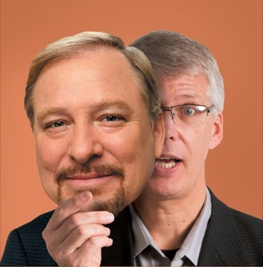
You can’t fake it for too long—
It shows in our ability to get along with others
Ephesians 4:2
with all humility and gentleness, with patience, bearing with one another in love, (ESV)
(prautetos)

Slide 20
You can’t fake it for too long—
It shows in how we react to those who oppose you:
2 Timothy 2:24-25— And the Lord’s servant must not be quarrelsome but kind to everyone, able to teach, patiently enduring evil, ²⁵correcting his opponents with gentleness. God may perhaps grant them repentance leading to a knowledge of the truth (ESV)

Slide 21
You can’t fake it for too long—
It shows his level of godly wisdom:
James 3:13—Who among you is wise and understanding? Let him show by his good behaviour his deeds in the gentleness of wisdom. (NASB95) (prauteti)

Slide 22
You can’t fake it for too long—
It shows on the outside:
1 Peter 3:3-4
Do not let your adorning be external—the braiding of hair and the putting on of gold jewellery, or the clothing you wear— ⁴but let your adorning be the hidden person of the heart with the imperishable beauty of a gentle and quiet spirit, which in God’s sight is very precious. (ESV)

Slide 23
Jesus is calling us to be like Him—Gentle and Humble in heart.
The first step is…

Slide 24

Acts 8:12—¹²But when they believed Philip preaching the good news about the kingdom of God and the name of Jesus Christ, they were being baptized, men and women alike. (NASB95)

