Slide 1
Honour

Slide 2

Godly communication is the bedrock of godly relationships.

Slide 3


Godly relationships are the foundation of a truly useful Christian life.

Slide 4

Is reasoned discourse imperilled?

Slide 5
Is reasoned discourse imperilled?
When was the last time you did this?
Pray for ears that hear—Listen
Pray for a mind of wisdom—Think
Pray for words to heal—Talk
Repeat…

Slide 6
Is reasoned discourse imperilled?
In a world brainwashed into believing that one man’s ‘truth’ is as good as the next man’s ‘truth,’ are we really able to find godly harmony?

Slide 7
Is reasoned discourse imperilled?
Are we too far gone to come back from this messed up world?

Slide 8
Is reasoned discourse imperilled?
Where is
REASIONED
DISCOURSE
at these
days?
What not to do…

Slide 9

Reasoned discourse has increasingly given way to in-your-face sound bites…

Slide 10
Reasoned discourse has increasingly given way to in-your-face sound bites…
Being force-fed ideas never goes down well.

Slide 11
Reasoned discourse has increasingly given way to in-your-face sound bites…
Being force-fed ideas never goes down well.
Since the Lord invites His people to reasonable discussion, so should we:

Slide 12
Reasoned discourse has increasingly given way to in-your-face sound bites…
Being force-fed ideas never goes down well.
Since the Lord invites His people to reasonable discussion, so should we:
Isaiah 1:18—“Come now, and let us reason together,” Says the Lord, “Though your sins are as scarlet, They will be as white as snow; Though they are red like crimson, They will be like wool. (NASB95)

Slide 13



When our interchanges are confrontational, divisive, and dismissive.

Slide 14
When our interchanges are confrontational, divisive, and dismissive.
These things are clear indications of a lack of spiritual progress

Slide 15
When our interchanges are confrontational, divisive, and dismissive.
These things are clear indications of a lack of spiritual progress
Hebrews 5:14—But solid food is for the mature, who because of practice have their senses trained to discern good and evil. (NASB95)

Slide 16
When our interchanges are confrontational, divisive, and dismissive.
The mature Christian has grown out of this ungodly behaviour.

Slide 17
When our interchanges are confrontational, divisive, and dismissive.
The mature Christian has grown out of this ungodly behaviour.
Titus 2:11-13—¹ For the grace of God has appeared, bringing salvation to all men,¹²instructing us to deny ungodliness and worldly desires and to live sensibly, righteously and godly in the present age, ¹³looking for the blessed hope and the appearing of the glory of our great God and Saviour, Christ Jesus, (NASB95)

Slide 18

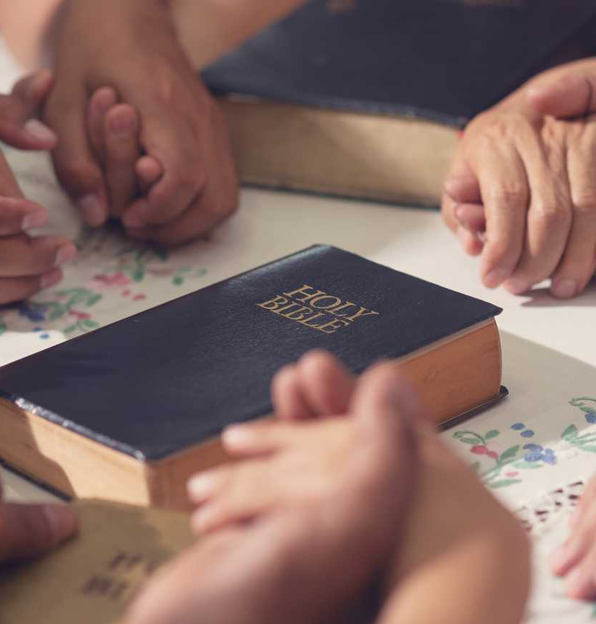
If truth is not something we expect to emerge from a conversation—Reasoned discourse will not be invited.
Truth is imbibed into our hearts and minds by reading, meditating, talking, obeying the word of God.
It changes us.
Truth is carried around in our in our thoughts and feelings, expressed in our words and actions.

Slide 19
If truth is not something we expect to emerge from a conversation—Reasoned discourse will not be invited.
Truth is imbibed into our hearts and minds by reading, meditating, talking about and obeying the word of God.
It changes us.
Truth is carried around in our in our thoughts and feelings, expressed in our words and actions.

Slide 20
If truth is not something we expect to emerge from a conversation—Reasoned discourse will not be invited.
Truth is imbibed into our hearts and minds by reading, meditating, talking about and obeying the word of God.
It changes us.
Truth is carried around in our in our thoughts and feelings, expressed in our words and actions.

Slide 21
If truth is not something we expect to emerge from a conversation—Reasoned discourse will not be invited.
Truth is imbibed into our hearts and minds by reading, meditating, talking about and obeying the word of God.
It changes us.
Truth is carried around in our in our thoughts and feelings, expressed in our words and actions.

Slide 22

Honour is the Answer
Christians should give honor to whom honor is due.

Slide 23
Honour is the Answer
Christians should give honor to whom honor is due.
To who is it due…?

Slide 24
Honour is the Answer
1 Peter 2:17
Honour all people, love the brotherhood, fear God, honour the king.
Put another way…

Slide 25
Honour is the Answer
1 Peter 2:17
Honour all people, love the brotherhood, fear God, honour the king. (NASB95)
God
Church
Government
Everyone—All people

Slide 26
Honour is the Answer
Romans 12:10
Be devoted to one another in brotherly love; give preference to one another in honour; (NASB95)

Slide 27
Honour is the Answer
Philippians 2:3
³ Do nothing from selfishness or empty conceit, but with humility of mind regard one another as more important than yourselves; (NASB95)

Slide 28

Honour Jesus
1 Timothy 1:17
Now to the King eternal, immortal, invisible, the only God, be honour and glory forever and ever. Amen.
He is Creator, Saviour, King, Mentor and Friend—He is worthy!
How we talk about him is the level standard of honour we demonstrate for him.

Slide 29
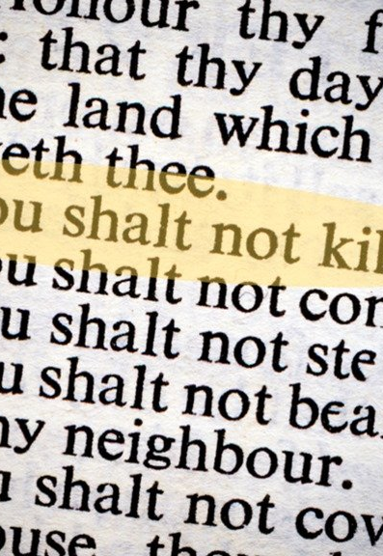
Honour Life
The last thing LaShanda Calloway saw before she died was people literally stepping over her to continue shopping as if nothing had happened. Calloway had stopped to shop in a convenience store in Wichita, Kansas, when she was stabbed in an altercation. As she lay dying, a surveillance camera recorded no less than five people stepping over her to continue down the store’s aisles. Only one stopped briefly—to take a picture of Calloway with a cell phone camera. (2007)

Slide 30

Honour your parents
Ephesians 6:1-3
Children, obey your parents in the Lord, for this is right. ²Honour your father and mother (which is the first commandment with a promise), ³so that it may be well with you, and that you may live long on the earth.
Exodus 20:12
    The 4th Commandment / 1st Promise

Slide 31
Honour your parents
In Ephesians 6:2 the Greek verb “timaō” is used and means “to estimate” of “to fix the value of” and also “to revere” or “venerate” so to honour our parents is to have a high estimation of them, to revere them or have a high regard for them, so much so that it holds a lot of weight as we know it does before God.

Slide 32
Honour your parents
This fifth command doesn’t say to honour your parents if they are worthy of it or if they are Christian. This commandment is not qualified by extenuating circumstances.

Slide 33
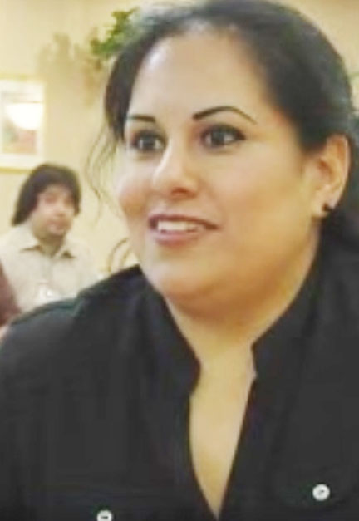
Honour pays off
Every day, for close to seven years, Walter "Buck" Swords cursed and stomped his feet in his favourite restaurant, Luby’s Cafeteria, demanding that he get his food exactly as he wanted it. Every day, for close to seven years, his preferred waitress, Melina Salazar, offered a patient smile and did whatever she could to help her most stubborn customer. After years of thankless service, Salazar was rewarded. When Swords died at 89 years old, just days before Christmas (2007), …

Slide 34
Honour pays off
…he left Salazar $50,000 and a 2000 Buick.
“I still can’t believe it,” she said. After all, she says, he was always “kind of mean.”

Slide 35
