Slide 1
I’m not Ashamed
PM Sermon
Morningside Church of Christ
Sunday 21 April 2019
John Staiger

Slide 2
I’m not Ashamed

Slide 3

Life can be daunting
Like a deer caught in the headlights
The way ahead out of focus
…and the last thing on our minds is evangelism

Slide 4

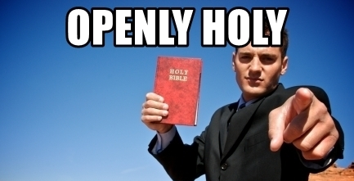
Is this you…?

Slide 5
Can you see yourself preaching in public like this?

Slide 6
Can a Christian be accused of being ashamed of Christ if they don’t preach in public?

Slide 7


Maybe you prefer a quieter approach.
Visual objects:
  Biblical
  Helpful
  Confronting

Slide 8
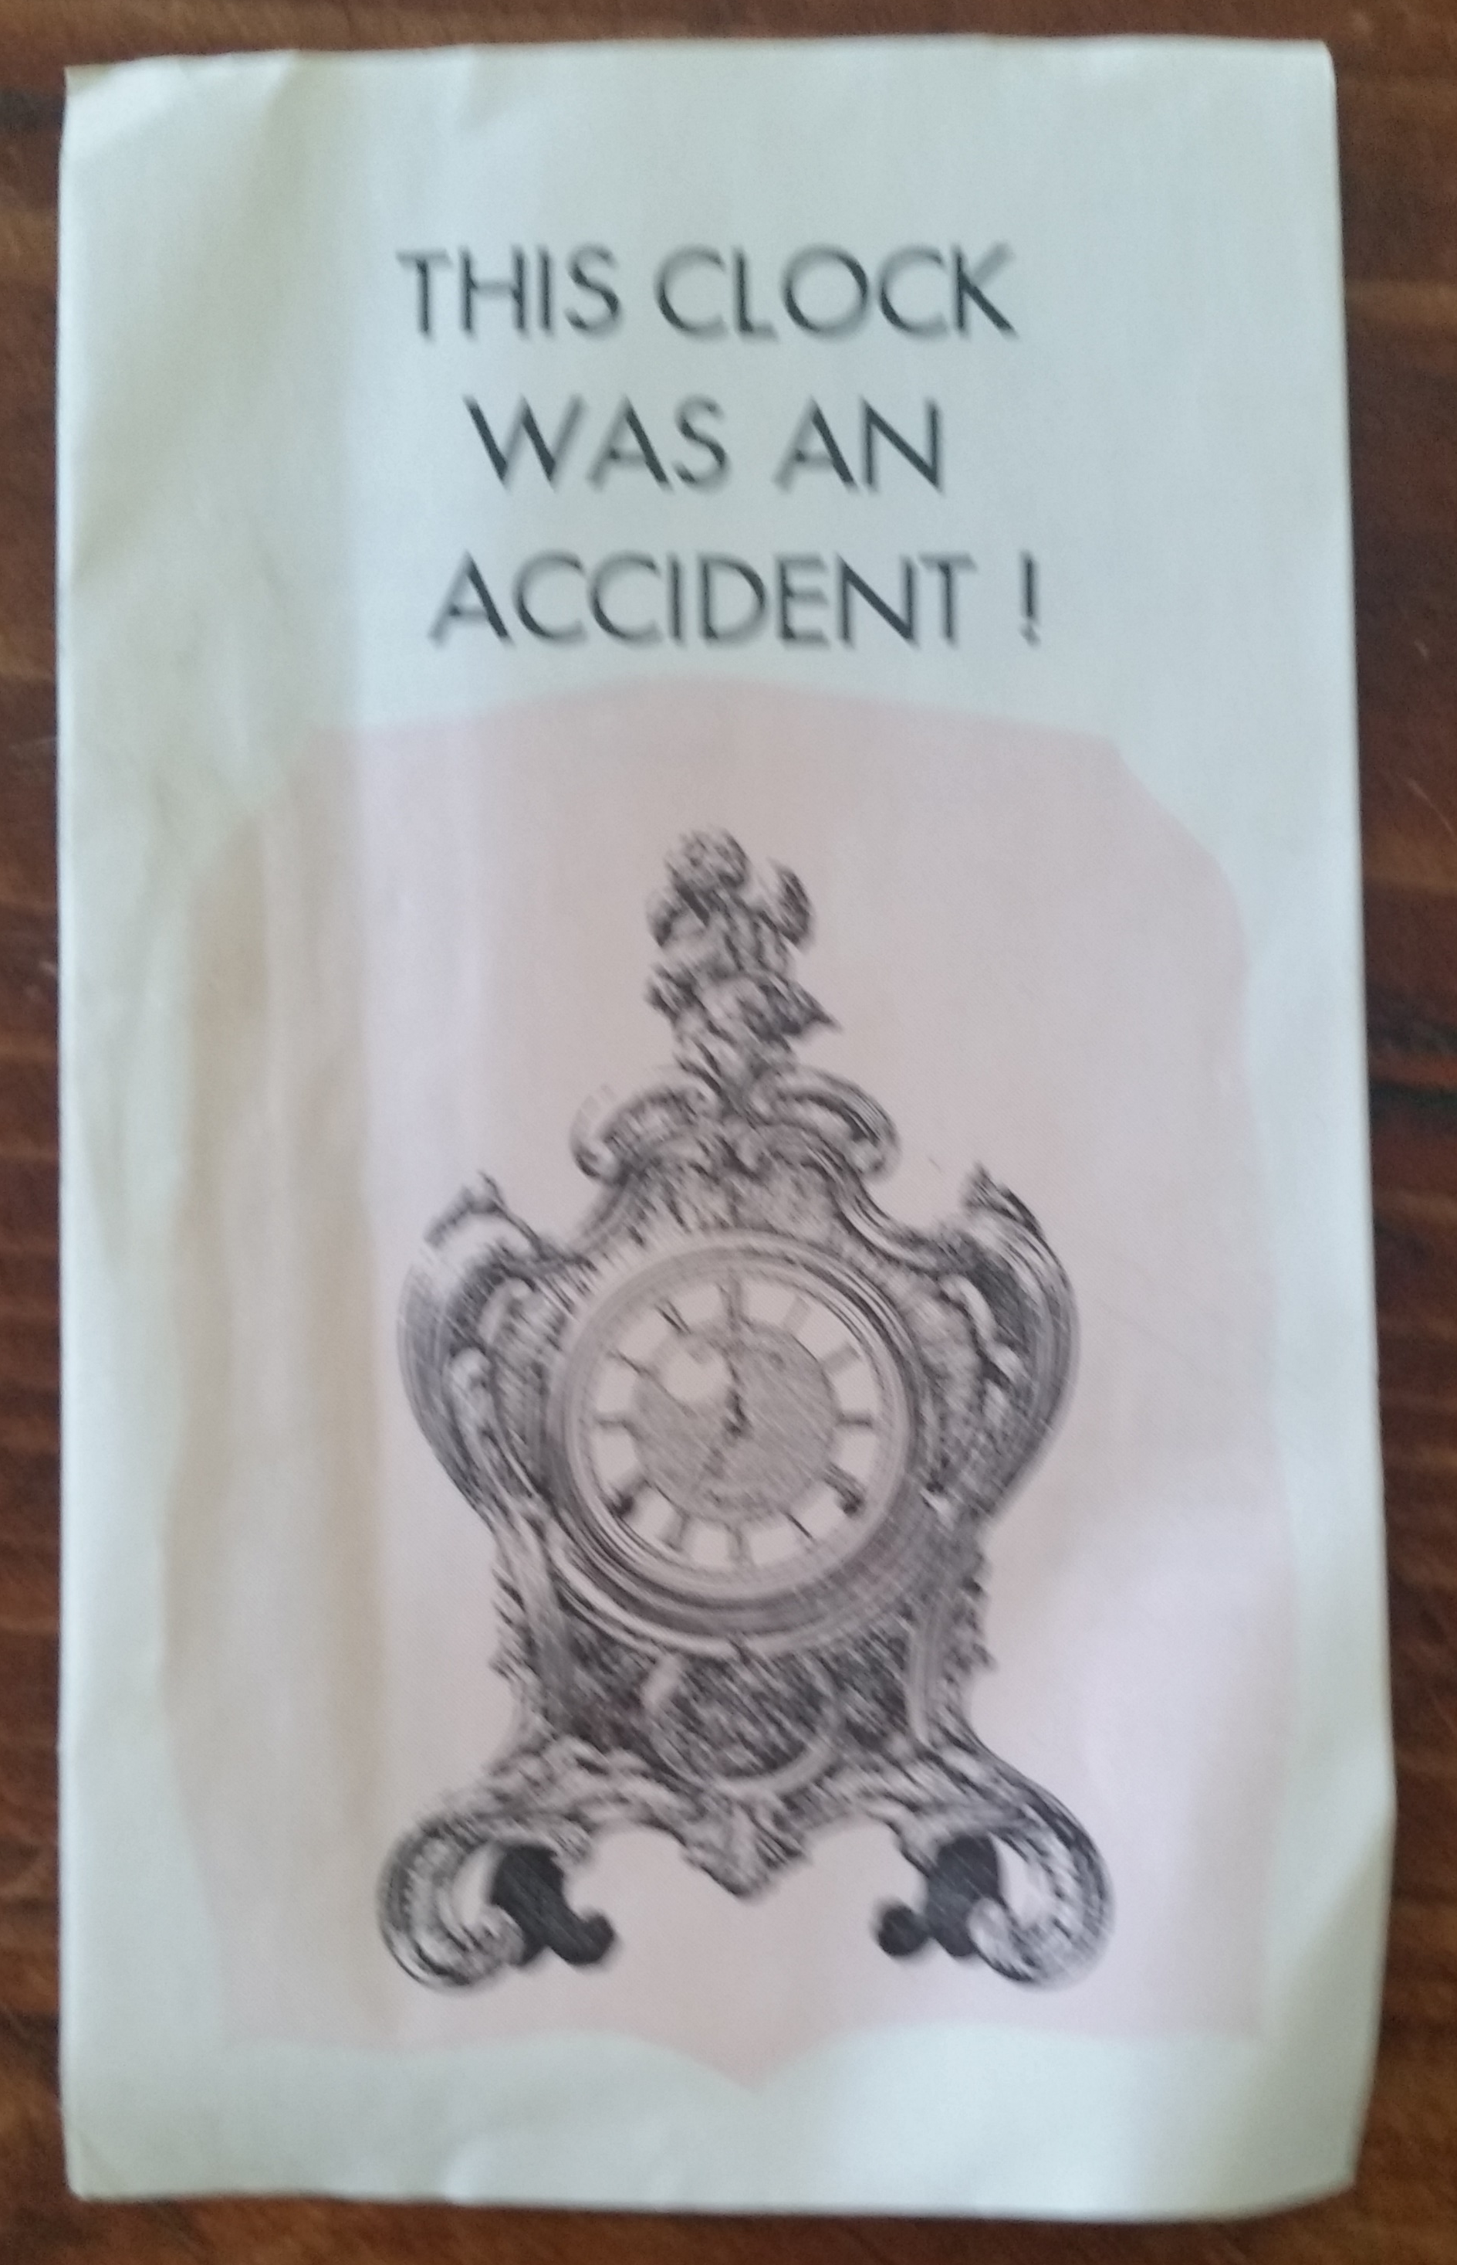
Maybe you prefer a quieter approach.
Letterboxing material
  An effective form of passive evangelism
This broacher was letterboxed in Tauranga by the Otumoetai church of Christ in about 1980.

Slide 9
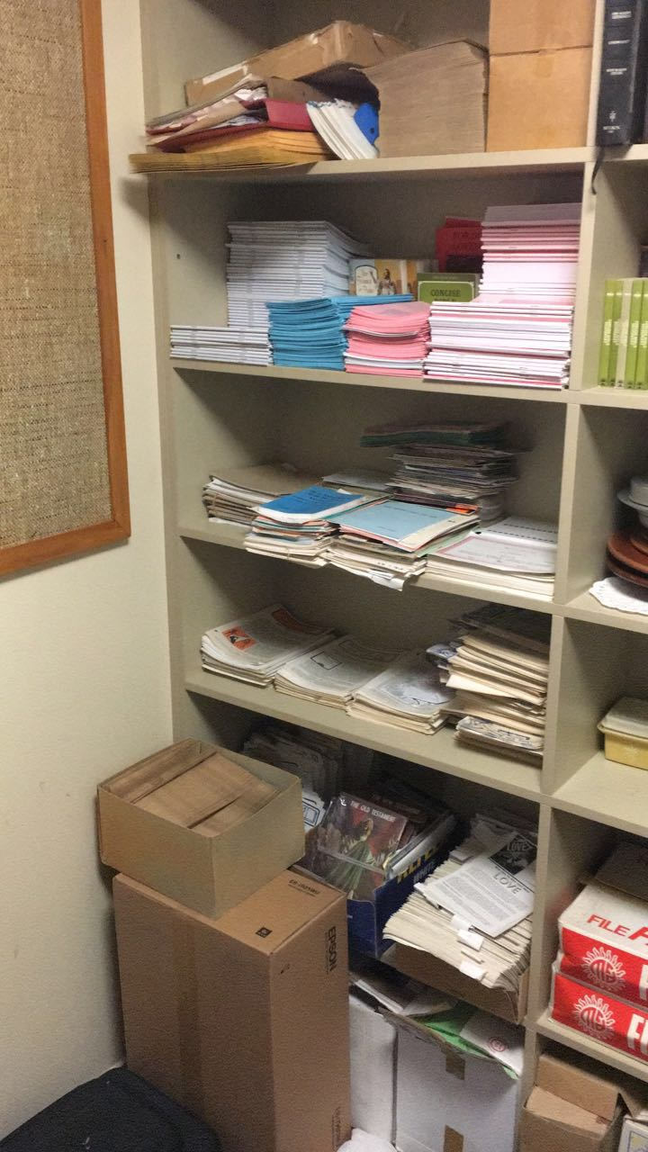
Maybe you prefer a quieter approach.
Bible correspondence courses have brought many to Christ
Helped to teach the basics of the gospel to new Christians.

Slide 10
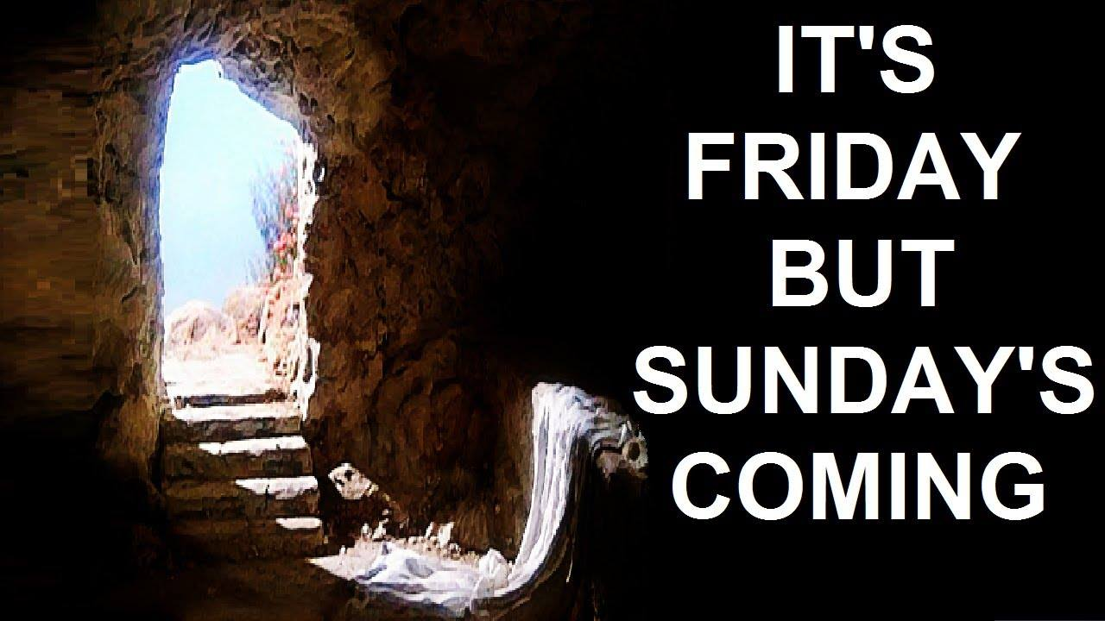
Is Sunday your ‘church’ day?
Is Jesus confined to a service or two a week?
Devotion to worship and fellowship is empowering.
Preparation is vital—Clear the calendar. DE-distract.

Slide 11
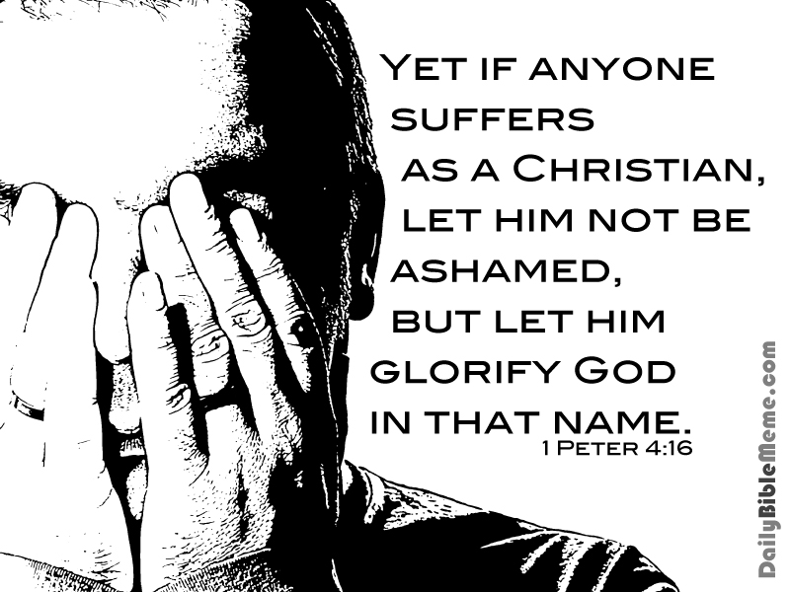
1 Peter 4:15-16—
¹⁵Make sure that none of you suffers as a murderer, or thief, or evildoer, or a troublesome meddler;
¹⁶but if anyone suffers as a Christian, he is not to be ashamed, but is to glorify God in this name. (NASB95)

Slide 12

Romans 1:16—For I am not ashamed of the gospel, for it is the power of God for salvation to everyone who believes, to the Jew first and also to the Greek. (NASB95)

Slide 13

Jesus is not ashamed to be our brother
Hebrews 2:11—For both He who sanctifies and those who are sanctified are all from one Father; for which reason He is not ashamed to call them brethren, (NASB95)

Slide 14
The Father is not ashamed to be our God
Hebrews 11:16—But as it is, they desire a better country, that is, a heavenly one. Therefore God is not ashamed to be called their God; for He has prepared a city for them. (NASB95)

Slide 15
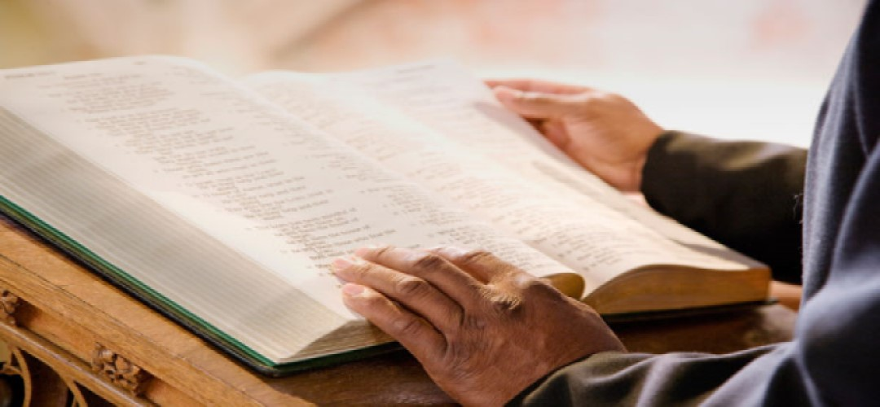
2 Timothy 2:15—Be diligent to present yourself approved to God as a workman who does not need to be ashamed, accurately handling the word of truth. (NASB95)

Slide 16

2 Timothy 1:12—For this reason I also suffer these things, but I am not ashamed; for I know whom I have believed and I am convinced that He is able to guard what I have entrusted to Him until that day. (NASB95)

Slide 17

…But there is also a way to make God proud of us!
Matthew 10:32-33—³²“Therefore everyone who confesses Me before men, I will also confess him before My Father who is in heaven. ³³But whoever denies Me before men, I will also deny him before My Father who is in heaven. (NASB95)

