Slide 1
It will not return to me empty
Isaiah 55:11
AM Sermon
Morningside Church of Christ
Sunday 3 February 2019
By John Staiger

Slide 2
It will not return to me empty
Isaiah 55:11

Slide 3
Isaiah 55:10-11
¹⁰“For as the rain and the snow come down from heaven,
And do not return there without watering the earth
And making it bear and sprout,
And furnishing seed to the sower and bread to the eater;
¹¹So will My word be which goes forth from My mouth;
It will not return to Me empty,
Without accomplishing what I desire,
And without succeeding in the matter for which I sent it. (NASB95)

Slide 4
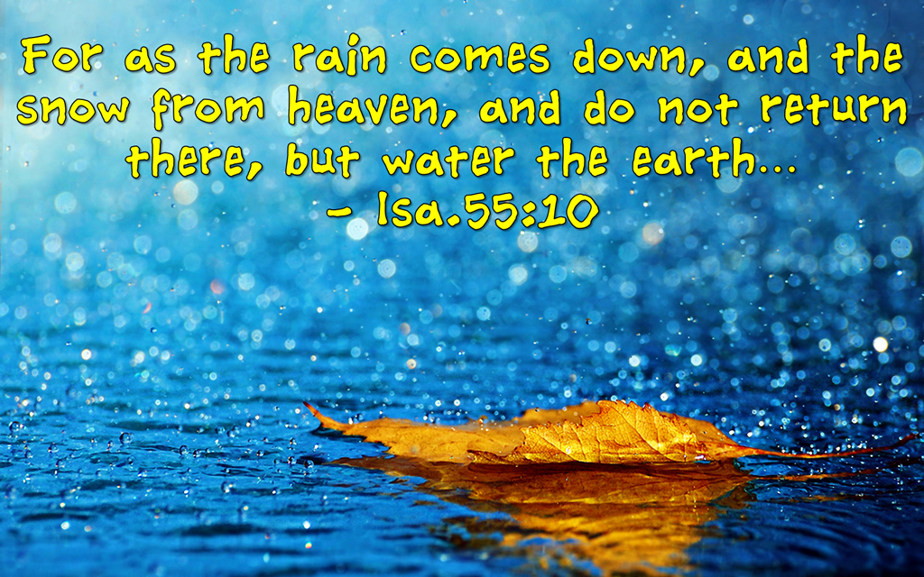
Isaiah 55:10
¹⁰“For as the rain and the snow come down from heaven,
And do not return there without watering the earth
And making it bear and sprout,
And furnishing seed to the sower and bread to the eater; (NASB)

Slide 5
Isaiah 55:10
¹⁰“For as the rain and the snow come down from heaven,
And do not return there without watering the earth
And making it bear and sprout,
And furnishing seed to the sower and bread to the eater; (NASB)
I. A natural order of things:

Slide 6

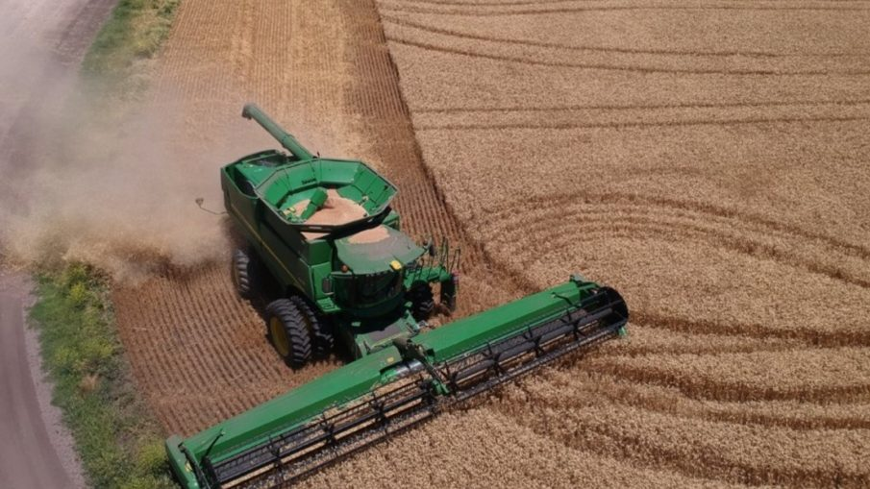
Isaiah 55:10
¹⁰“For as the rain and the snow come down from heaven,
And do not return there without watering the earth
And making it bear and sprout,
And furnishing seed to the sower and bread to the eater; (NASB)
I. A natural order of things:
The agricultural cycle

Slide 7
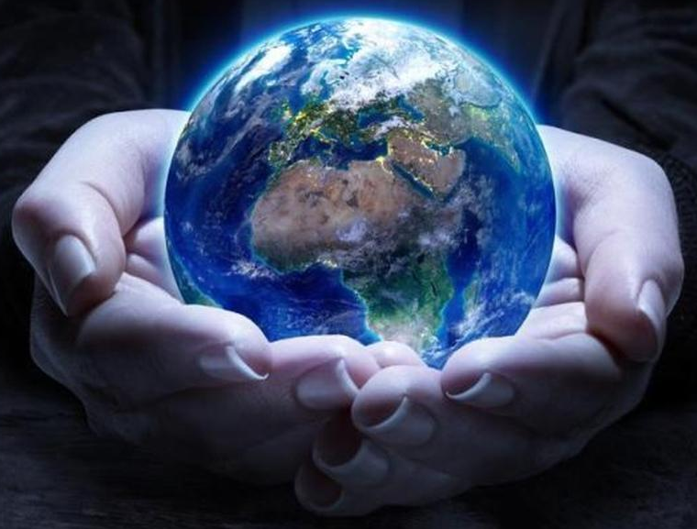
Isaiah 55:10
¹⁰“For as the rain and the snow come down from heaven,
And do not return there without watering the earth
And making it bear and sprout,
And furnishing seed to the sower and bread to the eater; (NASB)
I. A natural order of things:
The agricultural cycle
God provides all
  Rain
  Sun
  Wind
  Soil
  Seed
  Farming skills
  Food

Slide 8
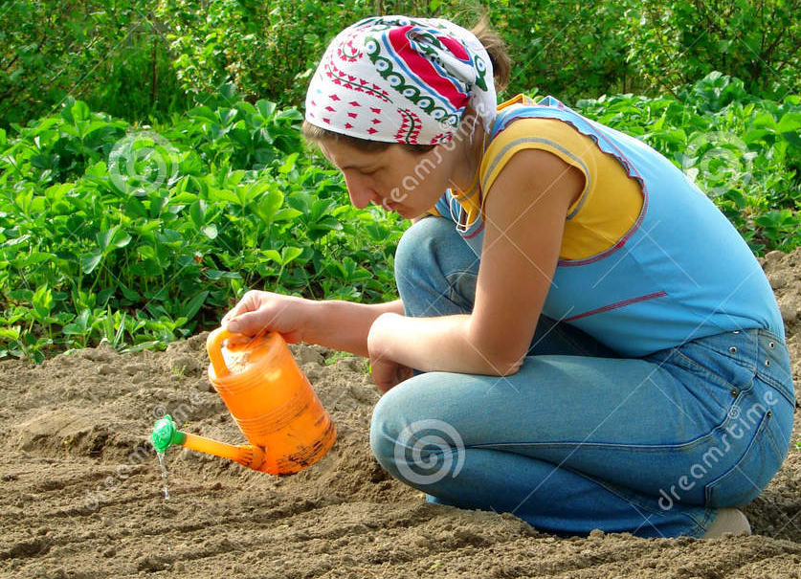
Isaiah 55:10
¹⁰“For as the rain and the snow come down from heaven,
And do not return there without watering the earth
And making it bear and sprout,
And furnishing seed to the sower and bread to the eater; (NASB)
I. A natural order of things:
The agricultural cycle
As long as the elements are in place all goes to plan
  Sowing and watering

Slide 9
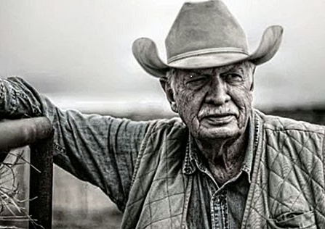
Isaiah 55:10
¹⁰“For as the rain and the snow come down from heaven,
And do not return there without watering the earth
And making it bear and sprout,
And furnishing seed to the sower and bread to the eater; (NASB)
I. A natural order of things:
The agricultural cycle
Nobody questions
  Prior knowledge
  Experience shows
  Understanding of procedures
  Processes in place

Slide 10
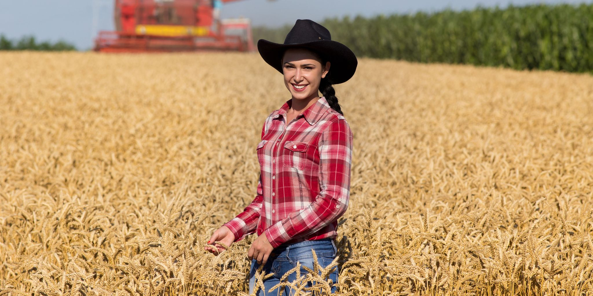
Isaiah 55:10
¹⁰“For as the rain and the snow come down from heaven,
And do not return there without watering the earth
And making it bear and sprout,
And furnishing seed to the sower and bread to the eater; (NASB)
I. A natural order of things:
The agricultural cycle
Nobody doubts
  Harvest is prepared for
  The farmer is watchful
  Work is ahead of him
  The HOPE of an ingathering

Slide 11
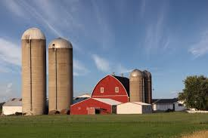
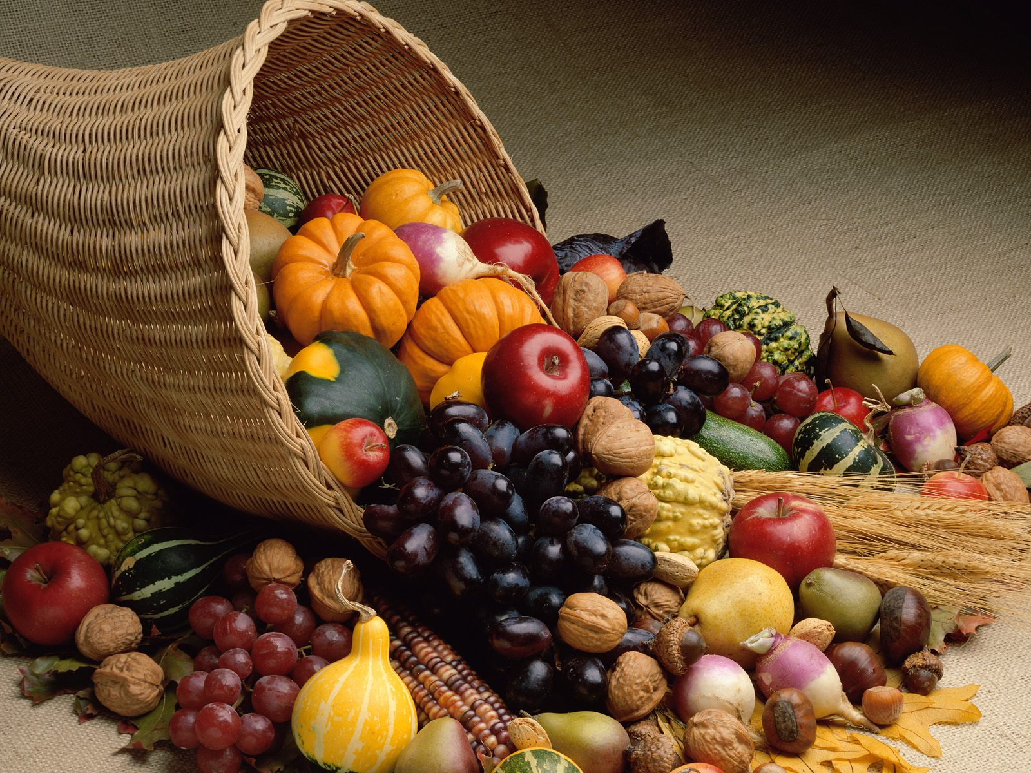
Isaiah 55:10
¹⁰“For as the rain and the snow come down from heaven,
And do not return there without watering the earth
And making it bear and sprout,
And furnishing seed to the sower and bread to the eater; (NASB)
I. A natural order of things:
The agricultural cycle
The blessings come
  Barns are filled
  Grain silos full
  A time of plenty

Slide 12
Isaiah 55:11
¹¹So will My word be which goes forth from My mouth;
It will not return to Me empty,
Without accomplishing what I desire,
And without succeeding in the matter for which I sent it. (NASB95)

Slide 13
Isaiah 55:11
¹¹So will My word be which goes forth from My mouth;
It will not return to Me empty,
Without accomplishing what I desire,
And without succeeding in the matter for which I sent it. (NASB95)
II. A Spiritual order of things:

Slide 14
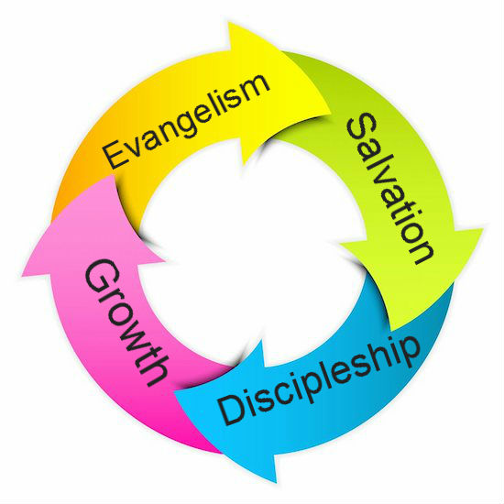
Isaiah 55:11
¹¹So will My word be which goes forth from My mouth;
It will not return to Me empty,
Without accomplishing what I desire,
And without succeeding in the matter for which I sent it. (NASB95)
II. A Spiritual order of things:
The Evangelism cycle

Slide 15
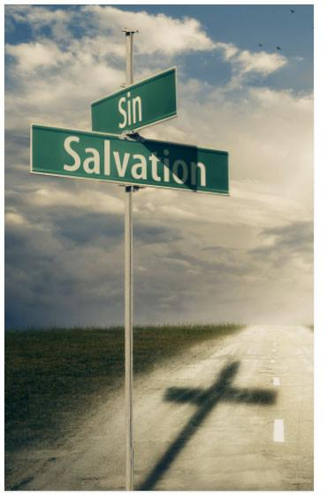

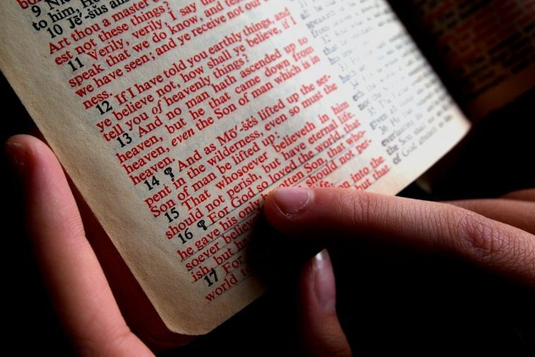
Isaiah 55:11
¹¹So will My word be which goes forth from My mouth;
It will not return to Me empty,
Without accomplishing what I desire,
And without succeeding in the matter for which I sent it. (NASB95)
II. A Spiritual order of things:
The Evangelism cycle
God provides all
  Our very being
  Conviction of our sin
  Our Saviour, Jesus
  The Bible
  The Church
  Our talents

Slide 16
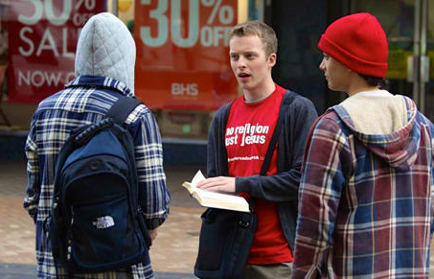
Isaiah 55:11
¹¹So will My word be which goes forth from My mouth;
It will not return to Me empty,
Without accomplishing what I desire,
And without succeeding in the matter for which I sent it. (NASB95)
II. A Spiritual order of things:
The Evangelism cycle
As long as the elements are in place all goes to plan
  Sowers & Waterers
    Heart for the lost
    Word of God
    Tell it
  Each person determines the receptiveness of their own heart
    Believe
    Believe not!

Slide 17
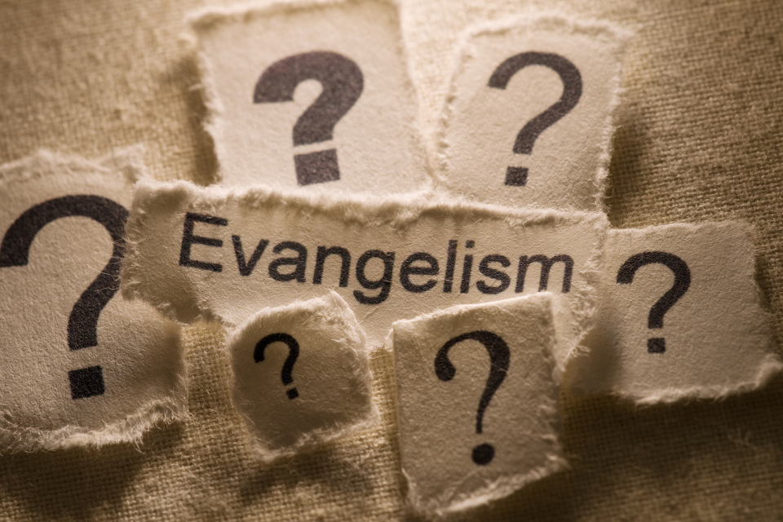
Isaiah 55:11
¹¹So will My word be which goes forth from My mouth;
It will not return to Me empty,
Without accomplishing what I desire,
And without succeeding in the matter for which I sent it. (NASB95)
II. A Spiritual order of things:
The Evangelism cycle
Nobody questions
  Actually, they do…!
    When will we grow?
    Best methods?
    Soil testing?
  Don’t worry, our questions do not negate the efficacy of God’s powerful word.
  It will get through!

Slide 18
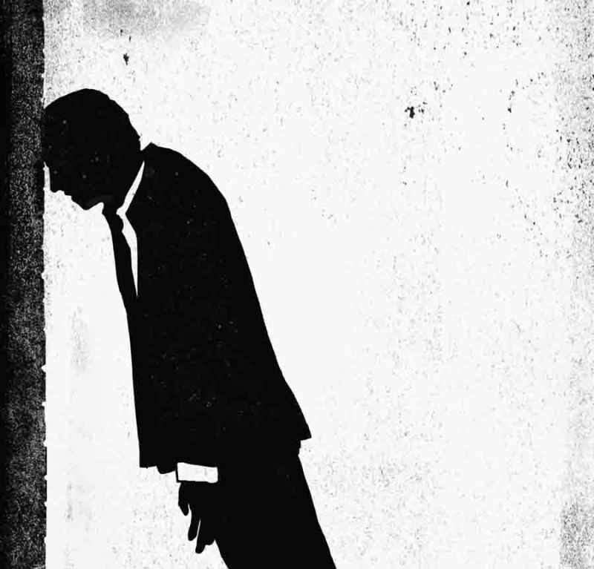
Isaiah 55:11
¹¹So will My word be which goes forth from My mouth;
It will not return to Me empty,
Without accomplishing what I desire,
And without succeeding in the matter for which I sent it. (NASB95)
II. A Spiritual order of things:
The Evangelism cycle
Nobody doubts
  Everyone does!
  Fear of :
    Failure
    Embarrassment
    Judgement

Slide 19
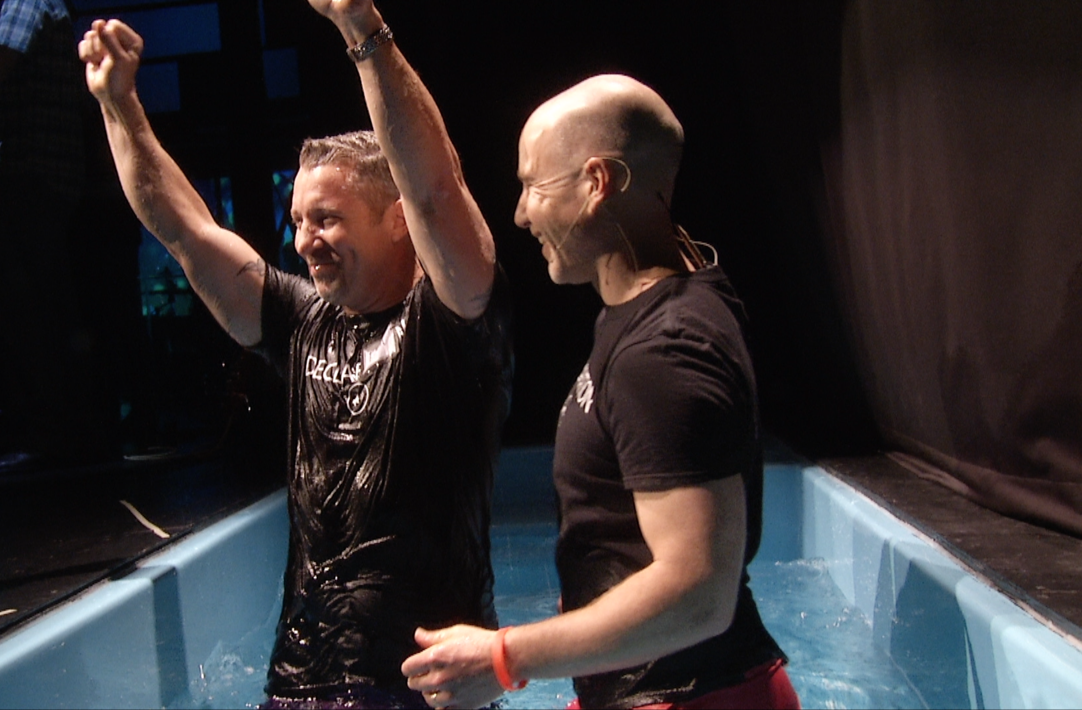
Isaiah 55:11
¹¹So will My word be which goes forth from My mouth;
It will not return to Me empty,
Without accomplishing what I desire,
And without succeeding in the matter for which I sent it. (NASB95)
II. A Spiritual order of things:
The Evangelism cycle
The blessings come
  God gives the increase
1 Corinthians 3:6
⁶ I planted, Apollos watered, but God was causing the growth. (NASB95)

Slide 20
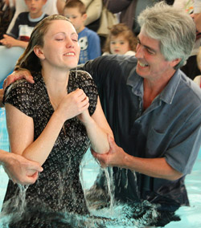
Isaiah 55:11
¹¹So will My word be which goes forth from My mouth;
It will not return to Me empty,
Without accomplishing what I desire,
And without succeeding in the matter for which I sent it. (NASB95)
II. A Spiritual order of things:
The Evangelism cycle
The blessings come
  God gives the increase
  Adds to His church
Acts 2:41
So then, those who had received his word were baptized; and that day there were added about three thousand souls. (NASB95)

Slide 21
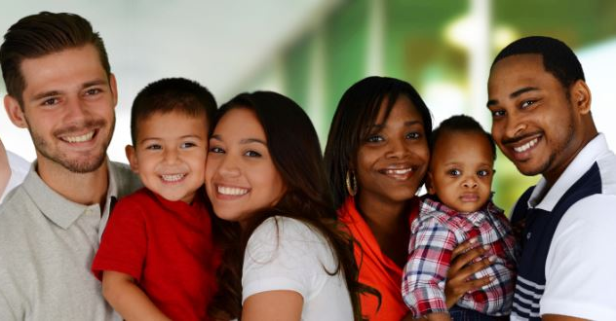
Isaiah 55:11
¹¹So will My word be which goes forth from My mouth;
It will not return to Me empty,
Without accomplishing what I desire,
And without succeeding in the matter for which I sent it. (NASB95)
II. A Spiritual order of things:
The Evangelism cycle
The blessings come
  God gives the increase
  Adds to His church
  Local evangelism
    Family
    Neighbours
    Workmates
    School friends

Slide 22

Isaiah 55:11
¹¹So will My word be which goes forth from My mouth;
It will not return to Me empty,
Without accomplishing what I desire,
And without succeeding in the matter for which I sent it. (NASB95)
II. A Spiritual order of things:
The Evangelism cycle
The blessings come
  God gives the increase
  Adds to His church
  Local evangelism
  Churches send forth preachers
Romans 10:15
¹⁵ How will they preach unless they are sent? Just as it is written, “How beautiful are the feet of those who bring good news of good things!” (NASB95)

Slide 23

Matthew 28:18-20—¹⁸And Jesus came up and spoke to them, saying, “All authority has been given to Me in heaven and on earth. ¹⁹Go therefore and make disciples of all the nations, baptizing them in the name of the Father and the Son and the Holy Spirit,²⁰ teaching them to observe all that I commanded you; and lo, I am with you always, even to the end of the age.” (NASB95)

Slide 24

John 3:5
⁵Jesus answered, “Truly, truly, I say to you, unless one is born of water and the Spirit, he cannot enter the kingdom of God. (ESV)

