Slide 1
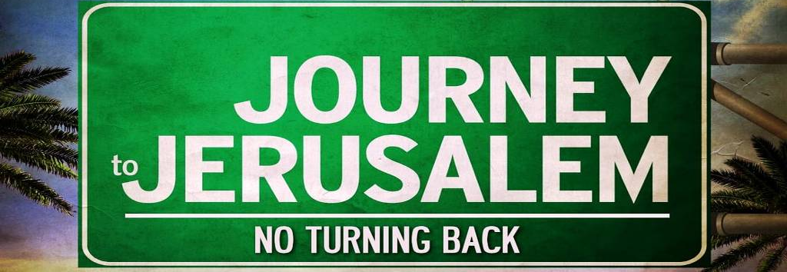

Slide 2
Luke 9:51
⁵¹When the days drew near for him to be taken up, he set his face to go to Jerusalem. (ESV)

Slide 3
What thoughts would be going around in your head at this time?

Slide 4
The Disciples showed what was on their minds and Jesus knew all…

Slide 5
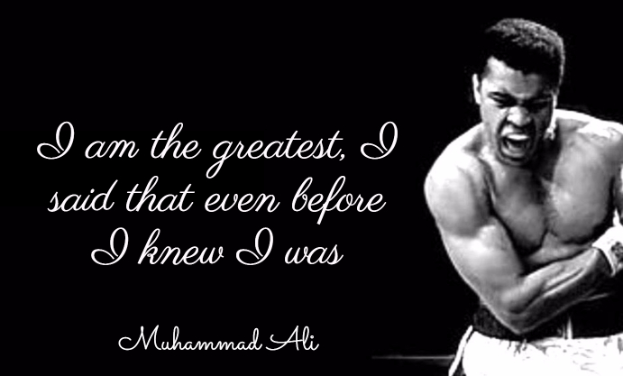
I am the Greatest!
Luke 9:46-48

Slide 6
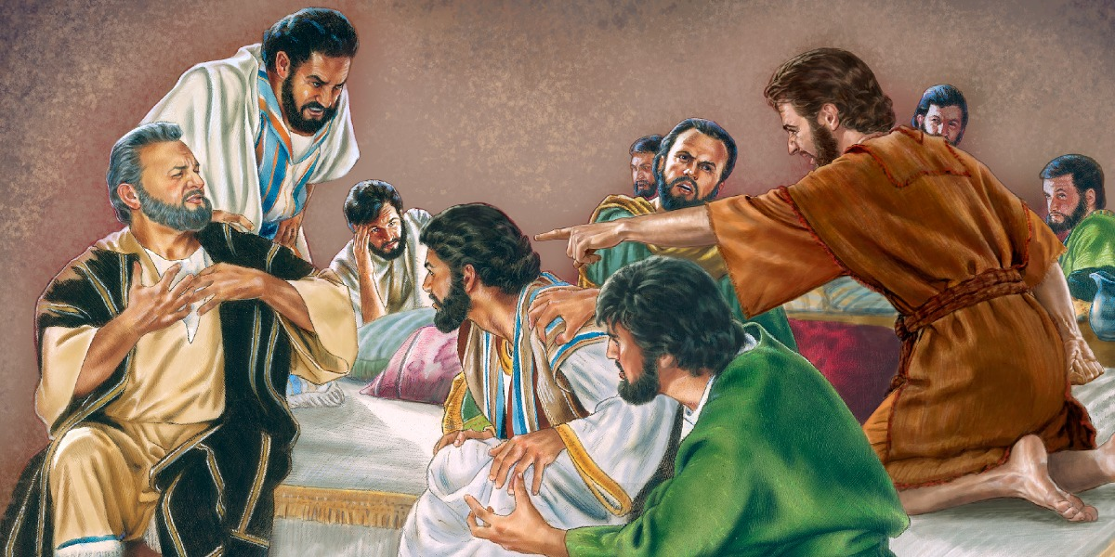
I am the Greatest!
Luke 9:46-48

Slide 7
I am the Greatest!
Luke 9:46-48
⁴⁶ An argument arose among them as to which of them was the greatest. ⁴⁷ But Jesus, knowing the reasoning of their hearts, took a child and put him by his side ⁴⁸ and said to them, “Whoever receives this child in my name receives me, and whoever receives me receives him who sent me. For he who is least among you all is the one who is great.” (ESV)

Slide 8
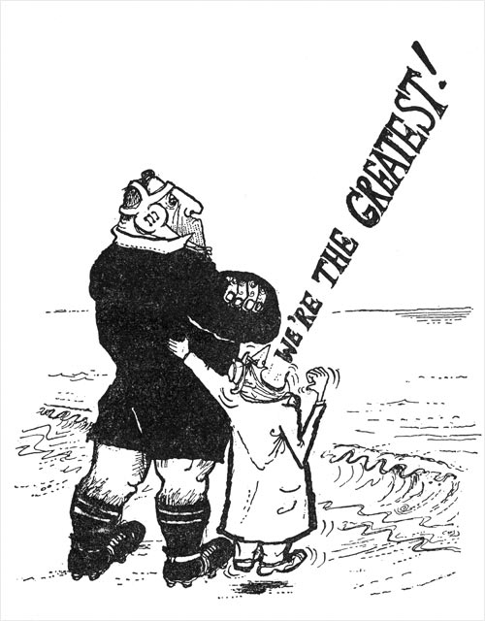
We are the Greatest!

Slide 9
We are the Greatest!
Luke 9:49-50
⁴⁹ John answered, “Master, we saw someone casting out demons in your name, and we tried to stop him, because he does not follow with us.” ⁵⁰ But Jesus said to him, “Do not stop him, for the one who is not against you is for you.”(ESV)

Slide 10
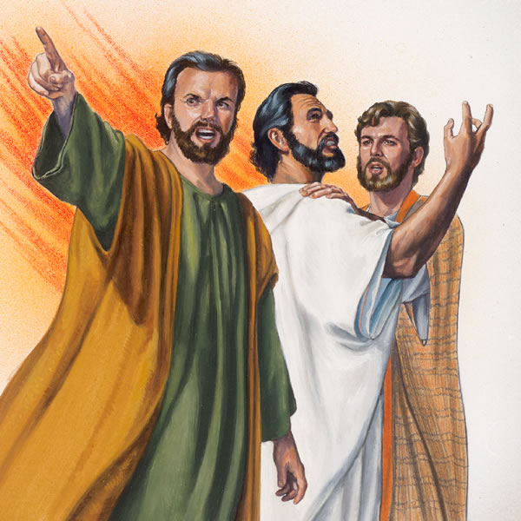
Let us show them who is the Greatest!

Slide 11
Let us show them who is the Greatest!
Luke 9:51-56
⁵¹When the days were approaching for His ascension, He was determined to go to Jerusalem; ⁵²and He sent messengers on ahead of Him, and they went and entered a village of the Samaritans to make arrangements for Him. ⁵³But they did not receive Him, because He was traveling toward Jerusalem. ⁵⁴When His disciples James and John saw this, they said, “Lord, do You want us to command fire to come down from heaven and consume them?” ⁵⁵But He turned and rebuked them, [[and said, “You do not know what kind of spirit you are of; ⁵⁶ for the Son of Man did not come to destroy men’s lives, but to save them.”] And they went on to another village. (NASB95)

Slide 12
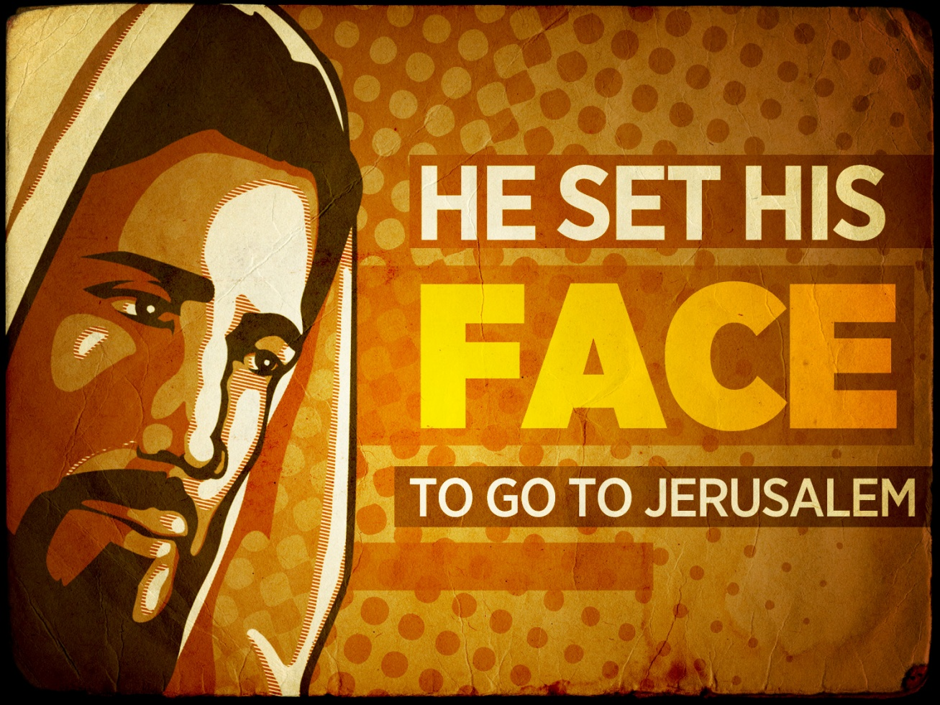
The Greatest is what the Greatest did!
Luke 9:51
⁵¹When the days were approaching for His ascension, He was determined to go to Jerusalem; (NASB95)

Slide 13

The Greatest is what the Greatest did!
Luke 9:51
⁵¹When the days were approaching for His ascension, He was determined to go to Jerusalem; (NASB95)
1. The events that followed were done out of choice by Jesus

Slide 14
The Greatest is what the Greatest did!
Luke 9:51
⁵¹When the days were approaching for His ascension, He was determined to go to Jerusalem; (NASB95)
1. The events that followed were done out of choice by Jesus
He knew what was ahead (Mt.16:21)

Slide 15
Matthew 16:21
²¹From that time Jesus began to show His disciples that He must go to Jerusalem, and suffer many things from the elders and chief priests and scribes, and be killed, and be raised up on the third day. (NASB95)

Slide 16
The Greatest is what the Greatest did!
Luke 9:51
⁵¹When the days were approaching for His ascension, He was determined to go to Jerusalem; (NASB95)
1. The events that followed were done out of choice by Jesus
He knew what was ahead
He did it voluntarily (John 10:17-18)

Slide 17
John 10:17-18
¹⁷ For this reason the Father loves Me, because I lay down My life so that I may take it again. ¹⁸ No one has taken it away from Me, but I lay it down on My own initiative. I have authority to lay it down, and I have authority to take it up again. This commandment I received from My Father.” (NASB95)

Slide 18
The Greatest is what the Greatest did!
Luke 9:51
⁵¹When the days were approaching for His ascension, He was determined to go to Jerusalem; (NASB95)
2. Jesus proceeded despite how his disciples appeared at that time

Slide 19
The Greatest is what the Greatest did!
Luke 9:51
⁵¹When the days were approaching for His ascension, He was determined to go to Jerusalem; (NASB95)
2. Jesus proceeded despite how his disciples appeared at that time
The Holy Spirit would bring everything to light on the Day of Pentecost and beyond (John 14:26)

Slide 20
John 14:26
²⁶But the Helper, the Holy Spirit, whom the Father will send in My name, He will teach you all things, and bring to your remembrance all that I said to you. (NASB95)

Slide 21
The Greatest is what the Greatest did!
Luke 9:51
⁵¹When the days were approaching for His ascension, He was determined to go to Jerusalem; (NASB95)
3. Jesus was not put off by the dangers
Put himself in harms way

Slide 22
The Greatest is what the Greatest did!
Luke 9:51
⁵¹When the days were approaching for His ascension, He was determined to go to Jerusalem; (NASB95)
4. Jesus fixed his eyes on the cross in Jerusalem—We fix our eyes upon him
For the joy set before him (Heb.12:1-3)

Slide 23
Hebrews 12:1-3
Therefore, since we have so great a cloud of witnesses surrounding us, let us also lay aside every encumbrance and the sin which so easily entangles us, and let us run with endurance the race that is set before us, ²fixing our eyes on Jesus, the author and perfecter of faith, who for the joy set before Him endured the cross, despising the shame, and has sat down at the right hand of the throne of God.
³For consider Him who has endured such hostility by sinners against Himself, so that you will not grow weary and lose heart. (NASB95)

Slide 24

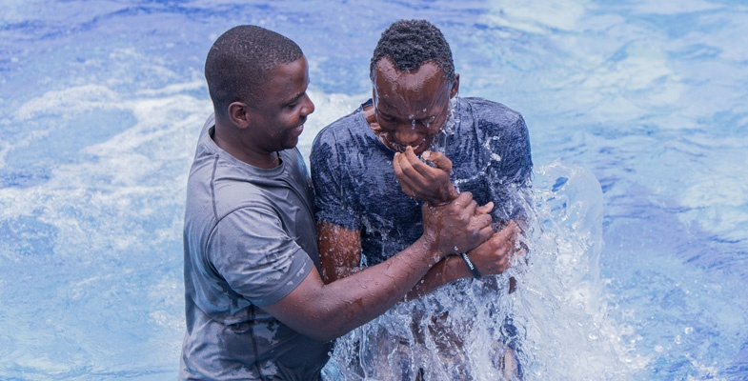
The Greatest thing you can do!
Romans 6:3-4 New American Standard Bible (NASB)
³ Or do you not know that all of us who have been baptized into Christ Jesus have been baptized into His death? ⁴ Therefore we have been buried with Him through baptism into death, so that as Christ was raised from the dead through the glory of the Father, so we too might walk in newness of life. (NASB95)

