Slide 1
Making Progress
PM Sermon
Sunday 14 April 2019
Morningside Church of Christ
John Staiger

Slide 2
Making Progress

Slide 3

Who is to say someone is moving forward?
Who are you to judge?
What are signs of spiritual progress…?
What does Christian progress
look like?

Slide 4

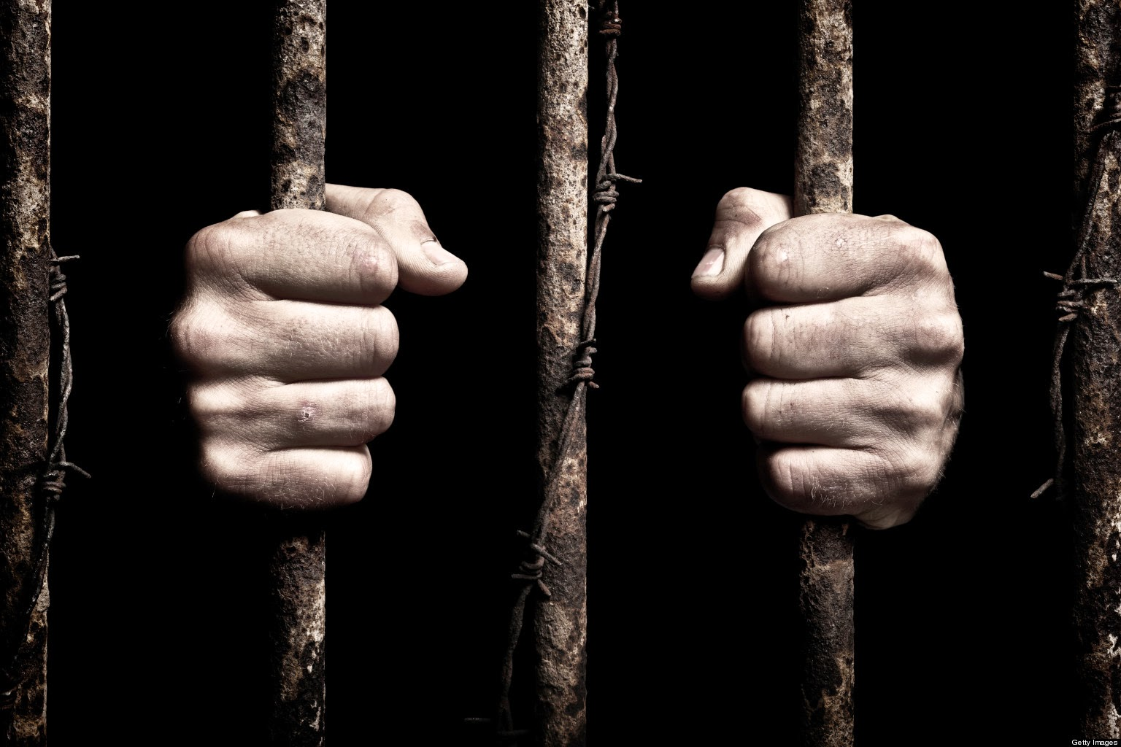
1. When the progress of the church is weighed in light of the glories of heaven.
Philippians 1:23-26
²³But I am hard-pressed from both directions, having the desire to depart and be with Christ, for that is very much better; ²⁴yet to remain on in the flesh is more necessary for your sake. ²⁵Convinced of this, I know that I will remain and continue with you all for your progress and joy in the faith, ²⁶so that your proud confidence in me may abound in Christ Jesus through my coming to you again. (NASB95)

Slide 5
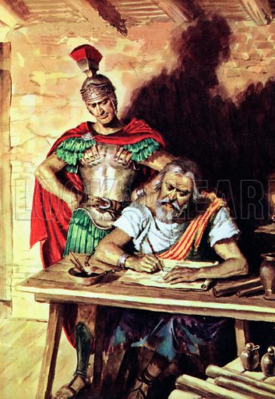
2. When we begin to define progress in terms of the spread and health of the Kingdom
Philippians 1:12-14—¹² Now I want you to know, brethren, that my circumstances have turned out for the greater progress of the gospel, ¹³so that my imprisonment in the cause of Christ has become well known throughout the whole praetorian guard and to everyone else, ¹⁴and that most of the brethren, trusting in the Lord because of my imprisonment, have far more courage to speak the word of God without fear. (NASB95)

Slide 6

3. When your work of service results in obvious spiritual fruit.
Special gift, yes
But special effort required
Absorbed in it
Progress can’t be missed
Special personal care
Special care in Teaching
Perseverance = Salvation
1 Timothy 4:14-16—¹⁴Do not neglect the spiritual gift within you, which was bestowed on you through prophetic utterance with the laying on of hands by the presbytery. ¹⁵Take pains with these things; be absorbed in them, so that your progress will be evident to all. ¹⁶Pay close attention to yourself and to your teaching; persevere in these things, for as you do this you will ensure salvation both for yourself and for those who hear you. (NASB95)

Slide 7

4. When you practice forgiveness in the same manner as Jesus practices it.
Sin is inevitable
Be ever vigilant
Call out sin
Once isn’t enough?
Feeling inadequate?
Tiny amounts of faith do the impossible
Is this faith and forgiveness made easy?
Luke 17:3-6—³Be on your guard! If your brother sins, rebuke him; and if he repents, forgive him. ⁴And if he sins against you seven times a day, and returns to you seven times, saying, ‘I repent,’ forgive him.” ⁵The apostles said to the Lord, “Increase our faith!” ⁶And the Lord said, “If you had faith like a mustard seed, you would say to this mulberry tree, ‘Be uprooted and be planted in the sea’; and it would obey you. (NASB95)

Slide 8

5. When you are walking the walk…!
Received Christ by teaching and example
Act out your Christian life accordingly
You have been fixed firmly and deeply in Christ
Correctly constructed in Christ
Your faith is set in place
In accordance with the teachings of Christ
Thus, gratitude pours forth!
Colossians 2:6-7—⁶Therefore as you have received Christ Jesus the Lord, so walk in Him, ⁷having been firmly rooted and now being built up in Him and established in your faith, just as you were instructed, and overflowing with gratitude. (NASB95)

