Slide 1
Parenthood
AM Sermon
Morningside Church of Christ
Sunday 7 April 2019
By John Staiger

Slide 2
Parenthood

Slide 3
The preacher was visiting the 10 year old’s Sunday School class to talk about marriage as part of the lesson. He asked the class, ''What does the Bible say about marriage?'' Immediately, one little boy replied,...

Slide 4
`Father forgive them,
for they know not what they do.'

Slide 5
Spiritual Parents
Paul spoke of Timothy as “…my true child in the faith” (1Tim.1:2).
Paul had spiritual mothers: Rufus’ mother—
Romans 16:13
Greet Rufus, a choice man in the Lord, also his mother and mine.
3. Paul and the churches—
1 Corinthians 4:15
For if you were to have countless tutors in Christ, yet you would not have many fathers, for in Christ Jesus I became your father through the gospel.

Slide 6
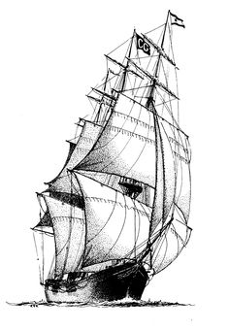
A nautical theme

Slide 7
Pilot
Anchor
Rescue crew
Engineer
Navigator
Training School

Slide 8
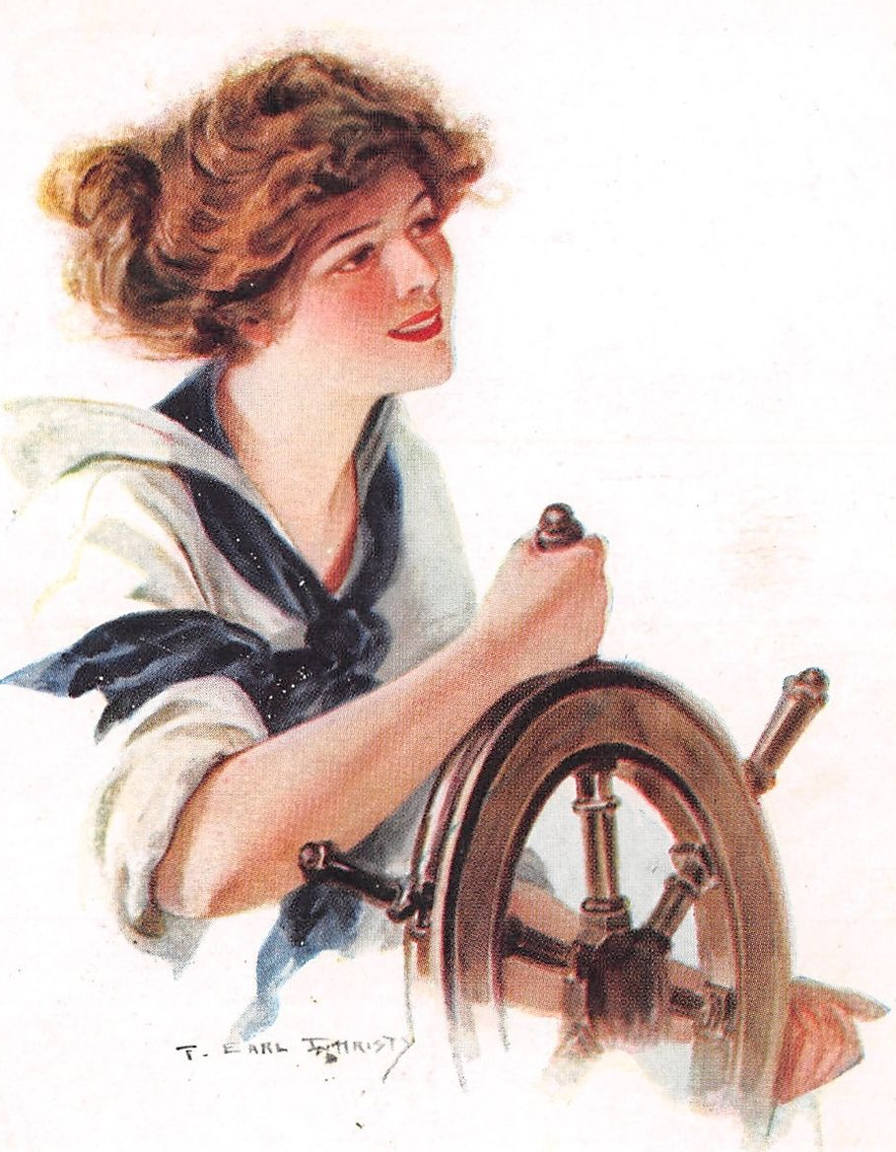
Pilot
The ship’s pilot is an expert on local knowledge.
Conditions of the coast and harbour—Avoiding the DANGERS!
Rocks, sandbars, traffic lanes, wrecks, currents, wind, rocks, how shallow, how deep, what size ship could go where…

Slide 9
Parent – Pilots
Parents must become experts on local knowledge.
Spiritual conditions of the churches, homes and neighbourhoods and nations—Avoiding the DANGERS by…
…Following Jesus’ instruction guide
…Having godly friends who stick closer than a brother (Pro.18:24)
…Guiding internet content and traffic
Ever steering into the spiritual depths
…Where you go, they go!

Slide 10

Parent-Pilot
The Bible will guide your family through the depths, currents, and hazards—Know it!

Slide 11
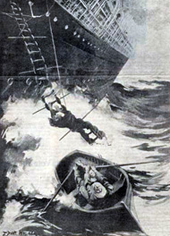
Parent-Pilot
Safety means action—Children are precious cargo
Parents brave the perils to make sure that the schemes of Satan are made known before he shipwrecks the family

Slide 12
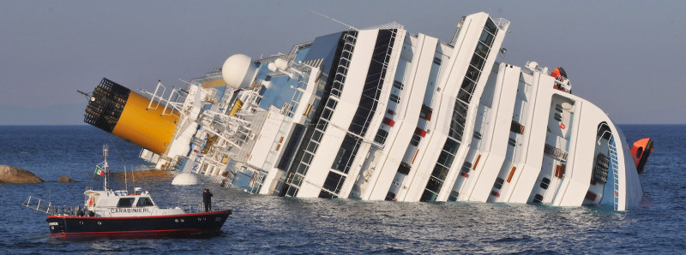
The cruise ship Costa Concordia off the Italian island of Giglio, on Jan. 14, 2012.
Parent-Pilot
Parents teach their children to “…flee from youthful lusts and pursue righteousness, faith, love and peace, with those who call on the Lord from a pure heart. (2Tim.2:22)
“keeping faith and a good conscience, which some have rejected and suffered shipwreck in regard to their faith. (1Tim.1:19)

Slide 13
Pilot
Anchor
Rescue crew
Engineer
Navigator
Training School

Slide 14
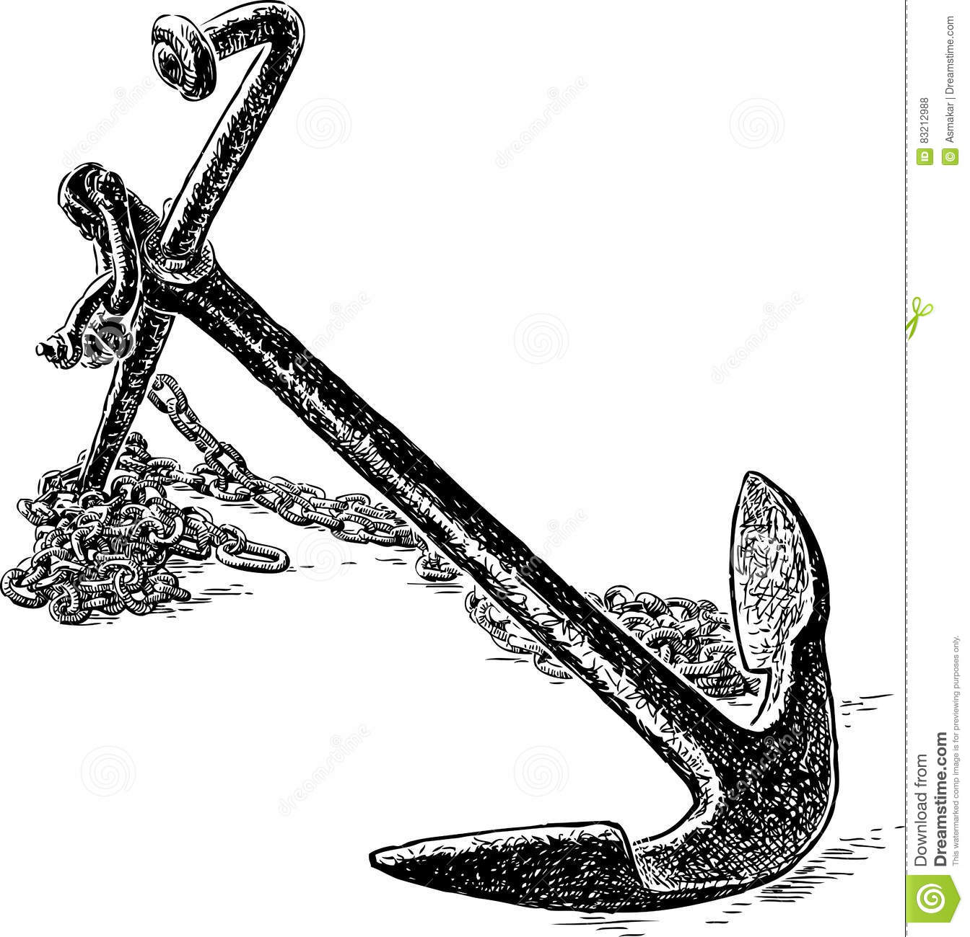
Anchor
Hebrews 6:19 (ESV)
¹⁹We have this as a sure and steadfast anchor of the soul,…
That which anchors mum and dad – Conviction of the Hope of Heaven – Anchors the children.

Slide 15
Anchor
What happens when anchors fail to hold…?

Slide 16
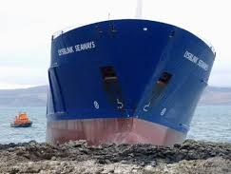
Anchor
Anchor-Parents
Prevent kids from being dragged by the currents of popular opinion
Colossians 3:20
Children, be obedient to your parents in all things, for this is well-pleasing to the Lord.

Slide 17
Anchor
Anchor-Parents
Hold fast in the storms—
  Doubt
  Temptation

Slide 18
Anchor
Anchor-Parents
Stops kids from drifting—
  Bad company (1Cor.15:33)
  Loneliness
  False doctrines
  Drifting away from Christ
Hebrews 2:1—For this reason we must pay much closer attention to what we have heard, so that we do not drift away from it. (NASB95)

Slide 19
Pilot
Anchor
Rescue crew
Engineer
Navigator
Training School

Slide 20
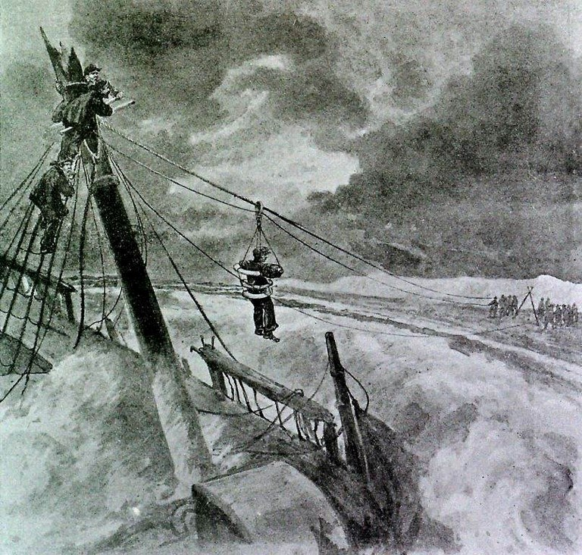
Rescue crew—Parents
Kids get is trouble…
Know where they are.
Know who they are with.
Know what they are doing.
Know what they like.
Know what they are wearing.
Know what they are watching.

Slide 21
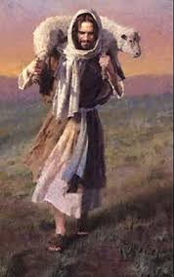
Rescue crew—Parents
Luke 15:4
“What man among you, if he has a hundred sheep and has lost one of them, does not leave the ninety-nine in the open pasture and go after the one which is lost until he finds it?

Slide 22
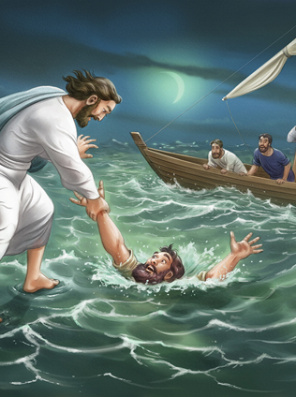
Rescue crew—Parents
Peter’s act of faith turned into doubt
Matthew 14:30
But seeing the wind, he became frightened, and beginning to sink, he cried out, “Lord, save me!”

Slide 23
Pilot
Anchor
Rescue crew
Engineer
Navigator
Training School

Slide 24

Engineer—Parents
Home
  Forever maintaining
  Fixing
  Designing
  Building

Slide 25
Pilot
Anchor
Rescue crew
Engineer
Navigator
Training School

Slide 26
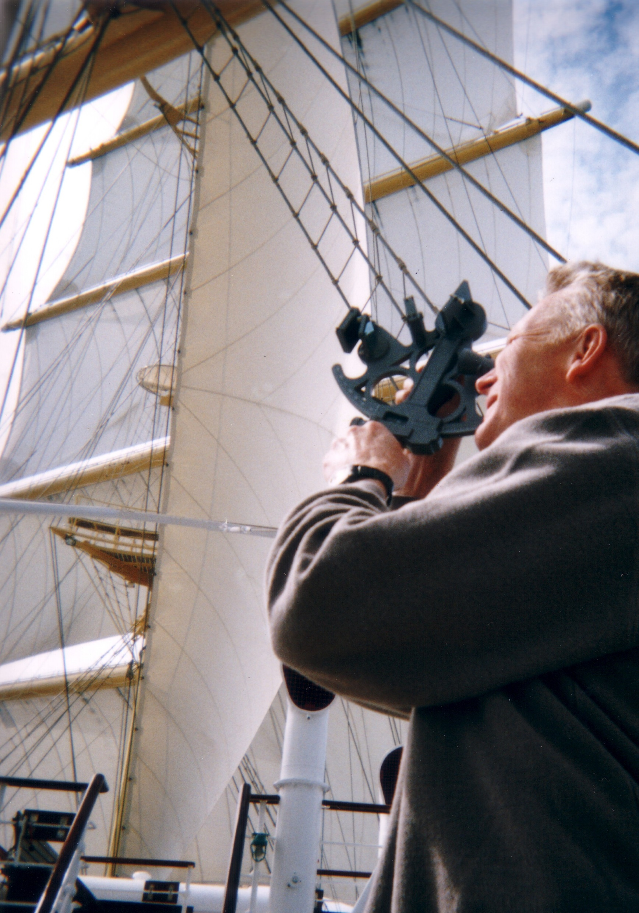
Navigator—Parents
Setting a course for our eternal home
They go in the same direction as their parents
Where are you going?
Ever correcting the course

Slide 27
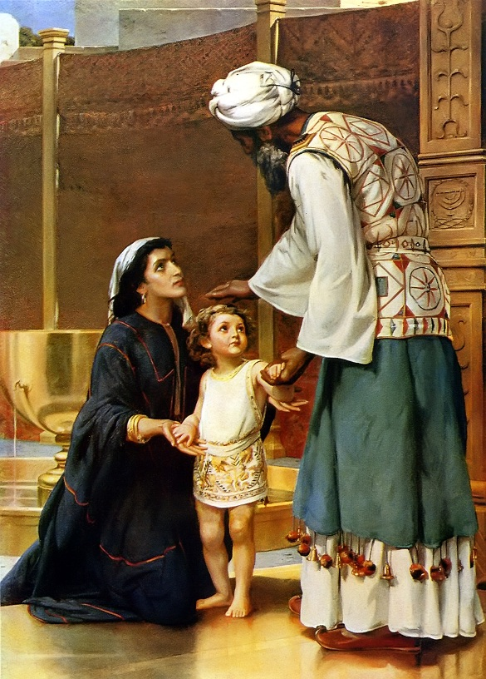
Navigator—Parents
Hannah set the course for Samuel when she gave him to Eli to be raised as a man of God.
  Priest
  Prophet
  Judge

Slide 28
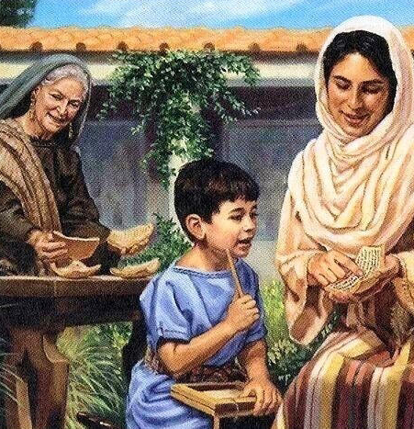
Navigator—Parents
Lois and Eunice set the course for Timothy when they raised him according to the Word of God.
  Man of God
  Missionary
  Preacher

Slide 29
Pilot
Anchor
Rescue crew
Engineer
Navigator
Training School

Slide 30
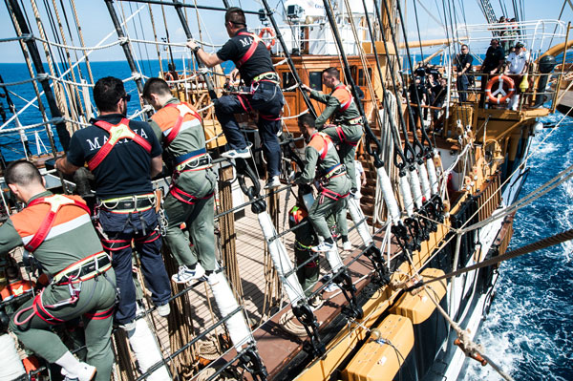
Training School—Parents

Slide 31
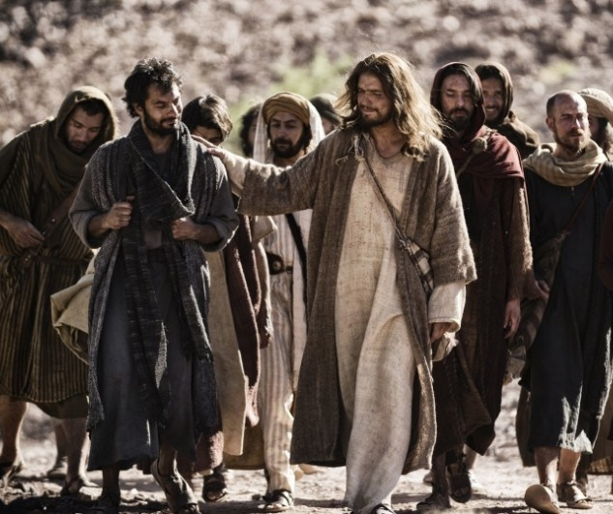

Training School—On the Job!
Jesus invented “Management by walking around’ long before the 1980s.

Slide 32
Training School—On the Job!
Mark 3:14
And He appointed twelve, so that they would be with Him and that He could send them out to preach,

Slide 33

Training School—On the Job!
Proverbs 22:6
Train up a child in the way he should go, Even when he is old he will not depart from it.

Slide 34
Training School—On the Job!
Ephesians 5:1-2
Therefore be imitators of God, as beloved children; and walk in love, just as Christ also loved you and gave Himself up for us,

Slide 35

John 3:5
⁵Jesus answered, “Truly, truly, I say to you, unless one is born of water and the Spirit, he cannot enter the kingdom of God. (ESV)

