Slide 1
Teachers—Where to Begin
PM Sermon
Morningside Church of Christ
Sunday 24 March 2018
By John Staiger

Slide 2
Teachers—Where to Begin

Slide 3
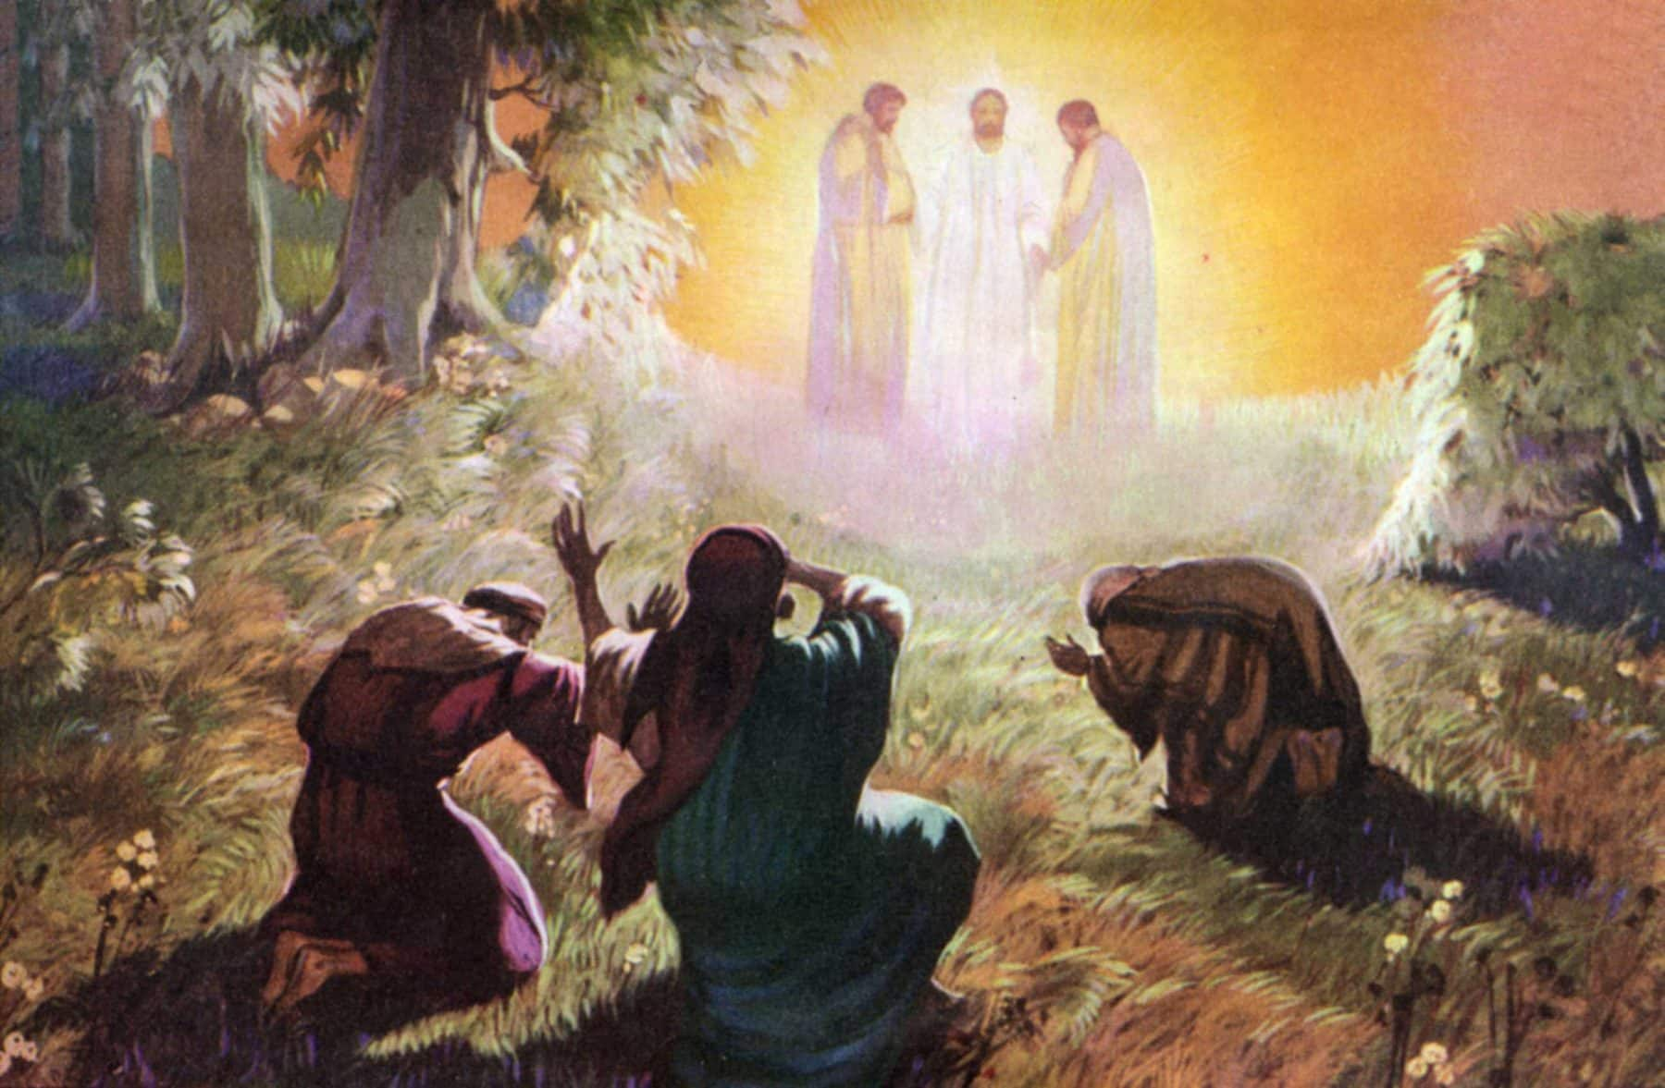
Jesus, the Master Teacher
Who is Jesus that we should listen to him?
The Chosen one
Verbal affirmation
Herald of God
Luke 9:35
Then a voice came out of the cloud, saying, “This is My Son, My Chosen One; listen to Him!” (NASB95)

Slide 4
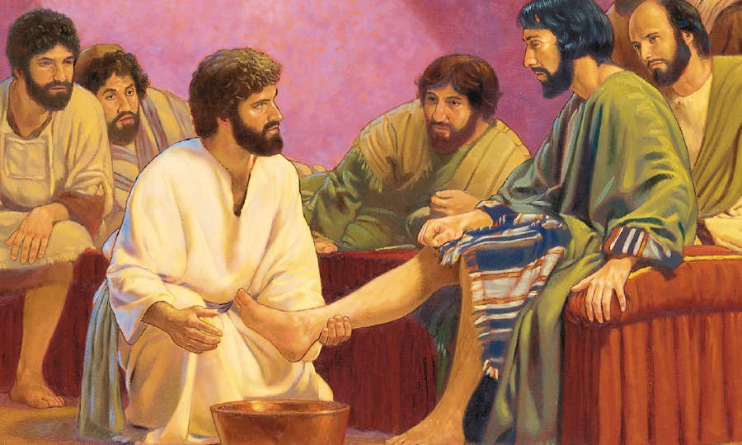
Jesus, the Master Teacher
Who is Jesus that we should listen to him?
Jesus knew what he was.
Lord!
Teacher!
Didn’t shy away from what that meant in its practical outworking.
Servant
Expected them to do likewise.
John 13:13-14—¹³You call Me Teacher and Lord; and you are right, for so I am. ¹⁴If I then, the Lord and the Teacher, washed your feet, you also ought to wash one another’s feet. (NASB95)

Slide 5
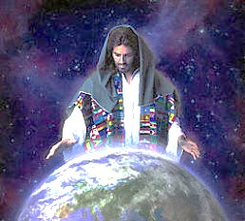
Jesus, the Master Teacher
Who is Jesus that we should listen to him?
Matthew 28:18-20—¹⁸And Jesus came up and spoke to them, saying, “All authority has been given to Me in heaven and on earth. ¹⁹Go therefore and make disciples of all the nations, baptizing them in the name of the Father and the Son and the Holy Spirit, ²⁰teaching them to observe all that I commanded you; and lo, I am with you always, even to the end of the age.” (NASB95)

Slide 6
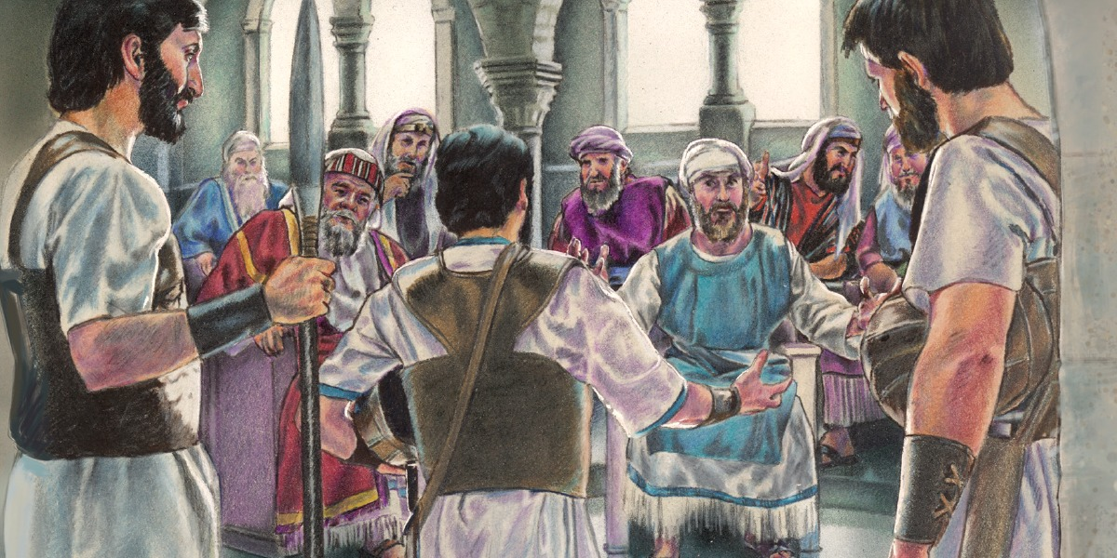
Jesus, the Master Teacher
Jesus’ impact upon people:
Disobeyed orders
Walked away in amazement
Singled Jesus out as being extraordinary
John 7:46—⁴⁶The officers answered, “Never has a man spoken the way this man speaks.” (NASB95)

Slide 7
Jesus, the Master Teacher
Jesus’ impact upon people:
Jesus’ authority was evident in his teachings.
In contrast to the teachers of the law.
Matthew 7:29—²⁹for He was teaching them as one having authority, and not as their scribes. (NASB95)

Slide 8
Jesus, the Master Teacher
Jesus’ purpose
Jesus’ own glorification by the Father was to bring glory to the Father.
Given authority over everyone
Lost sinners are given to Jesus, by the Father, for Jesus to save for eternity.
Eternal life is knowing the Father and the Son.
The Son reveals the Father to us (John 1:18)
John 17:1-3
¹Jesus spoke these things; and lifting up His eyes to heaven, He said, “Father, the hour has come; glorify Your Son, that the Son may glorify You, ²even as You gave Him authority over all flesh, that to all whom You have given Him, He may give eternal life. ³This is eternal life, that they may know You, the only true God, and Jesus Christ whom You have sent. (NASB95)

Slide 9
Communicating the truth

Slide 10
Have you ever heard someone say that they don’t believe in using ILLUSTRATIONS in sermons?

Slide 11
Why would someone be against ILLUSTRATIONS?

Slide 12
Why would someone be against ILLUSTRATIONS?
Do they have an aversion to creativity?

Slide 13
Why would someone be against ILLUSTRATIONS?
Do they have an aversion to creativity?
Some reasons why “Creativity” might not help…

Slide 14
Distracting from main point

Slide 15
Distracting from main point
Long……

Slide 16
Distracting from main point
Long……
Irrelevant

Slide 17
Distracting from main point
Long……
Irrelevant
Insensitive

Slide 18
Distracting from main point
Long……
Irrelevant
Insensitive
Poorly presented

Slide 19
Distracting from main point
Long……
Irrelevant
Insensitive
Poorly presented
Too many

Slide 20
Distracting from main point
Long……
Irrelevant
Insensitive
Poorly presented
Too many
Forced

Slide 21
Distracting from main point
Long……
Irrelevant
Insensitive
Poorly presented
Too many
Forced
Veiled gossip

Slide 22
Distracting from main point
Long……
Irrelevant
Insensitive
Poorly presented
Too many
Forced
Veiled gossip
Manipulation of emotions

Slide 23
Distracting from main point
Long……
Irrelevant
Insensitive
Poorly presented
Too many
Forced
Veiled gossip
Manipulation of emotions
Worldly

Slide 24
Distracting from main point
Long……
Irrelevant
Insensitive
Poorly presented
Too many
Forced
Veiled gossip
Manipulation of emotions
Worldly
Repetitive

Slide 25
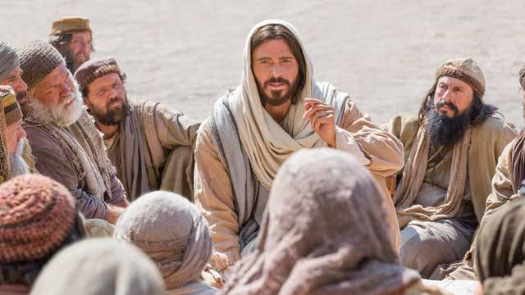
Then why use ILLUSTRATIONS?
Allow me to ILLUSTRATE…!

Slide 26
Which parable?

Slide 27
Which parable?

Slide 28
Which parable?

Slide 29
Which parable?

Slide 32
Stories, stories and more stories…
Matthew 13:13
Therefore I speak to them in parables; because while seeing they do not see, and while hearing they do not hear, nor do they understand. (NASB95)
Parables
Not only a means of enlightenment, but a means of hiding the truth from the unbelieving.

Slide 33
Stories, stories and more stories…
Parables
They seem simple.
The messages they convey are, in fact, deep.
Central to the teachings of Jesus.
If Jesus used stories so powerfully in his teaching and preaching…
So must we!

