Slide 1
Teachers
AM Sermon
Morningside Church of Christ
Sunday 17 March 2018
By John Staiger
A recording of this sermon is available. Click here:
https://drive.google.com/file/d/1QImu0Z7poFZHZJQkloCxBu8-TqgS-K1C/view?usp=drivesdk

Slide 2


Teachers

Slide 3
In every congregation of the Lord’s church the Word of God is to be:
    Read
    Taught
    Displayed (Lived)
    Encouraged.

Slide 4
We talk about:
That which comes from the
“The PULPIT”?
    Which permeates to—
      The Classroom
      That which is to be taken home
      And shared with out neighbours

Slide 5
What is Our Goal?
When the Word of God is being presented in this church, is that it be seen for what it is:
  Holy
  Healthy
  Hopeful
  Helpful

Slide 6
Who is to present the Word of God in the church?
The simple answer is, those who:
  Preach
  Teach

Slide 7

Sooner or later, every Christian will hear these scriptures and wonder at their part in them:
2 Timothy 4:2—preach the word; be ready in season and out of season; reprove, rebuke, exhort, with great patience and instruction. (NASB95)

Slide 8
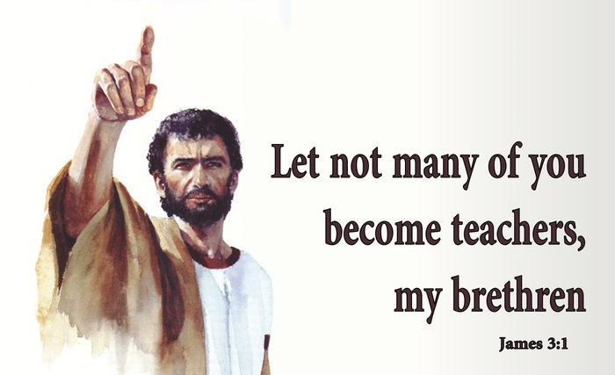
Sooner or later, every Christian will hear these scriptures and wonder at their part in them:
James 3:1—Let not many of you become teachers, my brethren, knowing that as such we will incur a stricter judgment. (NASB95)

Slide 9
Sooner or later, every Christian will hear these scriptures and wonder at their part in them:
Teaching by word and example…
Titus 2:1-8—But as for you, speak the things which are fitting for sound doctrine. ²Older men are to be temperate, dignified, sensible, sound in faith, in love, in perseverance.
³Older women likewise are to be reverent in their behaviour, not malicious gossips nor enslaved to much wine, teaching what is good, ⁴so that they may encourage the young women to love their husbands, to love their children, ⁵to be sensible, pure, workers at home, kind, being subject to their own husbands, so that the word of God will not be dishonoured.
⁶Likewise urge the young men to be sensible; ⁷in all things show yourself to be an example of good deeds, with purity in doctrine, dignified, ⁸sound in speech which is beyond reproach, so that the opponent will be put to shame, having nothing bad to say about us. (NASB95)

Slide 10

Should
I
be a Teacher?

Slide 11


When is the answer a definite
NO?

Slide 12
This must never be an OPINION ZONE.
An ‘I don’t like you so that must make you unfit to teach’ zone
This is a ‘NO-WAY!’ because it is not GOD’S WAY’ zone.
It is heart-breaking, difficult and life-and-death stuff.
Souls depend on it.

Slide 13
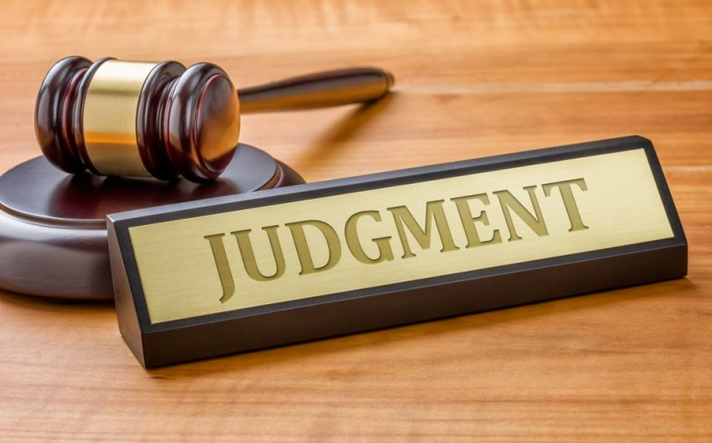
When teaching God’s word will bring you condemnation.
James 3:1—Not many of you should become teachers, my brothers, for you know that we who teach will be judged with greater strictness. (ESV)
False teaching
Divisiveness
Judgemental spirit
Heartless

Slide 14

When external behaviour is a to mask to hide internal ungodliness.
Hypocrisy.
Man can be fooled—God can’t.
Hebrews 4:13—¹³ And no creature is hidden from his sight, but all are naked and exposed to the eyes of him to whom we must give account. (ESV)

Slide 15

When your life is a mess:
You find yourself apologizing for swearing, explicit jokes, flirting,…
You are unreliable.
Hidden sins.
You are rebellious.
You are unrepentant.
You are destructive

Slide 16
When is the answer
MAYBE?

Slide 17
When life’s burdens are getting the better of you:
Grief
Sickness
Struggles
Discouragement
Life crowds in on you.
You need to be spiritually re-charged
Step back
Taking a break is wisdom, not shame.

Slide 18
When temptation is getting the better of us:
Beset by weakness.
Doubt
Evil influence
Everyone is tempted.
Everyone is a sinner.
Grow in:
Strength
Accountability (Jm.5:16)
Godly habits

Slide 19
Not ready, yet:
New in the faith
Stage fright
Lacking knowledge
These things are not insurmountable
Prayer.
Time in the word.
Encouragement.
These move us toward the goal of effective teaching.

Slide 20
When is the answer a definite
YES!

Slide 21
When you and everyone else knows you are spiritually ready:
You know the Lord.
You know the Bible.
You know the subject.

Slide 22
It is your talent:
Dig it up!
Use it or lose it!
This is not your talent, it is God’s, and is to be used for his purposes.

Slide 23

The Need is ever before you:
The lost
The growing
The tired
The wayward
The ignorant

Slide 24
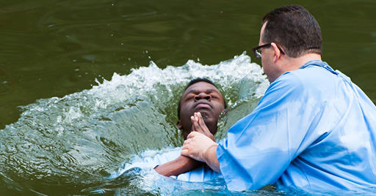
Mark 16:15-16—¹⁵And He said to them, “Go into all the world and preach the gospel to all creation. ¹⁶ He who has believed and has been baptized shall be saved; but he who has disbelieved shall be condemned. (NASB95)

Slide 25

Don’t let the devil in:
Repent
Confess your sins
Be Accountable
Study
Start small
Have something good to say
Write it out—word for word

Slide 26
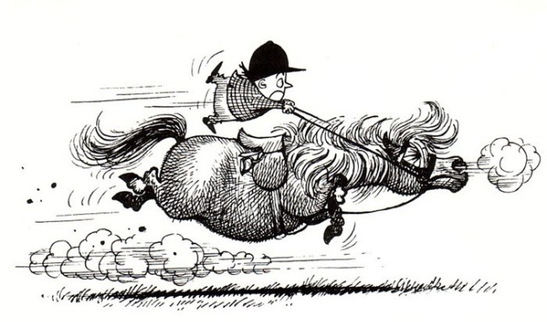
Be Careful
Proverbs 16:18— Pride goeth before destruction, and an haughty spirit before a fall. (KJV)
1 Corinthians 8:1b—…This “knowledge” puffs up, but love builds up. (ESV)
Luke 6:26—Woe to you when all men speak well of you, for their fathers used to treat the false prophets in the same way. (NASB95)

Slide 27


Slide 28


Slide 34
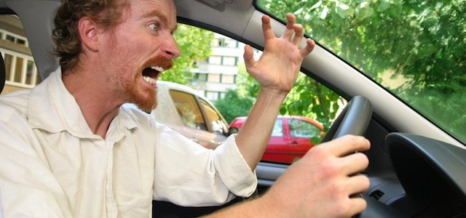
I thought that I was a good person, but the way I react when people drive too slowly in front of me would suggest otherwise.

Slide 35
Health (Sound Doctrine)
Hope
Help
Honour
Humility
Harm
Hidden
Hindrance
Hubris
Hypocrisy

Slide 36
Health (Sound Doctrine)
Harm
Spiritual anaemia
Stumble / fall
False doctrine

Slide 37
Honour
Privilege
Call no man teacher
Hubris
arrogance, conceit, conceitedness, haughtiness, pride, vanity, self-importance, self-conceit, pomposity, superciliousness, feeling of superiority; hauteur; informal: uppitiness, big-headedness

Slide 38
So what’s the problem with saying, “Accept Jesus just in case Christianity is true”?

Slide 39


Slide 40


Slide 41
