Slide 1
Yesterday, Today and Beyond
AM Sermon
Morningside Church of Christ
Sunday 28 April 2019
John Staiger

Slide 2
Yesterday, Today and Beyond…

Slide 3

It is natural for you and I to think in terms of TIME.
After all, this is our present reality.

Slide 4
Ecclesiastes 3:11—He has made everything appropriate in its time. He has also set eternity in their heart, yet so that man will not find out the work which God has done from the beginning even to the end. (NASB95)
But being made in the image of God gives us a perspective beyond this world

Slide 5
We have the ability to seek the answers of life: Where we came from
Why we are here
Where are we going…?

Slide 6
God has revealed Himself to us:
Creation
Bible
Jesus Christ

Slide 7
Though WE live out our existence through a cycle of days, months and years…

Slide 8

God is Timeless
  Eternal—no beginning, no end
  Exists outside of time
  God governs time

Slide 9
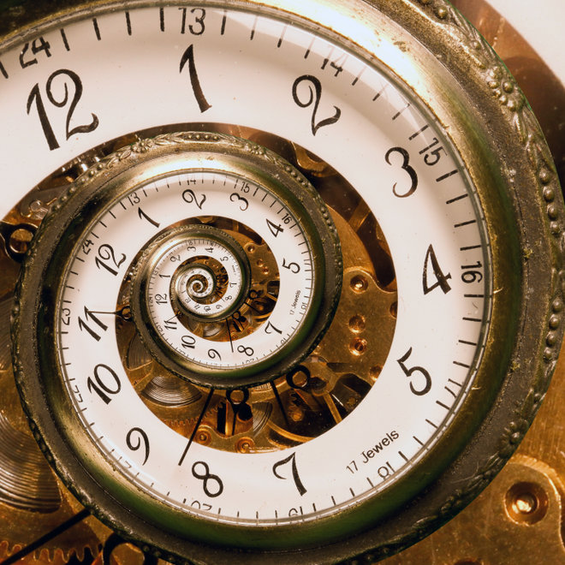
We are governed by time
We live in a paradigm of:
    Past memory
    Present
      senses
      thoughts
      actions
    Future
      Anticipation
God is not confined to such a linier existence

Slide 10
God doesn’t have to line up his thoughts
  We struggle or delight in past, present or possible future events .
  God doesn’t live by memories and aspirations as we do.
Isaiah 55:8—
⁸ “For My thoughts are not your thoughts,
Nor are your ways My ways,”
declares the Lord. (NASB95)

Slide 11
  God doesn’t change his interpretation of events.
  We
  re-evaluate
  re-interpret
  re-calibrate
  our thoughts and memories.
    God lives in the reality of truth and purity.
    God doesn’t change His mind…

Slide 12
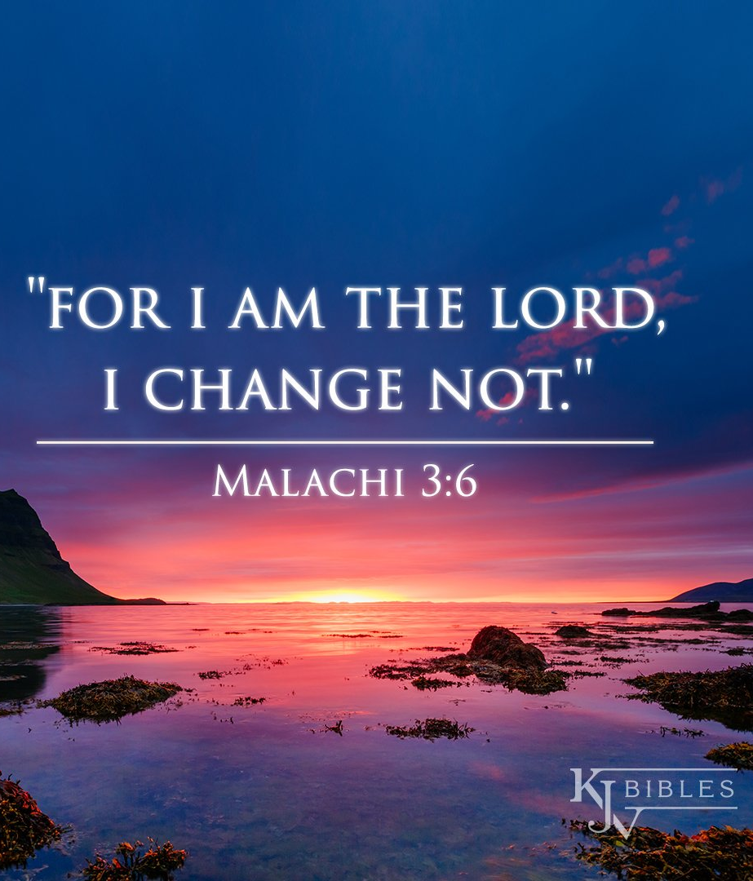

Slide 13
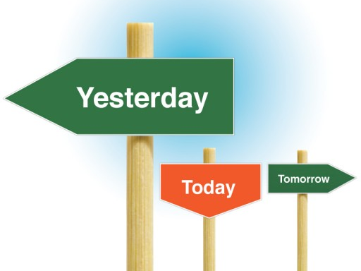

Slide 14


Slide 15
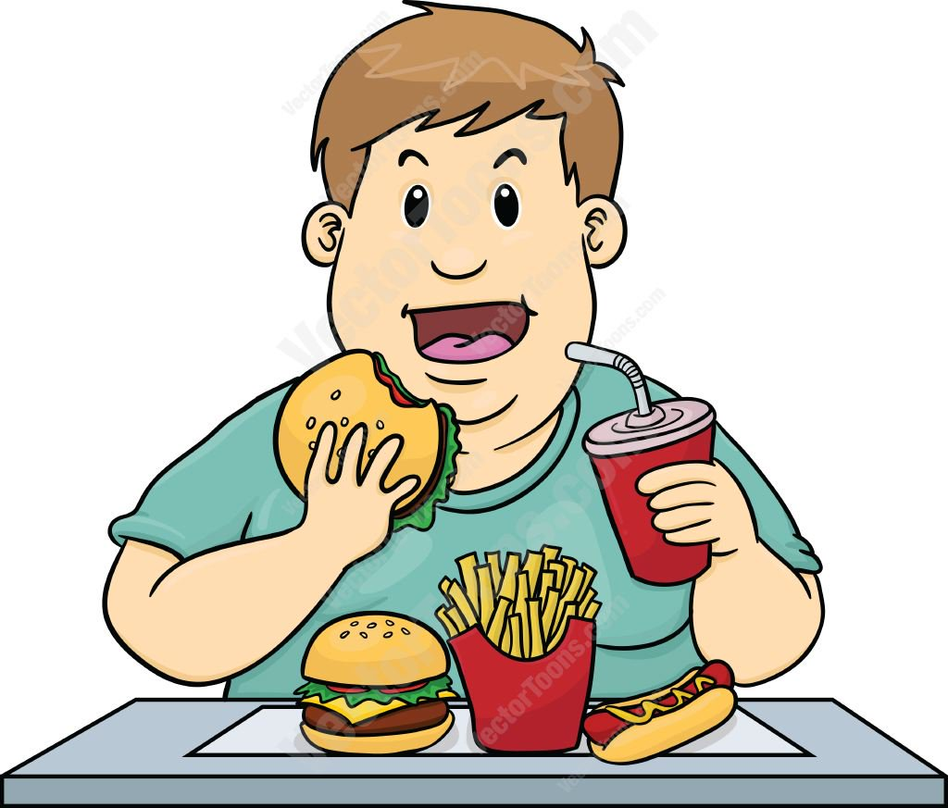
Yesterday
It is naive to think that yesterday doesn’t have an impact on today.
That’s like saying that all that junk food that I have eaten over the years has had no impact upon my present waistline.
Y
E
S
T
E
R
D
A
Y

Slide 16
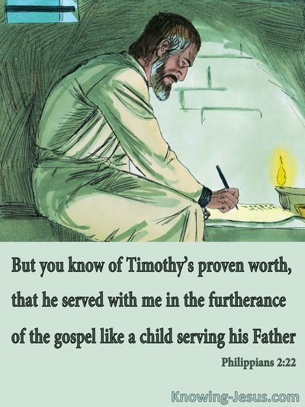
Yesterday
Re-lived over and over again…
Past compliments:
  They are stored in a safe vault in our hearts
  They are weapons against discouragement
  The victories of past inspire us - to this very minute!
Y
E
S
T
E
R
D
A
Y

Slide 17
Yesterday
Re-lived over and over again…
Past criticisms
  They are stored as grudges, hurts and wounds.
  They are weapons against encouragement
  The past will stop you in your tracks if you let it
Y
E
S
T
E
R
D
A
Y
1 Timothy 1:12-14—¹²I thank Christ Jesus our Lord, who has strengthened me, because He considered me faithful, putting me into service, ¹³even though I was formerly a blasphemer and a persecutor and a violent aggressor. Yet I was shown mercy because I acted ignorantly in unbelief; ¹⁴ and the grace of our Lord was more than abundant, with the faith and love which are found in Christ Jesus. (NASB95)

Slide 18

Yesterday
Practice selective membership.
  You can’t change your past, but you can choose which parts to invite to your ministry for Jesus
  Presents from your past.
  Make a list of the good things and praise God for them.
Y
E
S
T
E
R
D
A
Y
Romans 15:4—⁴ For whatever was written in earlier times was written for our instruction, so that through perseverance and the encouragement of the Scriptures we might have hope. (NASB95)

Slide 19
Today
Every good deed is rewarded
  Your past good deeds—the fruit of your service for the Lord—has ben couriered ahead.
  Send some more!
  Today is the day to ask, “How do I store up treasure in heaven?
  What is this ‘Heavenly Treasure?’
    Everyday works of service done in the name of Jesus
    Seeking the welfare of the lost and saved alike
    The needs of the widow and orphan go on
T
O
D
A
Y
James 1:27—Pure and undefiled religion in the sight of our God and Father is this: to visit orphans and widows in their distress, and to keep oneself unstained by the world. (NASB95)

Slide 20
Today
  Is welcomed and used for the opportunity it is—to impact lives for Jesus:
T
O
D
A
Y
As a Christian, you are called upon to
factually inform the misinformed.
Not everybody is receptive.
Perspective clouds the truth.
This can be no fun.
However, it must be done!
But how…?

Slide 21
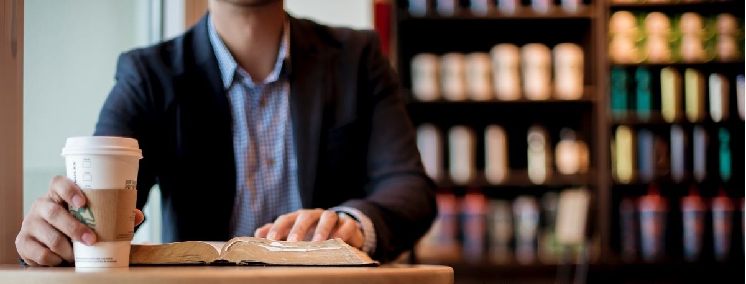
Today is welcomed and used for the opportunity it is—to impact lives for Jesus:
T
O
D
A
Y
Colossians 4:5-6—⁵Conduct yourselves with wisdom toward outsiders, making the most of the opportunity. ⁶Let your speech always be with grace, as though seasoned with salt, so that you will know how you should respond to each person. (NASB95)

Slide 22
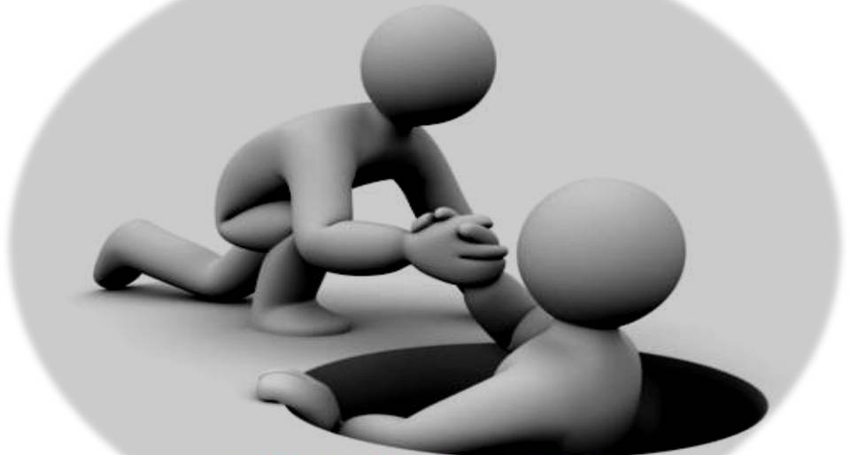
Today is welcomed and used for the opportunity it is—to impact lives for Jesus:
T
O
D
A
Y
Galatians 6:10—So then, while we have opportunity, let us do good to all people, and especially to those who are of the household of the faith. (NASB95)

Slide 23
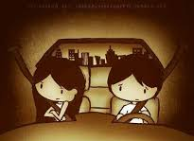
Today is welcomed and used for the opportunity it is—to impact lives for Jesus:
Ephesians 4:26-28—²⁶ Be angry, and yet do not sin; do not let the sun go down on your anger, ²⁷and do not give the devil an opportunity.
²⁸He who steals must steal no longer; but rather he must labour, performing with his own hands what is good, so that he will have something to share with one who has need. (NASB95)
T
O
D
A
Y

Slide 24
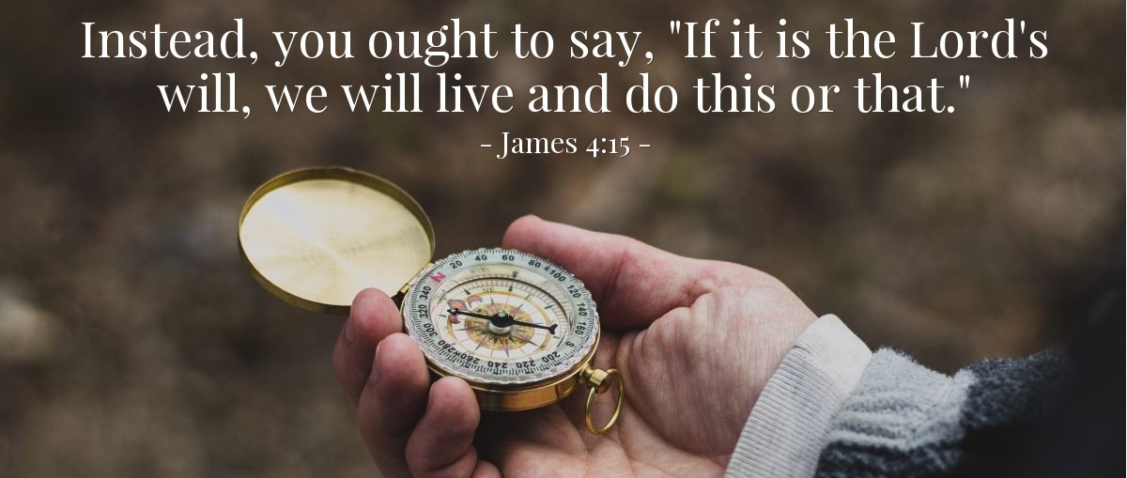
Beyond
  God promises that he will always be with us…but that promise does not include a guarantee of a tomorrow on this earth.
  From this minute on, we preface every plan to act with, “If the Lord wills.” James 4:15—
B
E
Y
O
N
D

Slide 25
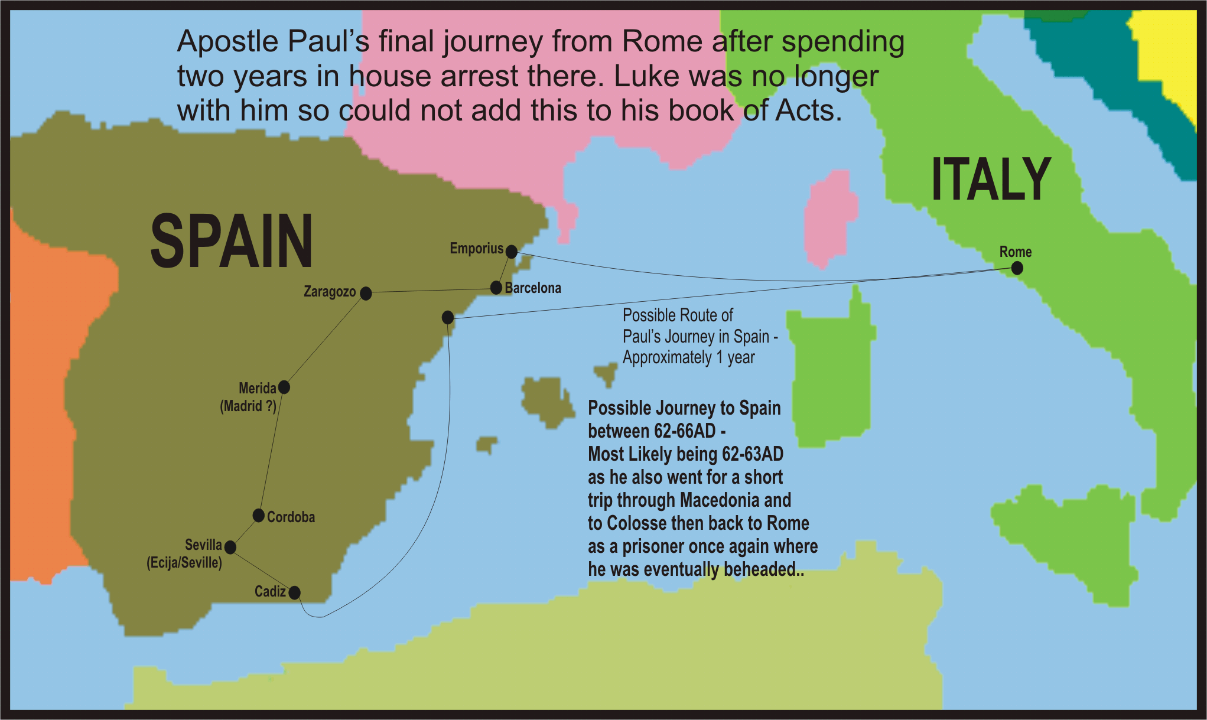
Beyond
  Jesus planned in eternity, carried out our salvation in time and space, and is working presently from the father’s side and through the Holy Spirit to bring us to heaven
  The future is to be planned and anticipated
  Paul planned to evangelize in Spain
B
E
Y
O
N
D
Romans 15:28
Therefore, when I have finished this, and have put my seal on this fruit of theirs, I will go on by way of you to Spain. (NASB95)

Slide 26
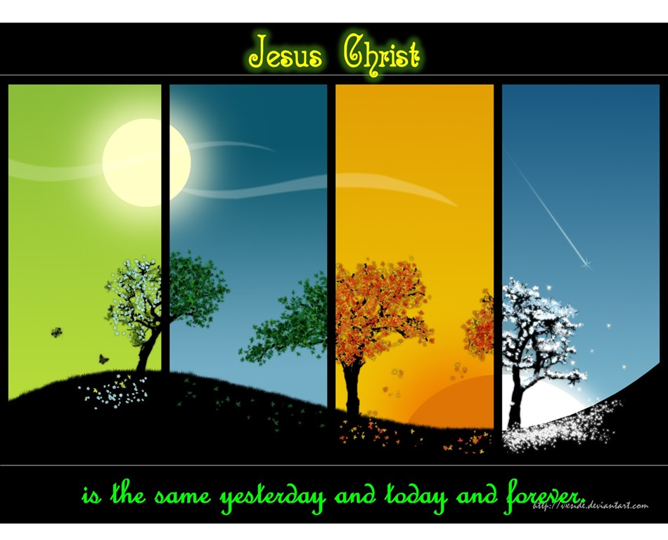
Hebrews 13:8

Slide 27

Philippians 1:21-26—²¹For to me, to live is Christ and to die is gain. ²²But if I am to live on in the flesh, this will mean fruitful labour for me; and I do not know which to choose. ²³But I am hard-pressed from both directions, having the desire to depart and be with Christ, for that is very much better; ²⁴yet to remain on in the flesh is more necessary for your sake. ²⁵Convinced of this, I know that I will remain and continue with you all for your progress and joy in the faith, ²⁶so that your proud confidence in me may abound in Christ Jesus through my coming to you again. (NASB95)

Slide 28
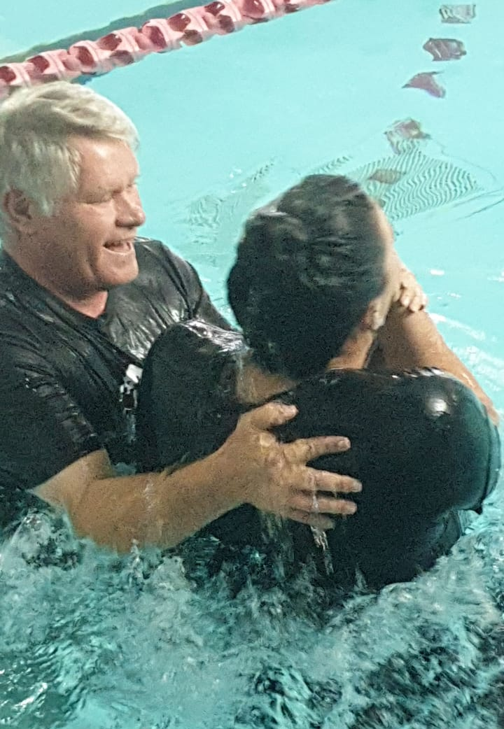
Galatians 3:27
²⁷For as many of you as were baptized into Christ have put on Christ. (ESV)

