Slide 1
What to say to God

Slide 2

A time to wonder
James 1:2-3—²Consider it all joy, my brethren, when you encounter various trials, ³knowing that the testing of your faith produces endurance. (NASB95)

Slide 3
A time to wonder
Life’s circumstances get the better of us—if we let them
Be careful not to become cynical or hand life over to fate
Or always making hard times…

Slide 4
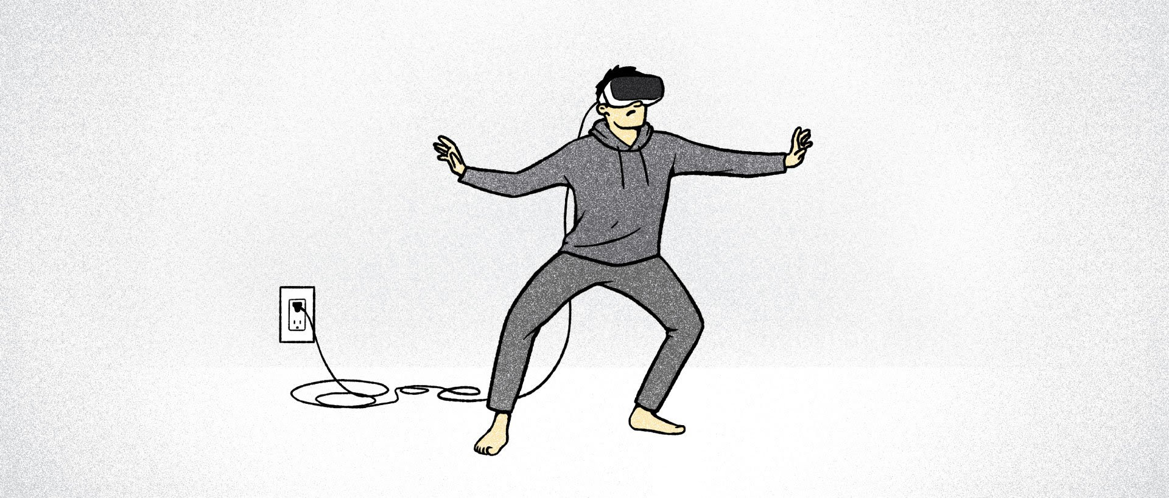
A time to escape from reality?
It’s a small and easy step
We are surrounded by ways to distract ourselves
Easy to waste time
Easier still to lose our spiritual bearings

Slide 5

A time to stop!
Stop…
  Expecting circumstances to be ideal on a corrupted planet
  Expecting people to be perfect in a fallen world
  Expecting holy outcomes from an unholy world
  Expecting peace when being disconnected from the prince of peace
  Expecting to be spiritual when giving in to social norms.

Slide 6

A time to ask!
Q—What is my part in God’s divine will—does he have a plan for my life?
A—’The righteous will live by faith.’
How do I know how to walk by faith?

Slide 7

A time to listen…
Reading the Bible is listening to what God wants you to know…
About God’s interaction with man from the beginning
Eden’s perfect walk
The Fall’s complete destruction
The Cross’s eternal reconciliation

Slide 8

A time to accept
Q—How can I be sure that God is listening to me?
A—The evidence is everywhere.
If God knows…
  Every cell in your body
  Every atom that makes up the universe
  Every thought and movement ever made
Then, Undoubtedly he knows…

Slide 9
A time to accept
Q—How can I be sure that God is listening to me?
A—The evidence is everywhere.
Then, Undoubtedly he knows…
  Every desire of our heart
  Every sorrow and sadness
  Every good or bad deed
  Every need of your soul
  Every prayer were should pray and how we should pray it…

Slide 10

A time to talk
Q—What kind of communication process does God want?
A—It is conversation between the mortal and the Divine.

Slide 11
A time to talk
Jesus tells us how to pray in Matthew 6
⁹ “Pray, then, in this way:
‘Our Father who is in heaven,
Hallowed be Your name.
¹⁰ ‘Your kingdom come.
Your will be done,
On earth as it is in heaven.
¹¹ ‘Give us this day our daily bread.
¹² ‘And forgive us our debts, as we also have forgiven our debtors.
¹³ ‘And do not lead us into temptation, but deliver us from evil. [For Yours is the kingdom and the power and the glory forever. Amen.’] (NASB95)

Slide 12
A time to talk
Jesus tells us how to pray in Matthew 6:9
⁹ “Pray, then, in this way:
‘Our Father who is in heaven,
Hallowed be Your name.
(NASB95)
Jesus leaves us in no doubt:
  How? – IN THIS WAY:
  Who? - We are speaking to OUR FATHER
  Where? - HEAVEN is His dwelling place
  What? - We speak His name for what it is—HOLY!

Slide 13
A time to talk
Matthew 6:10
¹⁰ ‘Your kingdom come.
Your will be done,
On earth as it is in heaven.
(NASB95)
Jesus came to establish the KINGDOM:
  The Day of Pentecost was in the future
  Jesus prayed in the garden, “YOUR WILL BE DONE” and it was!
  Heaven’s will was done on earth
  It is still being done—we cry out to be ever part of it.

Slide 14
A time to talk
Matthew 6:11
¹¹ ‘Give us this day our daily bread.
(NASB95)
Jesus reminds us of the source of our physical blessings:
  Enough is enough
  Matthew 6:34—³⁴“So do not worry about tomorrow; for tomorrow will care for itself. Each day has enough trouble of its own.(NASB95)
  All good things come down from above (James 1:17)
  Food, clothing and shelter is all we need
  1 Timothy 6:8—If we have food and covering, with these we shall be content.

Slide 15
A time to talk
Matthew 6:12
¹² ‘And forgive us our debts, as we also have forgiven our debtors.
(NASB95)
If you don’t FORGIVE, you can’t expect God to FORGET:
  Unforgiven, unresolved and unforgotten sins
  Shows a heart that doesn’t understand God
  Demonstrates a spirit outside of the will and work of God
  Progress cannot be easy

Slide 16
A time to talk
Matthew 6:13
¹³ ‘And do not lead us into temptation, but deliver us from evil.
(NASB95)
God’s desire is always to LEAD and DELIVER:
  We are spiritual soldiers being lead by the Spirit through a spiritual warzone.
  We are every surrounded by the circumstances of a sinful world
  Satan presents himself as an angel of light
  Temptations are unavoidable.
  We cry out to God for careful guidance and immediate deliverance

Slide 17
A time to talk
Jesus tells us how to pray in Matthew 6
⁹ “Pray, then, in this way:
‘Our Father who is in heaven,
Hallowed be Your name.
¹⁰ ‘Your kingdom come.
Your will be done,
On earth as it is in heaven.
¹¹ ‘Give us this day our daily bread.
¹² ‘And forgive us our debts, as we also have forgiven our debtors.
¹³ ‘And do not lead us into temptation, but deliver us from evil. [For Yours is the kingdom and the power and the glory forever. Amen.’] (NASB95)

Slide 18

Time to get on with it
Ephesians 6:18-20
¹⁸With all prayer and petition pray at all times in the Spirit, and with this in view, be on the alert with all perseverance and petition for all the saints, ¹⁹and pray on my behalf, that utterance may be given to me in the opening of my mouth, to make known with boldness the mystery of the gospel, ²⁰for which I am an ambassador in chains; that in proclaiming it I may speak boldly, as I ought to speak. (NASB95)

Slide 19
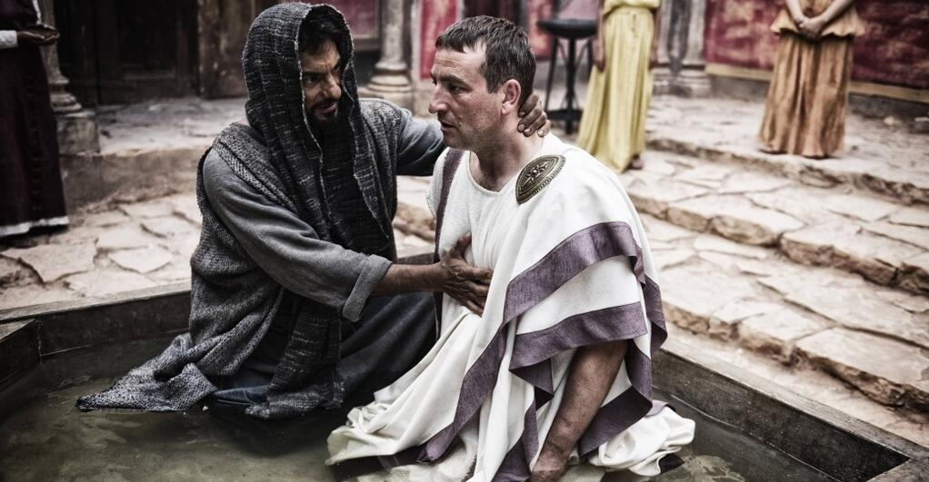
His time had come
Come Acts 10:4—Cornelius…The angel answered, “Your prayers and gifts to the poor have come up as a memorial offering before God.
Acts 10:48—⁴⁸ So he [Peter] ordered that they be baptized in the name of Jesus Christ. Then they asked Peter to stay with them for a few days.

