Slide 1
Sermon: John Staiger
“Generosity—“Staring into the heart of God-2.”
Sunday 28 July 2019
Morningside Church of Christ

Slide 2
God
The Mite
and The Likewise

Slide 3

1. God—Maker of Heaven and Earth
King David understood the true source of all things that pertain to generosity toward God

Slide 4
1. God—Maker of Heaven and Earth
David’s Prayer
1 Chronicles 29:10-19
¹⁰So David blessed the Lord in the sight of all the assembly; and David said, “Blessed are You, O Lord God of Israel our father, forever and ever.
¹¹Yours, O Lord, is the greatness and the power and the glory and the victory and the majesty, indeed everything that is in the heavens and the earth; Yours is the dominion, O Lord, and You exalt Yourself as head over all.
¹²Both riches and honour come from You, and You rule over all, and in Your hand is power and might; and it lies in Your hand to make great and to strengthen everyone. (NASB95)

Slide 5
1. God—Maker of Heaven and Earth
David’s Prayer
1 Chronicles 29:10-19
¹³Now therefore, our God, we thank You, and praise Your glorious name.
¹⁴“But who am I and who are my people that we should be able to offer as generously as this? For all things come from You, and from Your hand we have given You.
¹⁵For we are sojourners before You, and tenants, as all our fathers were; our days on the earth are like a shadow, and there is no hope.
¹⁶O Lord our God, all this abundance that we have provided to build You a house for Your holy name, it is from Your hand, and all is Yours. (NASB95)

Slide 6
1. God—Maker of Heaven and Earth
David’s Prayer
1 Chronicles 29:10-19
¹⁷Since I know, O my God, that You try the heart and delight in uprightness, I, in the integrity of my heart, have willingly offered all these things; so now with joy I have seen Your people, who are present here, make their offerings willingly to You.
¹⁸O Lord, the God of Abraham, Isaac and Israel, our fathers, preserve this forever in the intentions of the heart of Your people, and direct their heart to You;
¹⁹and give to my son Solomon a perfect heart to keep Your commandments, Your testimonies and Your statutes, and to do them all, and to build the temple, for which I have made provision.”(NASB95)

Slide 7
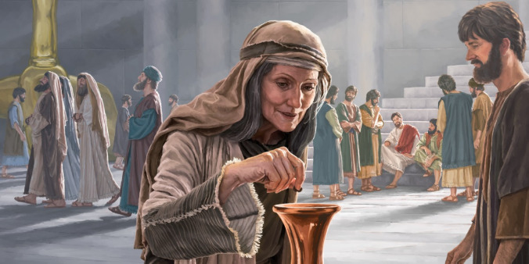
2. The Widow’s Mite

Slide 8

2. The Widow’s Mite
Mark 12:41-44—⁴¹And He sat down opposite the treasury, and began observing how the people were putting ^{[a]}money into the treasury; and many rich people were putting in large sums. ⁴²A poor widow came and put in two ^{[b]}small copper coins, which amount to a ^{[c]}cent. ⁴³Calling His disciples to Him, He said to them, “Truly I say to you, this poor widow put in more than all ^{[d]}the contributors to the treasury; ⁴⁴for they all put in out of their ^{[e]}surplus, but she, out of her poverty, put in all she owned, ^{[f]}all she had to live on.” (NASB95) [a]I.e. copper coins [b]Gr lepta [c]Gr quadrans; i.e. 1/64 of a denarius [d]Lit those who were putting in [e]Or abundance [f]Lit her whole livelihood

Slide 9
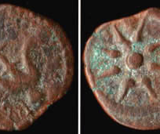

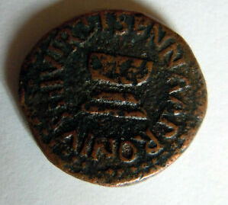
2. The Widow’s Mite
Two mites
(Greek lepta)
are together worth a quadrans, the smallest Roman coin.

Slide 10
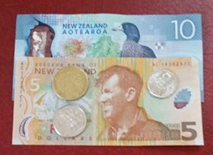
2. The Widow’s Mite
A lepton was the smallest and least valuable coin in circulation in Judea, worth about six minutes of an average daily wage.
NZ minimum wage is
$17.70 an hour.
6 minutes of that is worth
$1.77
x2
$3.54

Slide 11
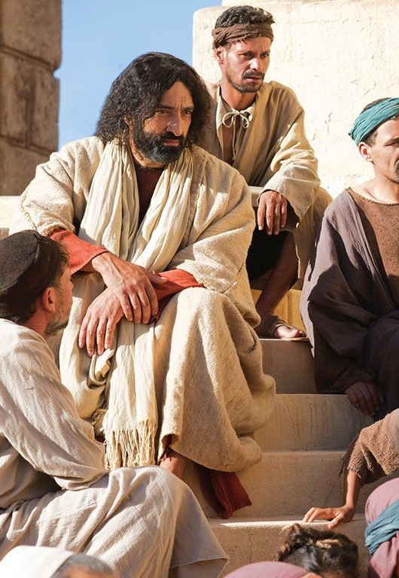
A. Jesus watched the contribution
2. The Widow’s Mite
Mark 12:41-44—
⁴¹And He sat down opposite the treasury, and began observing how the people were putting money into the treasury;
What he saw was not unusual…

Slide 12
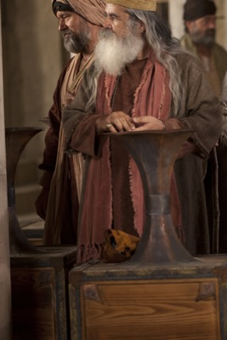
B. The ‘big’ contributors
2. The Widow’s Mite
Mark 12:41c—
⁴¹…and many rich people were putting in large sums. (NASB95)

Slide 13
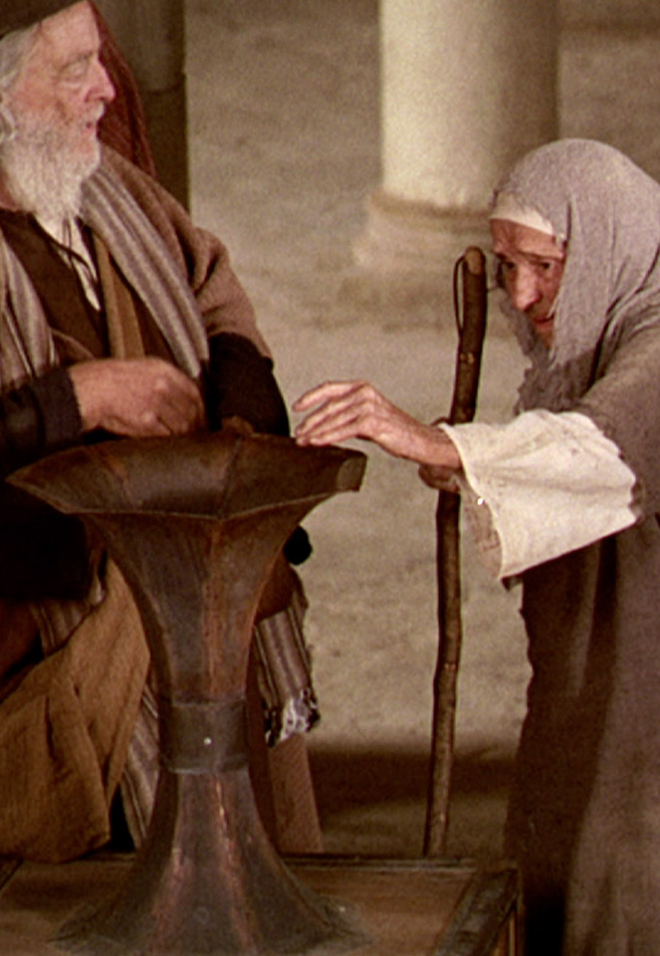
C. The ‘biggest’ contributor
2. The Widow’s Mite
Mark 12:42
⁴²A poor widow came and put in two small copper coins, which amount to a cent. (NASB95)

Slide 14
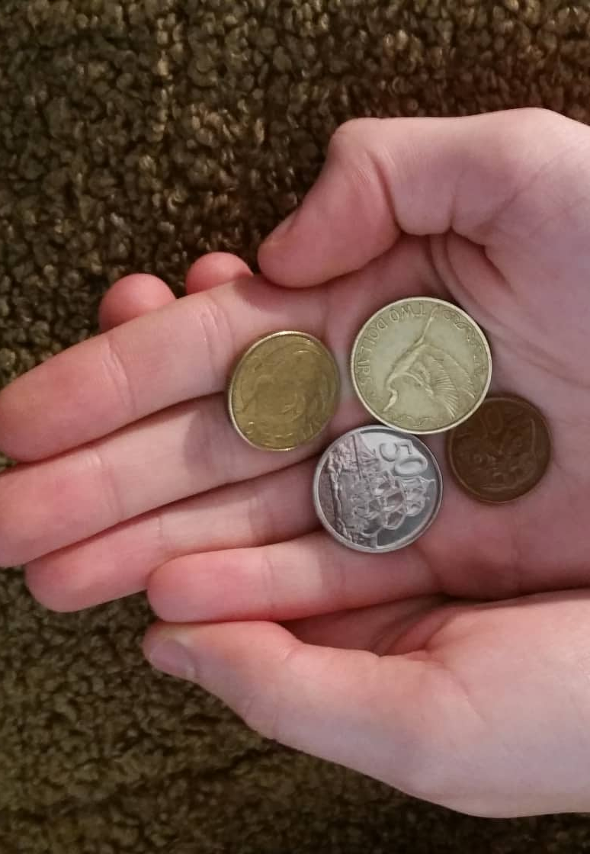
D. Jesus’ Summary
2. The Widow’s Mite
Mark 12:43-44
⁴³Calling His disciples to Him, He said to them, “Truly I say to you, this poor widow put in more than all the contributors to the treasury; ⁴⁴for they all put in out of their surplus, but she, out of her poverty, put in all she owned, all she had to live on.” (NASB95)

Slide 15
D. Jesus’ Summary
2. The Widow’s Mite
a. Come and see what I see
1) What the disciples were seeing:
  The rich, the poor and everyone in-between putting coins into 13 trumpet shaped containers placed around the temple courts.
  The money was for the temple
  The sound of the coins signalled the volumes of amounts given

Slide 16
D. Jesus’ Summary
2. The Widow’s Mite
2) What Jesus saw:
  Come and see what I see
  The amounts given
  The hearts of the givers
  The true meaning of sacrifice before God.
  Widow—Little was everything because it was everything
  Rich—More was nothing, because it was surplus.

Slide 17
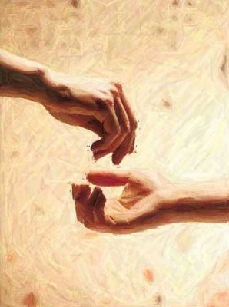
3. Go and do likewise
—Blessed
Acts 20:35—
³⁵In everything I showed you that by working hard in this manner you must help the weak and remember the words of the Lord Jesus, that He Himself said, ‘It is more blessed to give than to receive.’” (NASB95)
We are blessed to receive, but the great blessings come to the generous.
We are doing as God does
Reflecting His nature.
Being a distributor of His gifts
Storing up treasures in heaven

Slide 18
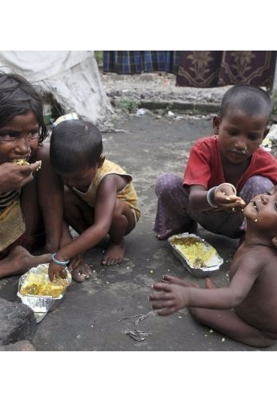
3. Go and do likewise
—Blessed again
Proverbs 22:9—
⁹He who is generous will be blessed,
For he gives some of his food to the poor. (NASB95)

Slide 19
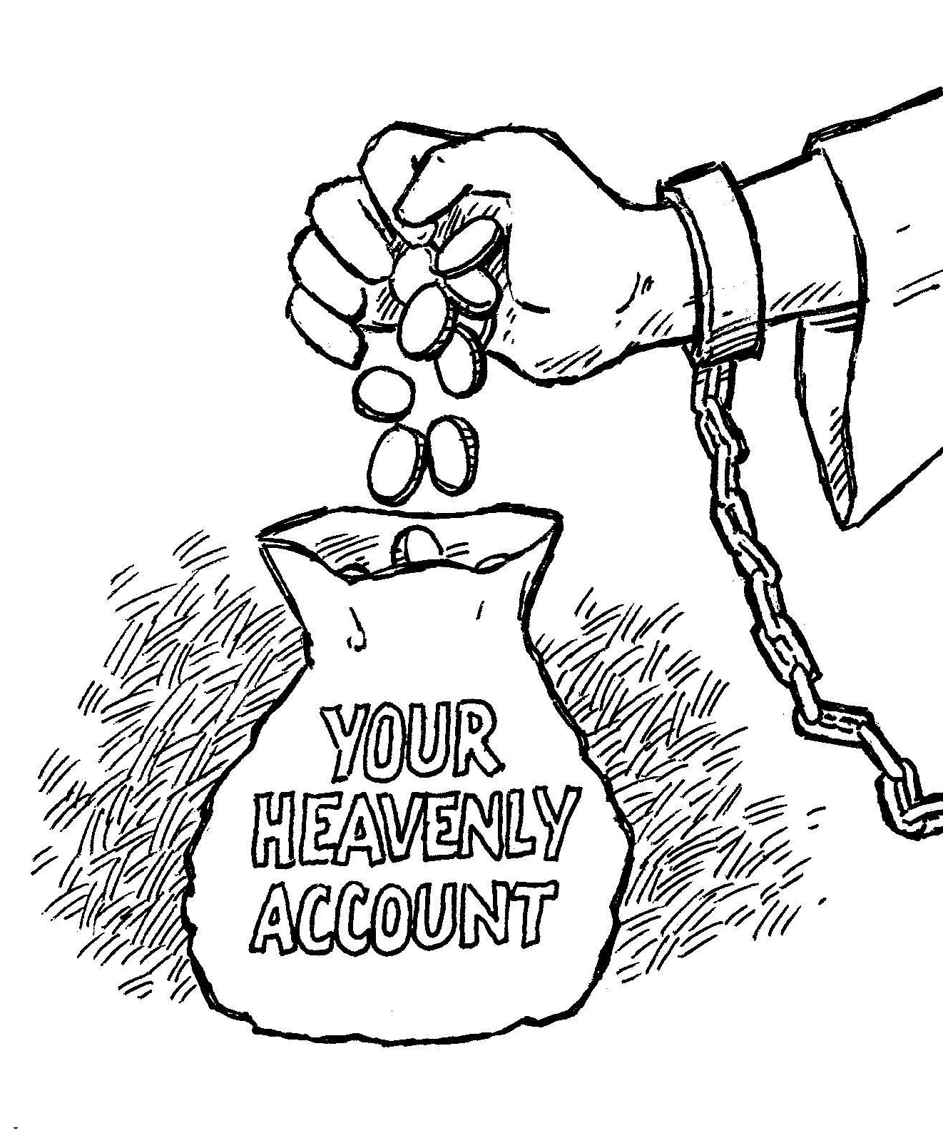
3. Go and do likewise
—Blessed again… and again
Philippians 4:17
¹⁷Not that I seek the gift itself, but I seek for the profit which increases to your account. (NASB95)
Paul rejoices in the spiritual blessings that will result for them because of their giving.
The sooner we get our minds off earthly (temporary) blessings and see the heavenly (eternal) blessings, the better off we will be.

Slide 20

3. Go and do likewise—Happily!
2 Corinthians 9:7
⁷Each one must do just as he has purposed in his heart, not grudgingly or under compulsion, for God loves a cheerful giver. (NASB95)
Your disposition in giving is indicative of the health of your spiritual life.

Slide 21
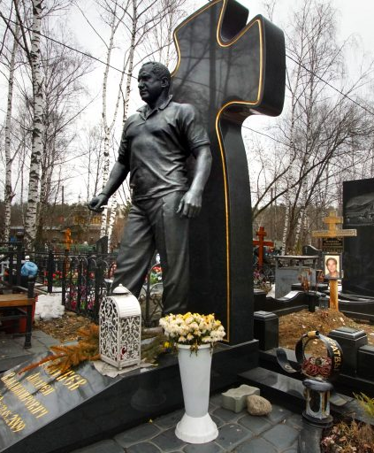
3. Go and do likewise—Look to your soul
Proverbs 11:4
⁴Riches do not profit in the day of wrath,
But righteousness delivers from death. (NASB95)
This is the grave of a Russian Mafia boss.
I pray he made his peace with God before he died.

Slide 22
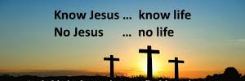
1 John 5:11
¹¹And the testimony is this, that God has given us eternal life, and this life is in His Son. (NASB95)

Slide 23
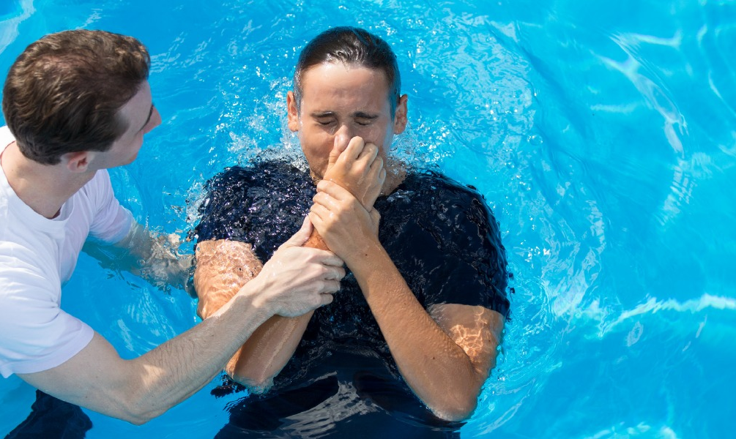
Acts 2:38
³⁸ Peter said to them, “Repent, and each of you be baptized in the name of Jesus Christ for the forgiveness of your sins; and you will receive the gift of the Holy Spirit. (NASB95)

