Slide 2
Generosity
Staring into the heart of God

Slide 3

We do not walk alone in this world
God’s generosity—
Is not about ‘YOU.’

Slide 4
God generously provides for our needs
Isolation and loneliness are curses
God’s generosity—
Is not about ‘YOU.’

Slide 5

God generously provides for our needs
Those walls we erect behind us just make the problems worse.
Self-made
Self-reliant
Self-supporting
Self-sustaining
Self-contained
God’s generosity—
Is not about ‘YOU.’

Slide 6
God generously provides for our needs
They must be smashed.
God’s generosity—
Is not about ‘YOU.’

Slide 7
God generously provides for our needs
Only then can
God
GIVE
that which is
to be
GIVEN-AWAY
God’s generosity—
Is not about ‘YOU.’

Slide 8
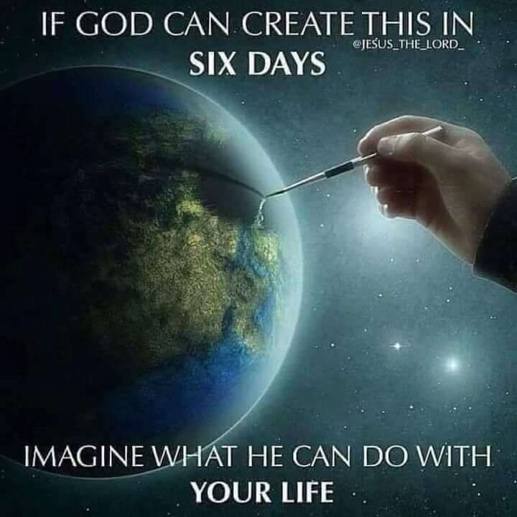
God’s generosity—
To All
We are God’s creation—
He provides…

Slide 9
God generously provides for our needs
Acts 17:25—
”…He Himself gives
to all people
life
and
breath
and
all things.”
God’s generosity—
To All

Slide 10
God generously provides for our needs
Acts 17:28—
²⁸for in Him we live and move and have our being, as also some of your own poets have said, ‘For we are also His offspring.’ (NKJV)
God’s generosity—
To All

Slide 11
God generously provides for our needs
Matthew 5:45 --
⁴⁵…for He causes His sun to rise on the evil and the good, and sends rain on the righteous and the unrighteous. (NASB95)
God’s generosity—
To All

Slide 12

God’s generosity—
His Way
All
is
Given
to
be
Shared

Slide 13
God’s generosity—
His Way
Psalm 68:6—
⁶God sets the lonely in families…

Slide 14
God’s generosity—
His Way
But this is not just any family
It is the family of God
The place where we are right with God and our fellow believers

Slide 15
God’s generosity—
His Way
2 Peter 1:3—
³seeing that His divine power has granted to us everything pertaining to life and godliness, through the true knowledge of Him who called us by His own glory and excellence. (NASB95)

Slide 16
God’s generosity—
His Way
Romans 12:5—
⁵so we, who are many, are one body in Christ, and individually members one of another. (NASB95)

Slide 17

God’s generosity—
Transforms our outlook
1 Timothy 4:4-6
⁴For everything created by God is good, and nothing is to be rejected if it is received with gratitude; ⁵for it is sanctified by means of the word of God and prayer. (NASB95)

Slide 18
God’s generosity—
Transforms our outlook
James 1:17—
¹⁷ Every good thing given and every perfect gift is from above, coming down from the Father of lights, with whom there is no variation or shifting shadow. (NASB95)
We are truly blessed…!

Slide 19
God’s generosity—
Transforms our outlook
But these blessings came at an extreme cost

Slide 20
God’s generosity—
Transforms our outlook
And it is that
COST
that sets the
STANDARD
for our
GENEROSITY.

Slide 21
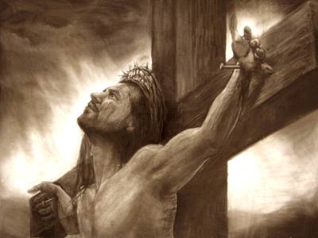
The Face of—
God’s generosity.
Paid up in advance
The
FACE
of God’s generosity

Slide 22
The Face of—
God’s generosity.
Paid up in advance
1) God’s self-sacrifice
John 3:16
¹⁶“For God so loved the world, that He gave His only begotten Son, that whoever believes in Him shall not perish, but have eternal life. (NASB95)

Slide 23
The Face of—
God’s generosity.
Paid up in advance
Romans 5:6—⁶For while we were still helpless, at the right time Christ died for the ungodly. (NASB95)

Slide 24
The Face of—
God’s generosity.
Paid up in advance
Romans 5:8—⁸But God demonstrates His own love toward us, in that while we were yet sinners, Christ died for us. (NASB95)

Slide 25
The Face of—
God’s generosity.
Paid up in advance
b) Our self-sacrifice
1 John 3:16
¹⁶We know love by this, that He laid down His life for us; and we ought to lay down our lives for the brethren. (NASB95)

Slide 26
The Face of—
God’s generosity.
Paid up in advance
b) Our self-sacrifice
John 13:34—
³⁴ A new commandment I give to you, that you love one another, even as I have loved you, that you also love one another. (NASB95)

Slide 27
The Face of—
God’s generosity.
Paid up in advance
b) Our self-sacrifice
Our generosity is motivated by our appreciation for God’s generosity toward mankind.

Slide 28
The Face of—
God’s generosity.
Paid up in advance
b) Our self-sacrifice
Time
Talents
Money
Homes
Cars
…are translated into acts of worship
…to a kind and generous God
…and toward the needy around us
…as gifts passed on from God

Slide 29

God’s generosity—
Gift of Eternal Life
c) Our self-denial
Ephesians 2:8-10
⁸ For by grace you have been saved through faith; and that not of yourselves, it is the gift of God; ⁹not as a result of works, so that no one may boast. ¹⁰For we are His workmanship, created in Christ Jesus for good works, which God prepared beforehand so that we would walk in them. (NASB95)

