Slide 1
What to say to God
3

Slide 2

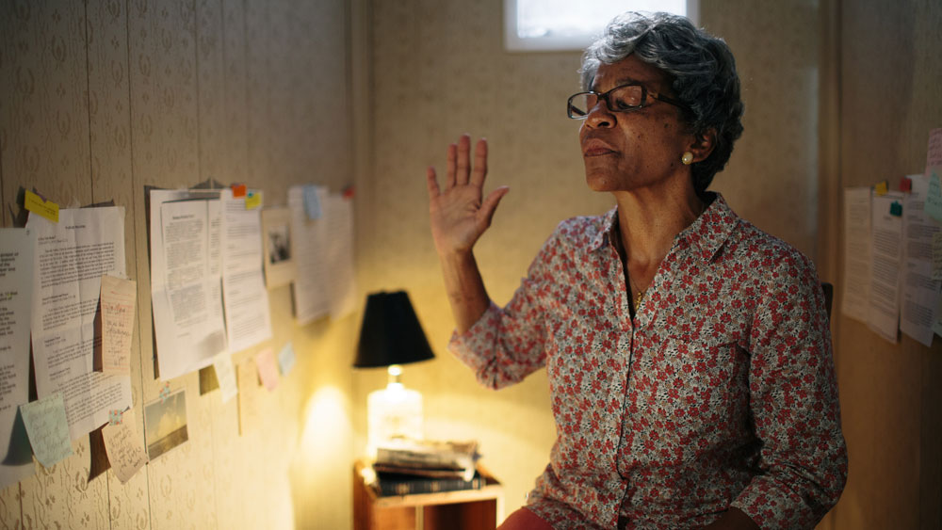
WAR ROOM (2015 Christian film)

Slide 3
The central character, ‘Miss Clara,’ shows Elizabeth (her real estate agent, who is struggling in her marriage) a special closet she has dedicated to praying,…

Slide 4
…and calls it her "War Room!"
Because as she puts it,…

Slide 5
"In order to stand up and fight the enemy, you need to get on your knees and pray."

Slide 6
Matthew 6:6—⁶But you, when you pray, go into your inner room, close your door and pray to your Father who is in secret, and your Father who sees what is done in secret will reward you. (NASB95)

Slide 7

Our ‘Prayer Closet’ is our Spiritual Oasis
In it is where we find fellowship alone with the Lord
There our thirst for God is satisfied—We find the strength to walk the street’s in this world—in the Light!
The spiritual wasteland still surrounds us

Slide 8
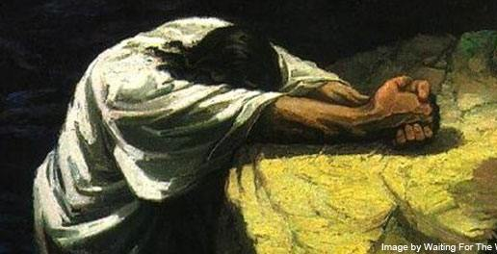
Jesus’ prayer closet was the Garden of Gethsemane (Lk.22:39-46f)
Often—Prayed alone
A time of agony—Sweat like drops of blood
Had found the strength to say, “not my will, but yours be done.”
Angels attended him—but the devil was coming

Slide 9

Your prayer closet doesn’t remove you from that which surrounds you
We are surrounded by the forces of the devil
Temptation is always there
But, we find protection in Christ.

Slide 10

We must challenge secular ideas about prayer:
  A harmless way to calm your emotions when overwhelmed
  Something for the weak to hang on to when things get tough
  Reserved for times of sadness
  The last hope for the desperate
  Any temple will do

Slide 11
Also, we must challenge some of our Christian ideas about prayer:
  Presenting my ideas on complete spiritual self-fulfilment
  A way of letting God know what is best for me
  Telling God my needs so that He will know what to do
  Helping God design my future
  Offering solutions for other peoples’ problems
  Sharing my excuses as reasons for my lack of faith

Slide 12




We all have God-given core abilities and interests.

Slide 13
We all have God-given core abilities and interests.
These can change or be adjusted according to:

Slide 14
We all have God-given core abilities and interests.
These can change or be adjusted according to:
Your spiritual growth
Unforeseen circumstances
Shifting needs

Slide 15
We all have God-given core abilities and interests.
These can change or be adjusted according to:
Your spiritual growth
Shifting needs

Slide 16

1. Your spiritual growth

Slide 17

1. Your spiritual growth
Ceaseless prayer is at the very heart of this (1Thess.5:17)
If you have a prayer life—you have a growing spiritual life!
If…

Slide 18
1. Your spiritual growth
Ceaseless prayer is at the very heart of this (1Thess.5:17)
If you have a life that is “pure, then peace-loving, considerate, submissive, full of mercy and good fruit, impartial and sincere” – Then, you only got it by asking (Jm.1:5) – It is “wisdom that comes from above” (Jm.3:17).
If…

Slide 19
1. Your spiritual growth
Ceaseless prayer is at the very heart of this (1Thess.5:17)
If you are where God wants you to be, and doing what God wants you to be doing – Then, you are praying, “If the Lord wills, we will live and also do this or that.” (Jm.4:15)

Slide 20

John 15:7—⁷If you abide in Me, and My words abide in you, ask whatever you wish, and it will be done for you. (NASB95)
1. Your spiritual growth
b. We speak to God while He speaks to us through His Word.
If Jesus is doing for you “whatever you wish” – Then, he is doing it because you are abiding in him, and his Word is abiding in you (Jn.15:7).

Slide 21
John 15:7—⁷If you abide in Me, and My words abide in you, ask whatever you wish, and it will be done for you. (NASB95)
1. Your spiritual growth
b. We speak to God while He speaks to us through His Word.
If Jesus is doing for you “whatever you wish” – Then, he is doing it because you are abiding in him, and his Word is abiding in you (Jn.15:7)
What does the Christian “wish for”?

Slide 22
John 15:7—⁷If you abide in Me, and My words abide in you, ask whatever you wish, and it will be done for you. (NASB95)
1. Your spiritual growth
b. We speak to God while He speaks to us through His Word.
If Jesus is doing for you “whatever you wish” – Then, he is doing it because you are abiding in him, and his Word is abiding in you (Jn.15:7)
What does the Christian “wish”?
That all be done according to the will of God

Slide 23
1 John 5:14—¹⁴This is the confidence which we have before Him, that, if we ask anything according to His will, He hears us. (NASB95)
1. Your spiritual growth
b. We speak to God while He speaks to us through His Word.
If Jesus is doing for you “whatever you wish” – Then, he is doing it because you are abiding in him, and his Word is abiding in you (Jn.15:7)
What does the Christian “wish for”?
That all be done according to the will of God
1 John 5:14

Slide 24
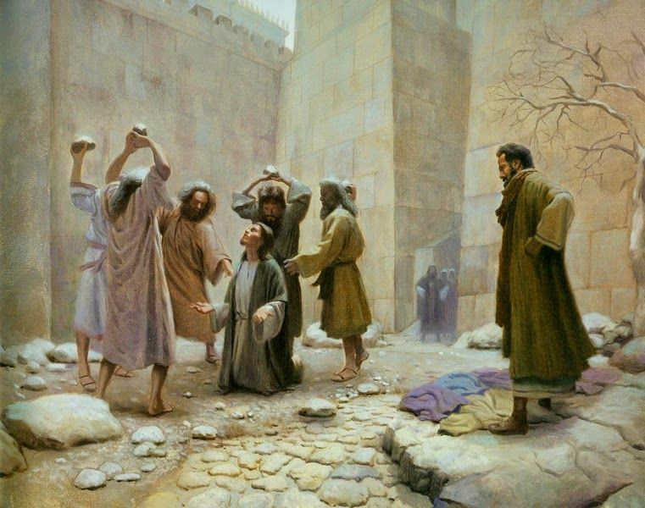
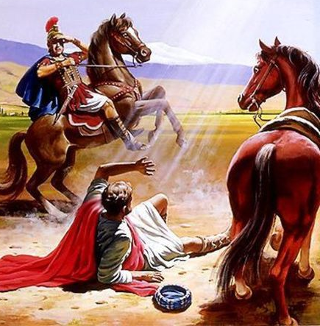
2. Shifting Needs
a. Church needs change and we must adjust
b.
Persecution—Religious
Made the Christians leave Jerusalem—The gospel was spread to Samaria and beyond (Acts 8)
Paul persecuted the church—Paul was converted (Acts 9)

Slide 25
1 Corinthians 6:9-11
⁹ Or do you not know that the unrighteous will not inherit the kingdom of God? Do not be deceived; neither fornicators, nor idolaters, nor adulterers, nor effeminate, nor homosexuals, ¹⁰nor thieves, nor the covetous, nor drunkards, nor revilers, nor swindlers, will inherit the kingdom of God. ¹¹Such were some of you; but you were washed, but you were sanctified, but you were justified in the name of the Lord Jesus Christ and in the Spirit of our God. (NASB95)
2. Shifting Needs
a. Church needs change and we must adjust
b.
Persecution—Moral
Our government has listened to voices that insist that they be listened to on moral issues—these affect the believer.
Paul brings hope: “Such were some of you;...” (1Cor.6:11)

Slide 26

2. Shifting Needs
a. Church needs change and we must adjust
b.
Changing Circumstances—Growth & Decline
Churches grow and shrink
Trouble and blessings are normal
Families go through their cycles
Friends come and go
Some Christians grow—some fall away
Tragedy visits us all

Slide 27

2. Shifting Needs
b. All these are met with continual prayer
b.
The 24 hour cycle—Take time to pray!
Humble yourself
Have a list ready
Believe
Expect results
Be thankful
Talk to others who spend time in their own WAR ROOM.

Slide 28
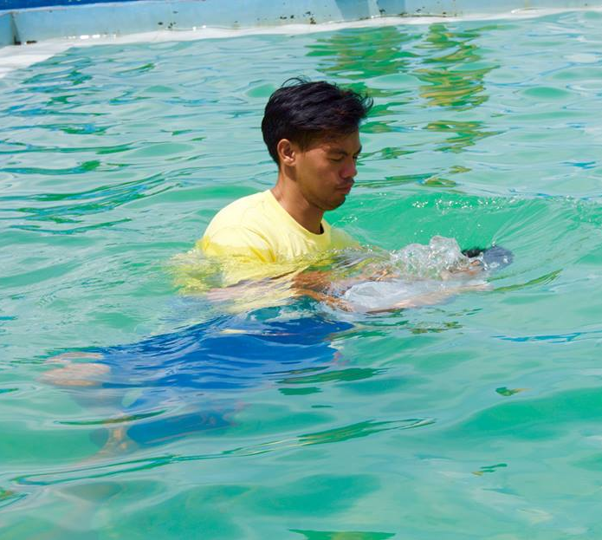

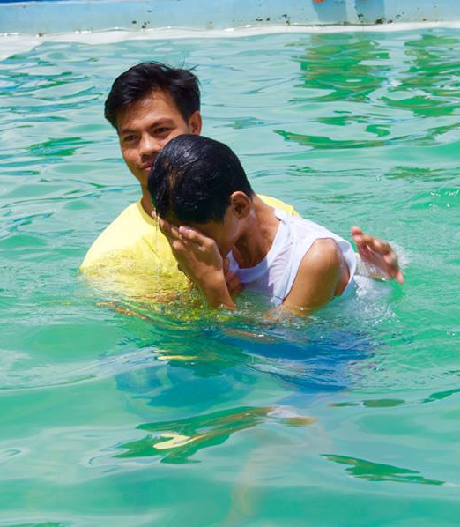
Acts 22:16
¹⁶ Now why do you delay? Get up and be baptized, and wash away your sins, calling on His name.’ (NASB95)

