Slide 1
What to say to God, too

Slide 2


There’s a story about a young boy’s family who went to his grandmother’s house for dinner.
Once the food was placed on the table, the boy quickly filled his plate and began to eat.
His mother said, “We haven’t asked God to bless the food yet. You know that at home we always say a prayer before we eat.”
The boy replied, “But we don’t have to say a prayer here. This is grandma’s house…

Slide 3
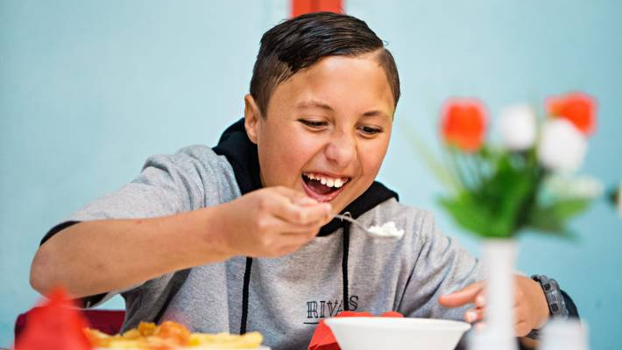
…She knows how to cook.”

Slide 4
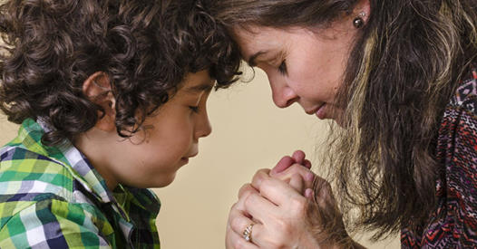
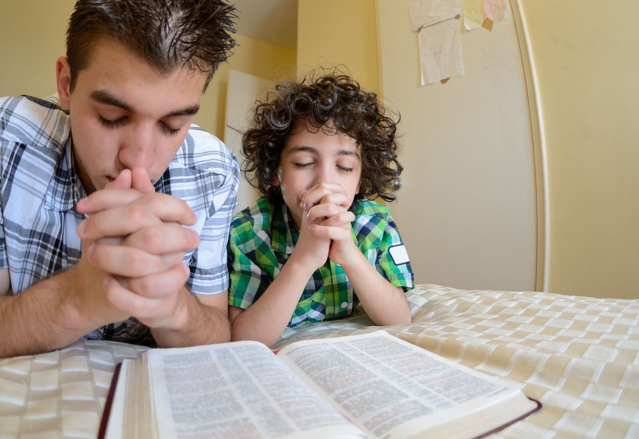
Prayer is best taught from childhood.

Slide 5
Prayer is best taught from childhood.
Children hear, see and feel everything that makes up your prayers:

Slide 6
Prayer is best taught from childhood.
Children hear, see and feel everything that makes up your prayers:
Humble reliance

Slide 7
Prayer is best taught from childhood.
Children hear, see and feel everything that makes up your prayers:
Humble reliance
Hopeful longing

Slide 8
Prayer is best taught from childhood.
Children hear, see and feel everything that makes up your prayers:
Humble reliance
Hopeful longing
Honour filled praise

Slide 9
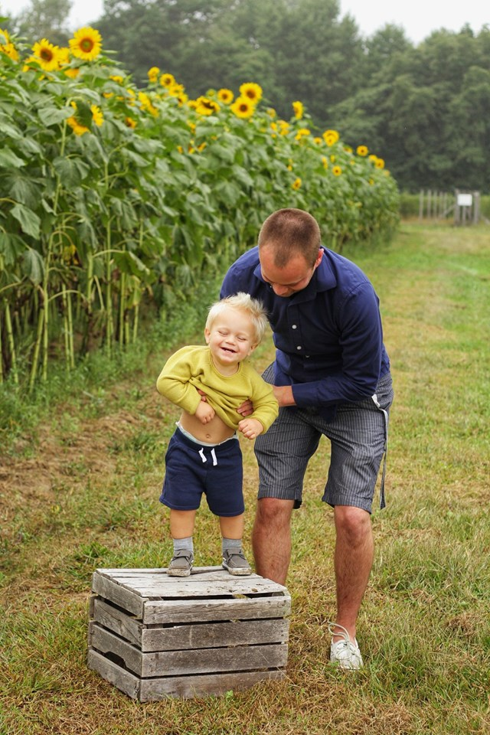
If earthly fathers want their children to do well—How much more does our Heavenly Father want us to do well?
Jesus put it this way…

Slide 10
Matthew 7:11
¹¹ If you then, being evil, know how to give good gifts to your children, how much more will your Father who is in heaven give what is good to those who ask Him! (NASB95)

Slide 11

Prayer is best talked about in prayer
Do you struggle with prayer…?

Slide 12
Prayer is best talked about in prayer
Do you struggle with prayer?
PRAY!

Slide 13
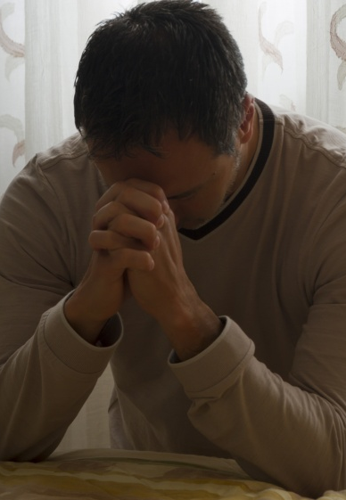
Prayer is best talked about in prayer
Do you have trouble putting your thoughts into words..?

Slide 14
Prayer is best talked about in prayer
Do you have trouble putting your thoughts into words?
PRAY!

Slide 15
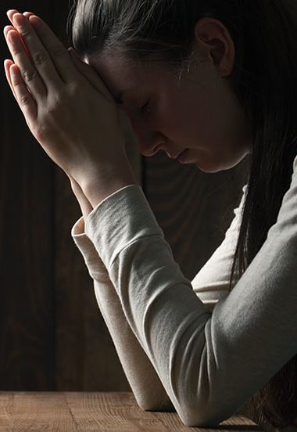
Prayer is best talked about in prayer
Is there unresolved issues…baggage…clutter…?

Slide 16
Prayer is best talked about in prayer
Is there unresolved issues…baggage…clutter…?
  Resentment
  Pride
  Fear
  Envy
  Laziness
  Unforgiveness

Slide 17
Prayer is best talked about in prayer
Is there unresolved issues…baggage…clutter…?
  Resentment
  Pride
  Fear
  Envy
  Laziness
  Unforgiveness
PRAY!

Slide 18
Prayer is best talked about in prayer
Is there unresolved issues…baggage…clutter…?
  Resentment
  Pride
  Fear
  Envy
  Laziness
  Unforgiveness
PRAY!
THEN…

Slide 19


Prayer is best talked about in prayer
…GO!
Resolve these issues
Drop the baggage
Clear away the clutter
Easy?
Probably not.
Worth it?
Liberating—to say the least!

Slide 20

Prayer is best talked about in prayer
As you go ‘PRAY’ that God will change you heart and actions
  Resentment to friendship
  Pride to humility
  Fear to courage
  Envy to appreciation
  Laziness to meaningful work
  Unforgiveness to brotherly love

Slide 21

Prayer is best…
Just done !
Like oxygen to the lungs, is prayer to the soul—You’re not going to stay alive without it!

Slide 22

Prayer is best…
Just done!
Ephesians 6:18-20
¹⁸With all prayer and petition pray at all times in the Spirit, and with this in view, be on the alert with all perseverance and petition for all the saints, ¹⁹and pray on my behalf, that utterance may be given to me in the opening of my mouth, to make known with boldness the mystery of the gospel, ²⁰for which I am an ambassador in chains; that in proclaiming it I may speak boldly, as I ought to speak. (NASB95)

Slide 23

Ephesians 6:18—¹⁸With all prayer and petition pray at all times in the Spirit, and with this in view, be on the alert with all perseverance and petition for all the saints, (NASB95)
1. As for you—Pray at all times in the Spirit
Jude gives us an excellent contrast between those living life in the Spirit and those living outside of the Spirit…

Slide 24
Ephesians 6:18—¹⁸With all prayer and petition pray at all times in the Spirit, and with this in view, be on the alert with all perseverance and petition for all the saints, (NASB95)
1. As for you—Pray at all times in the Spirit
Jude 17-21—¹⁷ But you, beloved, ought to remember the words that were spoken beforehand by the apostles of our Lord Jesus Christ, ¹⁸that they were saying to you, “In the last time there will be mockers, following after their own ungodly lusts. “ ¹⁹These are the ones who cause divisions, worldly-minded, devoid of the Spirit. ²⁰But you, beloved, building yourselves up on your most holy faith, praying in the Holy Spirit, ²¹keep yourselves in the love of God, waiting anxiously for the mercy of our Lord Jesus Christ to eternal life. (NASB95)

Slide 25
Ephesians 6:18-20—¹⁸With all prayer and petition pray at all times in the Spirit, and with this in view, be on the alert with all perseverance and petition for all the saints, (NASB95)
1. As for you—Pray at all times in the Spirit
Out of the Spirit (Jude 17-21)
Mockers
Following after their own ungodly lusts.
Who cause divisions
Worldly-minded
Devoid of the Spirit.
In the Spirit (Jude 17-21)
Beloved
Building yourselves up on your most holy faith
Praying in the Holy Spirit
Keep yourselves in the love of God
Waiting anxiously for the mercy of our Lord Jesus Christ to eternal life.

Slide 26
Ephesians 6:18-20—¹⁸With all prayer and petition pray at all times in the Spirit, and with this in view, be on the alert with all perseverance and petition for all the saints, (NASB95)
1. As for you—Pray at all times in the Spirit
Out of the Spirit (Jude 17-21)
Mockers
Following after their own ungodly lusts.
Who cause divisions
Worldly-minded
Devoid of the Spirit.
In the Spirit (Jude 17-21)
Beloved
Building yourselves up on your most holy faith
Praying in the Holy Spirit
Keep yourselves in the love of God
Waiting anxiously for the mercy of our Lord Jesus Christ to eternal life.

Slide 27
Ephesians 6:18-20—¹⁸With all prayer and petition pray at all times in the Spirit, and with this in view, be on the alert with all perseverance and petition for all the saints, (NASB95)
1. As for you—Pray at all times in the Spirit
Out of the Spirit (Jude 17-21)
Mockers
Following after their own ungodly lusts.
Who cause divisions
Worldly-minded
Devoid of the Spirit.
In the Spirit (Jude 17-21)
Beloved
Building yourselves up on your most holy faith
Praying in the Holy Spirit
Keep yourselves in the love of God
Waiting anxiously for the mercy of our Lord Jesus Christ to eternal life.

Slide 28
Ephesians 6:18-20—¹⁸With all prayer and petition pray at all times in the Spirit, and with this in view, be on the alert with all perseverance and petition for all the saints, (NASB95)
1. As for you—Pray at all times in the Spirit
Out of the Spirit (Jude 17-21)
Mockers
Following after their own ungodly lusts.
Who cause divisions
Worldly-minded
Devoid of the Spirit.
In the Spirit (Jude 17-21)
Beloved
Building yourselves up on your most holy faith
Praying in the Holy Spirit
Keep yourselves in the love of God
Waiting anxiously for the mercy of our Lord Jesus Christ to eternal life.

Slide 29
Ephesians 6:18-20—¹⁸With all prayer and petition pray at all times in the Spirit, and with this in view, be on the alert with all perseverance and petition for all the saints, (NASB95)
1. As for you—Pray at all times in the Spirit
Out of the Spirit (Jude 17-21)
Mockers
Following after their own ungodly lusts.
Who cause divisions
Worldly-minded
Devoid of the Spirit.
In the Spirit (Jude 17-21)
Beloved
Building yourselves up on your most holy faith
Praying in the Holy Spirit
Keep yourselves in the love of God
Waiting anxiously for the mercy of our Lord Jesus Christ to eternal life.

Slide 30
Ephesians 6:18-20—¹⁸With all prayer and petition pray at all times in the Spirit, and with this in view, be on the alert with all perseverance and petition for all the saints, (NASB95)
1. As for you—Pray at all times in the Spirit
Out of the Spirit (Jude 17-21)
Mockers
Following after their own ungodly lusts.
Who cause divisions
Worldly-minded
Devoid of the Spirit.
In the Spirit (Jude 17-21)
Beloved
Building yourselves up on your most holy faith
Praying in the Holy Spirit
Keep yourselves in the love of God
Waiting anxiously for the mercy of our Lord Jesus Christ to eternal life.

Slide 31
Ephesians 6:19—¹⁹and pray on my behalf, that utterance may be given to me in the opening of my mouth, to make known with boldness the mystery of the gospel, (NASB95)
2. For me—That I may speak this mystery boldly
The Mystery
Colossians 2:2
that their hearts may be encouraged, having been knit together in love, and attaining to all the wealth that comes from the full assurance of understanding, resulting in a true knowledge of God’s mystery, that is, Christ Himself, (NASB95)

Slide 32
Ephesians 6:19—¹⁹and pray on my behalf, that utterance may be given to me in the opening of my mouth, to make known with boldness the mystery of the gospel, (NASB95)
2. For me—That I may speak this mystery boldly
The Mystery revealed through Paul
Colossians 1:26-27
that is, the mystery which has been hidden from the past ages and generations, but has now been manifested to His saints, ²⁷to whom God willed to make known what is the riches of the glory of the mystery among the Gentiles, which is Christ in you, the hope of glory. (NASB95)

Slide 33
Ephesians 6:20—²⁰for which I am an ambassador in chains; that in proclaiming it I may speak boldly, as I ought to speak. (NASB95)
3. For me—Despite my circumstances
Gospel cannot be contained
2 Timothy 2:8—⁸ Remember Jesus Christ, risen from the dead, descendant of David, according to my gospel, ⁹for which I suffer hardship even to imprisonment as a criminal; but the word of God is not imprisoned. (NASB95)

Slide 34
Ephesians 6:20—²⁰for which I am an ambassador in chains; that in proclaiming it I may speak boldly, as I ought to speak. (NASB95)
3. For me—Despite my circumstances
Gospel cannot be contained
2 Timothy 2:8—⁸ Remember Jesus Christ, risen from the dead, descendant of David, according to my gospel, ⁹for which I suffer hardship even to imprisonment as a criminal; but the word of God is not imprisoned. (NASB95)
The Cause—My gospel
The Price—I suffer hardship
The extents—Even to imprisonment as a criminal
The Reality—But the word of God is not imprisoned.

Slide 35

Prayer is powerful
James said, “The effective prayer of a righteous man can accomplish much” (James 5:16).

Slide 36
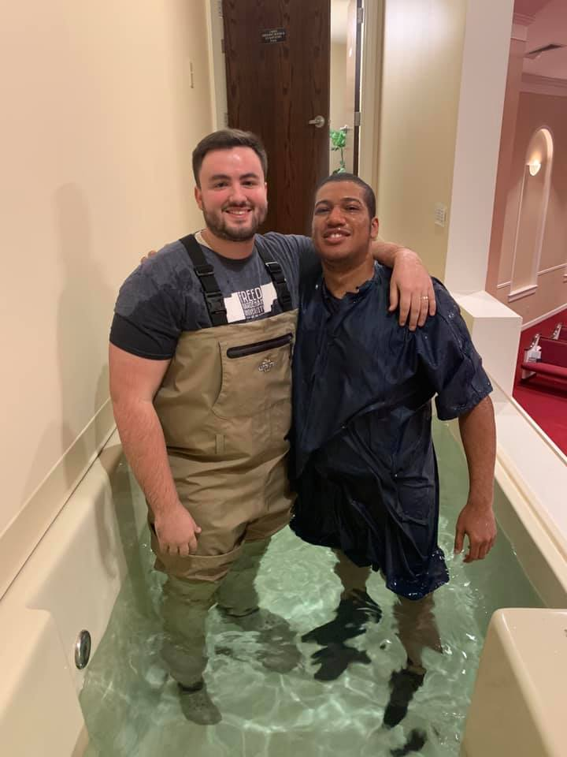
There is no greater answer to prayer than a person putting on Christ in baptism.
Acts 2:38
³⁸ Peter said to them, “Repent, and each of you be baptized in the name of Jesus Christ for the forgiveness of your sins; and you will receive the gift of the Holy Spirit. (NASB95)

