Slide 1
Sermon: John Staiger
“Generosity—“Staring into the heart of God-3.”
Sunday 4 August 2019
Morningside Church of Christ

Slide 2
“Generosity—“Staring into the heart of God-3.”

Slide 3

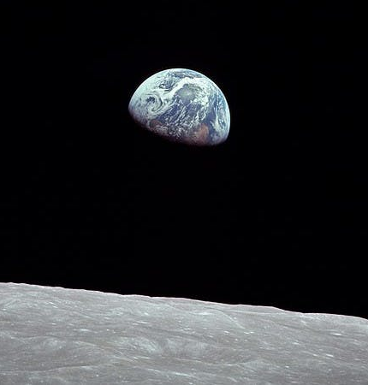
It all belongs to God.
Psalm 24:1-2
The earth is the LORD’s and all that is in it,
the world, and those who live in it;
for he has founded it on the seas,
and established it on the rivers.

Slide 4
It all belongs to God.
Psalm 89:11
The heavens are yours, the earth also is yours;
the world and all that is in it—you have founded
them.

Slide 5

What are we worrying about?
Ephesians 3:20-21
²⁰Now to Him who is able to do far more abundantly beyond all that we ask or think, according to the power that works within us, ²¹to Him be the glory in the church and in Christ Jesus to all generations forever and ever. Amen. (NASB95)

Slide 6
The source
Ephesians 3:20-21
²⁰Now to Him who is able to do far more abundantly beyond all that we ask or think, according to the power that works within us, ²¹to Him be the glory in the church and in Christ Jesus to all generations forever and ever. Amen. (NASB95)

Slide 7
The source
Don’t become guilty of regarding God as a man. He is…
Not limited by space and time
Not reliant on external help or resources
Not dependent on money, food, shelter, transport, friendship, entertainment…etc.

Slide 8
The Power
Ephesians 3:20-21
²⁰Now to Him who is able to do far more abundantly beyond all that we ask or think, according to the power that works within us, ²¹to Him be the glory in the church and in Christ Jesus to all generations forever and ever. Amen. (NASB95)

Slide 9
The Power
He is ALL powerful
He is EVER present
He is TOTALLY aware
Hebrews 1:3 …upholds all things by the word of His power.

Slide 10
The scope
Ephesians 3:20-21
²⁰Now to Him who is able to do far more abundantly beyond all that we ask or think, according to the power that works within us, ²¹to Him be the glory in the church and in Christ Jesus to all generations forever and ever. Amen. (NASB95)

Slide 11
The scope
Without limit
Beyond the imagination of man
Off the scale!
We have no language or thought-processes to mentally grasp what Paul is saying here.
But God’s ability to deliver us is not subject to our ability to understand how He can.

Slide 12
The recipients
Ephesians 3:20-21
²⁰Now to Him who is able to do far more abundantly beyond all that we ask or think, according to the power that works within us, ²¹to Him be the glory in the church and in Christ Jesus to all generations forever and ever. Amen. (NASB95)

Slide 13
The recipients
Christians!
You and I are spirit filled and empowered to do God’s work.
In terms of what God has given us to work with, you are in the drivers seat as to how much of it works in your life.
1 John 4:4—⁴You are from God, little children, and have overcome them; because greater is He who is in you than he who is in the world. (NASB95)

Slide 14
The recipients
Grasp this and…
We would revolutionize the local church.
The demons would tremble.
The working of God’s power would be commonplace among us.
Don’t let the weak link in the chain of Paul’s words lie in this statement: “according to the power that works in us.”

Slide 15
The purpose
Ephesians 3:20-21
²⁰Now to Him who is able to do far more abundantly beyond all that we ask or think, according to the power that works within us, ²¹to Him be the glory in the church and in Christ Jesus to all generations forever and ever. Amen. (NASB95)

Slide 16
The purpose
Man’s quest for glory resulted in extrication from paradise
For us, GODWARD glory is centred in Jesus’ church and the power of Jesus’ name.

Slide 17

Stewardship is not all about collecting money

Slide 18
Stewardship is not all about collecting money
  Stop connecting stewardship with just paying the bills
  A recipe for misery
  We will hate the subject
  And reduce God and the church to some sought of debt collecting agency

Slide 19

Stewardship is not something in the too hard pile

Slide 20
Stewardship is not something in the too hard pile
Like flat-pack furniture:
  You have the materials—you think.
  Understand the instructions—you hope.
  But without…
    Preparation
    Perseverance
    passion

Slide 21

Stewardship is not something in the too hard pile
Your stewardship will sooner-or-later become a confused mess
  A source of confusion
  An avenue of conflict
  Always in the way
Nehemiah 4:10—¹⁰Meanwhile, the people in Judah said, “The strength of the laborers is giving out, and there is so much rubble that we cannot rebuild the wall.”

Slide 22

Stewardship is not a game of wits

Slide 23
Stewardship is not a game of wits
Where a Christian must outwit the preacher
Enough not to feel guilty or look better than you are
Remember Ananias and Sapphira (Acts 5)

Slide 24

Stewardship is about making the most of all you have to work with

Slide 25
Stewardship is about making the most of all you have to work with
Time for…
  Prayer
  Scripture
  The lost
  The poor
  Hospitality
  The sick
  The lonely
  The hurt
Get all this right and…

Slide 26
Stewardship is about making the most of all you have to work with
Then money will…
  Be brought into spiritual focus
  Be one of our tools
  Not be obsessed over
  Not be wasted
  Go to godly ends
  Bring praise to God

Slide 27
Stewardship is about investing in the main things…

Slide 28
Stewardship is about investing in the main things…
2 Corinthians 9:6-8
⁶Now this I say, he who sows sparingly will also reap sparingly, and he who sows bountifully will also reap bountifully. ⁷Each one must do just as he has purposed in his heart, not grudgingly or under compulsion, for God loves a cheerful giver. ⁸And God is able to make all grace abound to you, so that always having all sufficiency in everything, you may have an abundance for every good deed; (NASB95)

Slide 29
Stewardship is about investing in the main things…
1 Corinthians 2:2
²For I determined to know nothing among you except Jesus Christ, and Him crucified. (NASB95)

Slide 30
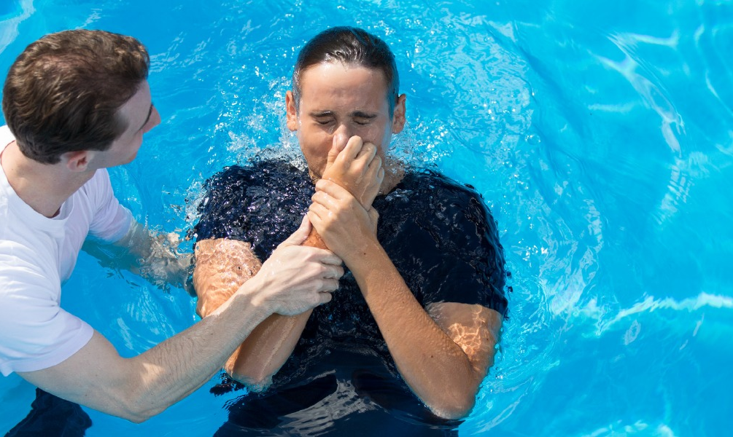
Acts 2:38
³⁸ Peter said to them, “Repent, and each of you be baptized in the name of Jesus Christ for the forgiveness of your sins; and you will receive the gift of the Holy Spirit. (NASB95)

