Slide 1

What are the probabilities of success?
1. Why bother?
The task is too big
Stories of failure abound
How many ex-Christians, ex-preachers, ex-churches…do you know?
Lots of bad guys
Lots of rip-offs
Lots of disappointments

Slide 2
What are the probabilities of success?
2. I’m Saved!
Praise God! Glory hallelujah!
We must not define our spiritual walk by a list of bad experiences
Yes, fair warning, but why should I join them?
(If we caused these bad experiences, we must repent)
Jesus called us to follow him—to be fishers of men (Mt.4:19)

Slide 3
What are the probabilities of success?
3. God keeps the score!
Get rid of the Clipboard-Questionnaire-Syndrome
2 Timothy 2:19—¹⁹ Nevertheless, the firm foundation of God stands, having this seal, “The Lord knows those who are His,” and, “Everyone who names the name of the Lord is to abstain from wickedness.” (NASB95)

Slide 4
What are the probabilities of success?
4. The nature of the Kingdom
It is the Kingdom of God
It is the Kingdom of Christ (Eph.5:5)
The gates of hell will not prevail against it (Mt.16:18)
It is eternal (2Pet.1:11)
It is like leaven (Mt.13:13)

Slide 5

Change of Direction
1. Leaving the old and clinging to the new
Give up your possessions (Luke 14:33)
Love God more than family (Mt.10:37)
Take up your cross (Mt.10:38)
Give up your life (Mt.10:39)

Slide 6

Change of Direction
2. Leaving the teachings of this world
Hebrews 4:12—¹² For the word of God is living and active and sharper than any two-edged sword, and piercing as far as the division of soul and spirit, of both joints and marrow, and able to judge the thoughts and intentions of the heart. (NASB95)

Slide 7

Change of Direction
3. Leaving the old habbits
We are heaven bound
We want others to be saved
We sacrifice to that end
We rejoice with the angels in heaven when a sinner is saved

Slide 8
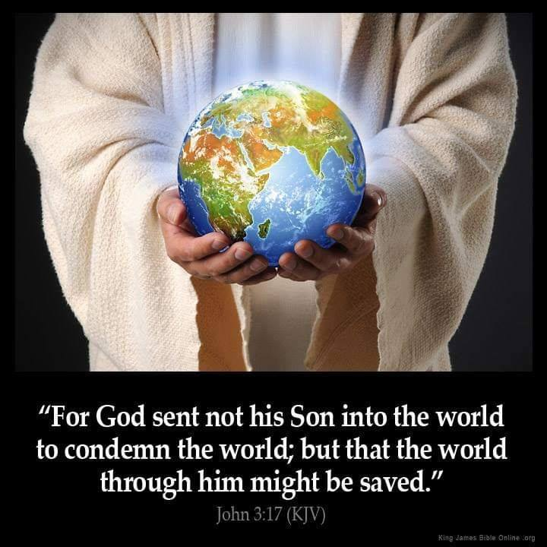
Jesus died to un-condemn the world
We were…
  —Lost
  —Unworthy
  —Sinners
  —Idolaters
  —Wicked
  —Helpless
  —Without Hope
  —Worldly wise
  —Fools
“UN-SAVED!”

Slide 9


Measuring Success
What do we use to gage progress?
The “Corporate Standard”
  Time and Motion study.
  The bottom line
The “Me Standard.”
  I have been around for a long time. I know what is needed.
The “Us Standard.”
  Group agreeance
  Look at us, we are growing—so should you be.

Slide 10
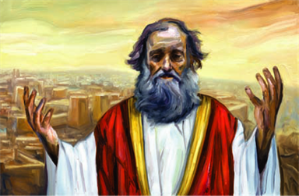
Measuring Success
1. By today’s standard Jeremiah was a complete and utter failure

Slide 11

Measuring Success
2. When Jesus preached total commitment, he decimated his audience (John 6:60f)

Slide 12
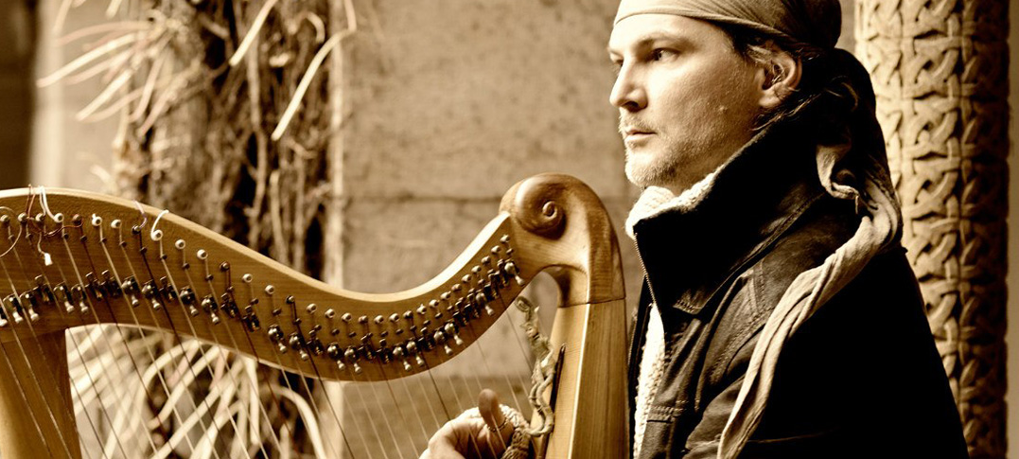
Measuring Success
3. Ezekiel the pop-star. He made some progress—NOT!
Ezekiel 33:32—
  ³²Behold, you are to them like a sensual song by one who has a beautiful voice and plays well on an instrument; for they hear your words but they do not practice them. (NASB95)

Slide 13

Measuring Success
4. Get on with it!
Preacher the Word
2 Timothy 4:2—²preach the word; be ready in season and out of season; reprove, rebuke, exhort, with great patience and instruction. (NASB95)

Slide 14
Measuring Success
4. Get on with it!
Let God do His work
Isaiah 55:11
¹¹So will My word be which goes forth from My mouth;
It will not return to Me empty,
Without accomplishing what I desire,
And without succeeding in the matter for which I sent it. (NASB95)

Slide 15
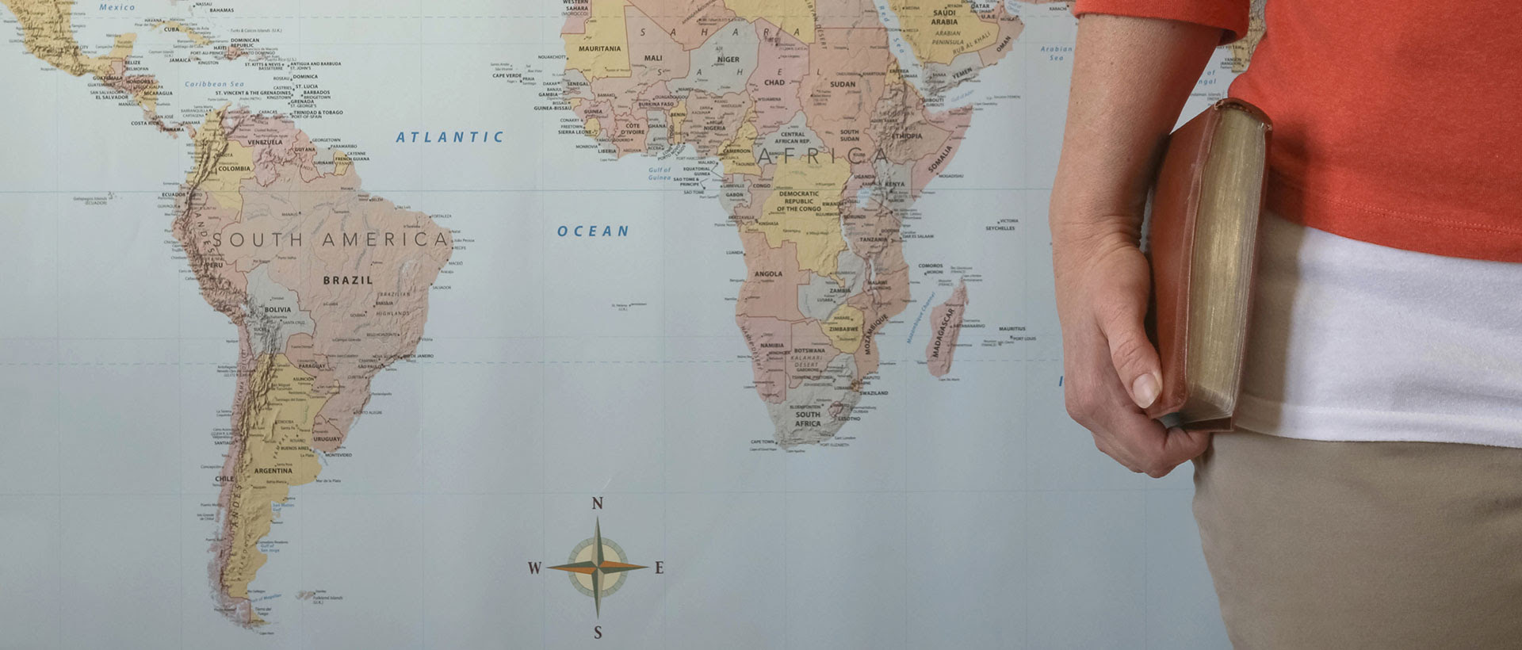
Ready to go—Ready to stay

Slide 16
Ready to go—Ready to stay
  1. Paul felt like John Mark should stay home
  Cousin Barnabas didn’t (Acts 15:36-41)
    —He believed in John Mark
    —Same vision—Different approach

Slide 17
Ready to go—Ready to stay
  2. Some brothers need to stay home
    —Culturally dysfunctional
    —Ill-taught and unteachable
    —If you are unteachable you will raise up disciples like yourself

Slide 18
Ready to go—Ready to stay
  3. Churches are to send—Missionaries are to go!
  Romans 10:14-15a—¹⁴How then will they call on Him in whom they have not believed? How will they believe in Him whom they have not heard? And how will they hear without a preacher? ¹⁵How will they preach unless they are sent?... (NASB95)

Slide 19
Ready to go—Ready to stay
  4. Looking after our Missionaries is looking after our mission!
  Spiritually cared for—Prayer and contact.
  Personally cared for—Wife, Kids, Health, Home, transport,…
  Church cared for—New Christians, Resources, Buildings,

Slide 20

  4. Go...
Matthew 28:19-20—¹⁹Go therefore and make disciples of all the nations, baptizing them in the name of the Father and the Son and the Holy Spirit, ²⁰teaching them to observe all that I commanded you; and lo, I am with you always, even to the end of the age.” (NASB95)

