Slide 2


Slide 3

1. Conscience a popular guide…
Two of the biggest names of the 20th century recommend the conscience as a guide

Slide 4
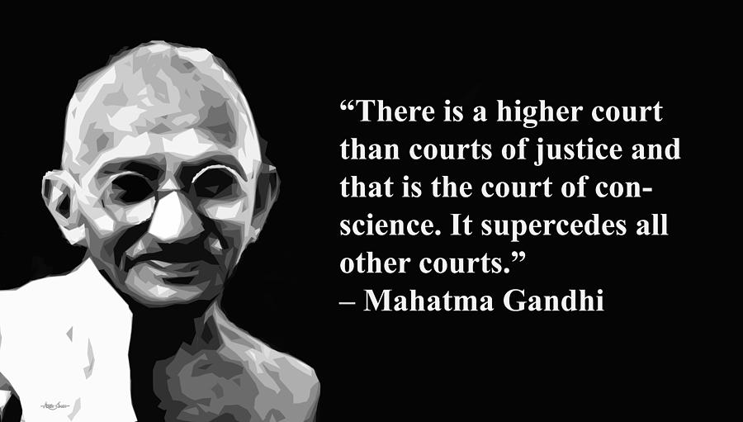
1. Conscience a popular guide…
Two of the biggest names of the 20th century recommend the conscience as a guide

Slide 5
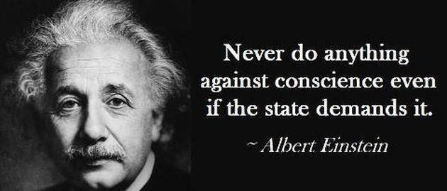
1. Conscience a popular guide…
Two of the biggest names of the 20th century recommend the conscience as a guide

Slide 6

1. Conscience a popular guide…
Beware…!

Slide 7

1. Conscience a popular guide…
Beware…!
Last weeks Conscience vote
Death to unborn babies: 94 – Life: 23

Slide 8

1. Conscience a popular guide…
Beware…!

Slide 9

2. Conscience can only be a trustworthy guide when it is taught and ruled by God.

Slide 10

2. Conscience can only be a trustworthy guide when it is taught and ruled by God.
A popular image of ‘good v evil’.
Angel—conscience
Devil—temptation

Slide 11
2. Conscience can only be a trustworthy guide when it is taught and ruled by God.
A more Biblical view is to consider the shoulder angel/devil as representing witnesses to our inner value system.

Slide 12
2. Conscience can only be a trustworthy guide when it is taught and ruled by God.
Our conscience is God-given
Everyone recognises right and wrong
Our conscience, in any given situation, bears witness to our accepted norms and values

Slide 13

3. Conscience – Corrupted or Purified – Your Choice
1 Timothy 4:1-5—But the Spirit explicitly says that in later times some will fall away from the faith, paying attention to deceitful spirits and doctrines of demons, ²by means of the hypocrisy of liars seared in their own conscience as with a branding iron, (NASB95)

Slide 14


3. Conscience – Corrupted or Purified – Your Choice
Titus 1:15—¹⁵To the pure, all things are pure; but to those who are defiled and unbelieving, nothing is pure, but both their mind and their conscience are defiled. (NASB95)

Slide 15

3. Conscience – Corrupted or Purified – Your Choice
1 Timothy 1:5—⁵But the goal of our instruction is love from a pure heart and a good conscience and a sincere faith. (NASB95)

Slide 16

3. Conscience – Corrupted or Purified – Your Choice
1 Peter 3:15-16—¹⁵but sanctify Christ as Lord in your hearts, always being ready to make a defence to everyone who asks you to give an account for the hope that is in you, yet with gentleness and reverence; ¹⁶and keep a good conscience so that in the thing in which you are slandered, those who revile your good behaviour in Christ will be put to shame. (NASB95)

Slide 17
3. Conscience – Corrupted or Purified – Your Choice
1. We should seek to live in good conscience before God all of our lives (Acts 23:1; 2 Cor. 1:12; 2 Tim. 1:3);
2. We should seek to live with a clear conscience before men (Acts 24:16; 2 Cor. 4:2; 1 Pet. 3:16);
3. Our conscience bears witness for/against us (Rom. 2:15; 9:1);
4. We should submit to government as a matter of conscience (Rom. 13:5);
5. But the conscience can be weak, defiled, and even seared (1 Cor. 8:7, 10, 12; 1 Tim. 4:12; Titus 1:5);

Slide 18
3. Conscience – Corrupted or Purified – Your Choice
6. We have a responsibility to consider the consciences of others in matters of worship (1 Cor. 10:27-29);
7. God’s word is meant to produce in us godly love that comes, in part, from a good conscience (1 Tim. 1:5);
8. One part of our spiritual warfare and faithfulness is defined by keeping a good conscience (1 Tim. 1:19);
9. The conscience is not perfected by religious acts of worship like sacrifices (Heb. 9:9) but only by the blood of Christ (Heb. 9:14; 10:22; 1 Pet. 3:21);
10. Christians should pray for one another, that our acts lead to a clean conscience (Heb. 13:18).

Slide 19

3. Conscience – Corrupted or Purified – Your Choice
1 Peter 3:21—²¹Corresponding to that, baptism now saves you—not the removal of dirt from the flesh, but an appeal to God for a good conscience—through the resurrection of Jesus Christ, (NASB95)

