Slide 2
How to Improve Relationships

Slide 3

Difficult people in the Bible
What would you do with…
A Hot-tempered Person

Slide 4

Difficult people in the Bible
What would you do with…
A Hot-tempered Person

Slide 5
Difficult people in the Bible
What would you do with…
A Hot-tempered Person

Slide 6
Difficult people in the Bible
What would you do with…
A man with murderous intent—p ….

Slide 7
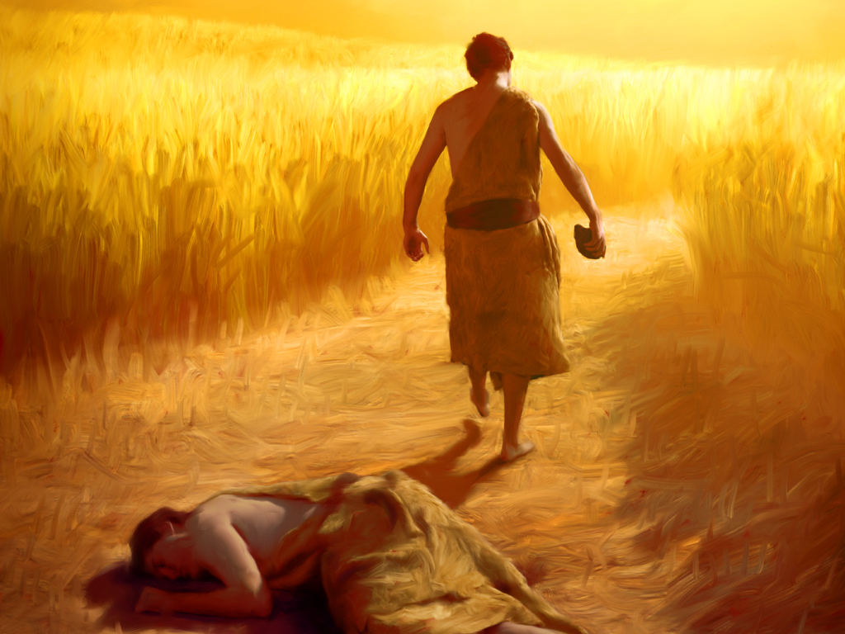
Difficult people in the Bible
What would you do with…
A man with murderous intent—p ….

Slide 8
Difficult people in the Bible
What would you do with…
A man with murderous intent—p ….
Genesis 4:7—
If you do well, will not your countenance be lifted up? And if you do not do well, sin is crouching at the door; and its desire is for you, but you must master it.” (NASB95)

Slide 9
Difficult people in the Bible
What would you do with…
A woman who messes with your hair—

Slide 10
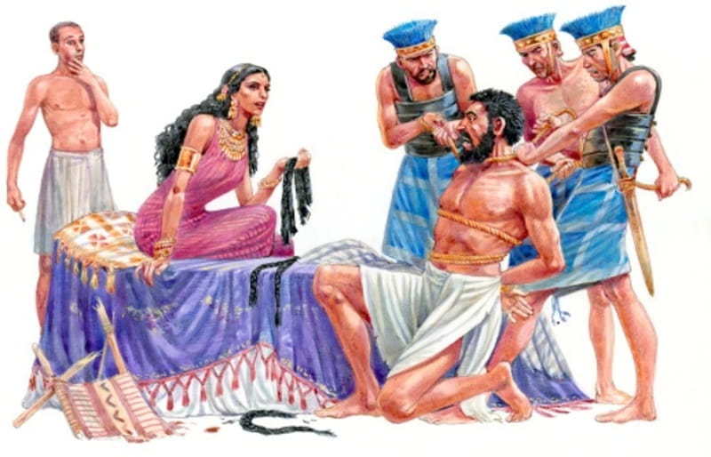
Difficult people in the Bible
What would you do with…
A woman who messes with your hair—

Slide 11
Difficult people in the Bible
What would you do with…
A woman who messes with your hair—
Judges 16:21—²¹Then the Philistines seized him and gouged out his eyes; and they brought him down to Gaza and bound him with bronze chains, and he was a grinder in the prison. (NASB95)

Slide 12

Why is everyone so hard to get along with?

Slide 13
Why is everyone so hard to get along with?
Usually, it is lesser stuff

Slide 14
Why is everyone so hard to get along with?
Usually, it is lesser stuff
  The way someone talks to you

Slide 15
Why is everyone so hard to get along with?
Usually, it is lesser stuff
  Trying to be funny—Attitudes that come out in humour

Slide 16
Why is everyone so hard to get along with?
Usually, it is lesser stuff
  Always seems to be judging

Slide 17
Why is everyone so hard to get along with?
Usually, it is lesser stuff
  Know-it-all

Slide 18
Why is everyone so hard to get along with?
Usually, it is lesser stuff
  Their friends / dog / family are hard to be around

Slide 19
Why is everyone so hard to get along with?
Usually, it is lesser stuff
  Talks too loudly

Slide 20
Why is everyone so hard to get along with?
Usually, it is lesser stuff
  Thinks they are in charge

Slide 21
Why is everyone so hard to get along with?
Usually, it is lesser stuff
  Bad drivers

Slide 22

I have tried everything

Slide 23
I have tried everything
They need to mature

Slide 24
I have tried everything
Somebody needs to sort them out

Slide 25
I have tried everything
They need to go to counseling

Slide 26
I have tried everything
Other people think the same as I do.

Slide 27
I have tried everything
I will just avoid them…

Slide 28

What did Jesus Do?

Slide 29
What did Jesus Do?
What state were we in?

Slide 30

What did Jesus Do?
What state were we in – AGAIN?

Slide 31
What did Jesus Do?
Did he owe us anything?

Slide 32
What did Jesus Do?
Doesn’t He still give us a choice?

Slide 33

Cure—
Take turns at cheerleading
1 Thessalonians 5:11—Therefore encourage one another and build up one another, just as you also are doing. (NASB95)

Slide 34


Cure—
Often! Now! With deliberate purpose!
Hebrews 3:13—But encourage one another day after day, as long as it is still called “Today,” so that none of you will be hardened by the deceitfulness of sin. (NASB95)

Slide 35

Cure—
Stop pleasing yourself
Proverbs 16:7—⁷ When a man’s ways are pleasing to the Lord,
He makes even his enemies to be at peace with him. (NASB95)

Slide 36

Cure—
Where ‘same’ trumps ‘diversity.’
Romans 15:5—Now may the God who gives perseverance and encouragement grant you to be of the same mind with one another according to Christ Jesus, (NASB95)

