Slide 1
Life choices
End-of-Life Decisions

Slide 2
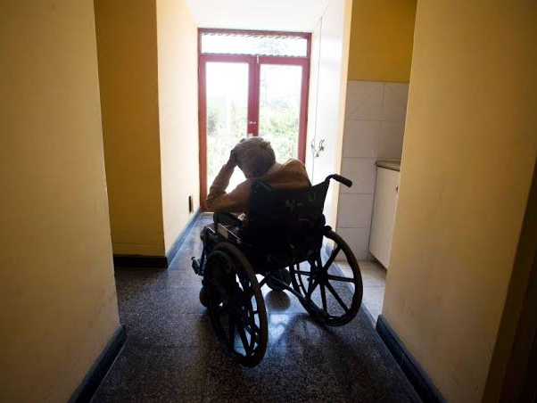
Notes:
First experience:
watching show about care of elderly; see a woman slumped in a wheelchair totally dependent on others for food, basic needs
dad said “shoot me if I ever get like that.”
As a Christian, I shrink back. The idea of killing someone just because life is hard, painful, undignified, seems wrong; life is precious, no matter what shape it takes.
Second experience:
elder pushing “Living Wills” at church in States

Slide 3
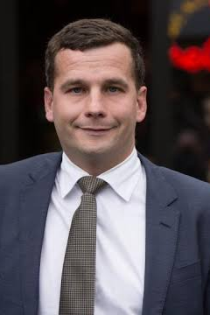
End-of-Life Choice Bill
tried several times over last 20 years
90% of public submissions were negative
1st reading passed 70-50 in June
debate and amendments shut down
Notes:
David Seymour, ACT MP
Thanks to Epsom for having this guy
highest median income of all NZ electorates
12th lowers on the Index of Multiple Deprivation

Slide 4

Here we Go Again
Not about: DNR, “pulling the plug,” or refusing treatment
If someone asks to be killed, then the doctors/nurses who “help” won’t be prosecuted
Medical people either may administer lethal drugs (euthanasia), or prescribe them for the patient (assisted suicide)
Notes:
24 August 2019
After considering a record-breaking 39,159 submissions on the End of Life Choice Bill, of which 90% were opposed,

Slide 5
Here we Go Again
For “patients” with a “terminal illness that is likely to end his or her life within 6 months”
No clear definitions of terms like terminal, intolerable, unbearable suffering, etc.
more info: euthanasiadebate.org.nz

Slide 6
The culture of Death

Slide 7
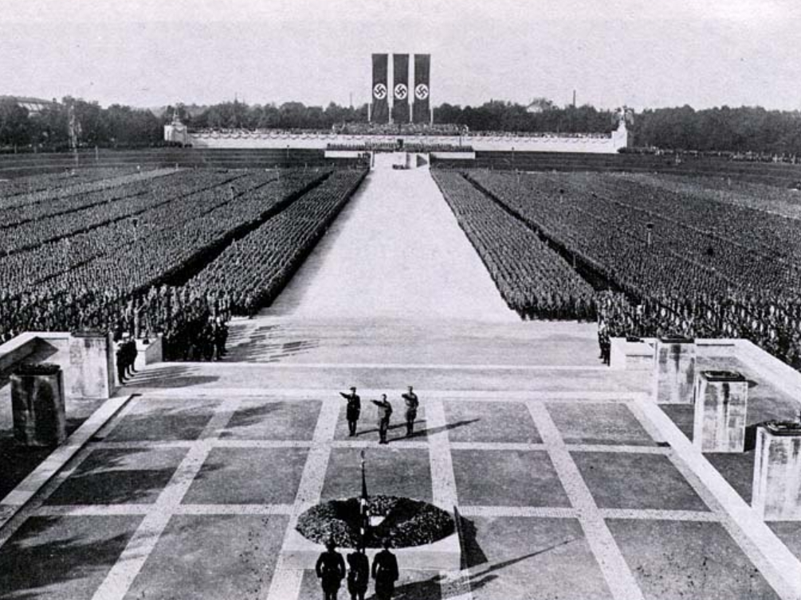
The GERMAN
EXPERIENCE
Notes:
Eugenics – who has a life worth living
Something they learned from people like Francis Galton, cousin of Charles Darwin
American eugenicists, Madison Grant
Medicalization of euthanasia (Binding and Hoche); acceptance among medical professionals
German killing program
Mentally disabled
Physically disabled
Orphans
Lessons learned from that program lead to the Holocaust

Slide 8

The DUTCH
EXPERIENCE
Notes:
decriminalization of assisted suicide
medicalization of euthanasia
involuntary euthanasia of infants, terminally ill, and others

Slide 9

SLIPPERY SLOPE
Notes:
If you object to euthanasia on the ground of where it could end up, people accuse you of using a bad argument – a fallacy of reasoning – called the slippery slope argument.
This certainly can be a bad argument
E.g., if you let your kids have one sweet/lolly/candy, the next thing you know, all their teeth will fall out and they’ll die of diabetes. Well, not necessarily.
Saying that this could happen does not justify the rule, “Thou shalt not have even one sugary snack.”
But what we see in the case of euthanasia, as we have already seen it in the case of abortion, is that one step away from the value of human life typically leads us in the wrong direction.
We have saw it in Nazi Germany, and we see it today in the Netherlands, Belgium, and other countries that have gone down this path.
----------
For more on this issue, see my brief article, “Slip Slidin’ Away,” available online at http://trevormajor.com/archives/527 (this appeared originally in the September 2010 issue of Think.)

Slide 10
End of Life Decisions

Slide 11

Is this the best time to be making end-of-life decisions?
Notes:
What happens at the end of life – our own or that of loved ones – is personal and traumatic
This is the worst time to start thinking about how we should make our choices
There is a tendency to be driven entirely by medical, legal, family, emotional pressures
Christians, influenced by the world, are tempted to follow a Quality of Life ethic

Slide 12
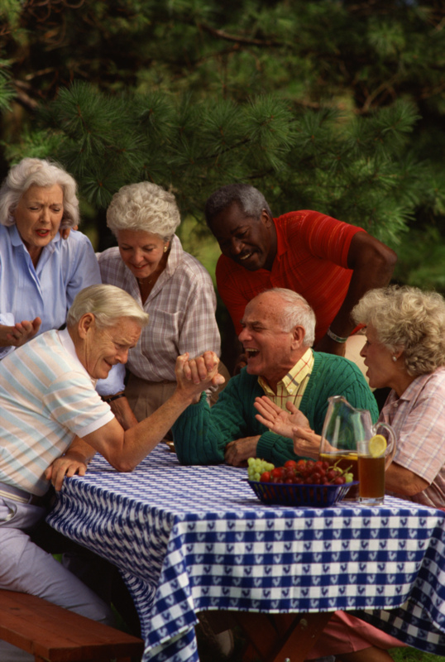
Quality of Life
Life has value only if it is good
“good” is relative, subjective

Slide 13
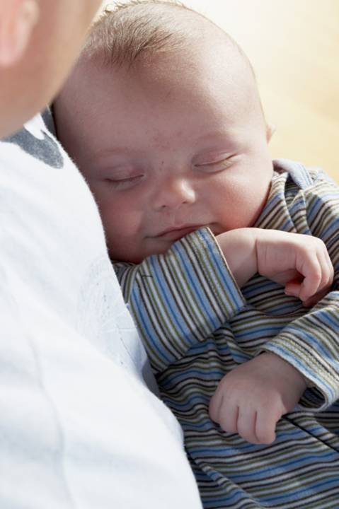
SANCTITY of Life
Life is good because it has intrinsic value
“good” depends on an absolute, objective standard

Slide 14
Do Christians believe that life can have quality, too?

Slide 15
I have been crucified with Christ. It is no longer I who live, but Christ who lives in me. And the life I now live in the flesh I live by faith in the Son of God, who loved me and gave himself for me.
– Gal. 2:20

Slide 16

Life
Intentions
Therapy
God will “reveal the counsels of the hearts” – 1 Cor. 4:5
Jesus “healed those who had need of healing” – Luke 9:11
Notes:
In making moral choices, intentions are (almost) all important
God searches hearts and understands motives (1 Chron. 28:9)
God weighs motives (Prov. 16:2)
God exposes the motives of men’s hearts (1 Cor. 4:5)
Family members, medical staff, etc., have a duty to do what is therapeutically sound
Duty comes from example of Christ and commands (e.g., “care for one another” – 1 Cor. 12:25; “serve one another,” Gal. 5:13)
Soundness cashed out in terms of efficacy: “What’s best – medically speaking – for the person under my care?”
Note:
Our word “therapy” comes from a Greek word meaning “a body of domestic servants” (e.g., “household” in Luke 12:42 – Vine’s)
By extension it could refer specifically to medical care and attention, cures, healing, etc. (e.g., Jesus’ actions in Luke 9:11)

Slide 17
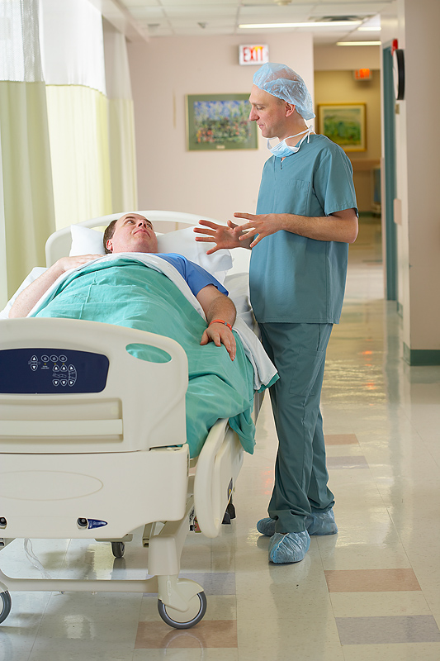
THE RIGHT CHOICE
 Check your intentions
What do I want for this person?
What do I want for me?
Notes:
Am I intending the death of the person who is in my care?
Are my decisions motivated primarily by…
a lack of love?
money and my own financial welfare?
my own emotional, physical welfare?
external, non-Biblical pressures from family, medical personnel?

Slide 18
 Check the treatment
Is it helping?
Is it harming?
Notes:
Does it have therapeutic value? Is it helping to improve or maintain the health of the patient?
If patient is terminal, then further treatment may not be efficacious, and may be harmful
Life-support ventilator may be withdrawn at brain death
Feeding tubes may be withdrawn if vital organs are shutting down, or when there are related complications

Slide 19
● Check for life
What is the prognosis for life itself?
Would withdrawal of treatment be the primary cause of death?
Notes:
What is the prognosis? Is it for a quality life, or life itself?
Decision to withhold/withdraw treatment should not depend on QoL considerations
Artificial respirators and feeding tubes are not extraordinary or heroic if they are helping to support life. Ask “Would their withdrawal be the primary cause of death?”

Slide 20
If life is ending, and the treatment is not helping, then it may be withheld or withdrawn
Duty to life continues
Notes:
Treatments may be withheld/withdrawn if they are no longer effective
Applies especially when person is in terminal condition
Duty to care continues: pain management, hygiene, and other basic needs

Slide 21

Planning
Talk to your family and doctor!
Notes:
Need to talk with family and doctors to ensure that your wishes are followed

Slide 22

Do not cast me off in the time of old age
Do not forsake me when my strength fails.
– Psalm 71:9
Notes:
Next lesson will be about our personal response. But we still have to defend the sanctity of life.

