Slide 2


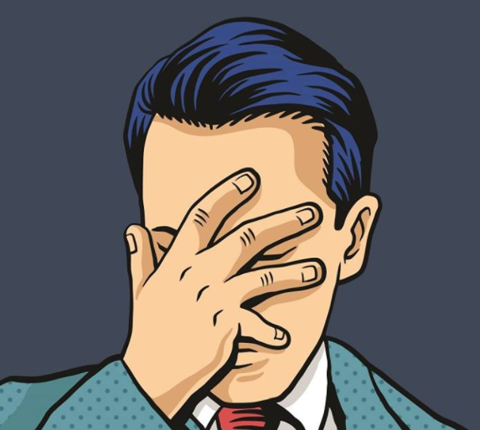
When
we
Fail

Slide 3
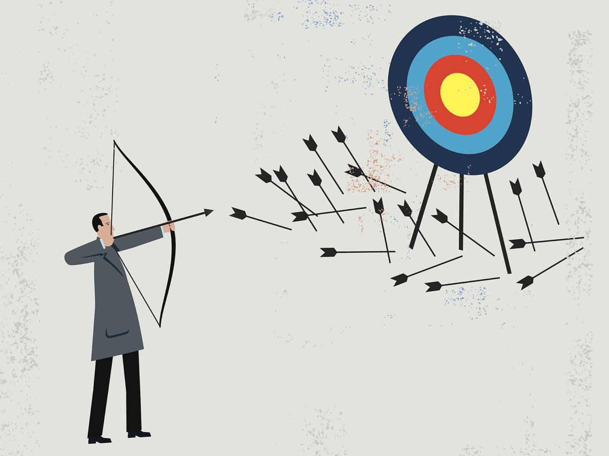
When we fail—Acceptance
1. Failure is inevitable:
Sin
Mistakes
Accidents
Poor planning
Lack of skill
Stupidity

Slide 4
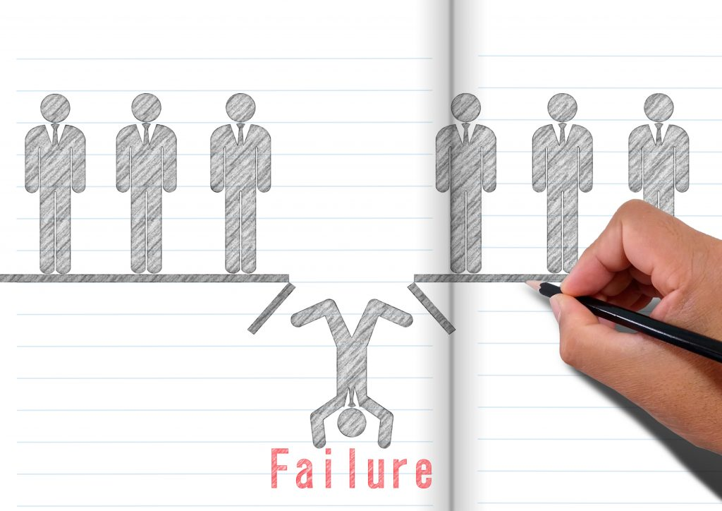
When we fail—Acceptance
2. Failure is costly:
Sin—Your soul
Mistakes—Time
Accidents—Resources
Poor planning—Opportunity
Stupidity—A lot of good will

Slide 5
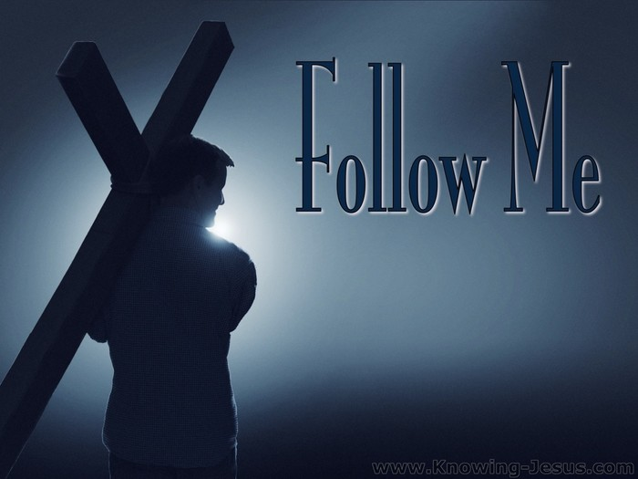
When we fail—Acceptance
3. Failure must be handled:
a. Sin’s debt
Colossians 2:14—¹⁴having cancelled out the certificate of debt consisting of decrees against us, which was hostile to us; and He has taken it out of the way, having nailed it to the cross. (NASB95)
The Christian looks to the cross

Slide 6
When we fail—Acceptance
3. Failure must be handled:
b. Selection and Direction failure—
Matthew 16:24—²⁴Then Jesus said to His disciples, “If anyone wishes to come after Me, he must deny himself, and take up his cross and follow Me. (NASB95)
The Christian looks to the cross

Slide 7
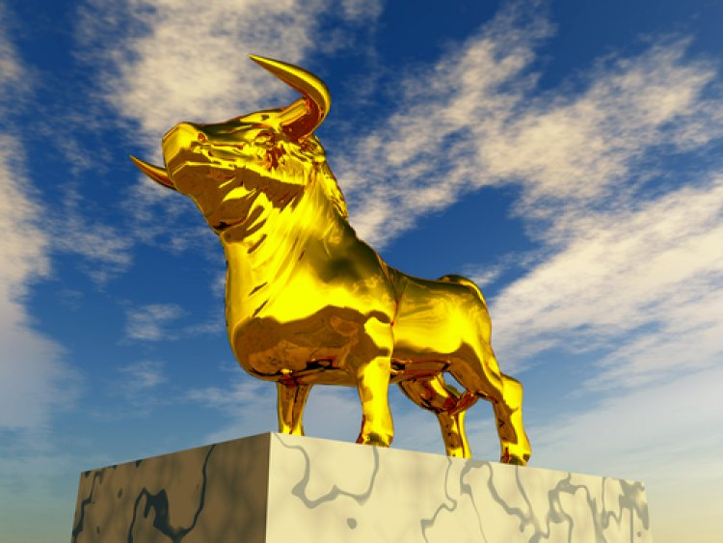
When we fail—Responsibility
Two Replies
1. It’s not my fault – Ex 32:21-24
Exodus 32:21-24—²¹Then Moses said to Aaron, “What did this people do to you, that you have brought such great sin upon them?” ²²Aaron said, “Do not let the anger of my lord burn; you know the people yourself, that they are prone to evil. ²³For they said to me, ‘Make a god for us who will go before us; for this Moses, the man who brought us up from the land of Egypt, we do not know what has become of him.’²⁴ I said to them, ‘Whoever has any gold, let them tear it off.’ So they gave it to me, and I threw it into the fire, and out came this calf.” (NASB95)

Slide 8
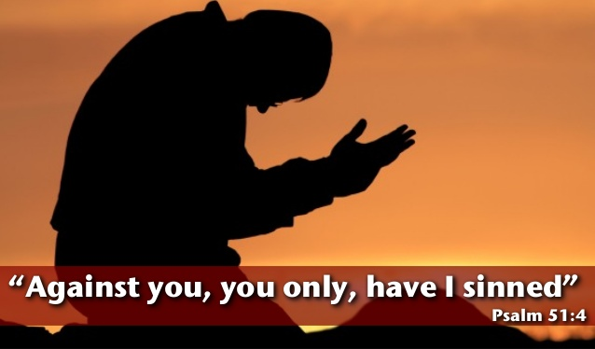
When we fail—Responsibility
Two Replies:
2. We blame ourselves – Psalm 51:4
Psalm 51:4—
⁴Against You, You only, I have sinned
And done what is evil in Your sight,
So that You are justified when You speak
And blameless when You judge. (NASB95)
God is waiting for us to confess our sins so He can forgive us
Only then can we move on

Slide 9
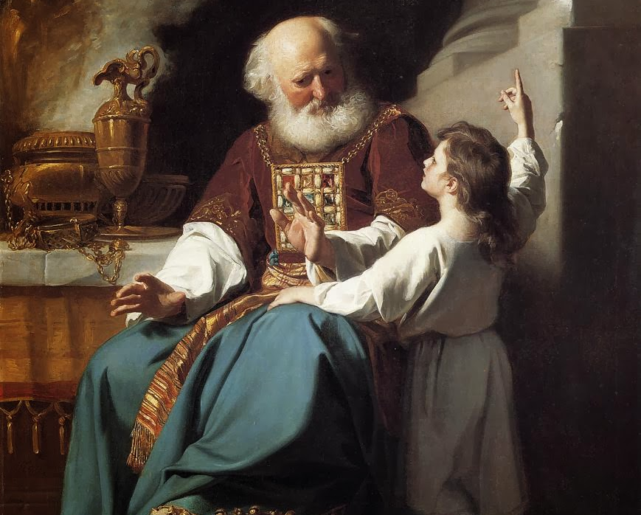
When we fail—Responsibility
Two Responses
1. We leave the failure
1 Samuel 3:13—¹³For I have told him that I am about to judge his house forever for the iniquity which he knew, because his sons brought a curse on themselves and he did not rebuke them. (NASB95)
Eli would not restrain his sons though he knew he should.

Slide 10
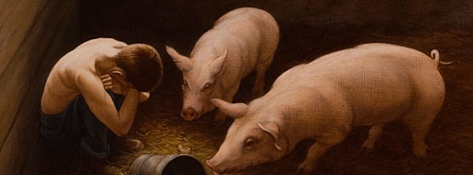
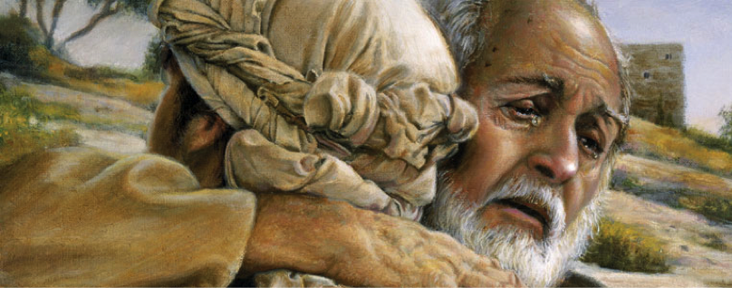
When we fail—Responsibility
Two Responses
2. We learn from the failure
Luke 15:17-18—
¹⁷But when he came to his senses, he said, ‘How many of my father’s hired men have more than enough bread, but I am dying here with hunger! ¹⁸I will get up and go to my father, and will say to him, “Father, I have sinned against heaven, and in your sight; (NASB95)
He had more sense than to stay where he was.

Slide 11
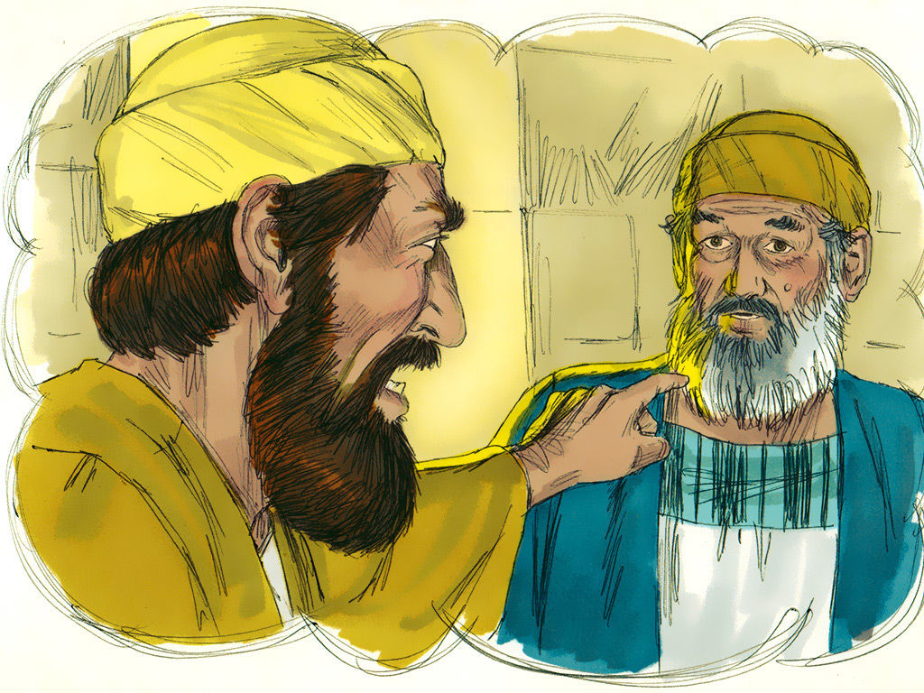
When we fail—Responsibility
Two Realizations
1. We Stay the same as before
Luke 15:31-32—³¹And he said to him, ‘Son, you have always been with me, and all that is mine is yours. ³²But we had to celebrate and rejoice, for this brother of yours was dead and has begun to live, and was lost and has been found.’” (NASB95)
Two Prodigals—The older brother was the prodigal that stayed home—and stayed the same!

Slide 12
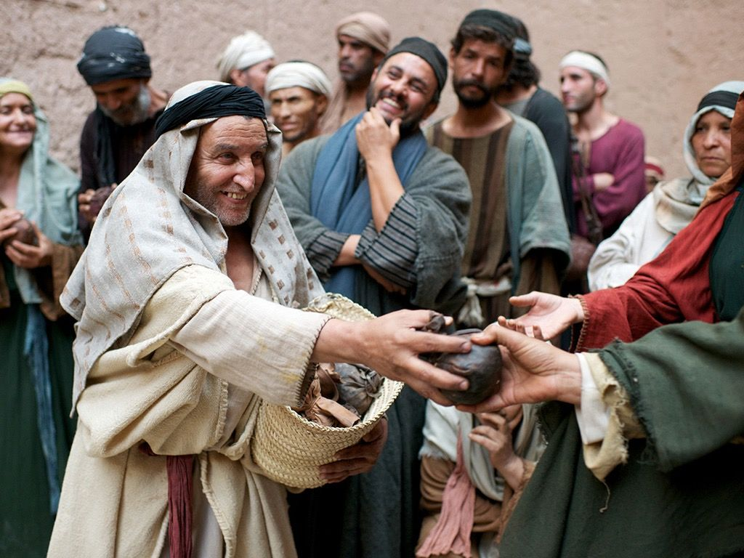
When we fail—Responsibility
Two Realizations
2. We are better than before
Luke 19:7-8—
⁷When they saw it, they all began to grumble, saying, “He has gone to be the guest of a man who is a sinner.” ⁸Zaccheus stopped and said to the Lord, “Behold, Lord, half of my possessions I will give to the poor, and if I have defrauded anyone of anything, I will give back four times as much.” (NASB95)
More precious than gold

Slide 13
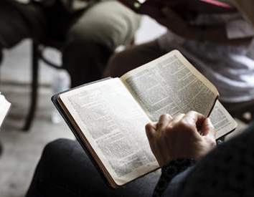
When we fail—Transformation
1. Teachable – Mt.13:16
Matthew 13:16-17—¹⁶But blessed are your eyes, because they see; and your ears, because they hear. ¹⁷For truly I say to you that many prophets and righteous men desired to see what you see, and did not see it, and to hear what you hear, and did not hear it. (NASB95)
Learning from the Lord…

Slide 14
When we fail—Transformation
1. Teachable – Mt.13:16
Learning from the Lord…
2Tim.2:15— accurately handling the word of truth.” (NASB95)
Mark 4:25a—²⁵For whoever has, to him more shall be given; and whoever does not have, even what he has shall be taken away from him.” (NASB95)
2 Peter 3:18a—¹⁸but grow in the grace and knowledge of our Lord and Saviour. (NASB95)

Slide 15
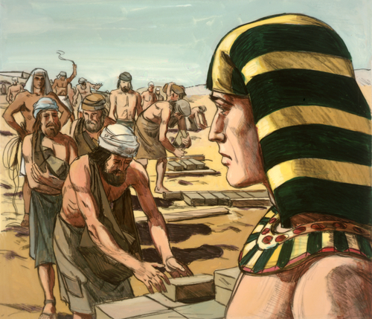
When we fail—Transformation
2. Realistic – Heb.11:24-25
Hebrews 11:24-25—²⁴By faith Moses, when he had grown up, refused to be called the son of Pharaoh’s daughter, ²⁵choosing rather to endure ill-treatment with the people of God than to enjoy the passing pleasures of sin, (NASB95)
Giving it all away…

Slide 16
When we fail—Transformation
2. Realistic – Heb.11:24-25
Giving it all away—It’s possible to lose everything you’ve worked for in a matter of moments.
Some jobs are closed to professing Christians
Some will cause you to fail because you are not willing to follow them.
Being a ‘forgiver’ means forgetting the loss.

Slide 17
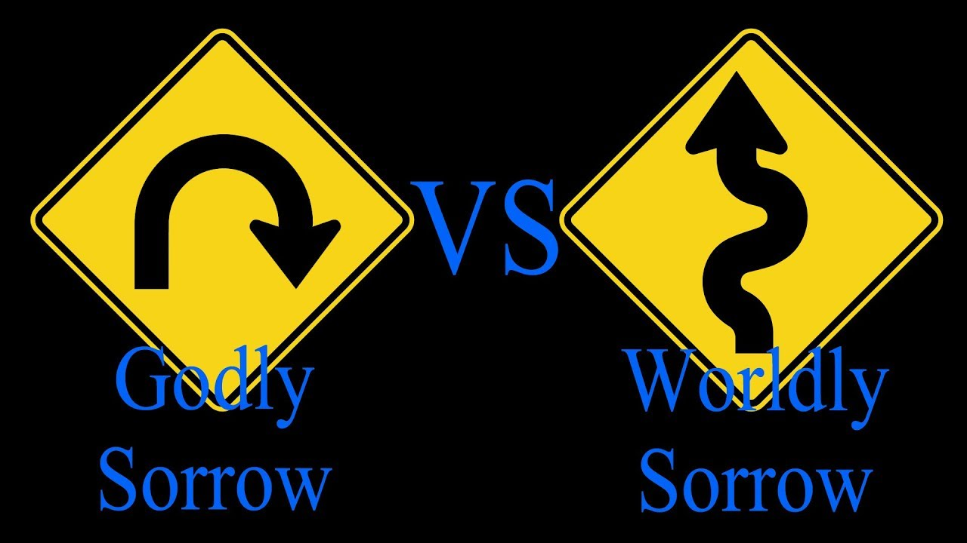
When we fail—Transformation
3. Repentant – 2Cor.7:10
2 Corinthians 7:10—¹⁰For the sorrow that is according to the will of God produces a repentance without regret, leading to salvation, but the sorrow of the world produces death. (NASB95)
Repentance says…

Slide 18
When we fail—Transformation
3. Repentant – 2Cor.7:10
I have failed to keep Jesus’ commands
I accept that I am a recipient of grace
My failings affect others.
I have to change
Credibility before God and man is important.
Credibility makes a difference—especially during a crisis of failure.

Slide 19
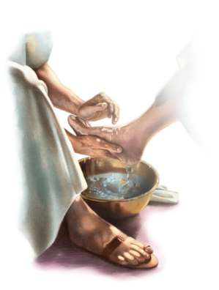
When we fail—Transformation
4. Unpretentious– 1Tim.1:15
1 Timothy 1:15—¹⁵It is a trustworthy statement, deserving full acceptance, that Christ Jesus came into the world to save sinners, among whom I am foremost of all. (NASB95)
That’s me, too…

Slide 20
When we fail—Transformation
4. Unpretentious– 1Tim.1:15
I am one of those sinners, also.
When I see my failures, I become less judgmental
I treat others the way Jesus treats me—better than Himself.
When their failures affect me, I am reminded that mine affect others.

Slide 21

When we fail—Transformation
5. Grateful
Hebrews 12:28—²⁸Therefore, since we receive a kingdom which cannot be shaken, let us show gratitude, by which we may offer to God an acceptable service with reverence and awe; (NASB95)
Shows appreciation…

Slide 22
When we fail—Transformation
5. Grateful
Shows appreciation for the cost of our salvation
Moves us away from self-pity
Focuses on what we do have
Brings us back to sharing the generosity of Christ…especially in our need!

Slide 23
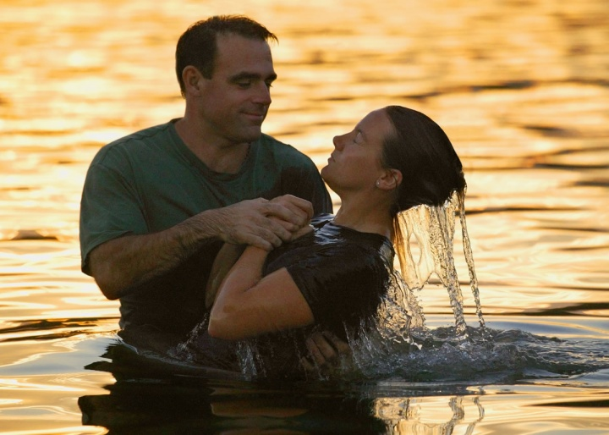
When we fail—
Jesus is our success story
Mark 16:16—
¹⁶He who has believed and has been baptized shall be saved; but he who has disbelieved shall be condemned. (NASB95)

