Slide 2
“Come now, let us reason together.”

Slide 3
God is not silent

Slide 4
God is not silent
  The Witnesses speak

Slide 5
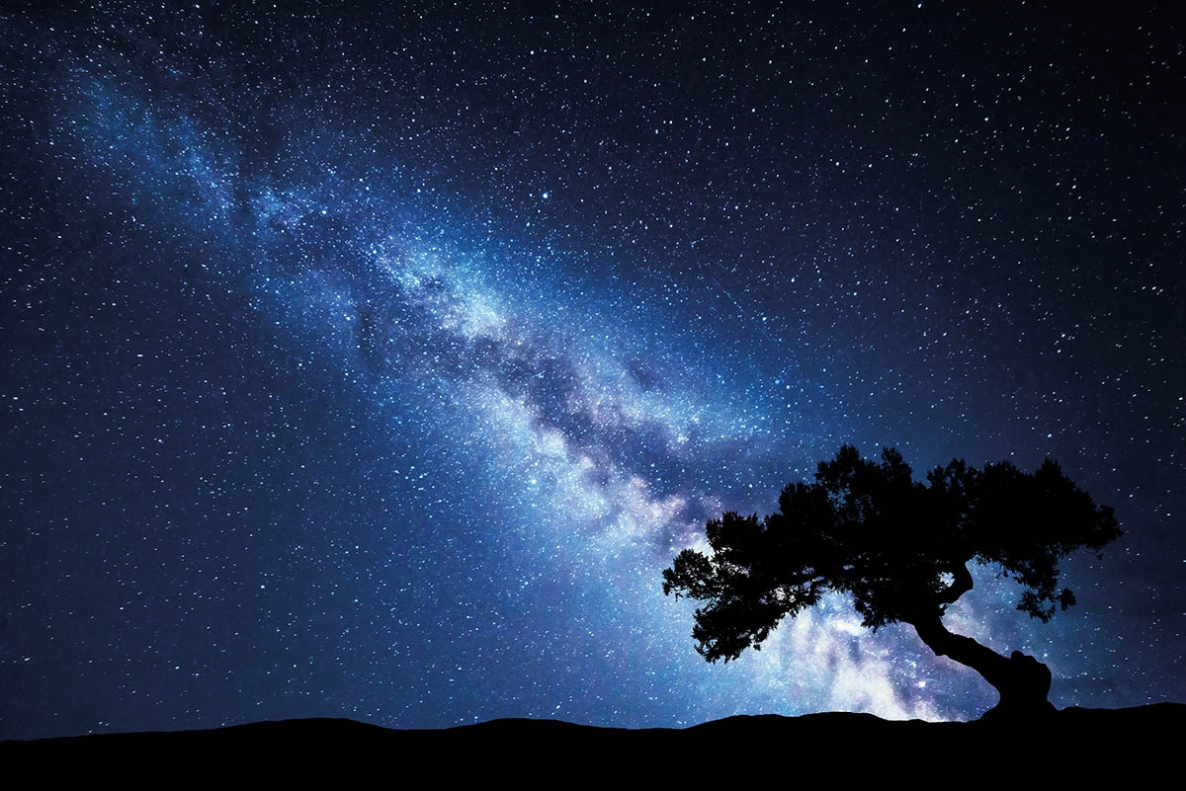
God is not silent
  The Witnesses speak
Testimony of Nature
    a. Psalm 19:1—
    The heavens are telling of the glory of God;
    And their expanse is declaring the work of His hands. (NASB95)

Slide 6
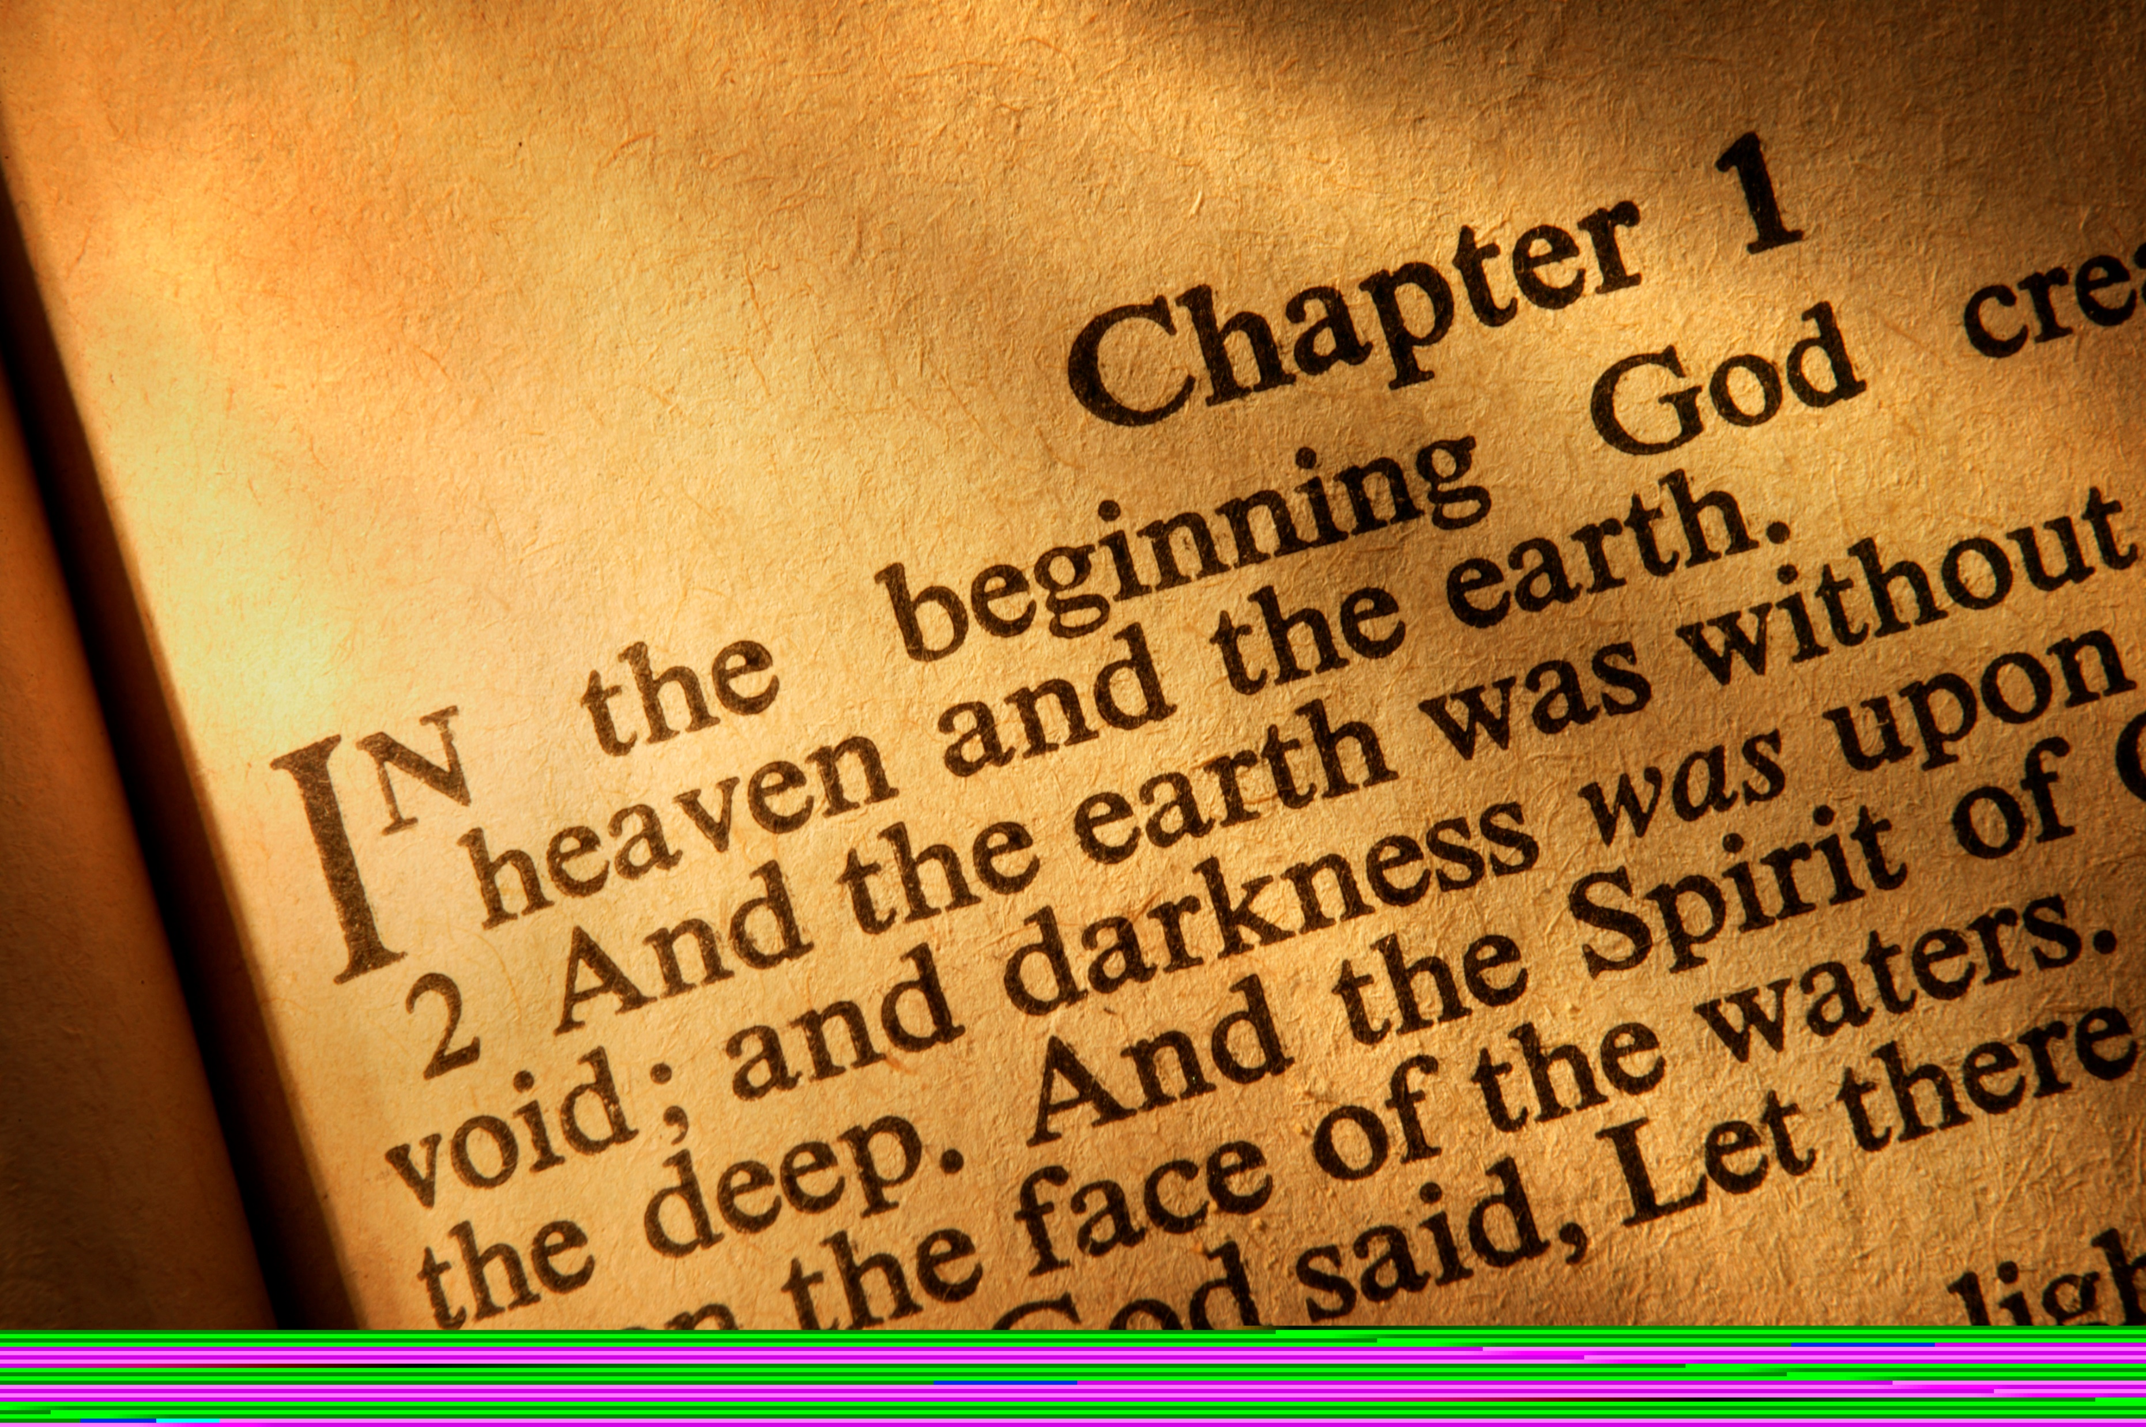
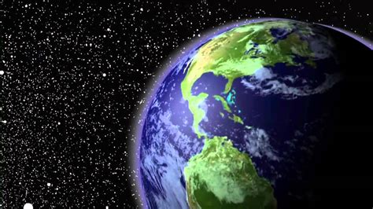
God is not silent
  The Witnesses speak
Testimony of Nature
    b. Romans 1:20—
    ²⁰ For since the creation of the world His invisible attributes, His eternal power and divine nature, have been clearly seen, being understood through what has been made, so that they are without excuse. (NASB95)

Slide 7
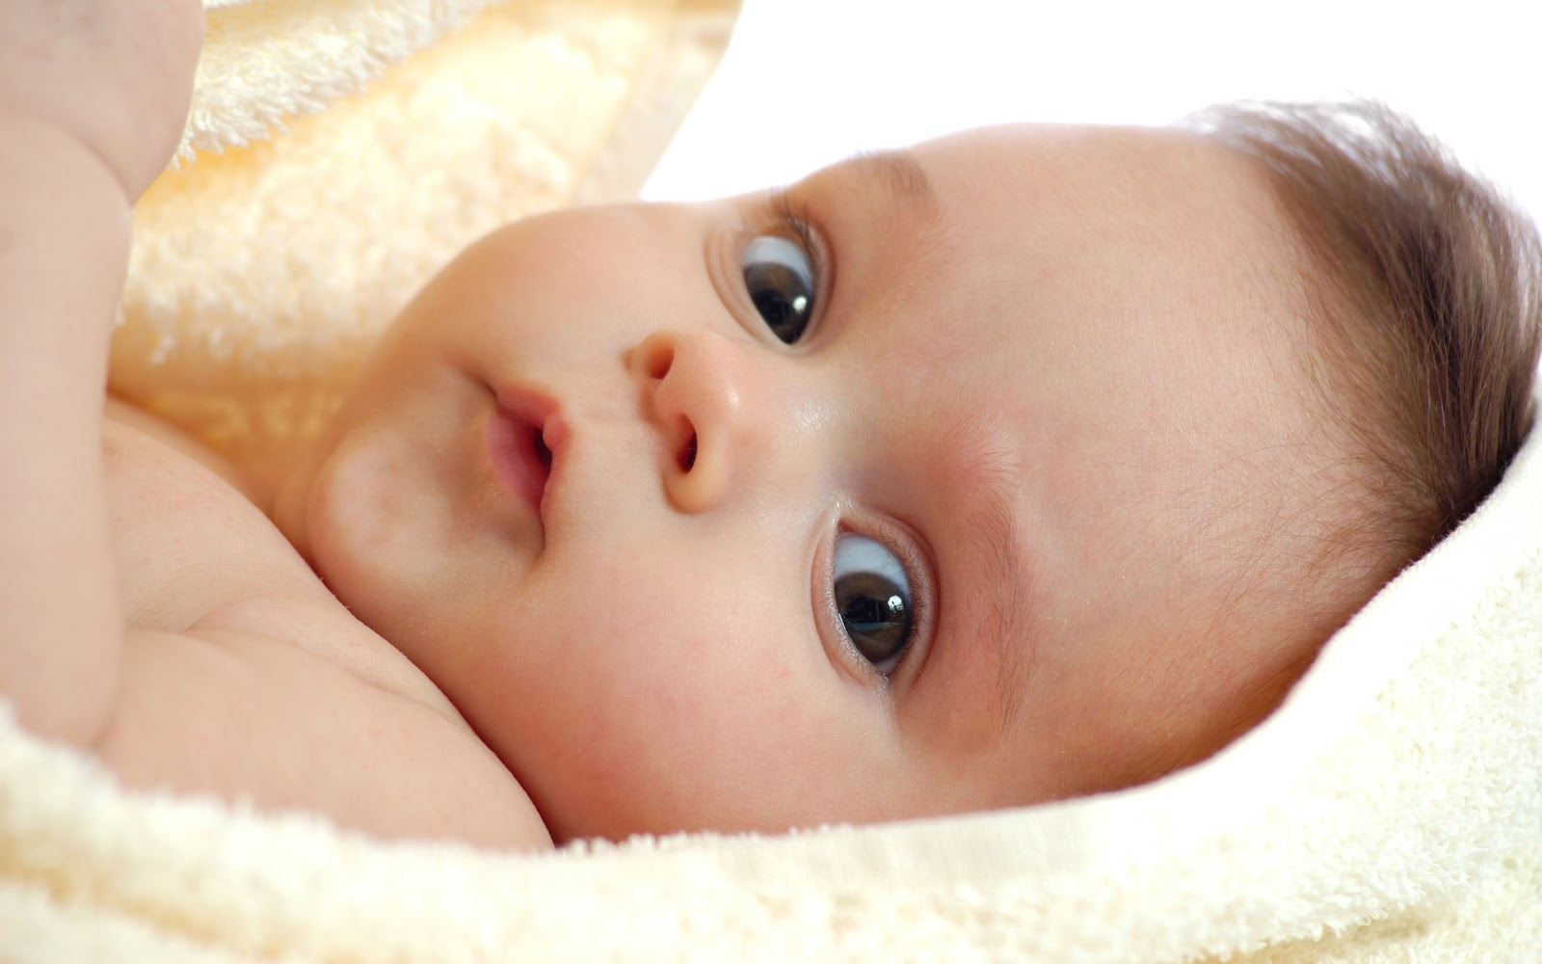
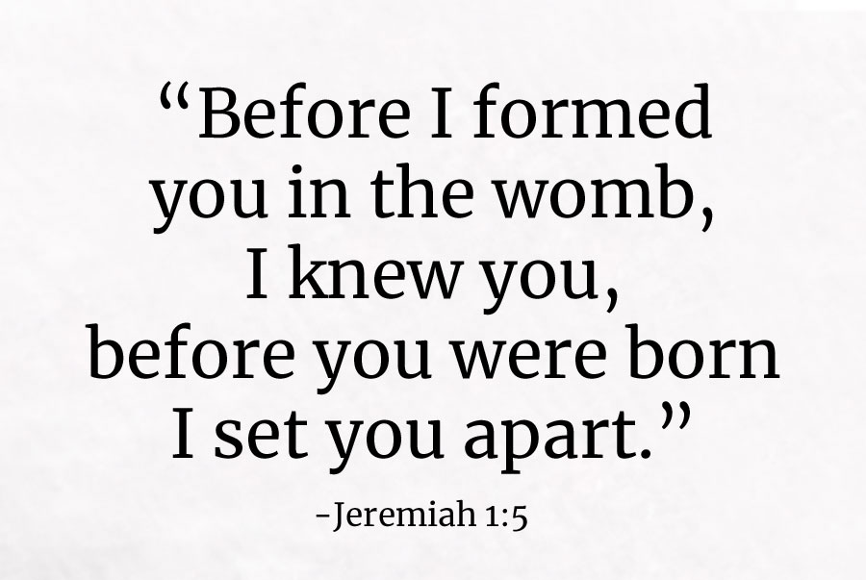
God is not silent
  The Witnesses speak
Testimony of Nature
    c. Psalm 139:14—
    ¹⁴I will give thanks to You,
    for I am fearfully and wonderfully made;
    Wonderful are Your works,
    And my soul knows it very well. (NASB95)

Slide 8
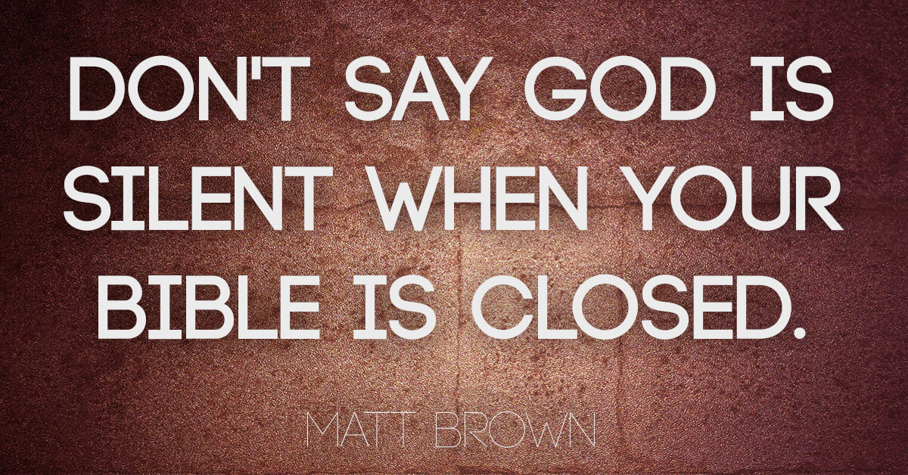

God is not silent
  The Witnesses speak
Testimony of Scripture
    The Bible

Slide 9
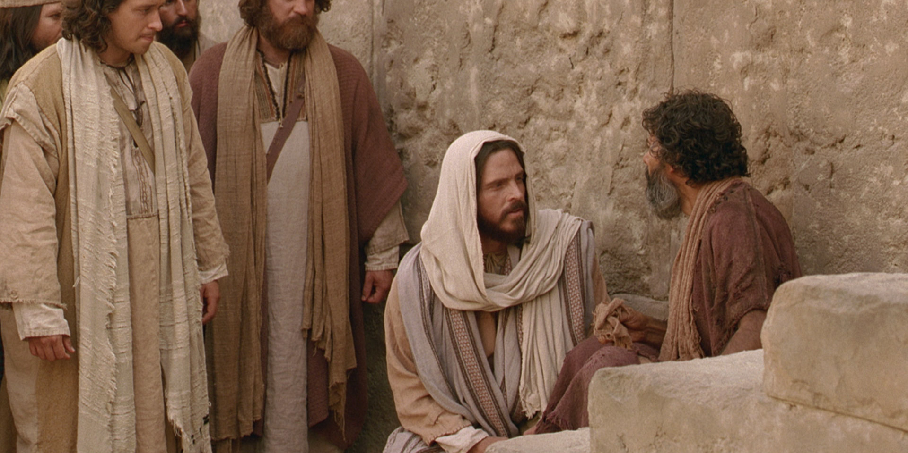
God is not silent
  The Witnesses speak
Testimony of Scripture
    a. The Bible
      We look to the Bible for an explanation of the knowledge of the being, character, and attributes of God
      Prophecy
      Jesus’ Teachings and Miracles
      Apostles, prophets, evangelists, teachers…

Slide 10

God is not silent
  The Witnesses
Testimony of Scripture
    b. The transforming work of the Holy Spirit in all believers
2 Corinthians 3:18—¹⁸But we all, with unveiled face, beholding as in a mirror the glory of the Lord, are being transformed into the same image from glory to glory, just as from the Lord, the Spirit. (NASB95)

Slide 11
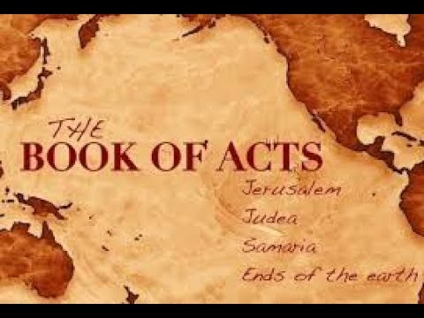
God is not silent
  The Witnesses
Testimony of Scripture
    c. The spread of the church
Acts 1:8—⁸but you will receive power when the Holy Spirit has come upon you; and you shall be My witnesses both in Jerusalem, and in all Judea and Samaria, and even to the remotest part of the earth.” (NASB95)

Slide 12

God is not silent
  The Witnesses
Testimony of Goodness
    a. The transforming work of the Holy Spirit in all believers
2 Corinthians 3:18—¹⁸But we all, with unveiled face, beholding as in a mirror the glory of the Lord, are being transformed into the same image from glory to glory, just as from the Lord, the Spirit. (NASB95)

Slide 13

God is not silent
  The Witnesses
Testimony of Goodness
b. He has left us the testimony of vibrant colour, energy and creativity for all to see.
    There is nothing boring about God.
    All good things are to His praise and our enjoyment
John 10:10
¹⁰The thief comes only to steal and kill and destroy; I came that they may have life, and have it abundantly. (NASB95)

Slide 14
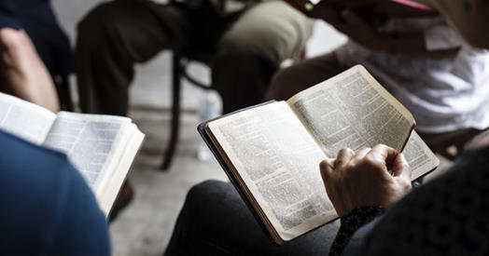

God is not silent
  The Witnesses
Testimony of Goodness
c. Ambassadors of Christ
      Taking “The Gospel of Christ.”
      With the gospel comes the church
      With the church comes…
        Education
        Morals
        Food
        Medicine
        Clean water
        Technology
        Peace
        Civilization

Slide 15
God is not silent
  The Witnesses
Testimony of Goodness
d. People of Faith and Reason
      We belief is built on that with is reasonable
      We check the facts—Witnesses (1Cor.15:3-7)
      We do not fear debate (Acts 15:2)
      Everything is laid out in the open (Acts 26:26)
      Come now, let us reason together…

Slide 16

Isaiah 1:18—
¹⁸ “Come now, and let us reason together,”
Says the Lord,
“Though your sins are as scarlet,
They will be as white as snow;
Though they are red like crimson,
They will be like wool.

