Slide 2
Fathers…

Slide 3
Fatherhood

Slide 4
Fatherhood
Your children will spend your time and money

Slide 5
Fatherhood
Your children will spend your time and money
Your children will wear out your carpet and furniture

Slide 6
Fatherhood
Your children will spend your time and money
Your children will wear out your carpet and furniture
Your children will break the unbreakable

Slide 7
Fatherhood
Your children will spend your time and money
Your children will wear out your carpet and furniture
Your children will break the unbreakable
Your children will bring out the best and worst in you

Slide 8
Fatherhood
Your children will spend your time and money
Your children will wear out your carpet and furniture
Your children will break the unbreakable
Your children will bring out the best and worst in you
Hardest job ever…!

Slide 9
Fatherhood
Your children will spend your time and money
Your children will wear out your carpet and furniture
Your children will break the unbreakable
Your children will bring out the best and worst in you
Hardest job ever…!
Most expensive job ever…!

Slide 10
Fatherhood
Your children will spend your time and money
Your children will wear out your carpet and furniture
Your children will break the unbreakable
Your children will bring out the best and worst in you
Hardest job ever…!
Most expensive job ever…!
Longest job ever…!

Slide 11
Fatherhood
Your children will spend your time and money
Your children will wear out your carpet and furniture
Your children will break the unbreakable
Your children will bring out the best and worst in you
Hardest job ever…!
Most expensive job ever…!
Longest job ever…!
Would I do it all again…?

Slide 12
Fatherhood

Slide 13
Ephesians 6:1-4—¹Children, obey your parents in the Lord, for this is right. ²Honor your father and mother (which is the first commandment with a promise), ³so that it may be well with you, and that you may live long on the earth.
⁴Fathers, do not provoke your children to anger, but bring them up in the discipline and instruction of the Lord. (NASB95)

Slide 14
Colossians 3:18-21—¹⁸Wives, be subject to your husbands, as is fitting in the Lord. ¹⁹Husbands, love your wives and do not be embittered against them. ²⁰Children, be obedient to your parents in all things, for this is well-pleasing to the Lord. ²¹Fathers, do not exasperate your children, so that they will not lose heart. (NASB95)

Slide 15
Instructions to Fathers
What NOT to do! (Eph.6:4a and Col.3:21a)
WHY not do it? (Col.3:21b)
What TO DO! (Eph.6:4b)

Slide 16
Instructions to Fathers
1. What NOT to do! (Eph.6:4a and Col.3:21a)
Ephesians 6:4a—⁴Fathers, do not provoke your children to anger, (NASB95)
Colossians 3:21a
²¹Fathers, do not exasperate your children, (NASB95)

Slide 17
Ephesians 6:4a—⁴Fathers, do not provoke your children to anger, (NASB95)
Colossians 3:21a—²¹Fathers, do not exasperate your children, (NASB95)
Exasperation…
Not a one-off thing…

Slide 18
Ephesians 6:4a—⁴Fathers, do not provoke your children to anger, (NASB95)
Colossians 3:21a—²¹Fathers, do not exasperate your children, (NASB95)
Exasperation…
Not a one-off thing…
Nagging
Niggling
Needling
Needless demands

Slide 19
Ephesians 6:4a—⁴Fathers, do not provoke your children to anger, (NASB95)
Colossians 3:21a—²¹Fathers, do not exasperate your children, (NASB95)
Exasperation…
Not a one-off thing…
Nagging
Niggling
Needling
Needless demands
Our children have their limits, too.

Slide 20
Ephesians 6:4a—⁴Fathers, do not provoke your children to anger, (NASB95)
Colossians 3:21a—²¹Fathers, do not exasperate your children, (NASB95)
Exasperation…
Not a one-off thing…
Nagging
Niggling
Needling
Needless demands
Our children have their limits, too.
They will show their frustration

Slide 21
Ephesians 6:4a—⁴Fathers, do not provoke your children to anger, (NASB95)
Colossians 3:21a—²¹Fathers, do not exasperate your children, (NASB95)
Exasperation…
Anger will out…

Slide 22
Ephesians 6:4a—⁴Fathers, do not provoke your children to anger, (NASB95)
Colossians 3:21a—²¹Fathers, do not exasperate your children, (NASB95)
Exasperation…
Anger will out…
Tears
Tantrums
Testings

Slide 23
Ephesians 6:4a—⁴Fathers, do not provoke your children to anger, (NASB95)
Colossians 3:21a—²¹Fathers, do not exasperate your children, (NASB95)
Exasperation…
Anger will out…
Tears
Tantrums
Testings
Remember, Paul is assuming that dad is the cause of these things.

Slide 24
Ephesians 6:4a—⁴Fathers, do not provoke your children to anger, (NASB95)
Colossians 3:21a—²¹Fathers, do not exasperate your children, (NASB95)
Exasperation…
Anger will out…
Tears
Tantrums
Testings
Remember, Paul is assuming that dad is the cause of these things.
The anger of man does not achieve the righteousness of God (James 1:20)

Slide 25
Instructions to Fathers
2. WHY not do it? (Col.3:21b)
Colossians 3:21b—²¹…, so that they will not lose heart. (NASB95)

Slide 26
Colossians 3:21b—²¹…, so that they will not lose heart. (NASB95)
Losing heart…

Slide 27
Colossians 3:21b—²¹…, so that they will not lose heart. (NASB95)
Losing heart…
This is an indictment again the Christian father…

Slide 28
Colossians 3:21b—²¹…, so that they will not lose heart. (NASB95)
Losing heart…
This is an indictment again the Christian father…
Unnecessary

Slide 29
Colossians 3:21b—²¹…, so that they will not lose heart. (NASB95)
Losing heart…
This is an indictment again the Christian father…
Unnecessary
Something he could have prevented

Slide 30
Colossians 3:21b—²¹…, so that they will not lose heart. (NASB95)
Losing heart…
This is an indictment again the Christian father…
Unnecessary
Something he could have prevented
Discouragement that sets in

Slide 31
Colossians 3:21b—²¹…, so that they will not lose heart. (NASB95)
Losing heart…
This is an indictment again the Christian father…
Unnecessary
Something he could have prevented
Discouragement that sets in
Debilitating

Slide 32
Colossians 3:21b—²¹…, so that they will not lose heart. (NASB95)
Losing heart…
This is an indictment again the Christian father…
Unnecessary
Something he could have prevented
Discouragement that sets in
Debilitating
Impedes progress towards the cross

Slide 33
Colossians 3:21b—²¹…, so that they will not lose heart. (NASB95)
Losing heart…
This is an indictment again the Christian father…
Unnecessary
Something he could have prevented
Discouragement that sets in
Debilitating
Impedes progress towards the cross
Isolates

Slide 34
Colossians 3:21b—²¹…, so that they will not lose heart. (NASB95)
Losing heart…
Doesn’t have to be a permanent state of affairs…
Galatians 6:9—⁹Let us not lose heart in doing good, for in due time we will reap if we do not grow weary. (NASB95)

Slide 35
Colossians 3:21b—²¹…, so that they will not lose heart. (NASB95)
Losing heart…
Doesn’t have to be a permanent state of affairs…
It is more than likely a reflection of dad’s own state of heart
Galatians 6:9—⁹Let us not lose heart in doing good, for in due time we will reap if we do not grow weary. (NASB95)

Slide 36
Colossians 3:21b—²¹…, so that they will not lose heart. (NASB95)
Losing heart…
Doesn’t have to be a permanent state of affairs…
It is more than likely a reflection of dad’s own state of heart
Revival brings renewal
Galatians 6:9—⁹Let us not lose heart in doing good, for in due time we will reap if we do not grow weary. (NASB95)

Slide 37
Colossians 3:21b—²¹…, so that they will not lose heart. (NASB95)
Losing heart…
Doesn’t have to be a permanent state of affairs…
It is more than likely a reflection of dad’s own state of heart
Revival brings renewal
2 Corinthians 4:16—
¹⁶Therefore we do not lose heart, but though our outer man is decaying, yet our inner man is being renewed day by day. (NASB95)
Galatians 6:9—⁹Let us not lose heart in doing good, for in due time we will reap if we do not grow weary. (NASB95)

Slide 38
Instructions to Fathers
3. What TO DO! (Eph.6:4b)
Ephesians 6:4b—
⁴…, but bring them up in the discipline and instruction of the Lord. (NASB95)

Slide 39
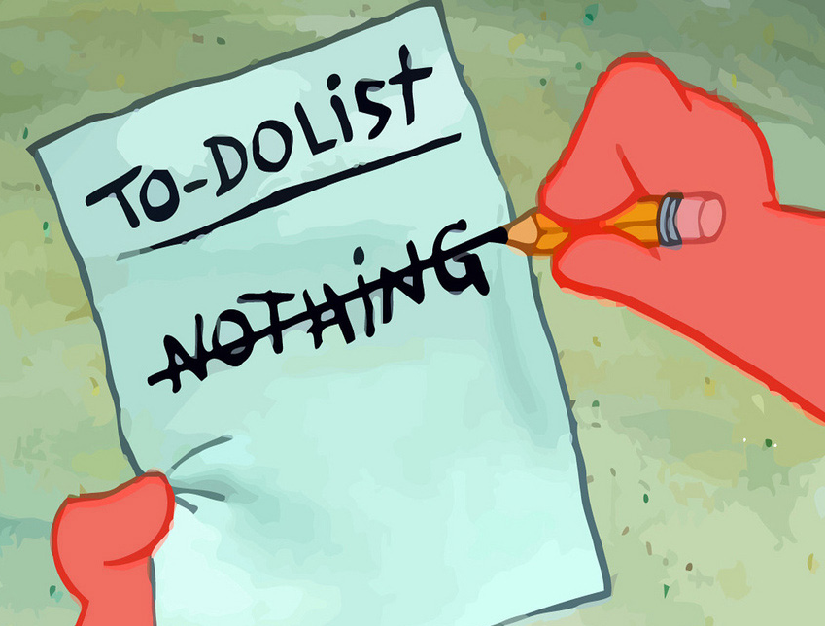
Ephesians 6:4b—
⁴…, but bring them up in the discipline and instruction of the Lord. (NASB95)
Bring them up…

Slide 40
Ephesians 6:4b—
⁴…, but bring them up in the discipline and instruction of the Lord. (NASB95)
Bring them up…
Ignoring the child is actually doing something…

Slide 41
Ephesians 6:4b—
⁴…, but bring them up in the discipline and instruction of the Lord. (NASB95)
Bring them up…
Ignoring the child is actually doing something…
Sin of neglect

Slide 42
Ephesians 6:4b—
⁴…, but bring them up in the discipline and instruction of the Lord. (NASB95)
Bring them up…
Ignoring the child is actually doing something…
Sin of neglect
Its leaving it to others

Slide 43
Ephesians 6:4b—
⁴…, but bring them up in the discipline and instruction of the Lord. (NASB95)
Bring them up…
Ignoring the child is actually doing something…
Sin of neglect
Its leaving it to others
Guess what they have planned?

Slide 44
Ephesians 6:4b—
⁴…, but bring them up in the discipline and instruction of the Lord. (NASB95)
Bring them up…
Discipline…(Nurture)

Slide 45
Ephesians 6:4b—
⁴…, but bring them up in the discipline and instruction of the Lord. (NASB95)
Bring them up…
Discipline…(Nurture)
The parameters are clearly defined: “…of the Lord.”

Slide 46
Ephesians 6:4b—
⁴…, but bring them up in the discipline and instruction of the Lord. (NASB95)
Bring them up…
Discipline…(Nurture)
The parameters are clearly defined: “…of the Lord.”
To ‘train up’ in a way that the Lord approves.

Slide 47
Ephesians 6:4b—
⁴…, but bring them up in the discipline and instruction of the Lord. (NASB95)
Bring them up…
Discipline…(Nurture)
The parameters are clearly defined: “…of the Lord.”
To ‘train up’ in a way that the Lord approves.
The discipline of the world seeks different outcomes

Slide 48
Ephesians 6:4b—
⁴…, but bring them up in the discipline and instruction of the Lord. (NASB95)
Bring them up…
Discipline…(Nurture)
The parameters are clearly defined: “…of the Lord.”
To ‘train up’ in a way that the Lord approves.
The discipline of the world seeks different outcomes
We train the soul for eternity

Slide 49
Ephesians 6:4b—
⁴…, but bring them up in the discipline and instruction of the Lord. (NASB95)
Bring them up…
Discipline…(Nurture)
The parameters are clearly defined: “…of the Lord.”
To ‘train up’ in a way that the Lord approves.
The discipline of the world seeks different outcomes
We train the soul for eternity
We grow—they grow!

Slide 50
Ephesians 6:4b—
⁴…, but bring them up in the discipline and instruction of the Lord. (NASB95)
Bring them up…
Instruction of the Lord…

Slide 51
Ephesians 6:4b—
⁴…, but bring them up in the discipline and instruction of the Lord. (NASB95)
Bring them up…
Instruction of the Lord…
Parameters—“…of the Lord.”

Slide 52
Ephesians 6:4b—
⁴…, but bring them up in the discipline and instruction of the Lord. (NASB95)
Bring them up…
Instruction of the Lord…
Parameters—“…of the Lord.”
Lit. “a putting in mind.”
The Lord corrects us
Our spiritual care and welfare depends on it
Dad’s have the same duty of care to correct.

Slide 53
Ephesians 6:4b—
⁴…, but bring them up in the discipline and instruction of the Lord. (NASB95)
Bring them up…
Instruction of the Lord…
Parameters—“…of the Lord.”
Lit. “a putting in mind.”
Teaching…
Proverbs 22:6—⁶Train up a child in the way he should go, Even when he is old he will not depart from it. (NASB95)

Slide 54
Ephesians 6:4b—
⁴…, but bring them up in the discipline and instruction of the Lord. (NASB95)
Bring them up…
Instruction of the Lord…
Parameters—“…of the Lord.”
Lit. “a putting in mind.”
Teaching…
God’s existence
Israel followed the God of their father Abraham
May our children see us following in the same steps.

Slide 55
Ephesians 6:4b—
⁴…, but bring them up in the discipline and instruction of the Lord. (NASB95)
Bring them up…
Instruction of the Lord…
Parameters—“…of the Lord.”
Lit. “a putting in mind.”
Teaching…
God’s existence
Christ’s saving grace
2 Peter 3:18a—¹⁸but grow in the grace and knowledge of our Lord and Saviour Jesus Christ. (NASB95)

Slide 56
Ephesians 6:4b—
⁴…, but bring them up in the discipline and instruction of the Lord. (NASB95)
Bring them up…
Instruction of the Lord…
Parameters—“…of the Lord.”
Lit. “a putting in mind.”
Teaching…
God’s existence
Christ’s saving grace
God’s claim on heart and life
Eph.2:10a—¹⁰For we are His workmanship, created in Christ Jesus for good works, (NASB95)

Slide 57
Ephesians 6:4b—
⁴…, but bring them up in the discipline and instruction of the Lord. (NASB95)
Bring them up…
Instruction of the Lord…
Parameters—“…of the Lord.”
Lit. “a putting in mind.”
Teaching…
God’s existence
Christ’s saving grace
God’s claim on heart and life
Peace, security and joy of faith and fellowship

Slide 58
Ephesians 6:4b—
⁴…, but bring them up in the discipline and instruction of the Lord. (NASB95)
Bring them up…
Instruction of the Lord…
Parameters—“…of the Lord.”
Lit. “a putting in mind.”
Teaching…
God’s existence
Christ’s saving grace
God’s claim on heart and life
Peace, security and joy of faith and fellowship
Example is the best teacher

Slide 59
Ephesians 6:4b—
⁴…, but bring them up in the discipline and instruction of the Lord. (NASB95)
Bring them up…
Dad’s To-do List…
Read your Bible
Pray for wisdom
Mind your attitudes
Teach the values of Christ
Take them to Sunday School
Be active in church-life
Salvation is the goal…

Slide 60
Galatians 3:26-27
²⁶So in Christ Jesus you are all children of God through faith, ²⁷for all of you who were baptized into Christ have clothed yourselves with Christ. (NIV)

