Slide 2

“Reaching out through Hospitality.”

Slide 3

Hospitality—
That’s Me…!
Bring it on…!
Men’s breakfasts
BBQs
Pre-game
Half-time
Post-game
Loves people
Loves food
Its his gift from God and he’s going to share it
His only fear…an empty room

Slide 4

Hospitality—
That’s Me…!
I have entertained angels
Bring it on…!
Master Chef
Memorized 100s of recipes
Spotless house
Guestroom ready
Food is a joy
Guests are a joyful ministry
Her kitchen is her place of Christian service

Slide 5


Hospitality—
That’s Me…!
Bring it on…!
Family motto:
Its a family affair
We love to share
It’s all about you
And yes, We Care!
House is always full
Everyone is an honoured guest
They thrive when serving…

Slide 6


Slide 7



Slide 8

Why Me?

Slide 9

I gave it my best shot…

Slide 10

“Mum, about me saying that I can handle this hospitality stuff…”

Slide 11

Hospitality—
Do you mean me…?
Ever wondered how others might react?
What if it’s a failure?
What if I embarrass myself?
What if they don’t like me?
I’m a lousy host!

Slide 12

Hospitality—
Creating a Christ-filled welcome
It is…
Nothing to do with impressing, but everything to do with making people feel welcome and wanted.

Slide 13

Hospitality—
Creating a Christ-filled welcome
It is…
The unselfish desire to meet the needs of others

Slide 14

Hospitality—
Creating a Christ-filled welcome
It is…
Making people feel better by the time they leave than before they came

Slide 15

Hospitality—
Creating a Christ-filled welcome
It is…
About providing physical food and friendship to bring people to Jesus’ spiritual food and friendship—Church!

Slide 16
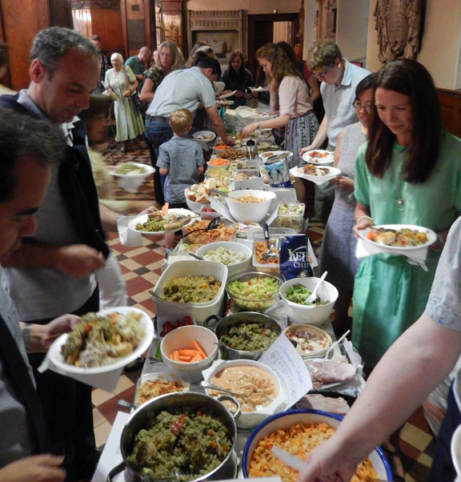
Hospitality—
Taking every opportunity
Fellowship meals at church is a readymade option—Don’t miss it!

Slide 17
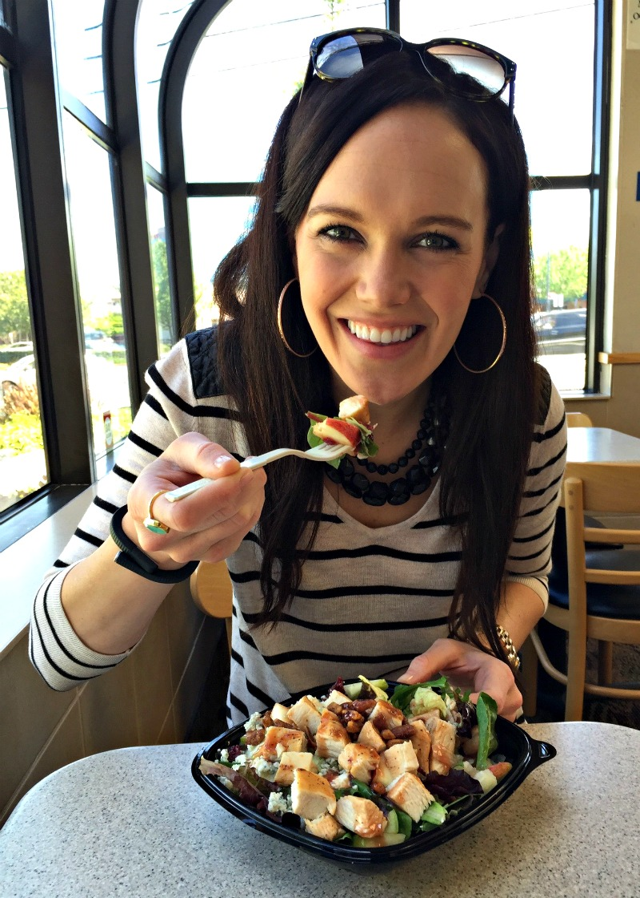
Hospitality—
Taking every opportunity
Nothing wrong with fast food restaurants.

Slide 18
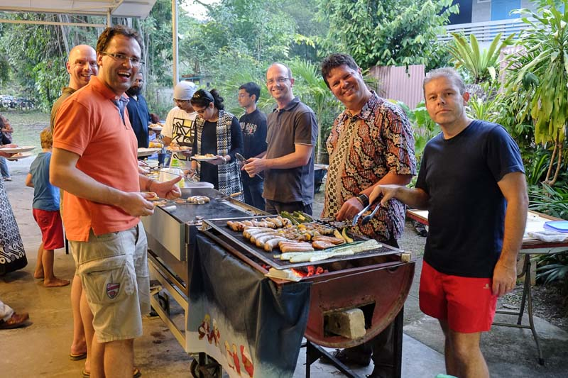
Hospitality—
Taking every opportunity
BBQs

Slide 19
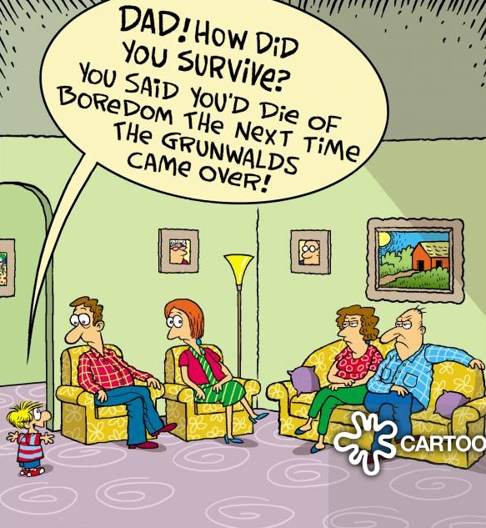
Hospitality—
You may want to prepare you heart first
Be prepared for surprisesFriends or relatives dropping by.

Slide 20
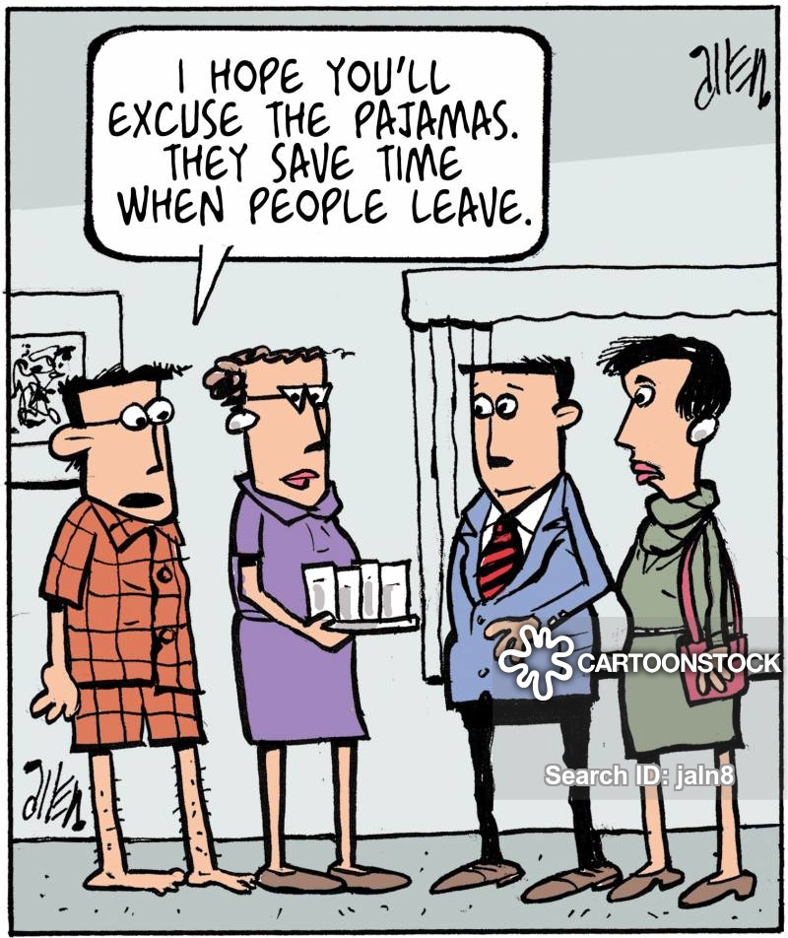
Hospitality—
You may want to prepare your heart first
This is all about being in the place of Jesus

Slide 21
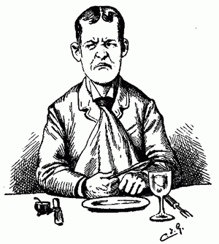
Things I‘ve learned about Christ-filled hospitality:
It may not have been as easy as I thought it should have been—But was worth it!
1 Peter 4:9 NIV 9 Offer hospitality to one another without grumbling.

Slide 22

Things I‘ve learned about Christ-filled hospitality:
I need to be a good listener
  To be genuinely interested in those whom God has put in front of me.

Slide 23

Things I‘ve learned about Christ-filled hospitality:
I need to care more about the person than how things might look.

Slide 24

Things I‘ve learned about Christ-filled hospitality:
I need to learn to laugh with my guests. Or cry with them—if need be.

Slide 25
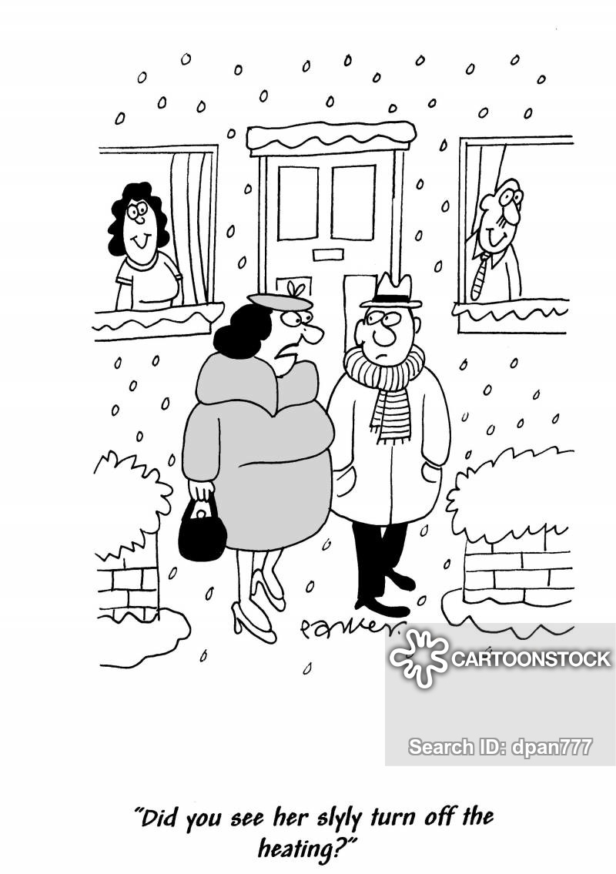
Things I‘ve learned about Christ-filled hospitality:
I need to accept that not everyone in the room is going to make me feel welcome. Hosts or guests—I have long since gotten over it!

Slide 26
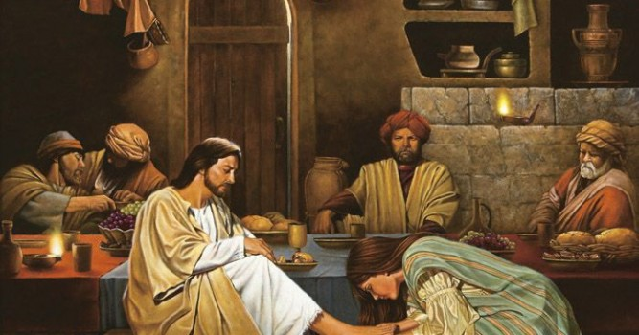
In Luke 7:36-50 the only person who made Jesus feel welcome in the home of Simon (a pharisee), was a ‘sinful’ woman.

Slide 27

Things I‘ve learned about Christ-filled hospitality:
It must be a team effort. Cooks, cleaners, talkers, listeners, baby-sitters, the fun, the serious,

Slide 28
Luke 14:12-14—¹² Then Jesus said to his host, "When you give a luncheon or dinner, do not invite your friends, your brothers or relatives, or your rich neighbours; if you do, they may invite you back and so you will be repaid. ¹³But when you give a banquet, invite the poor, the crippled, the lame, the blind,
¹⁴and you will be blessed. Although they cannot repay you, you will be repaid at the resurrection of the righteous.” (NIV84)
Things I‘ve learned about Christ-filled hospitality:
The needy stranger is our ultimate goal.

Slide 29

Matthew 28:19-20—¹⁹Go therefore and make disciples of all the nations, baptizing them in the name of the Father and the Son and the Holy Spirit, ²⁰ teaching them to observe all that I commanded you; and lo, I am with you always, even to the end of the age.” (NASB95)

