Slide 2
“Tolerance.”

Slide 3
Tolerance—In the name of love:
Every relationship needs it
If you think that no one ever has to tolerate you, you might want to ask the Lord for clarification on that point—but be prepared for disappointment
With a scoffing tone we ask, “How do you put up with that?”
Sanctification takes time
No one changes over night
We have to accept matters of opinion
I don’t always have to be right
It is a natural part of life
  One man’s patient endurance is another man’s torture
Acceptance comes in many forms
You may have no choice so make the most of the growth

Slide 4
Tolerance—In the name of love:
Every relationship needs it
If you think that no one ever has to tolerate you, you might want to ask the Lord for clarification on that point—but be prepared for disappointment
With a scoffing tone we ask, “How do you put up with that?”
Sanctification takes time
No one changes over night
We have to accept matters of opinion
I don’t always have to be right
It is a natural part of life
  One man’s patient endurance is another man’s torture
Acceptance comes in many forms
You may have no choice so make the most of the growth

Slide 5
Tolerance—In the name of love:
Every relationship needs it
If you think that no one ever has to tolerate you, you might want to ask the Lord for clarification on that point—but be prepared for disappointment
With a scoffing tone we ask, “How do you put up with that?”
Sanctification takes time
No one changes over night
We have to accept matters of opinion
I don’t always have to be right
It is a natural part of life
  One man’s patient endurance is another man’s torture
Acceptance comes in many forms
You may have no choice so make the most of the growth

Slide 6
Tolerance—In the name of love:
Every relationship needs it
If you think that no one ever has to tolerate you, you might want to ask the Lord for clarification on that point—but be prepared for disappointment
With a scoffing tone we ask, “How do you put up with that?”
Sanctification takes time
No one changes over night
We have to accept matters of opinion
I don’t always have to be right
It is a natural part of life
  One man’s patient endurance is another man’s torture
Acceptance comes in many forms
You may have no choice so make the most of the growth

Slide 7
Tolerance—In the name of love:
Every relationship needs it
If you think that no one ever has to tolerate you, you might want to ask the Lord for clarification on that point—but be prepared for disappointment
With a scoffing tone we ask, “How do you put up with that?”
Sanctification takes time
No one changes over night
We have to accept matters of opinion
I don’t always have to be right
It is a natural part of life
  One man’s patient endurance is another man’s torture
Acceptance comes in many forms
You may have no choice so make the most of the growth

Slide 8
Tolerance—In the name of love:
Every relationship needs it
If you think that no one ever has to tolerate you, you might want to ask the Lord for clarification on that point—but be prepared for disappointment
With a scoffing tone we ask, “How do you put up with that?”
Sanctification takes time
No one changes over night
We have to accept matters of opinion
I don’t always have to be right
It is a natural part of life
  One man’s patient endurance is another man’s torture
Acceptance comes in many forms
You may have no choice so make the most of the growth

Slide 9
Tolerance—In the name of love:
Every relationship needs it
If you think that no one ever has to tolerate you, you might want to ask the Lord for clarification on that point—but be prepared for disappointment
With a scoffing tone we ask, “How do you put up with that?”
Sanctification takes time
No one changes over night
We have to accept matters of opinion
I don’t always have to be right
It is a natural part of life
  One man’s patient endurance is another man’s torture
Acceptance comes in many forms
You may have no choice so make the most of the growth

Slide 10
Tolerance—In the name of love:
Every relationship needs it
If you think that no one ever has to tolerate you, you might want to ask the Lord for clarification on that point—but be prepared for disappointment
With a scoffing tone we ask, “How do you put up with that?”
Sanctification takes time
No one changes over night
We have to accept matters of opinion
I don’t always have to be right
It is a natural part of life
  One man’s patient endurance is another man’s torture
Acceptance comes in many forms
You may have no choice so make the most of the growth

Slide 11
Tolerance—In the name of love:
Every relationship needs it
If you think that no one ever has to tolerate you, you might want to ask the Lord for clarification on that point—but be prepared for disappointment
With a scoffing tone we ask, “How do you put up with that?”
Sanctification takes time
No one changes over night
We have to accept matters of opinion
I don’t always have to be right
It is a natural part of life
  One man’s patient endurance is another man’s torture
Acceptance comes in many forms
You may have no choice so make the most of the growth

Slide 12
Tolerance—In the name of love:
Every relationship needs it
If you think that no one ever has to tolerate you, you might want to ask the Lord for clarification on that point—but be prepared for disappointment
With a scoffing tone we ask, “How do you put up with that?”
Sanctification takes time
No one changes over night
We have to accept matters of opinion
I don’t always have to be right
It is a natural part of life
  One man’s patient endurance is another man’s torture
Acceptance comes in many forms
You may have no choice so make the most of the growth

Slide 13
Tolerance—In the name of love:
Every relationship needs it
If you think that no one ever has to tolerate you, you might want to ask the Lord for clarification on that point—but be prepared for disappointment
With a scoffing tone we ask, “How do you put up with that?”
Sanctification takes time
No one changes over night
We have to accept matters of opinion
I don’t always have to be right
It is a natural part of life
  One man’s patient endurance is another man’s torture
Acceptance comes in many forms
You may have no choice so make the most of the growth

Slide 14
Tolerance—In the name of love:
Every relationship needs it
If you think that no one ever has to tolerate you, you might want to ask the Lord for clarification on that point—but be prepared for disappointment
With a scoffing tone we ask, “How do you put up with that?”
Sanctification takes time
No one changes over night
We have to accept matters of opinion
I don’t always have to be right
It is a natural part of life
  One man’s patient endurance is another man’s torture
Acceptance comes in many forms
You may have no choice so make the most of the growth

Slide 15
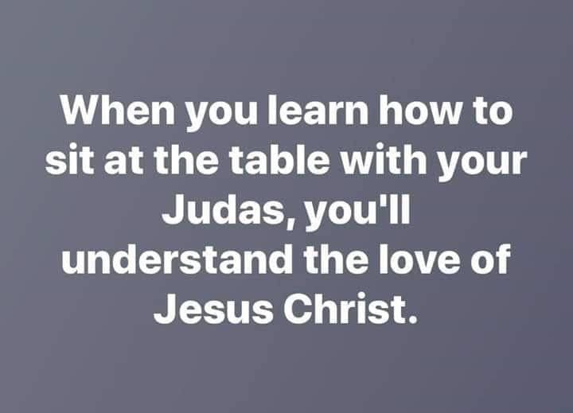
Tolerance—Part of being Worthy
Ephesians 4:1-2—
¹Therefore I, the prisoner of the Lord, implore you to walk in a manner worthy of the calling with which you have been called, ²with all humility and gentleness, with patience, showing tolerance for one another in love, ³being diligent to preserve the unity of the Spirit in the bond of peace. (NASB95)

Slide 16

Colossians 3:12-14
¹²So, as those who have been chosen of God, holy and beloved, put on a heart of compassion, kindness, humility, gentleness and patience;
¹³bearing with one another, and forgiving each other, whoever has a complaint against anyone; just as the Lord forgave you, so also should you.
¹⁴Beyond all these things put on love, which is the perfect bond of unity. (NASB95)

Slide 17

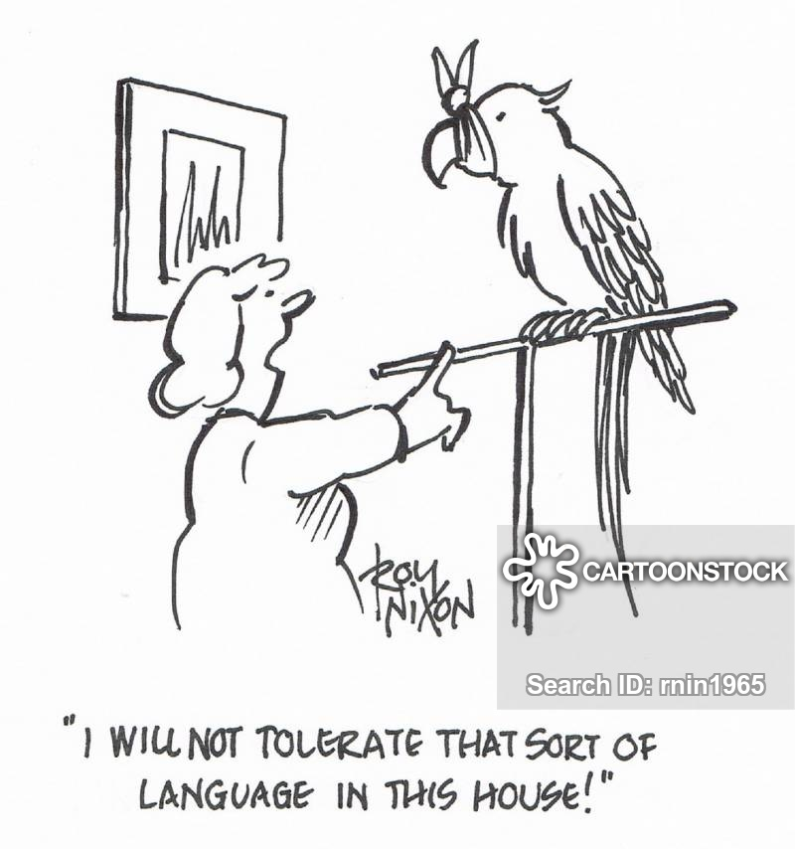
You might be surprised…
In our homes:
Disrespect
Bad language
Messiness
Waste
Moodiness

Slide 18
You might be surprised…
On our screens:
Swearing
Blaspheme
Nudity
Sex scenes
Lies and misinformation

Slide 19
You might be surprised…
In our relationships:
Bad manners
Being taken for granted
Bullying
Selfishness

Slide 20
You might be surprised…
In our churches:
Gossip
Being ignored
Minimum standards
Negativity
Opinionated people
Divisive behaviour
False teaching
Anger

Slide 21
Two Responses…

Slide 22

Two Responses…
Get real, John!
  This stuff is everywhere
  It’s a waste of time trying to fight it
  Let’s just do the best we can and hope for the best
“Live a life worthy of your calling!” (Eph.4:1)
  Learn what the changes are that Jesus expects of you
  Learn how to live in the world without being of it
  This will mean learning what God expects you to tolerate and what you are not to tolerate

Slide 23
Two Responses…
Get real, John!
  This stuff is everywhere
  It’s a waste of time trying to fight it
  Let’s just do the best we can and hope for the best
“Live a life worthy of your calling!” (Eph.4:1)
  Learn what the changes are that Jesus expects of you
  Learn how to live in the world without being of it
  This will mean learning what God expects you to tolerate and what you are not to tolerate

Slide 24
Two Responses…
Get real, John!
  This stuff is everywhere
  It’s a waste of time trying to fight it
  Let’s just do the best we can and hope for the best
“Live a life worthy of your calling!” (Eph.4:1)
  Learn what the changes are that Jesus expects of you
  Learn how to live in the world without being of it
  This will mean learning what God expects you to tolerate and what you are not to tolerate

Slide 25
Two Responses…
Get real, John!
  This stuff is everywhere
  It’s a waste of time trying to fight it
  Let’s just do the best we can and hope that someone can fix this world
“Live a life worthy of your calling!” (Eph.4:1)
  Learn what the changes are that Jesus expects of you
  Learn how to live in the world without being of it
  This will mean learning what God expects you to tolerate and what you are not to tolerate

Slide 26
Two Responses…
Get real, John!
  This stuff is everywhere
  It’s a waste of time trying to fight it
  Let’s just do the best we can and hope that someone can fix this world
“Live a life worthy of your calling!” (Eph.4:1)
  Learn what the changes are that Jesus expects of you
  Learn how to live in the world without being of it
  This will mean learning what God expects you to tolerate and what you are not to tolerate

Slide 27
Two Responses…
Get real, John!
  This stuff is everywhere
  It’s a waste of time trying to fight it
  Let’s just do the best we can and hope that someone can fix this world
“Live a life worthy of your calling!” (Eph.4:1)
  Learn what the changes are that Jesus expects of you
  Learn how to live in the world without being of it
  This will mean learning what God expects you to tolerate and what you are not to tolerate

Slide 28
Two Responses…
Get real, John!
  This stuff is everywhere
  It’s a waste of time trying to fight it
  Let’s just do the best we can and hope that someone can fix this world
“Live a life worthy of your calling!” (Eph.4:1)
  Learn what the changes are that Jesus expects of you
  Learn how to live in the world without being of it
  This will mean learning what God expects you to tolerate and what you are not to tolerate

Slide 29
Two Responses…
Get real, John!
  This stuff is everywhere
  It’s a waste of time trying to fight it
  Let’s just do the best we can and hope that someone can fix this world
“Live a life worthy of your calling!” (Eph.4:1)
  Learn what the changes are that Jesus expects of you
  Learn how to live in the world without being of it
  This will mean learning what God expects you to tolerate and what you are not to tolerate

Slide 30
Looking at the First Response…

Slide 31

Looking at the First Response…
Get real, John!
  This stuff is everywhere
  No, it is not everywhere!
    The
      Hearts,
      Habits
      and Homes
    of Christians have been cleansed by the Holy Spirit for 2000 years

Slide 32
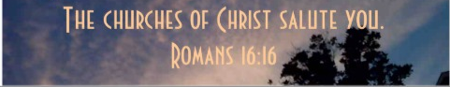
Looking at the First Response…
Get real, John!
  This stuff is everywhere
  No, it is not everywhere!
    The
      Hearts,
      Habits
      and Homes
    of Christians have been cleansed by the Holy Spirit for 2000 years

Slide 33

Looking at the First Response…
Get real, John!
  This stuff is everywhere
  No, it is not everywhere!
  1 Corinthians 6:9-11—⁹Or do you not know that the unrighteous will not inherit the kingdom of God? Do not be deceived; neither fornicators, nor idolaters, nor adulterers, nor effeminate, nor homosexuals, ¹⁰nor thieves, nor the covetous, nor drunkards, nor revilers, nor swindlers, will inherit the kingdom of God. ¹¹Such were some of you; but you were washed, but you were sanctified, but you were justified in the name of the Lord Jesus Christ and in the Spirit of our God. (NASB95)

Slide 34

Looking at the First Response…
Get real, John!
  It’s a waste of time trying to fight it
  No its not!

Slide 35
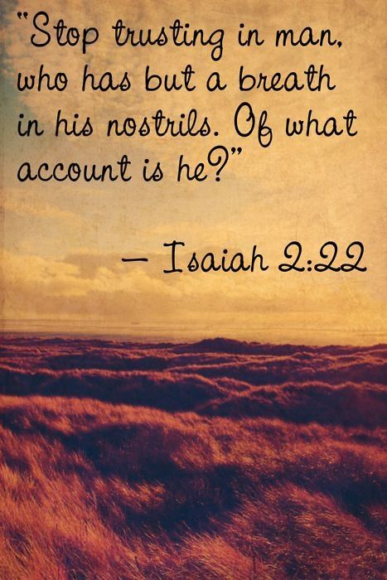
Looking at the First Response…
Get real, John!
  Let’s just do the best we can and hope that someone can fix this world
  No, that is the worst we can do—a hopeless road to nowhere
    Jeremiah 17:5—⁵ Thus says the Lord,
    “Cursed is the man who trusts in mankind
    And makes flesh his strength,
    And whose heart turns away from the Lord. (NASB95)

Slide 36
Looking at the Second Response…

Slide 37
Looking at the Second Response…
“Live a life worthy of your calling!” (Eph.4:1)
  Learn what the changes are that Jesus expects of you

Slide 38
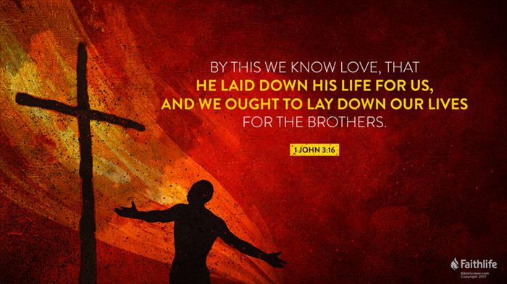
Looking at the Second Response…
“Live a life worthy of your calling!” (Eph.4:1)
  Learn what the changes are that Jesus expects of you
    Mirroring Jesus

Slide 39

Looking at the Second Response…
“Live a life worthy of your calling!” (Eph.4:1)
  Learn what the changes are that Jesus expects of you
    Repentance
Matthew 3:8—Therefore bear fruit in keeping with repentance;

Slide 40

Looking at the Second Response…
“Live a life worthy of your calling!” (Eph.4:1)
  Learn what the changes are that Jesus expects of you
    Washed and Raise to Walk in Newness of Life
Romans 6:4—⁴Therefore we have been buried with Him through baptism into death, so that as Christ was raised from the dead through the glory of the Father, so we too might walk in newness of life. (NASB95)

Slide 41

Looking at the Second Response…
“Live a life worthy of your calling!” (Eph.4:1)
  Learn how to live in the world without being of it
    Your “Heart – Possessions – Life” now belong to God.
Our everyday life is lived for God while still being surrounded by worldliness—we are Salt and Light!
1 John 2:15—¹⁵ Do not love the world nor the things in the world. If anyone loves the world, the love of the Father is not in him. (NASB95)

Slide 42
Looking at the Second Response…
“Live a life worthy of your calling!” (Eph.4:1)
  Learn how to live in the world without being of it
    Your “Heart – Possessions – Life” now belong to God.
Your everyday life is lived for God while still being surrounded by worldliness—we are Salt and Light!
1 John 2:15—¹⁵ Do not love the world nor the things in the world. If anyone loves the world, the love of the Father is not in him. (NASB95)

Slide 43
Looking at the Second Response…
“Live a life worthy of your calling!” (Eph.4:1)
  Learn how to live in the world without being of it
    Your “Heart – Possessions – Life” now belong to God.
Your everyday life is lived for God while still being surrounded by worldliness—we are Salt and Light!
1 John 2:15—¹⁵ Do not love the world nor the things in the world. If anyone loves the world, the love of the Father is not in him. (NASB95)

Slide 44

Looking at the Second Response…
“Live a life worthy of your calling!” (Eph.4:1)
  This will mean learning what God expects you to tolerate and what you are not to tolerate
    (DO NOT) Tolerating evil spreads in a spirit of arrogance
1 Corinthians 5:6—⁶Your boasting is not good. Do you not know that a little leaven leavens the whole lump of dough? (NASB95)

Slide 45
Looking at the Second Response…
“Live a life worthy of your calling!” (Eph.4:1)
  This will mean learning what God expects you to tolerate and what you are not to tolerate
    (DO NOT) Tolerating evil will give false teachers power to destroy the church
Romans 16:17
¹⁷Now I urge you, brethren, note those who cause divisions and offenses, contrary to the doctrine which you learned, and avoid them. (NKJV)

Slide 46
Looking at the Second Response…
“Live a life worthy of your calling!” (Eph.4:1)
  This will mean learning what God expects you to tolerate and what you are not to tolerate
    (DO NOT) Tolerating evil will keep you out of heaven
John 14:6
⁶Jesus said to him,
“I am the way,
the truth,
and the life.
No one comes
to the Father
except through Me.
(NKJV)

Slide 47

Ultimately, it is about spreading the Gospel…
Paul was willing to TOLERATE those who didn’t think much of him as long as it didn’t hinder the spread of the Gospel.

Slide 48

1 Peter 3:21—²¹ Corresponding to that, baptism now saves you—not the removal of dirt from the flesh, but an appeal to God for a good conscience—through the resurrection of Jesus Christ, (NASB95)

