Slide 2
Blinded by the Light

Slide 3
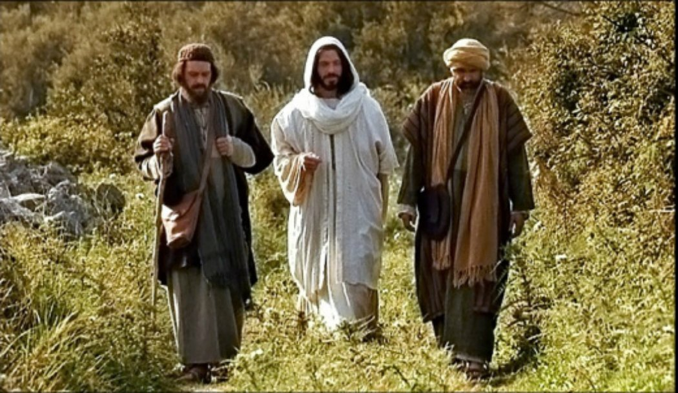
Light withheld
Luke 24:31-32
³¹Then their eyes were opened and they recognized Him; and He vanished from their sight. ³² They said to one another, “Were not our hearts burning within us while He was speaking to us on the road, while He was explaining the Scriptures to us?” (NASB95)
Road to Emmaus

Slide 4
When the light might be a little dim!

Slide 5
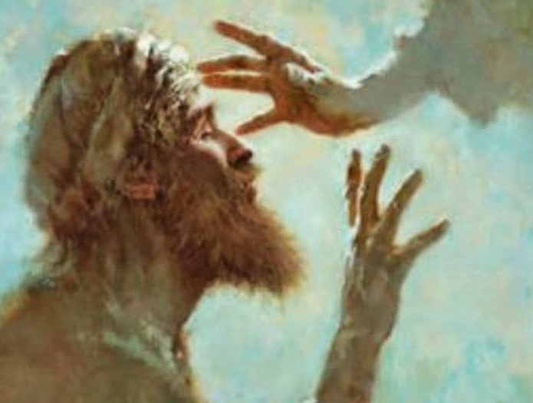
Blind from Birth to bring glory to God
The curse of Blindness
John 9:2—²And His disciples asked Him, “Rabbi, who sinned, this man or his parents, that he would be born blind?” (NASB95)

Slide 6
Blind from Birth to bring glory to God
The curse of Blindness
A blind priest couldn’t serve in the temple
John 9:2—²And His disciples asked Him, “Rabbi, who sinned, this man or his parents, that he would be born blind?” (NASB95)

Slide 7
Blind from Birth to bring glory to God
The curse of Blindness
A blind priest couldn’t serve in the temple
Unless exceptional, a blind person was a liability
John 9:2—²And His disciples asked Him, “Rabbi, who sinned, this man or his parents, that he would be born blind?” (NASB95)

Slide 8
Blind from Birth to bring glory to God
The curse of Blindness
A blind priest couldn’t serve in the temple
Unless exceptional, a blind person was a liability
A drain on family resources
John 9:2—²And His disciples asked Him, “Rabbi, who sinned, this man or his parents, that he would be born blind?” (NASB95)

Slide 9
Blind from Birth to bring glory to God
The curse of Blindness
A blind priest couldn’t serve in the temple
Unless exceptional, a blind person was a liability
A drain on family resources
Someone needed to look after them
John 9:2—²And His disciples asked Him, “Rabbi, who sinned, this man or his parents, that he would be born blind?” (NASB95)

Slide 10
Blind from Birth to bring glory to God
The curse of Blindness
A blind priest couldn’t serve in the temple
Unless exceptional, a blind person was a liability
A drain on family resources
Someone needed to look after them
Destined to beg to stay alive
John 9:2—²And His disciples asked Him, “Rabbi, who sinned, this man or his parents, that he would be born blind?” (NASB95)

Slide 11
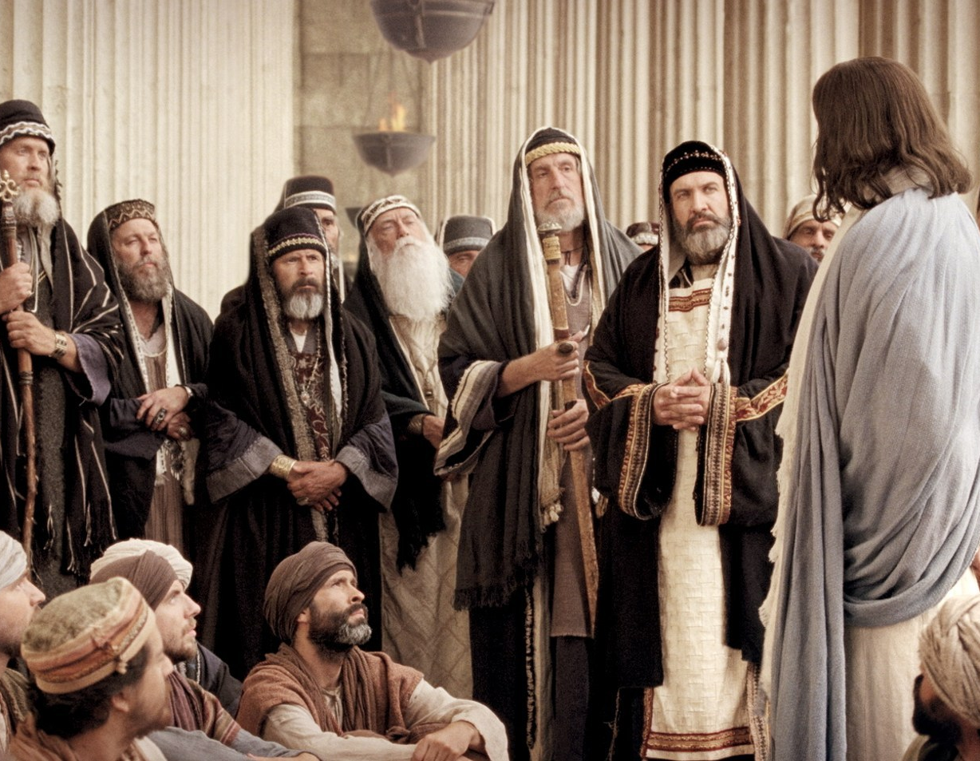
Blind—By Self-righteousness
John 9:39-41
³⁹And Jesus said, “For judgment I came into this world, so that those who do not see may see, and that those who see may become blind.” ⁴⁰Those of the Pharisees who were with Him heard these things and said to Him, “We are not blind too, are we?” ⁴¹Jesus said to them, “If you were blind, you would have no sin; but since you say, ‘We see,’ your sin remains. (NASB95)

Slide 12
Blind—By Self-righteousness
Their spiritual blindness came from a hard heart

Slide 13
Blind—By Self-righteousness
Practicing their traditions made them comfortable

Slide 14
Blind—By Self-righteousness
Experts in judging others

Slide 15
Blind—By Self-righteousness
Authorities for God in every situation

Slide 16
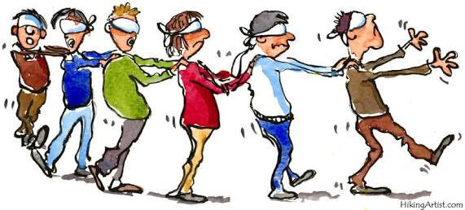
Blind—By Self-righteousness
Jesus called them “Blind guides”
Avoid them
Matthew 15:14—¹⁴Let them alone; they are blind guides of the blind. And if a blind man guides a blind man, both will fall into a pit.” (NASB95)

Slide 17
Blinded—By self-deception
Laodicea—The church that nauseated Jesus
Revelation 3:15-18—¹⁵ ‘I know your deeds, that you are neither cold nor hot; I wish that you were cold or hot. ¹⁶ So because you are lukewarm, and neither hot nor cold, I will spit you out of My mouth. ¹⁷ Because you say, “I am rich, and have become wealthy, and have need of nothing,” and you do not know that you are wretched and miserable and poor and blind and naked, ¹⁸I advise you to buy from Me gold refined by fire so that you may become rich, and white garments so that you may clothe yourself, and that the shame of your nakedness will not be revealed; and eye salve to anoint your eyes so that you may see. (NASB95)

Slide 18
Blinded—By self-deception
Laodicea—The church that nauseated Jesus
Jesus shines the light of reality on this church
I know your deeds—So what?
Lukewarm—sickening
Self-fulfilled—Rich
Self-sufficient—Need nothing
But actually:
“You are wretched and miserable and poor and blind and naked,
Some advice—Wealth, sight and clothing is from God

Slide 19
Blinded—By stunted growth
Diligence
Faith
Moral excellence
Knowledge
Self-control
Perseverance
Godliness
Brotherly kindness
Love
2 Peter 1:9—⁹ For he who lacks these qualities is blind or short-sighted, having forgotten his purification from his former sins. (NASB95)

Slide 20
Blinded—By the Truth
Isaiah was told to go and proclaim truth to them— truth that will result in blinding their eyes. (Isa.6:9)
Hard hearts will not receive the truth
Until we admit blindness, there is no hope to see
John 12:40
⁴⁰“He has blinded their eyes and He hardened their heart, so that they would not see with their eyes and perceive with their heart, and be converted and I heal them.” (NASB95)

Slide 21
Blinded—By Hate
A simple eye test
He wanders—Directionless
He is ignorant
His mind entirely clouded
Love—Paramount in Christianity
Love—A central virtue in religion
Its light shines its influence over every aspect of a man‘s life—but he does not see it!
1 John 2:11—¹¹ But the one who hates his brother is in the darkness and walks in the darkness, and does not know where he is going because the darkness has blinded his eyes. (NASB95)

Slide 22
Blinded—To the Gospel
2 Corinthians 4:4—
⁴in whose case the god of this world has blinded the minds of the unbelieving so that they might not see the light of the gospel of the glory of Christ, who is the image of God. (NASB95)

Slide 23
The Cure
2 Corinthians 4:6—⁶ For God, who said, “Light shall shine out of darkness,” is the One who has shone in our hearts to give the Light of the knowledge of the glory of God in the face of Christ. (NASB95)

Slide 24
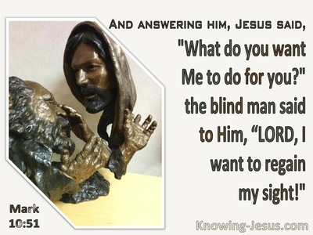
It applies to you, too!
When we lose sight of where we should be spiritually
To see through temptation
To gain Biblical insight
To test the spirits
To question your motives

Slide 25
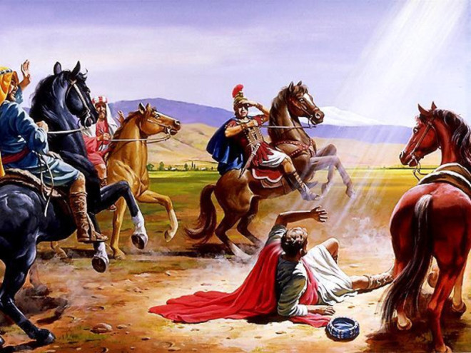
Blinded by the Light
Acts 9 tells of Paul’s conversion
If ever man believed that he was walking in the light it was Paul
God enlightened Paul by blinding him
Only then he was in a fit state to see who Jesus really was—The Light of salvation

Slide 26
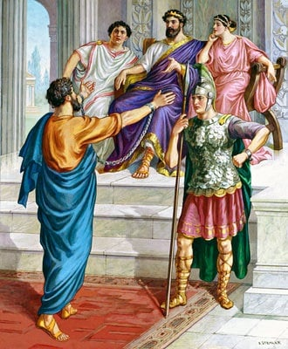
Send the Light
Paul recounting his Damascus Road experience to King Agrippa
Acts 26:17-18— ¹⁷…Gentiles, to whom I am sending you, ¹⁸to open their eyes so that they may turn from darkness to light and from the dominion of Satan to God, that they may receive forgiveness of sins and an inheritance among those who have been sanctified by faith in Me.’ (NASB95)

Slide 27
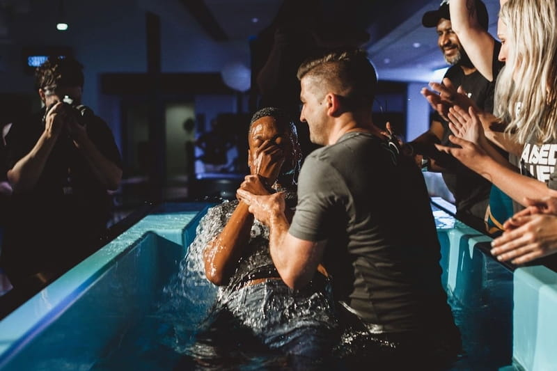
Acts 22:16—¹⁶Now why do you delay? Get up and be baptized, and wash away your sins, calling on His name.’ (NASB95)

