Slide 2
“Godly Sorrow.”

Slide 3
Everyone’s a sinner, brother, that’s the truth!

Slide 4

Everyone’s a sinner, brother, that’s the truth!
No room in the church for the “Holier than thou.”

Slide 5
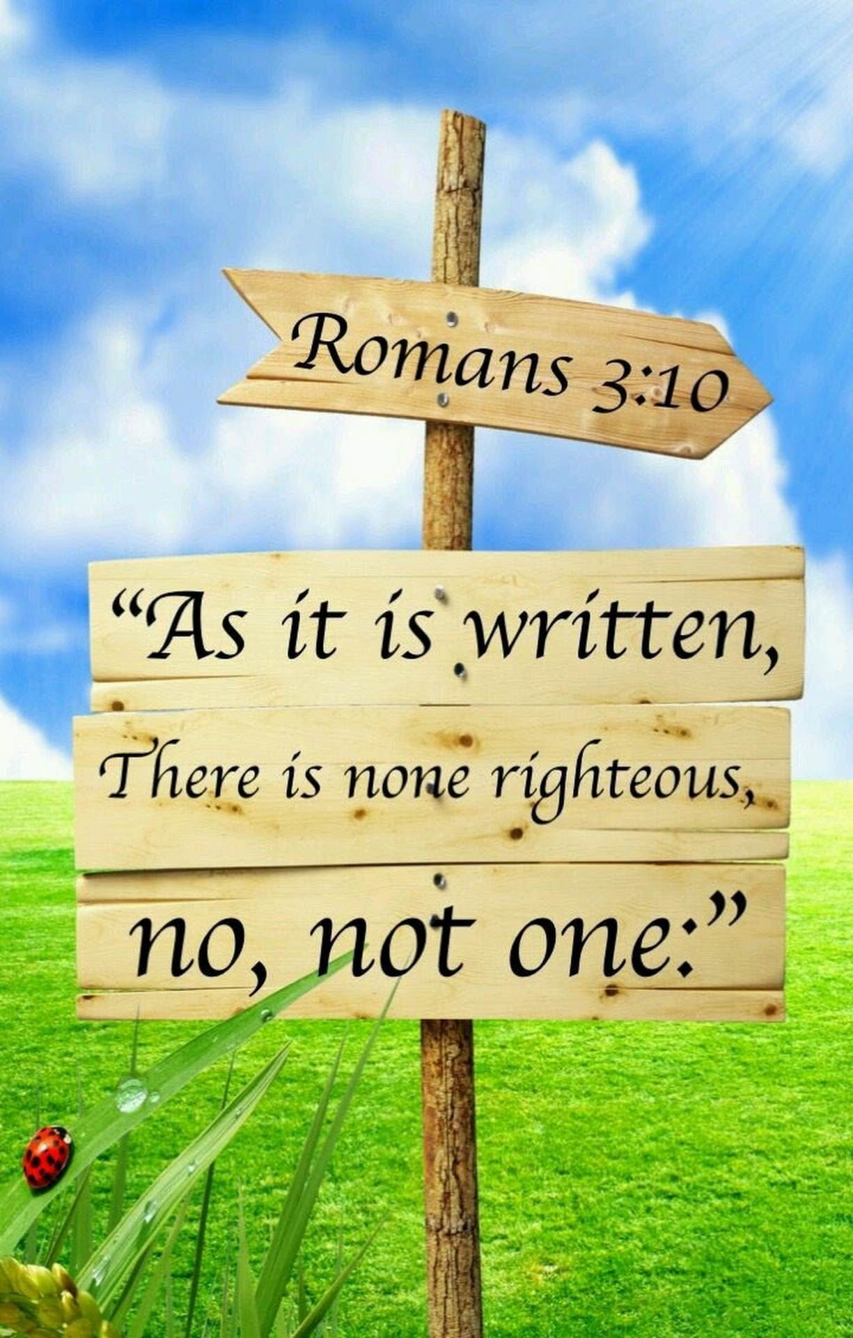
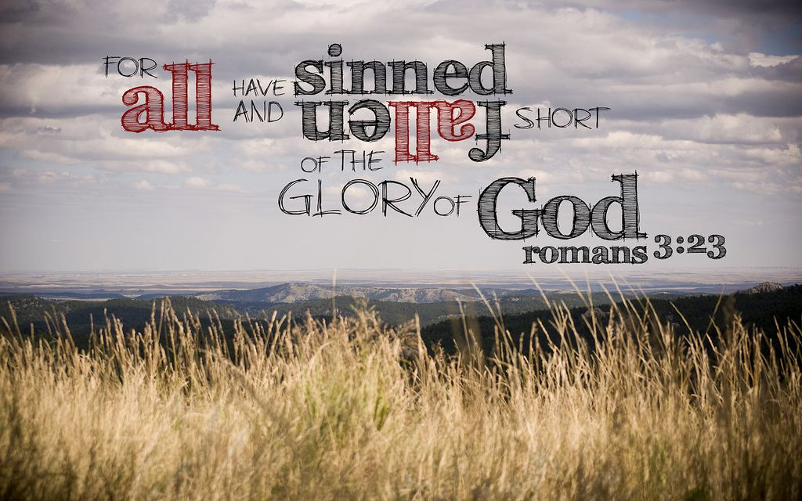
Everyone’s a sinner, brother, that’s the truth!
No room in the church for the “Holier than thou.”
  Go-to verses for a reality check
    Romans 3:10, 23

Slide 6
It’s all in the way you fall, next.

Slide 7
It’s all in the way you fall, next.
Headlong into sin and blame

Slide 8
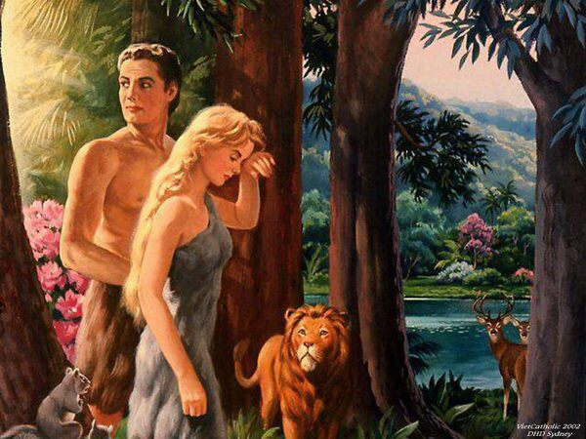
It’s all in the way you fall, next.
Headlong into sin and blame
  Adam and Eve chose to sin
    Adam blamed Eve and Eve blamed the devil
    Removed from the presence of God

Slide 9
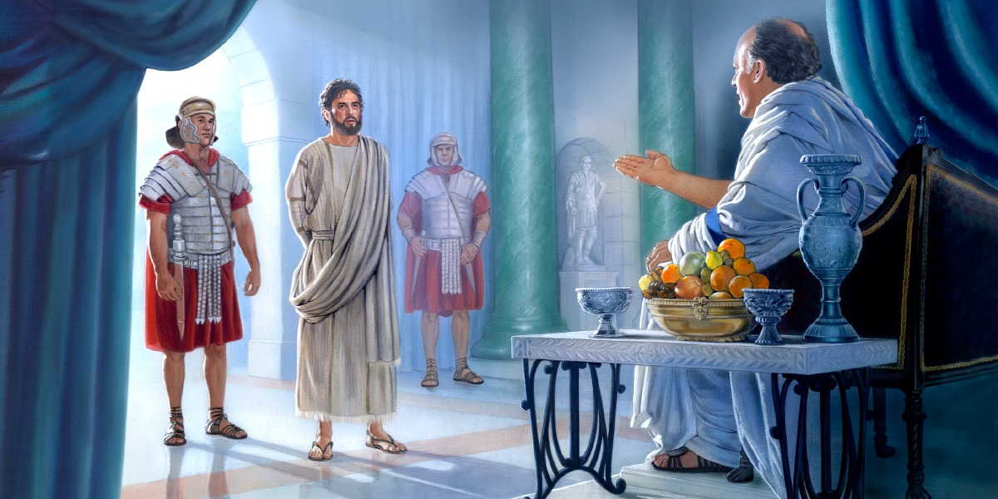
It’s all in the way you fall, next.
Headlong into sin and blame
  Herold dismissed Jesus – truth himself – with ‘What is truth?’

Slide 10
It’s all in the way you fall, next.
Or down on your knees

Slide 11
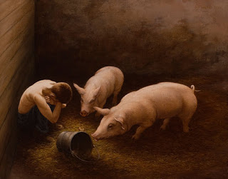
It’s all in the way you fall, next.
Or down on your knees
  The prodigal son came to his sense, went home and repented.
    Luke 15:17-18—¹⁷But when he came to his senses, he said, ‘How many of my father’s hired men have more than enough bread, but I am dying here with hunger! ¹⁸I will get up and go to my father, and will say to him, “Father, I have sinned against heaven, and in your sight; (NASB95)

Slide 12
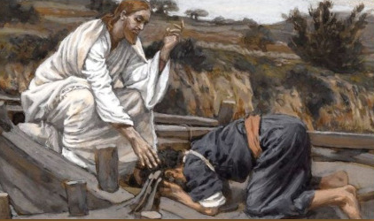
It’s all in the way you fall, next.
Or down on your knees
  Peter, when realizing Jesus’ miracle was proof of who he was – God in the flesh – fell to his knees
    Luke 5:8—⁸When Simon Peter saw it, he fell down at Jesus' knees, saying, Depart from me; for I am a sinful man, O Lord. (KJV)

Slide 13
God is patient for a reason.

Slide 14

God is patient for a reason.
He doesn’t want anyone to die
  But, the wages of sin have always been death
    Ezekiel 18:32—³²For I have no pleasure in the death of anyone who dies,” declares the Lord God. “Therefore, repent and live.” (NASB95)
    Don’t confuse
    Patience
    And
    Tolerance!

Slide 15
God is patient for a reason.
He doesn’t want anyone to die
  Spiritual life is the goal
    Romans 6:23—²³For the wages of sin is death, but the free gift of God is eternal life in Christ Jesus our Lord. (NASB95)

Slide 16
Repentance means more than just saying your sorry

Slide 17
Repentance means more than just saying your sorry
Change is in plain view

Slide 18
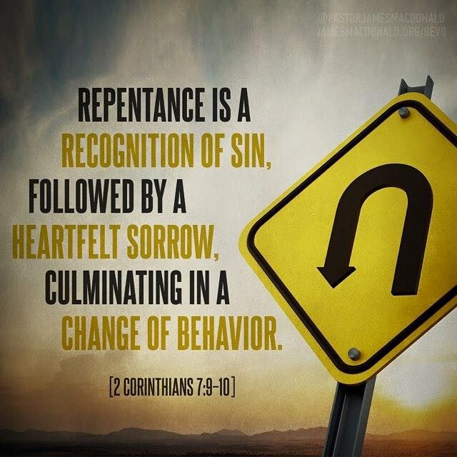
Repentance means more than just saying your sorry
Change is in plain view
  Godly sorrow is the domain of life
    2 Corinthians 7:10—For the sorrow that is according to the will of God produces a repentance without regret, leading to salvation, but the sorrow of the world produces death. (NASB95)

Slide 19
Now is a very good time.

Slide 20
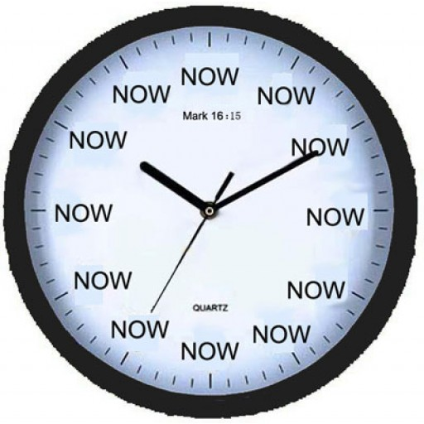
Now is a very good time.
Today
  Salvation in not a ‘Tomorrow’ word
    2 Corinthians 6:2—for He says, “At the acceptable time I listened to you, And on the day of salvation I helped you.” Behold, now is “the acceptable time,” behold, now is “the day of salvation”— (NASB95)

Slide 21
What must I do to be saved?

Slide 22
What must I do to be saved?
The Bible message hasn’t changed in 2000 years

Slide 23
What must I do to be saved?
The Bible message hasn’t changed in 2000 years
  Faith in Christ causes us to see our sin as separating us from God
  Seeking reconciliation causes us to repent
  Repentance is acknowledgement that Christ is Saviour
  We meet our Saviour, Jesus Christ, in baptism - Christ washes our sins away.
  We rise to walk in newness of life.
  Thus,…

Slide 24
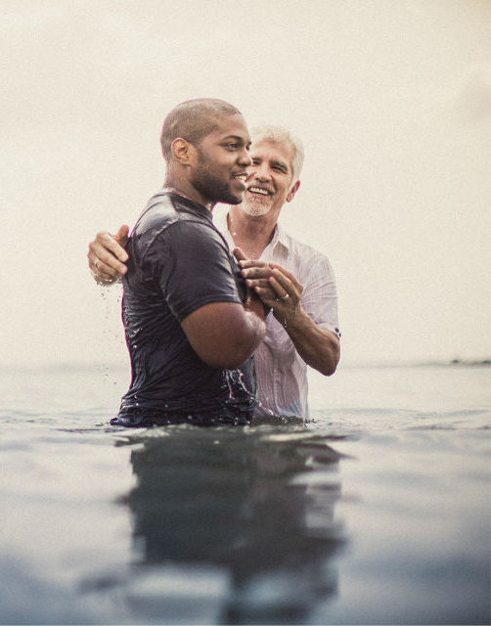
What must I do to be saved?
The Bible message hasn’t changed in 2000 years
  Thus,…
  Acts 2:37-38—³⁷Now when they heard this, they were pierced to the heart, and said to Peter and the rest of the apostles, “Brethren, what shall we do?” ³⁸ Peter said to them, “Repent, and each of you be baptized in the name of Jesus Christ for the forgiveness of your sins; and you will receive the gift of the Holy Spirit. (NASB95)

