Slide 2
“Greet
one
another.”

Slide 3
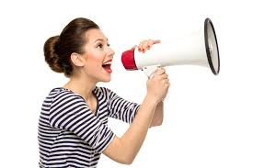
Some people are naturals…

Slide 4

But others…
Would rather run a mile in the opposite direction than to greet someone.

Slide 5
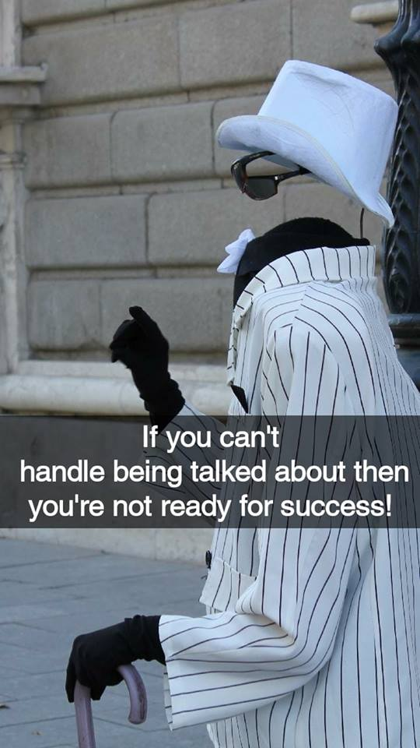
This is something for us to avoid at all cost.
That cost is the cost of change.
Change is our ability to deal with others outside of our comfort zone.
You treat me
like I’m invisible

Slide 6
This is something for us to avoid at all cost.
That cost is the cost of change.
Change is our ability to deal with others outside of our comfort zone.
You treat me
like I’m invisible

Slide 7
This is something for us to avoid at all cost.
That cost is the cost of change.
Change is our ability to deal with others outside of our comfort zone.
You treat me
like I’m invisible

Slide 8
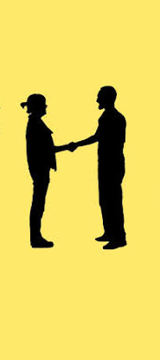
Start with the basics

Slide 9
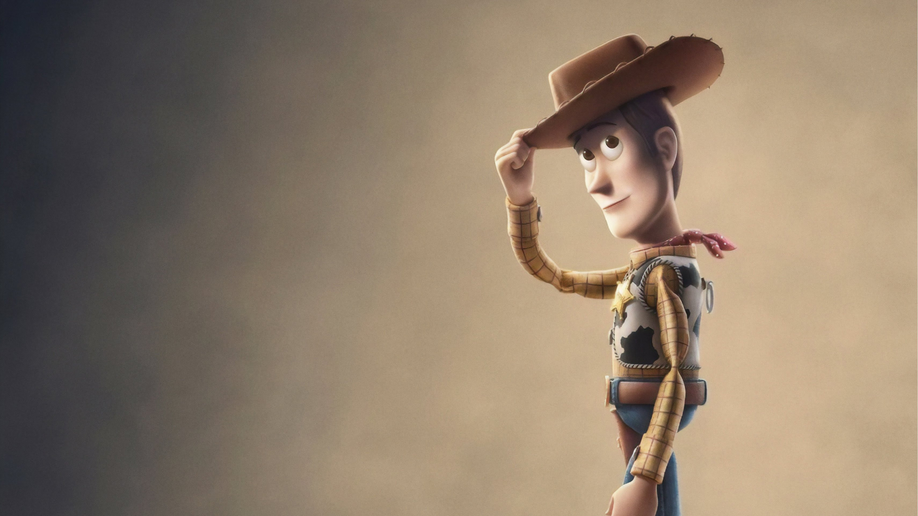
A nod is as good as a smile

Slide 10
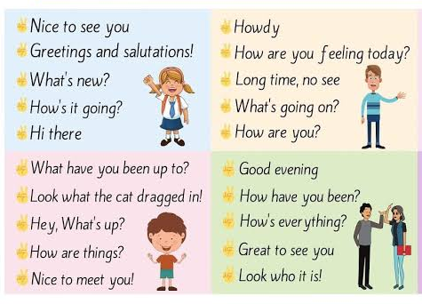
Simple greetings abound

Slide 11
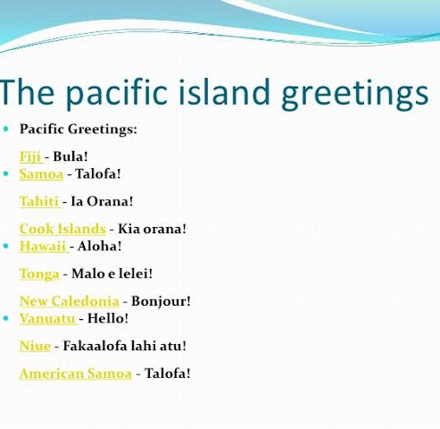
Simple greetings abound

Slide 12
Biblical Greetings
Romans 16:16—Greet one another with a holy kiss. All the churches of Christ greet you.

Slide 13
Biblical Greetings
3 John 1:15—Peace be to you. The friends greet you. Greet the friends by name.

Slide 14
Biblical Greetings
2 John 1:13—The children of your chosen sister greet you.

Slide 15
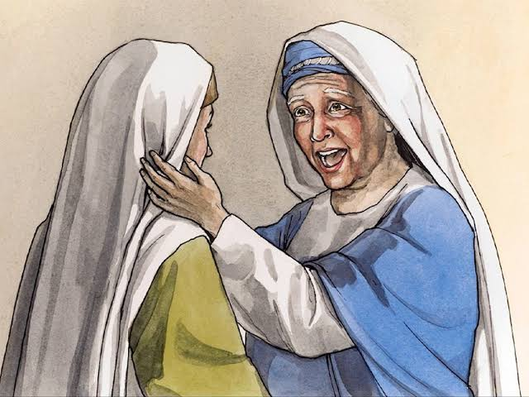
John the Baptist
Luke 1:41—
When Elizabeth heard Mary’s greeting, the baby leaped in her womb; and Elizabeth was filled with the Holy Spirit.
(NASB95)

Slide 16
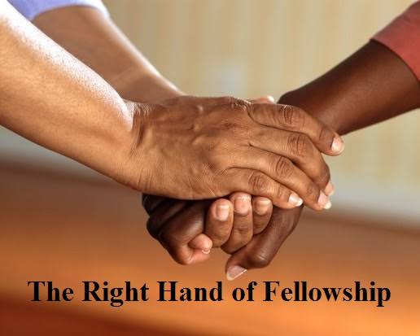
Paul’s first meeting
Galatians 2:9—
⁹ and recognizing the grace that had been given to me, James and Cephas and John, who were reputed to be pillars, gave to me and Barnabas the right hand of fellowship, so that we might go to the Gentiles and they to the circumcised. (NASB95)

Slide 17
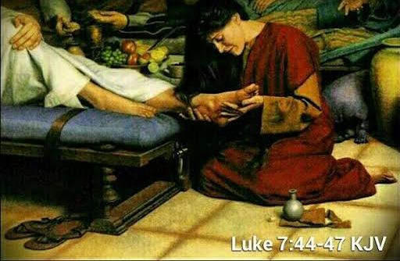
A ‘Sinners’ Greeting
Luke 7:45—You gave Me no kiss; but she, since the time I came in, has not ceased to kiss My feet. (NASB95)

Slide 18
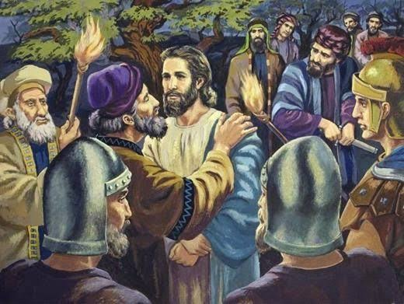
The Judas Kiss
A Greeting unto Death
Mark 14:43-46— ⁴³Immediately while He was still speaking, Judas, one of the twelve, *came up accompanied by a crowd with swords and clubs, who were from the chief priests and the scribes and the elders. ⁴⁴ Now he who was betraying Him had given them a signal, saying, “Whomever I kiss, He is the one; seize Him and lead Him away under guard.” ⁴⁵After coming, Judas immediately went to Him, saying, “Rabbi!” and kissed Him. ⁴⁶They laid hands on Him and seized Him. (NASB95)

Slide 19
The Judas Kiss
A Greeting unto Death
A respectful greeting became the kiss of death.
Jesus knew what was coming
Luke 22:48—But Jesus said to him, “Judas, are you betraying the Son of Man with a kiss?”

Slide 20

Takes Time
A greeting is an invitation to a life-long relationship.
Between you, him/her and Jesus
We are ambassadors for Jesus

Slide 21
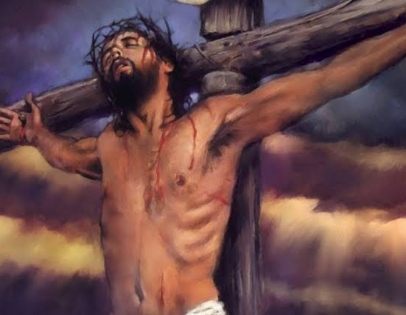
Greet NOT!
2 John 10-11—
¹⁰If anyone comes to you and does not bring this teaching, do not receive him into your house, and do not give him a greeting; ¹¹for the one who gives him a greeting participates in his evil deeds. (NASB95)

Slide 22
Greet NOT!
What teaching?
2 John 7—
⁷ For many deceivers have gone out into the world, those who do not acknowledge Jesus Christ as coming in the flesh. This is the deceiver and the antichrist.
(NASB95)

Slide 23
Greet NOT!
This false teaching was not to be entertained from the start.
“The Right Hand of Fellowship” was NOT to be extended.
All spiritual progress would be stopped if their teaching was accepted.
1 Peter 2:24—and He Himself bore our sins in His body on the cross,…

Slide 24
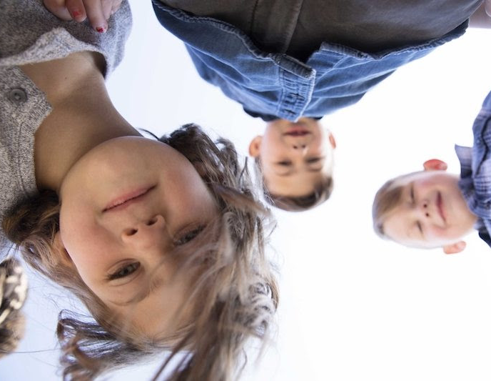
Share the Joy!
Luke 18:15-17—
And they were bringing even their babies to Him so that He would touch them, but when the disciples saw it, they began rebuking them. But Jesus called for them, saying, “Permit the children to come to Me, and do not hinder them, for the kingdom of God belongs to such as these. Truly I say to you, whoever does not receive the kingdom of God like a child will not enter it at all.” (NASB95)

Slide 25
Share the Joy
A welcoming spirit is the best start

Slide 26
Share the Joy
Learn from the experts

Slide 27
Share the Joy
It is the first step in a process of Discipleship, Salvation and Fellowship.

Slide 28
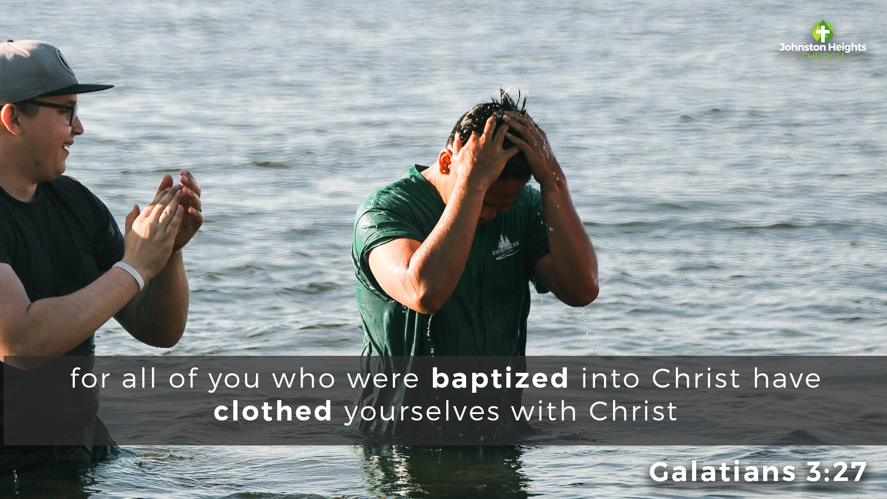
Luke 15:10—In the same way, I tell you, there is joy in the presence of the angels of God over one sinner who repents.”

