Slide 2
“Having your Doubts?”

Slide 3



Satan will do all he can to bring thoughts of doubt to mind
How many people do you know who have walked away from Jesus stating that they have doubts about…?
  Jesus’ claim to deity
  Reliability of the Bible
  The uniqueness of the church
  If their faith is real
  If they can endure

Slide 4

We walk by faith, not by sight (2Cor.5:7)
……………………………………………………………….…….

Slide 5
Doubts—We can relate:
Matthew 14:22-33—²²Immediately He made the disciples get into the boat and go ahead of Him to the other side, while He sent the crowds away. ²³ After He had sent the crowds away, He went up on the mountain by Himself to pray; and when it was evening, He was there alone. ²⁴ But the boat was already a long distance from the land, battered by the waves; for the wind was contrary. ²⁵And in the fourth watch of the night He came to them, walking on the sea. ²⁶When the disciples saw Him walking on the sea, they were terrified, and said, “It is a ghost!” And they cried out in fear. ²⁷ But immediately Jesus spoke to them, saying, “Take courage, it is I; do not be afraid.”
²⁸Peter said to Him, “Lord, if it is You, command me to come to You on the water.” ²⁹And He said, “Come!” And Peter got out of the boat, and walked on the water and came toward Jesus. ³⁰But seeing the wind, he became frightened, and beginning to sink, he cried out, “Lord, save me!” ³¹Immediately Jesus stretched out His hand and took hold of him, and *said to him, “You of little faith, why did you doubt?” ³²When they got into the boat, the wind stopped. ³³ And those who were in the boat worshiped Him, saying, “You are certainly God’s Son!” (NASB95)

Slide 6
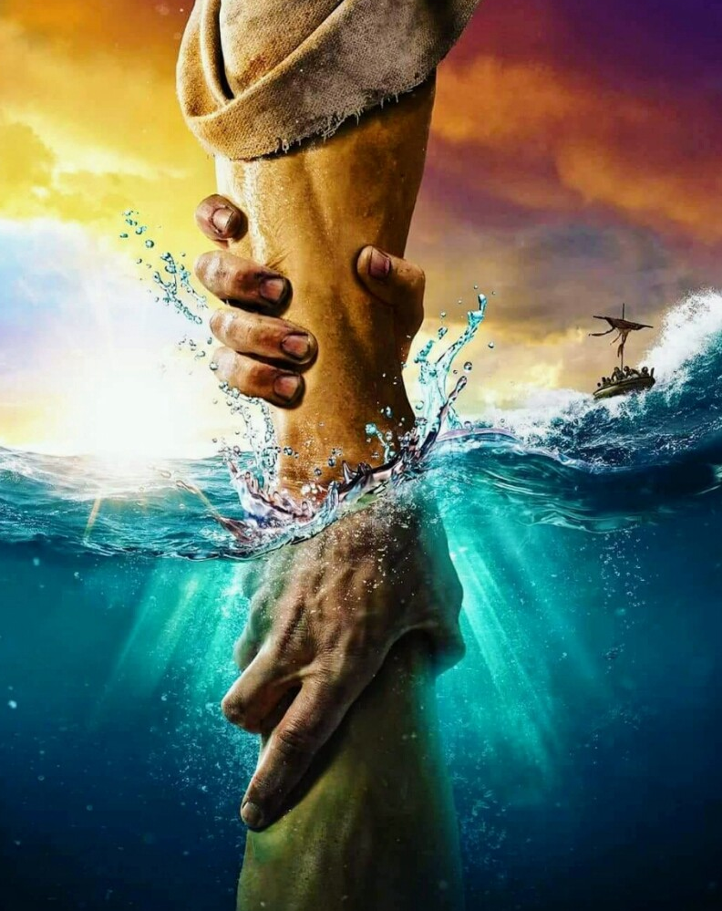
Doubts—We can relate:
Matthew 14:31—³¹Immediately Jesus stretched out His hand and took hold of him, and *said to him, “You of little faith, why did you doubt?” (NASB95)
A rhetorical question, but…
  All of us would be able to say why.
  We excuse doubt as being a natural part of being human
    Everyone knows waves are dangerous
    Who wouldn’t be afraid and lose focus
    If I had seen a few others walk on water further than I did, then maybe I could be called out for lacking faith
  Jesus calls us to the evidence right before us
  H

Slide 7
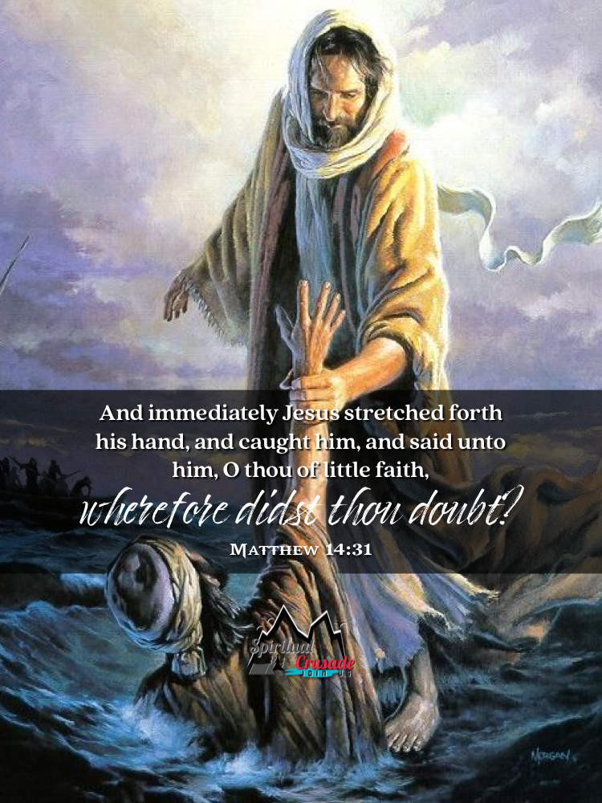
Doubts—We can relate:
Matthew 14:31—³¹Immediately Jesus stretched out His hand and took hold of him, and *said to him, “You of little faith, why did you doubt?” (NASB95)
A rhetorical question, but…
  All of us would be able to say why.
  We excuse doubt as being a natural part of being human
    Everyone knows waves are dangerous
    Who wouldn’t be afraid and lose focus
    If I had seen a few others walk on water further than I did, then maybe I could be called out for lacking faith
  Jesus calls us to the evidence right before us
  H

Slide 8
Doubts—We can relate:
Matthew 14:31—³¹Immediately Jesus stretched out His hand and took hold of him, and *said to him, “You of little faith, why did you doubt?” (NASB95)
A rhetorical question, but…
  All of us would be able to say why.
  We excuse doubt as being a natural part of being human
    Everyone knows waves are dangerous
    Who wouldn’t be afraid and lose focus
    If I had seen a few others walk on water further than I did, then maybe I could be called out for lacking faith
  Jesus calls us to the evidence right before us
  H

Slide 9
Doubts—We can relate:
Matthew 14:31—³¹Immediately Jesus stretched out His hand and took hold of him, and *said to him, “You of little faith, why did you doubt?” (NASB95)
A rhetorical question, but…
  All of us would be able to say why.
  We excuse doubt as being a natural part of being human
    Everyone knows waves are dangerous
    Who wouldn’t be afraid and lose focus
    If I had seen a few others walk on water further than I did, then maybe I could be called out for lacking faith
  Jesus calls us to the evidence right before us
  H

Slide 10
Doubts—We can relate:
Matthew 14:31—³¹Immediately Jesus stretched out His hand and took hold of him, and *said to him, “You of little faith, why did you doubt?” (NASB95)
A rhetorical question, but…
  All of us would be able to say why.
  We excuse doubt as being a natural part of being human
    Everyone knows waves are dangerous
    Who wouldn’t be afraid and lose focus
    If I had seen a few others walk on water further than I did, then maybe I could be called out for lacking faith
  Jesus calls us to the evidence right before us
  H

Slide 11
Doubts—We can relate:
Matthew 14:31—³¹Immediately Jesus stretched out His hand and took hold of him, and *said to him, “You of little faith, why did you doubt?” (NASB95)
A rhetorical question, but…
  All of us would be able to say why.
  We excuse doubt as being a natural part of being human
    Everyone knows waves are dangerous
    Who wouldn’t be afraid and lose focus?
    If I had seen a few others walk on water further than I did, then maybe I could be called out for lacking faith
  Jesus calls us to the evidence right before us
  H

Slide 12
Doubts—We can relate:
Matthew 14:31—³¹Immediately Jesus stretched out His hand and took hold of him, and *said to him, “You of little faith, why did you doubt?” (NASB95)
A rhetorical question, but…
  All of us would be able to say why.
  We excuse doubt as being a natural part of being human
    Everyone knows waves are dangerous
    Who wouldn’t be afraid and lose focus?
    If I had seen a few others walk on water further than I did, then maybe I could be called out for lacking faith
  Jesus calls us to the evidence right before us
  H

Slide 13
Doubts—We can relate:
Matthew 14:31—³¹Immediately Jesus stretched out His hand and took hold of him, and *said to him, “You of little faith, why did you doubt?” (NASB95)
A rhetorical question, but…
  All of us would be able to say why.
  We excuse doubt as being a natural part of being human
    Everyone knows waves are dangerous
    Who wouldn’t be afraid and lose focus?
    If I had seen a few others walk on water further than I did, then maybe I could be called out for lacking faith
  Jesus calls us to the evidence right before us
  .

Slide 14
Doubts—We can relate:
Matthew 14:31—³¹Immediately Jesus stretched out His hand and took hold of him, and *said to him, “You of little faith, why did you doubt?” (NASB95)
A rhetorical question, but…
  All of us would be able to say why.
  We excuse doubt as being a natural part of being human
    Everyone knows waves are dangerous
    Who wouldn’t be afraid and lose focus?
    If I had seen a few others walk on water further than I did, then maybe I could be called out for lacking faith
  Jesus calls us to the evidence right before us
  .
The Life and Work of Jesus—The Bible’s impact—Your transformed heart and life—The Church—Providence through prayer—Creation’s wonders

Slide 15
Doubts—A call for a Fearfully Cautious Compassionate Approach:
Jude 22-23—²²And have mercy on some, who are doubting; ²³ save others, snatching them out of the fire; and on some have mercy with fear, hating even the garment polluted by the flesh. (NASB95)
There is doubts and there are doubts!
  The under-developed faith:
  1 Thessalonians 5:14—¹⁴We urge you, brethren, admonish the unruly, encourage the fainthearted, help the weak, be patient with everyone. (NASB95)

Slide 16
Doubts—A call for a Fearfully Cautious Compassionate Approach:
Jude 22-23—²²And have mercy on some, who are doubting; ²³ save others, snatching them out of the fire; and on some have mercy with fear, hating even the garment polluted by the flesh. (NASB95)
There are doubts and there are doubts!
  The under-developed faith:
  1 Thessalonians 5:14—¹⁴We urge you, brethren, admonish the unruly, encourage the fainthearted, help the weak, be patient with everyone. (NASB95)

Slide 17
Doubts—A call for a Fearfully Cautious Compassionate Approach:
Jude 22-23—²²And have mercy on some, who are doubting; ²³ save others, snatching them out of the fire; and on some have mercy with fear, hating even the garment polluted by the flesh. (NASB95)
There are doubts and there are doubts!
  The under-developed faith:
  1 Thessalonians 5:14—¹⁴We urge you, brethren, admonish the unruly, encourage the fainthearted, help the weak, be patient with everyone. (NASB95)

Slide 18
Doubts—A call for a Fearfully Cautious Compassionate Approach:
Jude 22-23—²²And have mercy on some, who are doubting; ²³ save others, snatching them out of the fire; and on some have mercy with fear, hating even the garment polluted by the flesh. (NASB95)
There are doubts and there are doubts!
  The under-developed faith:
  1 Thessalonians 5:14—¹⁴We urge you, brethren, admonish the unruly, encourage the fainthearted, help the weak, be patient with everyone. (NASB95)

Slide 19
Doubts—A call for a Fearfully Cautious Compassionate Approach:
Jude 22-23—²²And have mercy on some, who are doubting; ²³ save others, snatching them out of the fire; and on some have mercy with fear, hating even the garment polluted by the flesh. (NASB95)
There are doubts and there are doubts!
  The polluted faith:
  Galatians 6:1—¹Brethren, even if anyone is caught in any trespass, you who are spiritual, restore such a one in a spirit of gentleness; each one looking to yourself, so that you too will not be tempted. (NASB95)

Slide 20
Doubts—A call for a Fearfully Cautious Compassionate Approach:
Jude 22-23—²²And have mercy on some, who are doubting; ²³ save others, snatching them out of the fire; and on some have mercy with fear, hating even the garment polluted by the flesh. (NASB95)
There are doubts and there are doubts!
  The polluted faith:
  Galatians 6:1—¹Brethren, even if anyone is caught in any trespass, you who are spiritual, restore such a one in a spirit of gentleness; each one looking to yourself, so that you too will not be tempted. (NASB95)

Slide 21
Doubt—Not an Ideal State of Being:
James 1:5-6—⁵But if any of you lacks wisdom, let him ask of God, who gives to all generously and without reproach, and it will be given to him. ⁶But he must ask in faith without any doubting, for the one who doubts is like the surf of the sea, driven and tossed by the wind. ⁷ For that man ought not to expect that he will receive anything from the Lord, ⁸being a double-minded man, unstable in all his ways. (NASB95)
The Door To Godly Wisdom Locked and Bolted:
  Daily trials are steppingstones to spiritual maturity.

Slide 22
Doubt—Not an Ideal State of Being:
James 1:5-6—⁵But if any of you lacks wisdom, let him ask of God, who gives to all generously and without reproach, and it will be given to him. ⁶But he must ask in faith without any doubting, for the one who doubts is like the surf of the sea, driven and tossed by the wind. ⁷ For that man ought not to expect that he will receive anything from the Lord, ⁸being a double-minded man, unstable in all his ways. (NASB95)
The Door To Godly Wisdom Locked and Bolted:
  Trails and temptations must be endured.

Slide 23
Doubt—Not an Ideal State of Being:
James 1:5-6—⁵But if any of you lacks wisdom, let him ask of God, who gives to all generously and without reproach, and it will be given to him. ⁶But he must ask in faith without any doubting, for the one who doubts is like the surf of the sea, driven and tossed by the wind. ⁷ For that man ought not to expect that he will receive anything from the Lord, ⁸being a double-minded man, unstable in all his ways. (NASB95)
The Door To Godly Wisdom Locked and Bolted:
  When we lack the faith to negotiate trials and temptations we must cry to God for wisdom.

Slide 24
Doubt—Not an Ideal State of Being:
James 1:5-6—⁵But if any of you lacks wisdom, let him ask of God, who gives to all generously and without reproach, and it will be given to him. ⁶But he must ask in faith without any doubting, for the one who doubts is like the surf of the sea, driven and tossed by the wind. ⁷ For that man ought not to expect that he will receive anything from the Lord, ⁸being a double-minded man, unstable in all his ways. (NASB95)
The Door To Godly Wisdom Locked and Bolted:
  Godly wisdom is ‘on-tap,’ for the Christian.
    God doesn’t look for reasons not to give it
    Except…!

Slide 25
Doubt—Not an Ideal State of Being:
James 1:5-6—⁵But if any of you lacks wisdom, let him ask of God, who gives to all generously and without reproach, and it will be given to him. ⁶But he must ask in faith without any doubting, for the one who doubts is like the surf of the sea, driven and tossed by the wind. ⁷ For that man ought not to expect that he will receive anything from the Lord, ⁸being a double-minded man, unstable in all his ways. (NASB95)
The Door To Godly Wisdom Locked and Bolted:
  DOUBT—The no go zone!
    Doubters are all over the place—Controlled by external forces—Can’t get his head straight—No solid foundation

Slide 26
Doubt—Not an Ideal State of Being:
James 1:5-6—⁵But if any of you lacks wisdom, let him ask of God, who gives to all generously and without reproach, and it will be given to him. ⁶But he must ask in faith without any doubting, for the one who doubts is like the surf of the sea, driven and tossed by the wind. ⁷ For that man ought not to expect that he will receive anything from the Lord, ⁸being a double-minded man, unstable in all his ways. (NASB95)
The Door To Godly Wisdom Locked and Bolted:
  DOUBT—Brings forth nothing from the hand of God
    God would be throwing his resources to the wind.

