Slide 2
The
Sword
that brings Peace

Slide 4
Things that make you go, “Hmmm!”
Not everything in the Bible is going to sound—
Easy
Pleasant
Pleasing
Some things are ‘Hard to understand,’ as Peter puts it (2Pet.3:16).

Slide 5
This is one of those “Hard sayings.”
Matthew 10:34-36
³⁴“Do not think that I came to bring peace on the earth; I did not come to bring peace, but a sword. ³⁵For I came to set a man against his father, and a daughter against her mother, and a daughter-in-law against her mother-in-law; ³⁶and a man’s enemies will be the members of his household.
(NASB95)

Slide 6
Barrier to the gospel?

Slide 7
Barrier to the gospel?
Many would see this passage as a hinderance to the gospel

Slide 8
Barrier to the gospel?
Many would see this passage as a hinderance to the gospel
They say:
“Surely, these can’t be the words of Jesus!”

Slide 9
Barrier to the gospel?
Many would see this passage as a hinderance to the gospel
They say:
“Surely, these can’t be the words of Jesus!”
“How can a God of love talk about swords and peace in the same breath?”

Slide 10
Barrier to the gospel?
Many would see this passage as a hinderance to the gospel
They say:
“Surely, these can’t be the words of Jesus!”
“How can a God of love talk about swords and peace in the same breath?”
Isn’t Jesus the ‘Prince of Peace’?

Slide 11
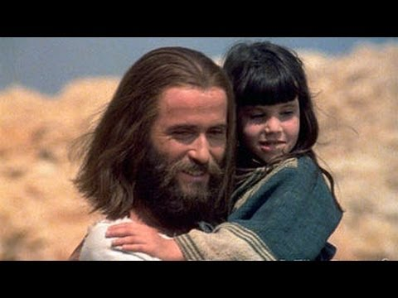
Jesus is indeed the Prince of Peace
1. Christians will be blessed and called sons of God because they are a peacemakers (Mt.5:9).

Slide 12
Jesus is indeed the Prince of Peace
2. Jesus calls all believers to “be at peace with one another”(Mk.9:50).

Slide 13
Jesus is indeed the Prince of Peace
3. The life of a Christian bears the fruit of peace when they walk by the Spirit (Galatians 5:22)

Slide 14
Jesus is indeed the Prince of Peace
4. The Christian man can’t be an elder in the church without being known as a peacemaker (1Tim.3:3).

Slide 15
Jesus is indeed the Prince of Peace
5. Witnessed in prophesy (1)
Isaiah 9:6-7a—⁶For a child will be born to us, a son will be given to us; And the government will rest on His shoulders; And His name will be called Wonderful Counsellor, Mighty God, Eternal Father, Prince of Peace. ⁷There will be no end to the increase of His government or of peace, (NASB95)

Slide 16
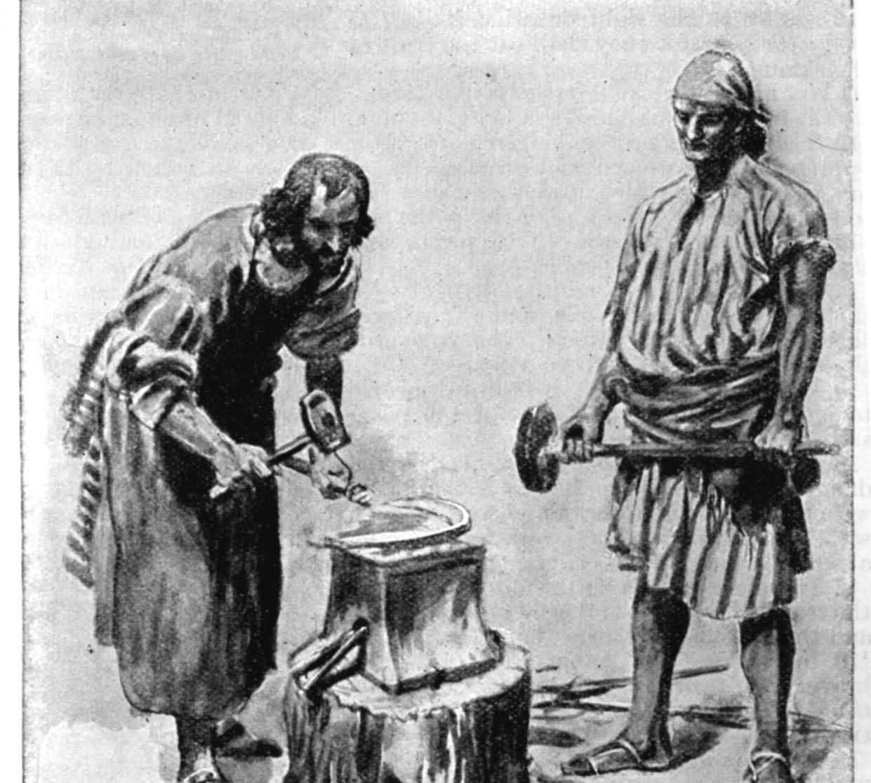
Jesus is indeed the Prince of Peace
6. Witnessed in prophesy (2)
Isaiah 2:4—⁴ And He will judge between the nations, And will render decisions for many peoples; And they will hammer their swords into plowshares and their spears into pruning hooks. Nation will not lift up sword against nation, And never again will they learn war. (NASB95)

Slide 17
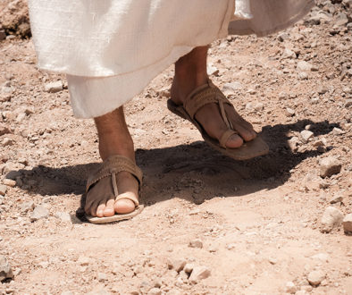
Jesus is indeed the Prince of Peace
7. Everyday battle armour for the mission of the Christian
Ephesians 6:14-15
¹⁴Stand firm therefore, having girded your loins with truth, and having put on the breastplate of righteousness, ¹⁵and having shod your feet with the preparation of the gospel of peace; (NASB95)

Slide 18
Jesus is indeed the Prince of Peace
8. Jesus’ peace is a choice that can be rejected, but the consequences of doing so, are unavoidable.
Luke 19:41-42—⁴¹When He approached Jerusalem, He saw the city and wept over it, ⁴²saying, “If you had known in this day, even you, the things which make for peace! But now they have been hidden from your eyes. (NASB95)

Slide 19
The War of the Worlds
Spiritual warfare
1. Jesus’ coming to earth was a mission of peace in a Spiritual Battle Zone!

Slide 20
The War of the Worlds
Spiritual warfare
2. He did not come to establish peace between:
Light and darkness
God and the devil

Slide 21
The War of the Worlds
Spiritual warfare
3. He came to reconcile those lost in darkness
Out of evil
Into Christ

Slide 22
The War of the Worlds
Spiritual warfare
4. Satan doesn’t like to lose members
He has his own kingdom
He is at war with God to keep the souls of man
Thus, Jesus’ shocking statements…

Slide 23
The War of the Worlds
Spiritual warfare
Matthew 10:34-36—³⁴“Do not think that I came to bring peace on the earth; I did not come to bring peace, but a sword. ³⁵For I came to set a man against his father, and a daughter against her mother, and a daughter-in-law against her mother-in-law; ³⁶and a man’s enemies will be the members of his household. (NASB95)

Slide 24
The War of the Worlds
No peace between Good and Evil

Slide 25
The War of the Worlds
No peace between Good and Evil
1. Eph.6:12—¹² For our struggle is not against flesh and blood, but against the rulers, against the powers, against the world forces of this darkness, against the spiritual forces of wickedness in the heavenly places. (NASB95)

Slide 26
The War of the Worlds
No peace between Good and Evil
2. Jesus’ domain:
The Spiritual world in Christ—Light and Righteousness

Slide 27
The War of the Worlds
Spiritual warfare
No peace between Good and Evil
3. Satan’s domain
Rulers…powers…world forces of this darkness…the spiritual forces of wickedness in the heavenly places.
The carnal world outside of Christ—Evil

Slide 28
The War of the Worlds
No peace between Good and Evil
4. Jesus brought a sword of division:
Because it separates light and darkness
It exposes the differences
The reactions are real and predictable
Evil either surrenders to the word of God or fights against it
This reality is played our in the home

Slide 29
The War of the Worlds
No peace between Good and Evil
5. Christians do all they can to speak the truth in love:
Their desire is for all to come to the truth
Thus, we become all things to all men—in the spirit of Christ.

Slide 30
Acts 22:16
¹⁶ Now why do you delay? Get up and be baptized, and wash away your sins, calling on His name.’ (NASB95)

