Slide 2
Truly Disciples
of
Mine

Slide 3
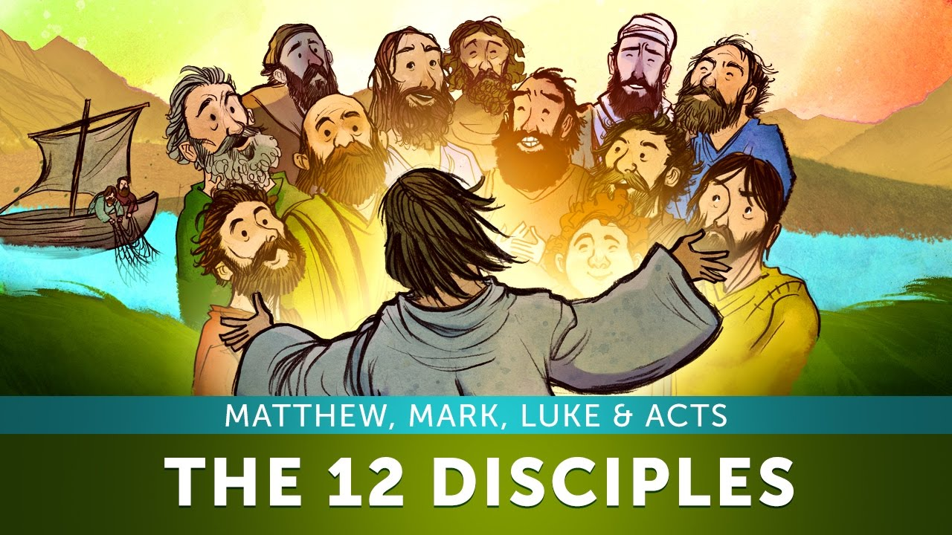
Disciple – What is it?
“To be a learner” is the literal answer to the question
Matthew 10:25—It is enough for the disciple that he become like his teacher, and the slave like his master. (NASB95)

Slide 4
Mark 3:14—¹⁴And He appointed twelve, so that they would be with Him and that He could send them out to preach, (NASB95)

Slide 5
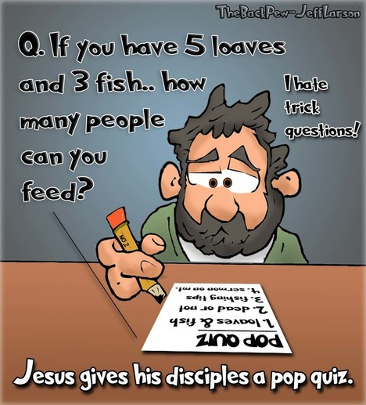

Slide 6
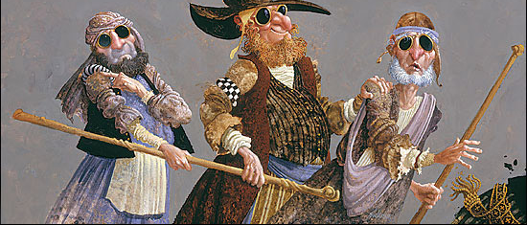
A disciple of the Scribes and Pharisees—
Destined for lesser things
Matthew 15:14—¹⁴ Let them alone; they are blind guides of the blind. And if a blind man guides a blind man, both will fall into a pit.”

Slide 7
A disciple of the Scribes and Pharisees—
Destined for lesser things
Matthew 23: ¹⁵ “Woe to you, scribes and Pharisees, hypocrites, because you travel around on sea and land to make one proselyte; and when he becomes one, you make him twice as much a son of hell as yourselves.”

Slide 8
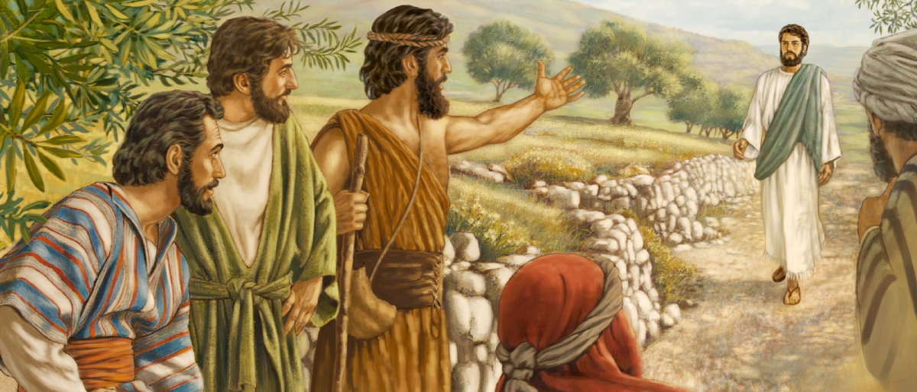
A disciple of John—
Destined for greater things
Mark 1:7—“And he was preaching and saying, “After me One is coming who is mightier than I, and I am not fit to stoop down and untie the thong of His sandals.”

Slide 9
A disciple of John—
Destined for greater things
John 1:29—“Behold, the lamb of God who takes away the sins of the world.”

Slide 10
A disciple of John—
Destined for greater things
John 3:30—“He must increase, but I must decrease.”

Slide 11
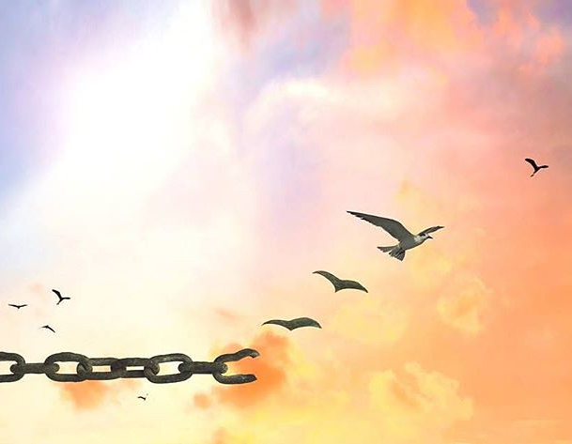
A disciple of Jesus—
Knows that Jesus’ words are the truth that brings spiritual freedom
John 8:31-32
³¹So Jesus was saying to those Jews who had believed Him, “If you continue in My word, then you are truly disciples of Mine; ³² and you will know the truth, and the truth will make you free.” (NASB95)

Slide 12
A disciple of Jesus—
Knows that Jesus’ words are the truth that brings spiritual freedom
“If you continue…”
The seed that fell on the ‘Rocky soil’ (Mt.13:5-6)
  Shallow soil
  Sprang up quickly
  Scorched
  Withered
  Short-lived
  Fruitless

Slide 13
A disciple of Jesus—
Knows that Jesus’ words are the truth that brings spiritual freedom
“In My word”:
The Bible—
‘Thy word, is a lamp unto my feet and a light unto my path’ (Psa.119:105)
‘How can a young man keep his way pure? By living according to Your word’ (Psa.119:9)
BUT—It is possible to be “⁷always learning and never able to come to the knowledge of the truth.” (2Tim.3:7)

Slide 14
A disciple of Jesus—
Knows that Jesus’ words are the truth that brings spiritual freedom
“Then you are truly disciples of Mine”:
A ‘real’ disciple:
Testing on this point starts with me.
Do I sound as if I have just had ‘a little talk with Jesus’?

Slide 15
A disciple of Jesus—
Knows that Jesus’ words are the truth that brings spiritual freedom
“And you will know the truth”:
“I am…the truth…” says Jesus. (Jn.14:6)
Obedience to the truth purifies our souls (1Pet.1:22).
1 John 2:4—⁴ The one who says, “I have come to know Him,” and does not keep His commandments, is a liar, and the truth is not in him; (NASB95)
John 15:7—⁷If you abide in Me, and My words abide in you, ask whatever you wish, and it will be done for you. (NASB95)

Slide 16
A disciple of Jesus—
Knows that Jesus’ words are the truth that brings spiritual freedom
“And the truth will make you free.”
Psalm 119:45—⁴⁵ And I will walk at liberty, For I seek Your precepts. (NASB95)
Isaiah 61:1—“…To proclaim liberty to captives And freedom to prisoners; (NASB95)
James 1:25—²⁵But one who looks intently at the perfect law, the law of liberty, and abides by it, not having become a forgetful hearer but an effectual doer, this man will be blessed in what he does. (NASB95)

Slide 17
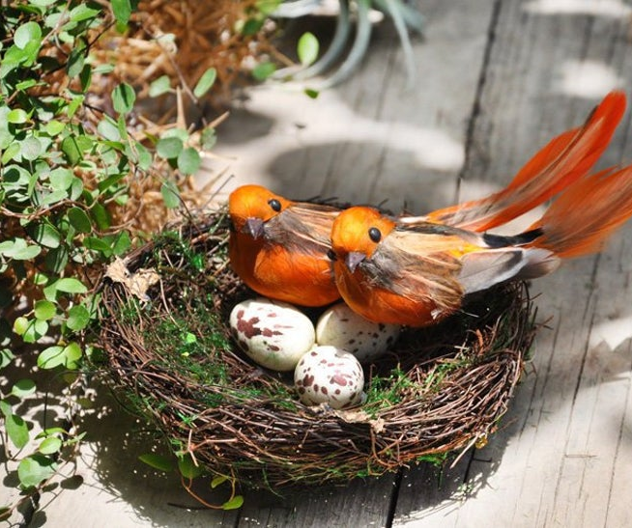
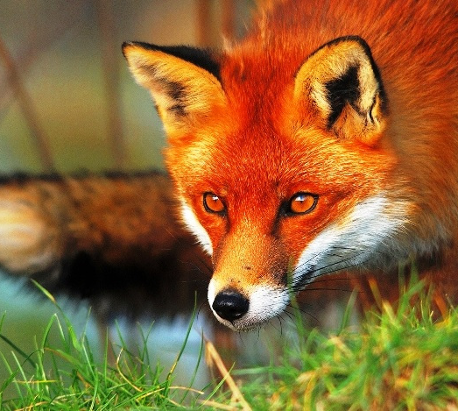
A disciple of Jesus—
Accepts that following Jesus will mean leaving behind the cares and comforts of this world!
Matthew 8:19-20
¹⁹Then a scribe came and said to Him, “Teacher, I will follow You wherever You go.” ²⁰Jesus *said to him, “The foxes have holes and the birds of the air have nests, but the Son of Man has nowhere to lay His head.” (NASB95)
(NASB95)

Slide 18
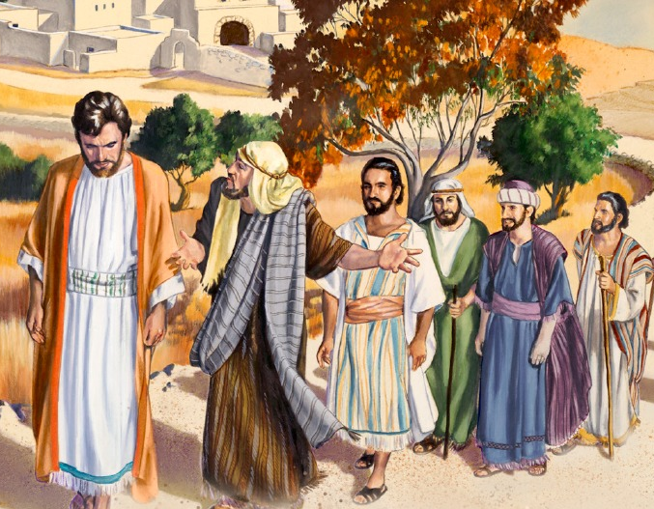
A disciple of Jesus—
Accepts that the words of Jesus can make you recoil!
Matthew 8:21-22
²¹Another of the disciples said to Him, “Lord, permit me first to go and bury my father.” ²²But Jesus *said to him, “Follow Me, and allow the dead to bury their own dead.”
(NASB95)

Slide 19

A disciple of Jesus—
Accepts the words of Jesus as an invitation—To stay or go!
Peter’s Confession of Faith
John 6:66-68—
⁶⁶ As a result of this many of His disciples withdrew and were not walking with Him anymore. ⁶⁷ So Jesus said to the twelve, “You do not want to go away also, do you?” ⁶⁸Simon Peter answered Him, “Lord, to whom shall we go? You have words of eternal life. (NASB95)

Slide 20
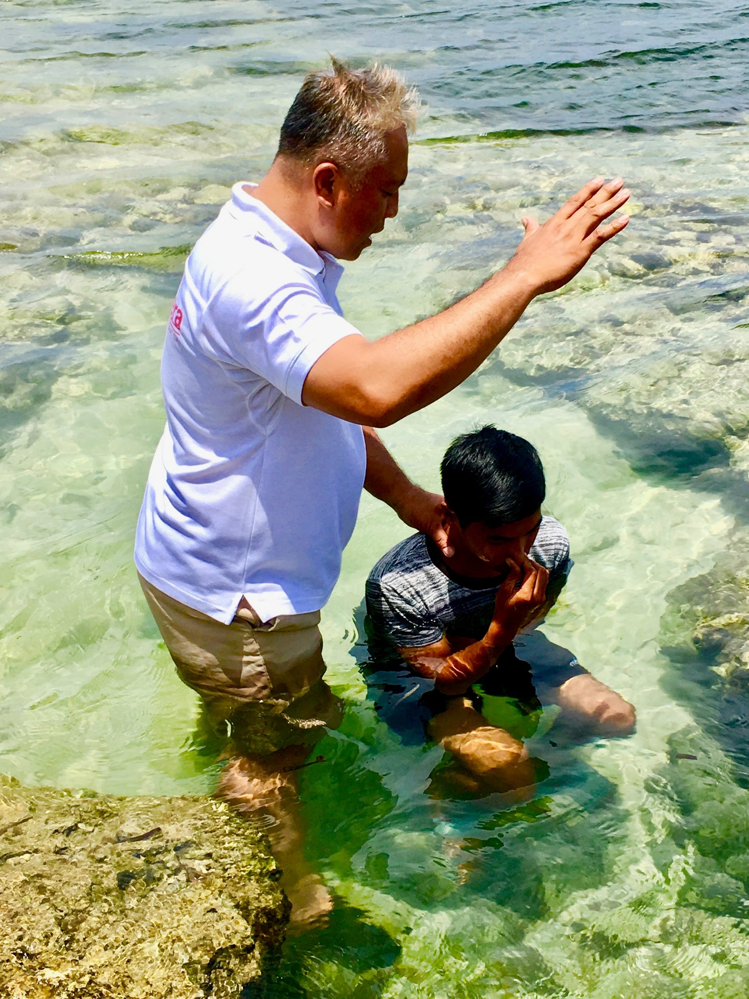
Matthew 28:18-20—¹⁸And Jesus came up and spoke to them, saying, “All authority has been given to Me in heaven and on earth. ¹⁹Go therefore and make disciples of all the nations, baptizing them in the name of the Father and the Son and the Holy Spirit, ²⁰teaching them to observe all that I commanded you; and lo, I am with you always, even to the end of the age.” (NASB95)

