Slide 2
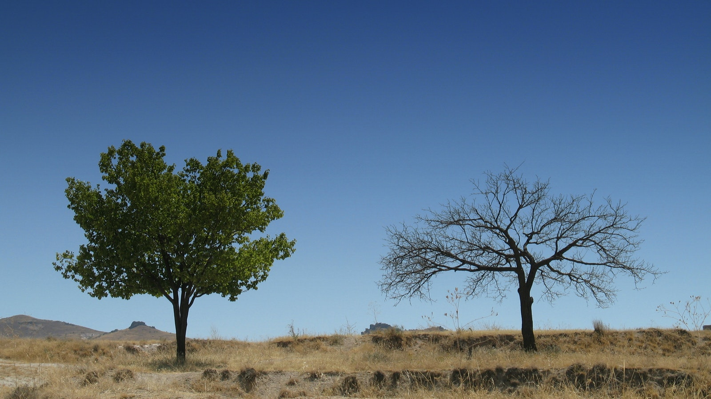
Faith, like trees need water to live and thrive.
Jesus gives us Living Water.
Jesus is our Life.
It is only from him that comes “Times of Refreshing.”
Faith, like trees need water to live and thrive.
Jesus gives us Living Water.
Jesus is our Life.
It is only from him that comes “Times of Refreshing.”

Slide 3
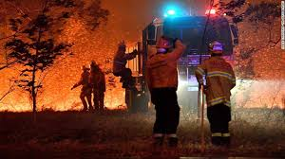
Faith, like trees need water to live and thrive.
Jesus gives us Living Water.
Jesus is our Life.
It is only from him that comes “Times of Refreshing.”
The Australian fires are testimony to the tragic effects of dryness.
Don’t miss the spiritual parallel.

Slide 4

“Times of Refreshing.”
Spiritual renewal is possible.
If this is your spiritual state of being, heed the words of Acts 3:19.
Acts 3:19—Therefore repent and return, so that your sins may be wiped away, in order that times of refreshing may come from the presence of the Lord; (NASB95)
with Him, but we get the rest of our lives. In some ways, knowing what we know now, we have an advantage. We see all of it put together in a way they might not have fully grasped at the time. And for all of that - for what He d

Slide 5
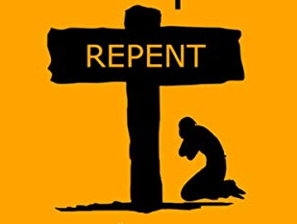
“Times of Refreshing.”
When the Gospel is understood, it starts with repentance.
Acts 3:19—Therefore repent and return, so that your sins may be wiped away, in order that times of refreshing may come from the presence of the Lord; (NASB95)
with Him, but we get the rest of our lives. In some ways, knowing what we know now, we have an advantage. We see all of it put together in a way they might not have fully grasped at the time. And for all of that - for what He d

Slide 6

“Times of Refreshing.”
With Repentance comes…Change, change, change!
We return to Paths of Righteousness.
Acts 3:19—Therefore repent and return, so that your sins may be wiped away, in order that times of refreshing may come from the presence of the Lord; (NASB95)
with Him, but we get the rest of our lives. In some ways, knowing what we know now, we have an advantage. We see all of it put together in a way they might not have fully grasped at the time. And for all of that - for what He d

Slide 7

“Times of Refreshing.”
A tree is known by its fruit.
Unmistakable fact.
You are what you are.
If you are not bearing fruit for God, who are you bearing fruit for…?
Acts 3:19—Therefore repent and return, so that your sins may be wiped away, in order that times of refreshing may come from the presence of the Lord; (NASB95)
with Him, but we get the rest of our lives. In some ways, knowing what we know now, we have an advantage. We see all of it put together in a way they might not have fully grasped at the time. And for all of that - for what He d

Slide 8

“Times of Refreshing.”
New Habits mean clearing out the old ones.
Replacing old ways with godly conduct.
Acts 3:19—Therefore repent and return, so that your sins may be wiped away, in order that times of refreshing may come from the presence of the Lord; (NASB95)
with Him, but we get the rest of our lives. In some ways, knowing what we know now, we have an advantage. We see all of it put together in a way they might not have fully grasped at the time. And for all of that - for what He d

Slide 9

“Times of Refreshing.”
New Life, New Plans, New Directions, New Boss…
Of course, this is all done when we return to God through Christ.
Acts 3:19—Therefore repent and return, so that your sins may be wiped away, in order that times of refreshing may come from the presence of the Lord; (NASB95)
with Him, but we get the rest of our lives. In some ways, knowing what we know now, we have an advantage. We see all of it put together in a way they might not have fully grasped at the time. And for all of that - for what He d

Slide 10

“Times of Refreshing.”
Be careful, the Word of God will overcome you—If you let!
It is designed to expose your inner thoughts.
Acts 3:19—Therefore repent and return, so that your sins may be wiped away, in order that times of refreshing may come from the presence of the Lord; (NASB95)
with Him, but we get the rest of our lives. In some ways, knowing what we know now, we have an advantage. We see all of it put together in a way they might not have fully grasped at the time. And for all of that - for what He d

Slide 11

“Times of Refreshing.”
Matthew 6:20—But store up for yourselves treasures in heaven, where neither moth nor rust destroys, and where thieves do not break in or steal; (NASB95)
Acts 3:19—Therefore repent and return, so that your sins may be wiped away, in order that times of refreshing may come from the presence of the Lord; (NASB95)

Slide 12
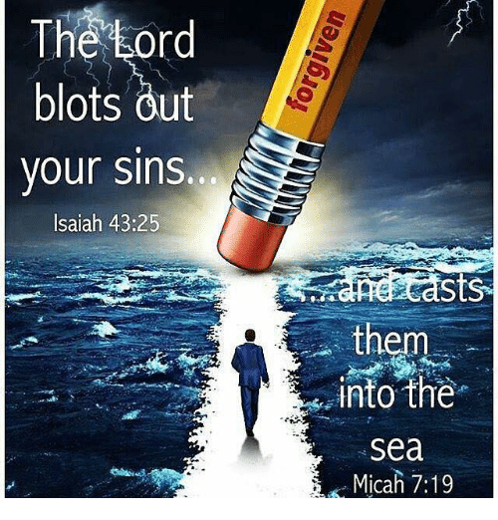
“Times of Refreshing.”
Free from the law of sin and death—“If you sin you die!”
Acts 3:19—Therefore repent and return, so that your sins may be wiped away, in order that times of refreshing may come from the presence of the Lord; (NASB95)
with Him, but we get the rest of our lives. In some ways, knowing what we know now, we have an advantage. We see all of it put together in a way they might not have fully grasped at the time. And for all of that - for what He d

Slide 13
“Times of Refreshing.”
Colossians 2:13-14—¹³When you were dead in your transgressions and the uncircumcision of your flesh, He made you alive together with Him, having forgiven us all our transgressions, ¹⁴having cancelled out the certificate of debt consisting of decrees against us, which was hostile to us; and He has taken it out of the way, having nailed it to the cross. (NASB95)
Acts 3:19—Therefore repent and return, so that your sins may be wiped away, in order that times of refreshing may come from the presence of the Lord; (NASB95)
with Him, but we get the rest of our lives. In some ways, knowing what we know now, we have an advantage. We see all of it put together in a way they might not have fully grasped at the time. And for all of that - for what He d

Slide 14
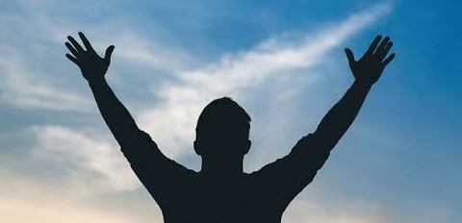
“Times of Refreshing.”
Romans 8:1-2—Therefore, there is now no condemnation for those who are in Christ Jesus, ²because through Christ Jesus the law of the Spirit who gives life has set you free from the law of sin and death. (NASB95)
Acts 3:19—Therefore repent and return, so that your sins may be wiped away, in order that times of refreshing may come from the presence of the Lord; (NASB95)
with Him, but we get the rest of our lives. In some ways, knowing what we know now, we have an advantage. We see all of it put together in a way they might not have fully grasped at the time. And for all of that - for what He d

Slide 15
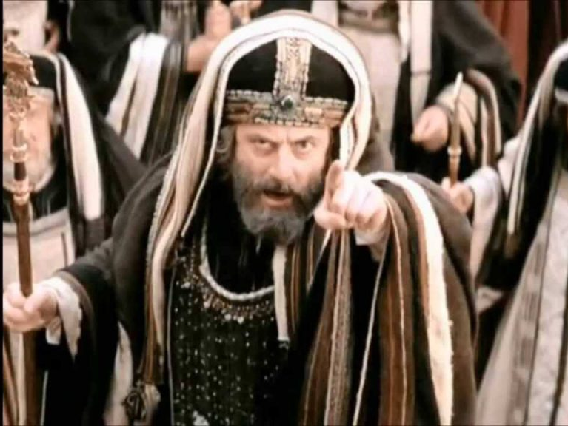
“Times of Refreshing.”
Free from the condemnation of Satan and man.
The hopeless doctrines of the Sadducees—Then and now!
Acts 3:19—Therefore repent and return, so that your sins may be wiped away, in order that times of refreshing may come from the presence of the Lord; (NASB95)
with Him, but we get the rest of our lives. In some ways, knowing what we know now, we have an advantage. We see all of it put together in a way they might not have fully grasped at the time. And for all of that - for what He d

Slide 16
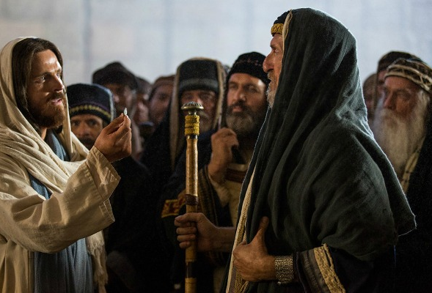
“Times of Refreshing.”
Free from the life-controlling doctrines of men.
The Pharisees (then and now) were experts at making new rules on behalf of God.
Acts 3:19—Therefore repent and return, so that your sins may be wiped away, in order that times of refreshing may come from the presence of the Lord; (NASB95)
with Him, but we get the rest of our lives. In some ways, knowing what we know now, we have an advantage. We see all of it put together in a way they might not have fully grasped at the time. And for all of that - for what He d

Slide 17
“Times of Refreshing.”
Is this your image in your spiritual mirror…?
Too much earthly wisdom…
Acts 3:19—Therefore repent and return, so that your sins may be wiped away, in order that times of refreshing may come from the presence of the Lord; (NASB95)
with Him, but we get the rest of our lives. In some ways, knowing what we know now, we have an advantage. We see all of it put together in a way they might not have fully grasped at the time. And for all of that - for what He d

Slide 18
“Times of Refreshing.”
James 3:14-16—¹⁴ But if you have bitter jealousy and selfish ambition in your heart, do not be arrogant and so lie against the truth. ¹⁵ This wisdom is not that which comes down from above, but is earthly, natural, demonic. ¹⁶For where jealousy and selfish ambition exist, there is disorder and every evil thing. (NASB95)
Acts 3:19—Therefore repent and return, so that your sins may be wiped away, in order that times of refreshing may come from the presence of the Lord; (NASB95)
with Him, but we get the rest of our lives. In some ways, knowing what we know now, we have an advantage. We see all of it put together in a way they might not have fully grasped at the time. And for all of that - for what He d

Slide 19
“Times of Refreshing.”
Refreshing takes place when Heavenly Wisdom is sought and applied…
Acts 3:19—Therefore repent and return, so that your sins may be wiped away, in order that times of refreshing may come from the presence of the Lord; (NASB95)

Slide 20
“Times of Refreshing.”
James 3:17-18—¹⁷But the wisdom from above is first pure, then peaceable, gentle, reasonable, full of mercy and good fruits, unwavering, without hypocrisy. ¹⁸And the seed whose fruit is righteousness is sown in peace by those who make peace. (NASB95)
Acts 3:19—Therefore repent and return, so that your sins may be wiped away, in order that times of refreshing may come from the presence of the Lord; (NASB95)

Slide 21
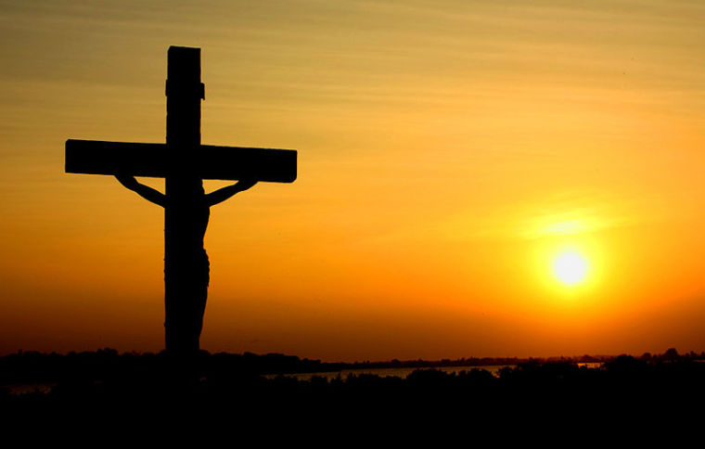
“Times of Refreshing.”
Luke 9:23—And He was saying to them all, “If anyone wishes to come after Me, he must deny himself, and take up his cross daily and follow Me. (NASB95)
Acts 3:19—Therefore repent and return, so that your sins may be wiped away, in order that times of refreshing may come from the presence of the Lord; (NASB95)

Slide 22
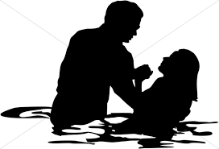
“Times of Refreshing.”
Acts 2:38—Peter said to them, “Repent, and each of you be baptized in the name of Jesus Christ for the forgiveness of your sins; and you will receive the gift of the Holy Spirit. (NASB95)
Acts 3:19—Therefore repent and return, so that your sins may be wiped away, in order that times of refreshing may come from the presence of the Lord; (NASB95)
Acts 2:38—Peter said to them, “Repent, and each of you be baptized in the name of Jesus Christ for the forgiveness of your sins; and you will receive the gift of the Holy Spirit. (NASB95)

