Slide 2
“Faithful unto Death.”

Slide 3
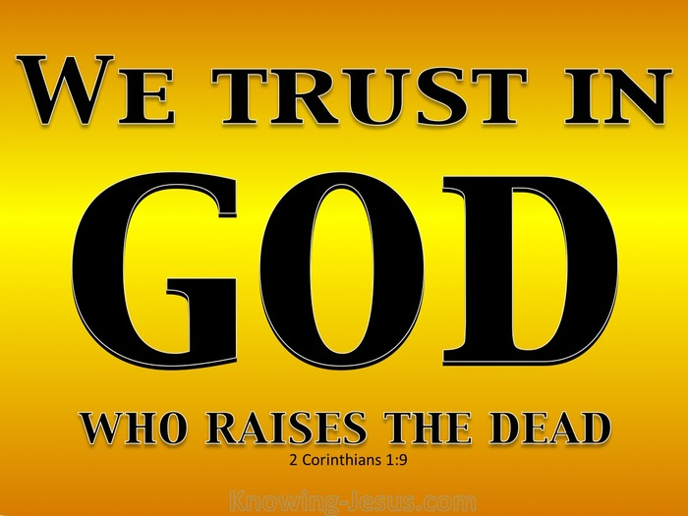
Faithful unto Death.
1. Faithfulness—God’s nature
2 Timothy 2:11-13—
¹¹ It is a trustworthy statement:
For if we died with Him, we will also live with Him;
¹²If we endure, we will also reign with Him;
If we deny Him, He also will deny us;
¹³If we are faithless, He remains faithful, for He cannot deny Himself. (NASB95)

Slide 4
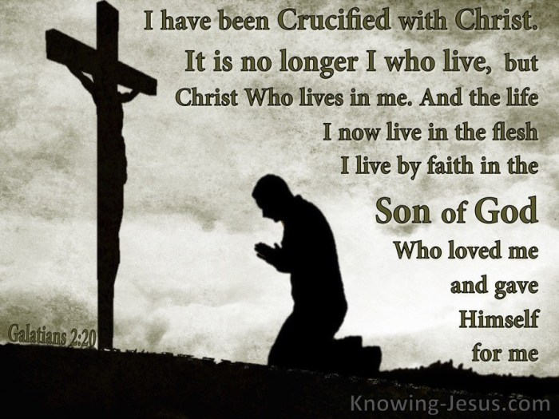
Faithful unto Death.
1. Faithful—Our spiritual life starts with a death
2 Timothy 2:11-13—
¹¹ It is a trustworthy statement:
For if we died with Him, we will also live with Him;
From Dead to Living
  I am crucified with Christ (Gal.2:20)
  We take up our cross daily and follow Jesus
  Keeping this life is losing eternal life

Slide 5
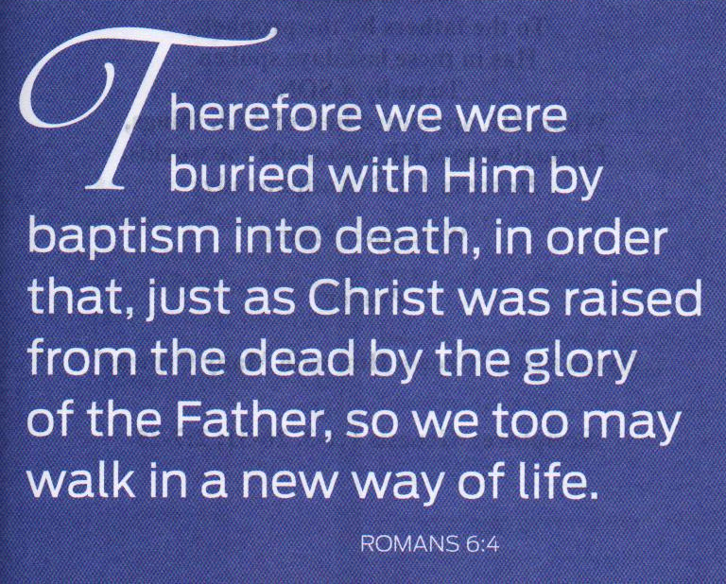
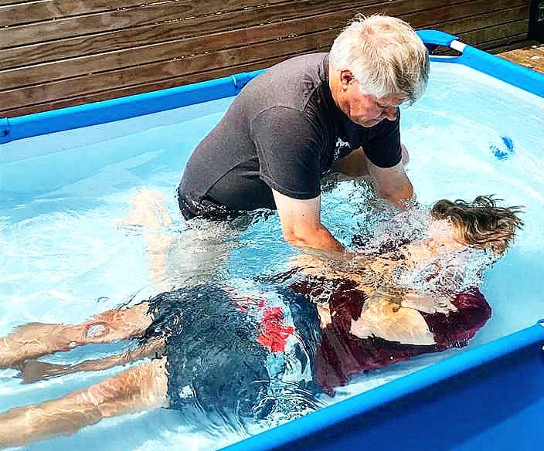
Faithful unto Death.
1. Faithful—Our spiritual life starts with a death
2 Timothy 2:11-13—
¹¹ It is a trustworthy statement:
For if we died with Him, we will also live with Him;
¹²If we endure, we will also reign with Him;
If we deny Him, He also will deny us;
¹³If we are faithless, He remains faithful, for He cannot deny Himself. (NASB95)
From Dead to Living
  Buried with Christ in baptism (Rom.6:4)

Slide 6
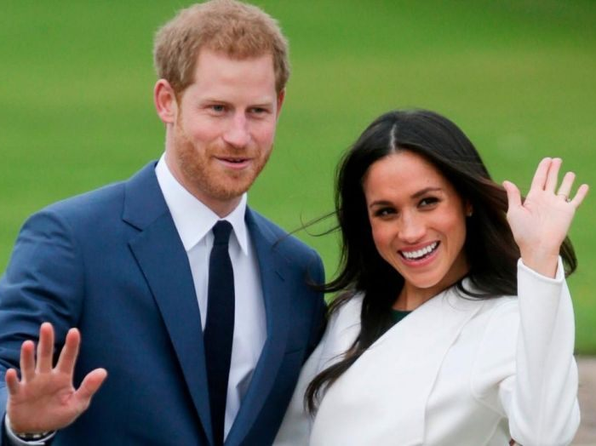
Faithful unto Death.
1. Faithful—Our spiritual life starts with a death
2 Timothy 2:11-13—
¹¹ It is a trustworthy statement:
For if we died with Him, we will also live with Him;
¹²If we endure, we will also reign with Him;
If we deny Him, He also will deny us;
¹³If we are faithless, He remains faithful, for He cannot deny Himself. (NASB95)
Enduring as Royals
  The ‘title’ goes with the willingness to endure

Slide 7
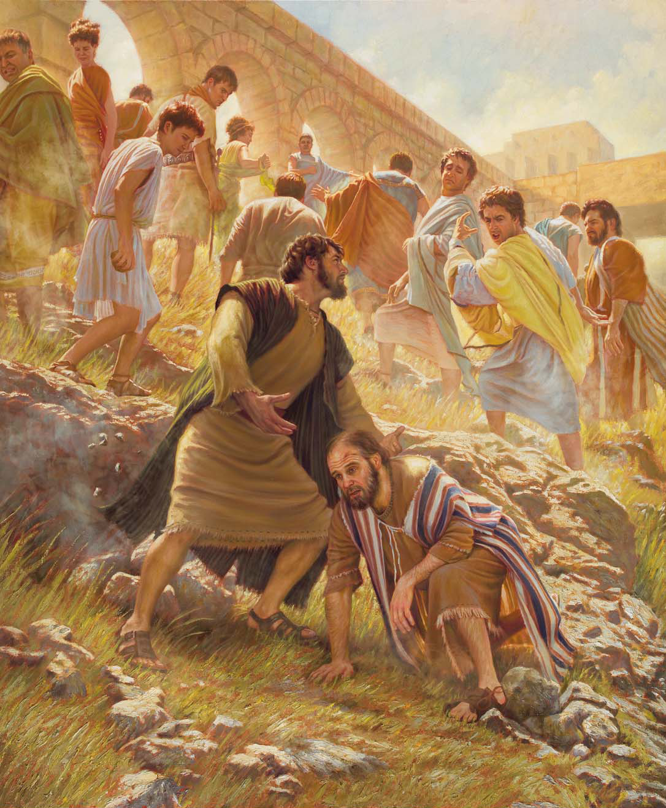
Faithful unto Death.
1. Faithful—Our spiritual life starts with a death
2 Timothy 2:11-13—
¹¹ It is a trustworthy statement:
For if we died with Him, we will also live with Him;
¹²If we endure, we will also reign with Him;
If we deny Him, He also will deny us;
¹³If we are faithless, He remains faithful, for He cannot deny Himself. (NASB95)
Enduring as Royals
  It can get tough…

Slide 8
Faithful unto Death.
2 Corinthians 11:23-29—
²³Are they servants of Christ?—I speak as if insane—I more so;
in far more labours,
in far more imprisonments,
beaten times without number,
often in danger of death.
²⁴Five times I received from the Jews thirty-nine lashes.
²⁵Three times I was beaten with rods,
once I was stoned,
three times I was shipwrecked, a night and a day I have spent in the deep.
²⁶I have been on frequent journeys,
in dangers from rivers, dangers from robbers, dangers from my countrymen, dangers from the Gentiles, dangers in the city, dangers in the wilderness, dangers on the sea, dangers among false brethren;
²⁷I have been in labour and hardship, through many sleepless nights, in hunger and thirst, often without food, in cold and exposure.
²⁸Apart from such external things, there is the daily pressure on me of concern for all the churches. ²⁹Who is weak without my being weak? Who is led into sin without my intense concern? (NASB95)

Slide 9
Faithful unto Death.
1. Faithful—Our spiritual life starts with a death
2 Timothy 2:11-13—
¹¹ It is a trustworthy statement:
For if we died with Him, we will also live with Him;
¹²If we endure, we will also reign with Him;
Enduring as Royals
  Giving it all—
2 Corinthians 12:15—
¹⁵I will most gladly spend and be expended for your souls… (NASB95)

Slide 10
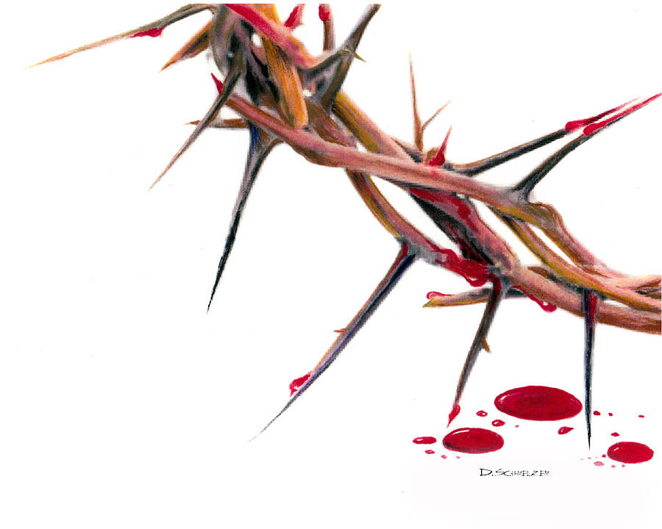
Faithful unto Death.
1. Faithful—Our spiritual life starts with a death
2 Timothy 2:11-13—
¹¹ It is a trustworthy statement:
For if we died with Him, we will also live with Him;
¹²If we endure, we will also reign with Him; (NASB95)
Enduring as Royals
  Reigning—
1 Peter 2:9—
⁹ But you are a chosen race, a royal priesthood, a holy nation, a people for God’s own possession, so that you may proclaim the excellencies of Him who has called you out of darkness into His marvelous light; (NASB95)

Slide 11
Faithful unto Death.
1. Faithful—Our spiritual life starts with a death
2 Timothy 2:11-13—
¹¹ It is a trustworthy statement:
For if we died with Him, we will also live with Him;
¹²If we endure, we will also reign with Him;
If we deny Him, He also will deny us; (NASB95)
Don’t Deny the Undeniable
  People do everyday—
    His Existence
    His authority
    His compassion
    His Call
    His commands
    His faithfulness

Slide 12

Faithful unto Death.
1. Faithful—Our spiritual life starts with a death
2 Timothy 2:11-13—
¹¹ It is a trustworthy statement:
For if we died with Him, we will also live with Him;
¹²If we endure, we will also reign with Him;
If we deny Him, He also will deny us; (NASB95)
Don’t Deny the Undeniable
  Our words are repeated in heaven—
Matthew 10:32-33—
³²“Therefore everyone who confesses Me before men, I will also confess him before My Father who is in heaven. ³³But whoever denies Me before men, I will also deny him before My Father who is in heaven. (NASB95)

Slide 13
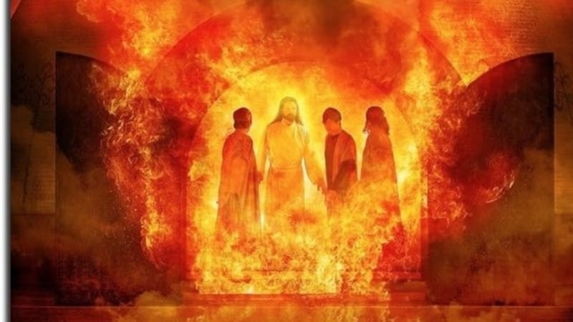
Faithful unto Death.
1. Faithful—Our spiritual life starts with a death
2 Timothy 2:11-13—
¹¹ It is a trustworthy statement:
For if we died with Him, we will also live with Him;
¹²If we endure, we will also reign with Him;
If we deny Him, He also will deny us;
¹³If we are faithless, He remains faithful, for He cannot deny Himself. (NASB95)
Man cannot change God’s nature
  Man’s Faithlessness must not affect God’s nature in us:
  Shadrach, Meshach and Abed-nego would rather have burned than bow down to an idol.
  Danial would rather have been eaten by lions than step aside for the pagan elite.
  Joseph faithfulness to his God made him ran from an adulterous wife.
  Jesus faced the cross rather than denying who he was to the faithless leaders.

Slide 14
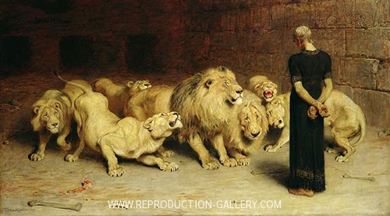
Faithful unto Death.
1. Faithful—Our spiritual life starts with a death
2 Timothy 2:11-13—
¹¹ It is a trustworthy statement:
For if we died with Him, we will also live with Him;
¹²If we endure, we will also reign with Him;
If we deny Him, He also will deny us;
¹³If we are faithless, He remains faithful, for He cannot deny Himself. (NASB95)
Man cannot change God’s nature
  Man’s Faithlessness must not affect God’s nature in us:
  Shadrach, Meshach and Abed-nego would rather have burned than bow down to an idol.
  Danial would rather have been eaten by lions than step aside for the pagan elite.

Slide 15
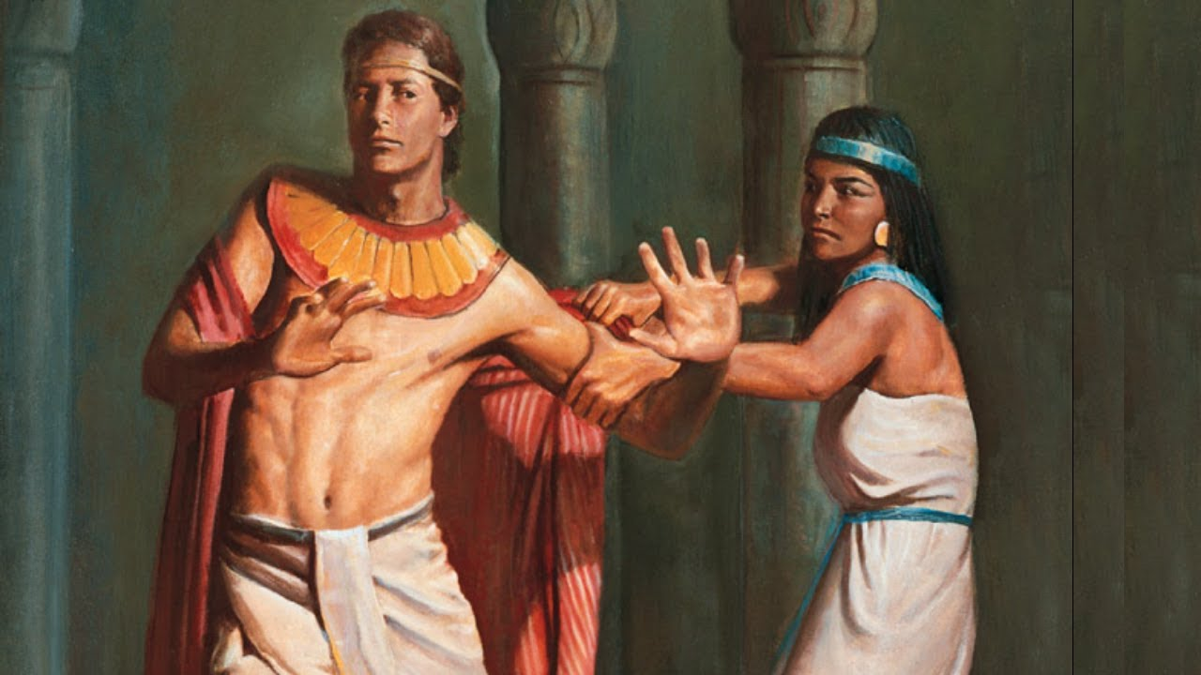
Faithful unto Death.
1. Faithful—Our spiritual life starts with a death
2 Timothy 2:11-13—
¹¹ It is a trustworthy statement:
For if we died with Him, we will also live with Him;
¹²If we endure, we will also reign with Him;
If we deny Him, He also will deny us;
¹³If we are faithless, He remains faithful, for He cannot deny Himself. (NASB95)
Man cannot change God’s nature
  Man’s Faithlessness must not affect God’s nature in us:
  Shadrach, Meshach and Abed-nego would rather have burned than bow down to an idol.
  Danial would rather have been eaten by lions than step aside for the pagan elite.
  Joseph faithfulness to his God made him ran from an adulterous wife.

Slide 16
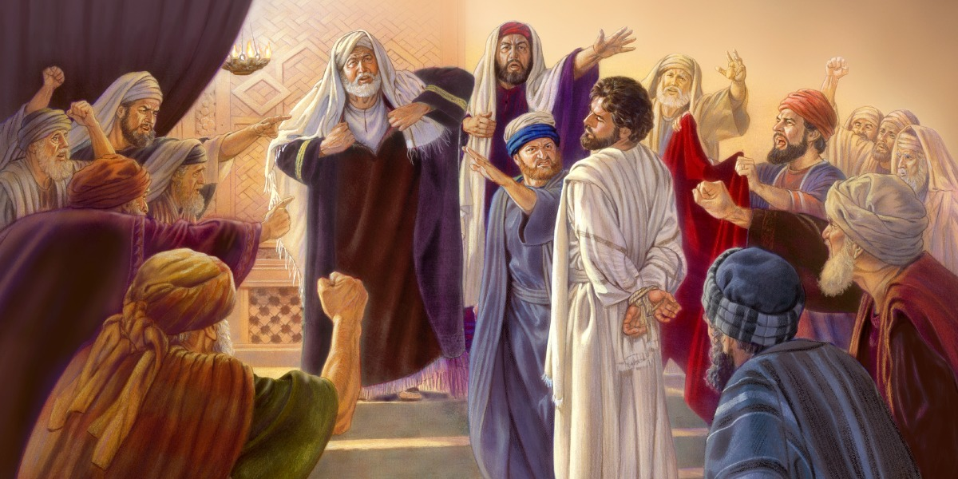
Faithful unto Death.
1. Faithful—Our spiritual life starts with a death
2 Timothy 2:11-13—
¹¹ It is a trustworthy statement:
For if we died with Him, we will also live with Him;
¹²If we endure, we will also reign with Him;
If we deny Him, He also will deny us;
¹³If we are faithless, He remains faithful, for He cannot deny Himself. (NASB95)
Man cannot change God’s nature
  Man’s Faithlessness must not affect God’s nature in us:
  Shadrach, Meshach and Abed-nego would rather have burned than bow down to an idol.
  Danial would rather have been eaten by lions than step aside for the pagan elite.
  Joseph faithfulness to his God made him ran from an adulterous wife.
  Jesus faced the cross rather than denying who he was to the faithless leaders.

Slide 17
Faithful unto Death.
1. Faithful—Our spiritual life starts with a death
2 Timothy 2:11-13—
¹¹ It is a trustworthy statement:
For if we died with Him, we will also live with Him;
¹²If we endure, we will also reign with Him;
If we deny Him, He also will deny us;
¹³If we are faithless, He remains faithful, for He cannot deny Himself. (NASB95)
Man cannot change God’s nature
  Everyday anew
Lamentations 3:22-24—
²²The Lord’s lovingkindnesses indeed never cease,
For His compassions never fail.
²³They are new every morning;
Great is Your faithfulness.
²⁴ “The Lord is my portion,” says my soul,
“Therefore I have hope in Him.”(NASB95)

Slide 18
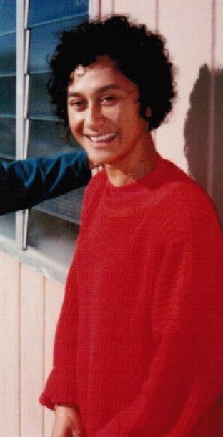
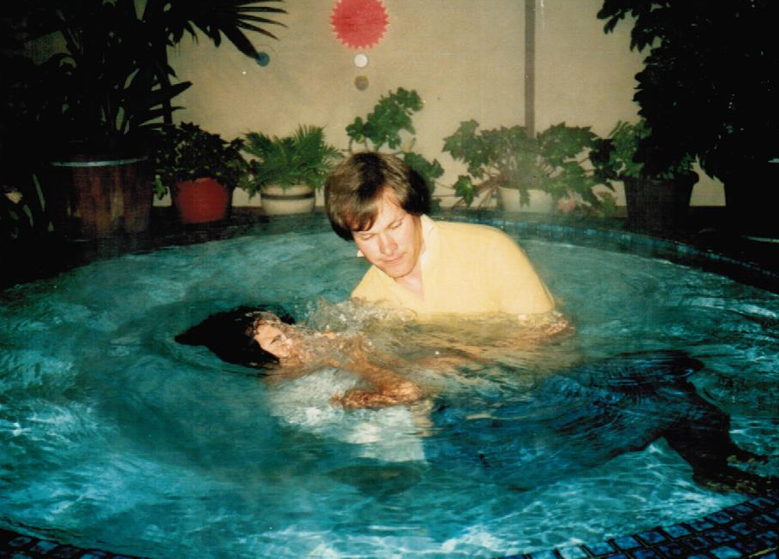
Faithful unto Death.
2. Faithful—Our spiritual life ends in LIFE ETERNAL!
Revelation 2:10—¹⁰…Be faithful until death, and I will give you the crown of life. (NASB95)
Roby Wiki went on to the Paradise on Saturday 1 February 2020.
We will see her again in the presence of her God and ours.

