Slide 2

Guidance…

Slide 3

Spiritual Guidance
Proverbs 1:5—
A wise man will hear and increase in learning,
And a man of understanding will acquire wise counsel, (NASB95)
Proverbs 12:15—
Ephesians 1:18-19—¹⁸I pray that the eyes of your heart may be enlightened, so that you will know what is the hope of His calling, what are the riches of the glory of His inheritance in the saints, ¹⁹and what is the surpassing greatness of His power toward us who believe. These are in accordance with the working of the strength of His might (NASB95)

Slide 4
Spiritual Guidance
Proverbs 12:15—
¹⁵ The way of a fool is right in his own eyes,
But a wise man is he who listens to counsel. (NASB95)
Guidance comes in various forms…
Ephesians 1:18-19—¹⁸I pray that the eyes of your heart may be enlightened, so that you will know what is the hope of His calling, what are the riches of the glory of His inheritance in the saints, ¹⁹and what is the surpassing greatness of His power toward us who believe. These are in accordance with the working of the strength of His might (NASB95)

Slide 5
Spiritual Guidance
Guidance comes in various forms…
First an foremost the Word of God—Not an optional extra, but the words of life.
The Word being taught and lived around us.
Godly advice from others
Experiences – Good and bad.
Ephesians 1:18-19—¹⁸I pray that the eyes of your heart may be enlightened, so that you will know what is the hope of His calling, what are the riches of the glory of His inheritance in the saints, ¹⁹and what is the surpassing greatness of His power toward us who believe. These are in accordance with the working of the strength of His might (NASB95)

Slide 6
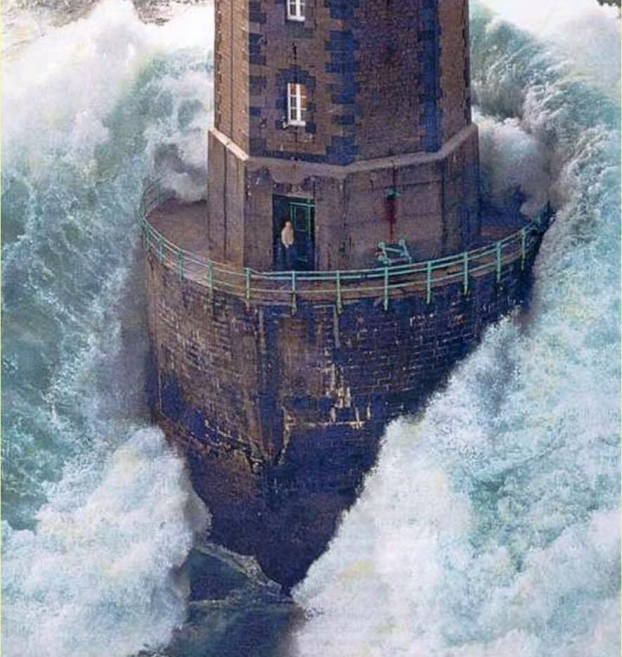
From a Rock-solid Foundation
The steadfast of mind—
-Not personal resolve
-Not personal strength
- Not personal wisdom
But…
Having a mind ‘supported by God.’
Isaiah 26:3-4—³“The steadfast of mind You will keep in perfect peace,
Because he trusts in You.
⁴“Trust in the Lord forever,
For in God the Lord, we have an everlasting Rock. (NASB95)

Slide 7
From a Rock-solid Foundation
Psalm 112:7—
⁷He is not afraid of bad news;
his heart is firm,
trusting in the Lord. (ESV)
Isaiah 26:3-4—³“The steadfast of mind You will keep in perfect peace,
Because he trusts in You.
⁴“Trust in the Lord forever,
For in God the Lord, we have an everlasting Rock. (NASB95)

Slide 8
From a Rock-solid Foundation
Psalm 112:8—
⁸His heart is upheld,
he will not fear,
Until he looks with
satisfaction on his adversaries. (NASB95)
Isaiah 26:3-4—³“The steadfast of mind You will keep in perfect peace,
Because he trusts in You.
⁴“Trust in the Lord forever,
For in God the Lord, we have an everlasting Rock. (NASB95)

Slide 9
From a Rock-solid Foundation
God can create “perfect peace” within your mind—
Isaiah 57:19—
¹⁹Creating the praise of the lips.
Peace, peace to him who is far and to him who is near,”
Says the Lord, “and I will heal him.” (NASB95)
Isaiah 26:3-4—³“The steadfast of mind You will keep in perfect peace,
Because he trusts in You.
⁴“Trust in the Lord forever,
For in God the Lord, we have an everlasting Rock. (NASB95)

Slide 10
From a Rock-solid Foundation
Though storms of trial rage around us—
Mark 4:39-40—
³⁹And He got up and rebuked the wind and said to the sea, “Hush, be still.” And the wind died down and it became perfectly calm. ⁴⁰And He said to them, “Why are you afraid? Do you still have no faith?” (NASB)
Isaiah 26:3-4—³“The steadfast of mind You will keep in perfect peace,
Because he trusts in You.
⁴“Trust in the Lord forever,
For in God the Lord, we have an everlasting Rock. (NASB95)

Slide 11
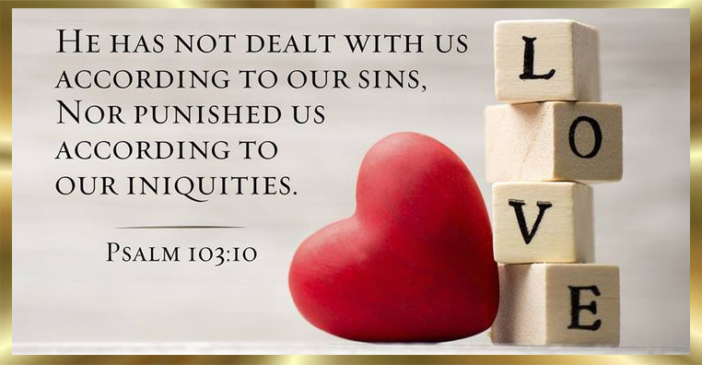
From a Heart of Love
1. Paradox of the Humble—
Those who know the most know how little they know.
God is Love
1 Corinthians 8:1-2—
Now concerning things sacrificed to idols, we know that we all have knowledge. Knowledge makes arrogant, but love edifies. ²If anyone supposes that he knows anything, he has not yet known as he ought to know; (NASB95)

Slide 12
From a Heart of Love
Big Heads-Small Hearts—
Knowledge for knowledge sake will make you nothing but an arrogant know-it-all.
Loaded to the gunwales with gifts…
God is Love
1 Corinthians 8:1-2—
Now concerning things sacrificed to idols, we know that we all have knowledge. Knowledge makes arrogant, but love edifies. ²If anyone supposes that he knows anything, he has not yet known as he ought to know; (NASB95)

Slide 13
From a Heart of Love
Big Heads-Small Hearts—
Loaded to the gunwales with gifts…
  Tongues
  Prophecy
  Know all mysteries
  All knowledge
  All faith, so as to remove mountains
“But do not have love, I am nothing.”
God is Love
1 Corinthians 8:1-2—
Now concerning things sacrificed to idols, we know that we all have knowledge. Knowledge makes arrogant, but love edifies. ²If anyone supposes that he knows anything, he has not yet known as he ought to know; (NASB95)

Slide 14

How to respond to the counsel of a fool
Don’t make godly arguments conform to his foolish pattern of thinking.
But, by wisdom,…
Proverbs 26:4-5— ⁴ Do not answer a fool according to his folly,
Or you will also be like him.
⁵ Answer a fool as his folly deserves,
That he not be wise in his own eyes. (NASB95)

Slide 15
How to respond to the counsel of a fool
But, by wisdom, bring humility to him by showing the logical conclusions of his foolishness.
Proverbs 26:4-5— ⁴ Do not answer a fool according to his folly,
Or you will also be like him.
⁵ Answer a fool as his folly deserves,
That he not be wise in his own eyes. (NASB95)

Slide 16

The Devil Quotes Scripture, too!
1. The devil twists scripture to the destruction of the will of God—
Jesus didn’t let him in the wilderness temptations
Paul warns us…
Psalm 50:16-17— ¹⁶But to the wicked God says:
What right have you to recite my statutes
or take my covenant on your lips?
¹⁷For you hate discipline,
and you cast my words behind you. (ESV)

Slide 17
The Devil Quotes Scripture, too!
1. The devil twists scripture to the destruction of the will of God—
Paul warns us:
  2 Corinthians 11:13-14—
  ¹³For such men are false apostles, deceitful workers, disguising themselves as apostles of Christ. ¹⁴No wonder, for even Satan disguises himself as an angel of light. (NASB95)
c. The wicked know…
Psalm 50:16-17— ¹⁶But to the wicked God says:
What right have you to recite my statutes
or take my covenant on your lips?
¹⁷For you hate discipline,
and you cast my words behind you. (ESV)

Slide 18
The Devil Quotes Scripture, too!
1. The devil twists scripture to the destruction of the will of God—
The wicked know their Bibles, too.
  Many a sin has been justified by quoting scripture out of context.
Psalm 50:16-17— ¹⁶But to the wicked God says:
What right have you to recite my statutes
or take my covenant on your lips?
¹⁷For you hate discipline,
and you cast my words behind you. (ESV)

Slide 19

Who you follow is who you will be!
Beware the ungodly
Sowers of doubt – Sounding positive, but always negative – Hobby horses everywhere – Never growing up in the Lord – Worse than 10 years ago – Divisive, yet spouting unity
Avoid these guys!
We need to be listening to…
Proverbs 11:14—
¹⁴Where there is no guidance the people fall,
But in abundance of counsellors there is victory.

Slide 20
Who you follow is who you will be!
We need to be listening to…
Godly mentors:
Preachers – Teachers – Elders – Deacons – Fathers – Mothers Brothers – Sisters
How do we know them?
Those who are…
Proverbs 11:14—
¹⁴Where there is no guidance the people fall,
But in abundance of counsellors there is victory.

Slide 21
Who you follow is who you will be!
We need to be listening to…
Those who are…
  In the Word
  In Prayer
  In Church
Those who are…
Proverbs 11:14—
¹⁴Where there is no guidance the people fall,
But in abundance of counsellors there is victory.

Slide 22
Who you follow is who you will be!
We need to be listening to…
Those who are…
  Loving
  Joyful
  Peaceful
  Patient
  Kind
  Good
  Faithful
  Gentle
  Self-controlled (Gal.5)
Proverbs 11:14—
¹⁴Where there is no guidance the people fall,
But in abundance of counsellors there is victory.

