Slide 2
“How to Failsafe Your Prayer-life.”
Part 1.
It starts in the hidden place.

Slide 3
Failsafe your Prayer-life
This is not a case of automatically going into a spiritual “Limp Mode.”
This is stacking the odds against failure.
Fool proofing your prayer life
Going on in spite of failure and accident

Slide 4


How to Failsafe Your Prayer-life.
But when you pray, go into your private room, shut your door, and pray to your Father who is in secret. And your Father who sees in secret will reward you. Matthew 6:6 (CSB)
It starts in the hidden place
Where do you pray in private?

Slide 5
How to Failsafe Your Prayer-life.
But when you pray, go into your private room, shut your door, and pray to your Father who is in secret. And your Father who sees in secret will reward you. Matthew 6:6 (CSB)
It starts in the hidden place
What do you bring with you?

Slide 6
How to Failsafe Your Prayer-life.
But when you pray, go into your private room, shut your door, and pray to your Father who is in secret. And your Father who sees in secret will reward you. Matthew 6:6 (CSB)
It starts in the hidden place
How long do you stay?

Slide 7
How to Failsafe Your Prayer-life.
But when you pray, go into your private room, shut your door, and pray to your Father who is in secret. And your Father who sees in secret will reward you. Matthew 6:6 (CSB)
It starts in the hidden place
What keeps you focused?

Slide 8
How to Failsafe Your Prayer-life.
But when you pray, go into your private room, shut your door, and pray to your Father who is in secret. And your Father who sees in secret will reward you. Matthew 6:6 (CSB)
It starts in the hidden place
ROOM—A metaphor:

Slide 9
How to Failsafe Your Prayer-life.
But when you pray, go into your private room, shut your door, and pray to your Father who is in secret. And your Father who sees in secret will reward you. Matthew 6:6 (CSB)
It starts in the hidden place
ROOM—A metaphor:
a. A time and place alone with God.

Slide 10
How to Failsafe Your Prayer-life.
But when you pray, go into your private room, shut your door, and pray to your Father who is in secret. And your Father who sees in secret will reward you. Matthew 6:6 (CSB)
It starts in the hidden place
ROOM—A metaphor:
b. Uninterrupted by distractions

Slide 11
How to Failsafe Your Prayer-life.
But when you pray, go into your private room, shut your door, and pray to your Father who is in secret. And your Father who sees in secret will reward you. Matthew 6:6 (CSB)
It starts in the hidden place
ROOM—A metaphor:
c. Enables you to focus on God’s will

Slide 12
How to Failsafe Your Prayer-life.
But when you pray, go into your private room, shut your door, and pray to your Father who is in secret. And your Father who sees in secret will reward you. Matthew 6:6 (CSB)
It starts in the hidden place
1. First—Clear the room

Slide 13
How to Failsafe Your Prayer-life.
But when you pray, go into your private room, shut your door, and pray to your Father who is in secret. And your Father who sees in secret will reward you. Matthew 6:6 (CSB)
It starts in the hidden place
1. First—Clear the room
a. The devil always turns up at worship:
i. Tempted Jesus in the wilderness (Mt.4)

Slide 14
How to Failsafe Your Prayer-life.
But when you pray, go into your private room, shut your door, and pray to your Father who is in secret. And your Father who sees in secret will reward you. Matthew 6:6 (CSB)
It starts in the hidden place
1. First—Clear the room
b. He will actively participate—if you let him
i. “Get behind me, Satan!” (Mt.16:23)

Slide 15
How to Failsafe Your Prayer-life.
But when you pray, go into your private room, shut your door, and pray to your Father who is in secret. And your Father who sees in secret will reward you. Matthew 6:6 (CSB)
It starts in the hidden place
1. First—Clear the room
c. He must be actively fought against:
i. “Resist the devil, and he will flee from you.” (Jm.4:7)

Slide 16
How to Failsafe Your Prayer-life.
But when you pray, go into your private room, shut your door, and pray to your Father who is in secret. And your Father who sees in secret will reward you. Matthew 6:6 (CSB)
It starts in the hidden place
2. Second—Prepare the room

Slide 17
How to Failsafe Your Prayer-life.
But when you pray, go into your private room, shut your door, and pray to your Father who is in secret. And your Father who sees in secret will reward you. Matthew 6:6 (CSB)
It starts in the hidden place
2. Second—Prepare the room
a.. Acknowledge the Father’s position.
i. “Our Father who is in heaven” (Mt.6:9)

Slide 18
How to Failsafe Your Prayer-life.
But when you pray, go into your private room, shut your door, and pray to your Father who is in secret. And your Father who sees in secret will reward you. Matthew 6:6 (CSB)
It starts in the hidden place
2. Second—Prepare the room
b. Acknowledge Jesus as Lord and Saviour.
i. “My Lord and my God” (John 20:28)

Slide 19
How to Failsafe Your Prayer-life.
But when you pray, go into your private room, shut your door, and pray to your Father who is in secret. And your Father who sees in secret will reward you. Matthew 6:6 (CSB)
It starts in the hidden place
2. Second—Prepare the room
c. Acknowledge the work of the Spirit:
i. “the Spirit Himself intercedes for us” (Rom.8:26)

Slide 20
How to Failsafe Your Prayer-life.
But when you pray, go into your private room, shut your door, and pray to your Father who is in secret. And your Father who sees in secret will reward you. Matthew 6:6 (CSB)
It starts in the hidden place
2. Second—Prepare the room
d. Acknowledge your prayers for what they are:
i. Expressing the desires of your heart to God.

Slide 21
How to Failsafe Your Prayer-life.
But when you pray, go into your private room, shut your door, and pray to your Father who is in secret. And your Father who sees in secret will reward you. Matthew 6:6 (CSB)
It starts in the hidden place
Make the desires of your heart the will of God, and you will see your prayers achieve more than you can ‘ask or imagine’ (Eph.3:20).

Slide 22
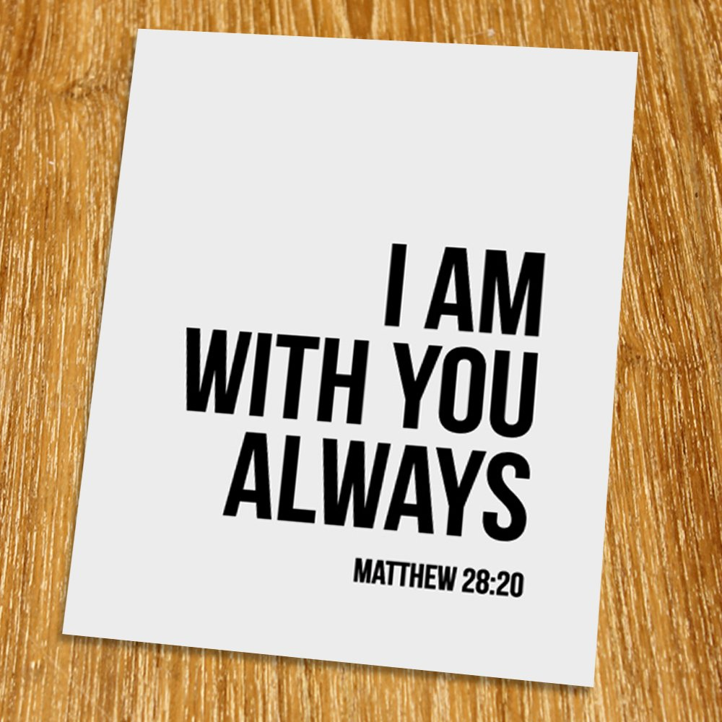
How to Failsafe Your Prayer-life.
You are my hiding place;
You preserve me from trouble;
You surround me with songs of deliverance. (Psalm 32:7—NASB95)
It starts in the hidden place
3. Third—Fill the room
a. The Father and the Son came in with you:
i. “your body is a temple of the Holy Spirit” (1Cor.6:19)

Slide 23

How to Failsafe Your Prayer-life.
Through Him then, let us continually offer up a sacrifice of praise to God, that is, the fruit of lips that give thanks to His name. (Heb.13:15—NASB95)
It starts in the hidden place
3. Third—Fill the room
b. With expressions of Praise and Thankfulness.

Slide 24
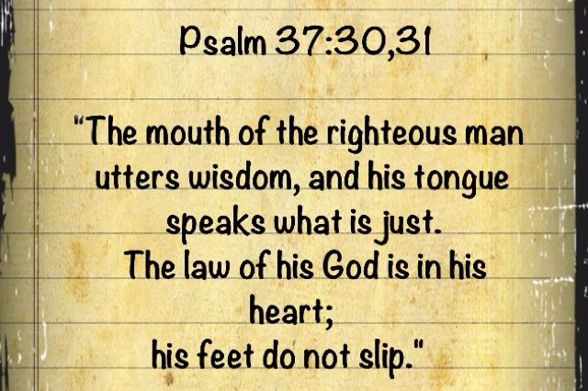
How to Failsafe Your Prayer-life.
³But know that the Lord has set apart the godly man for Himself;
The Lord hears when I call to Him. (Psalm 4:3—NASB95)
It starts in the hidden place
3. Third—Fill the room
c. With faith that God hears those who seek to be godly

Slide 25
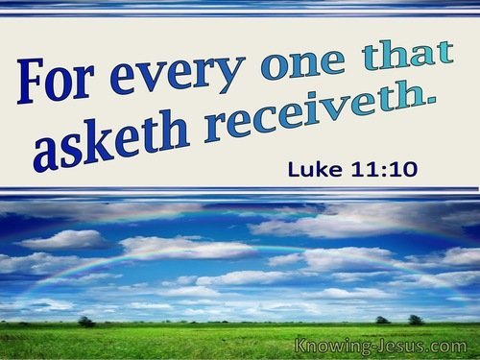
How to Failsafe Your Prayer-life.
¹⁴This is the confidence which we have before Him, that, if we ask anything according to His will, He hears us. (1John 5:14—NASB95)
It starts in the hidden place
3. Third—Fill the room
d. With assurance that God answers you

