Slide 1
How to Failsafe
Your Prayer-life.
Part 2.

Slide 2
How to Failsafe Your Prayer-life. Part 2.
It is crucial to put things in place to make sure your prayer-life does what it is supposed to do—To Failsafe it!

Slide 3
How to Failsafe Your Prayer-life. Part 2.
It is crucial to put things in place to make sure your prayer-life does what it is supposed to do—To Failsafe it!
A daily job.

Slide 4
How to Failsafe Your Prayer-life. Part 2.
It is crucial to put things in place to make sure your prayer-life does what it is supposed to do—To Failsafe it!
A daily job.
Distractions abound.

Slide 5
How to Failsafe Your Prayer-life. Part 2.
It is crucial to put things in place to make sure your prayer-life does what it is supposed to do—To Failsafe it!
A daily job.
Distractions abound.
Daily routines change.

Slide 6
How to Failsafe Your Prayer-life. Part 2.
It is crucial to put things in place to make sure your prayer-life does what it is supposed to do—To Failsafe it!
A daily job.
Distractions abound.
Daily routines change.
People and Things come and go.

Slide 7
How to Failsafe Your Prayer-life. Part 2.
It is crucial to put things in place to make sure your prayer-life does what it is supposed to do—To Failsafe it!
A daily job.
Distractions abound.
Daily routines change.
People and Things come and go.
The best-laid plans of mice and men often go awry.

Slide 8
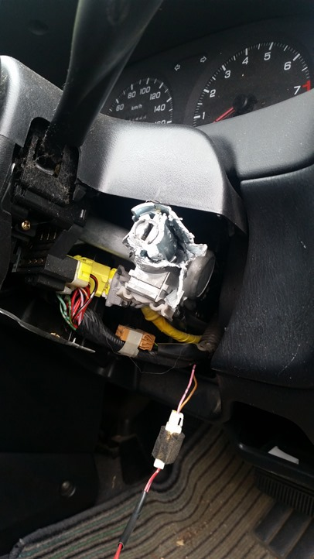
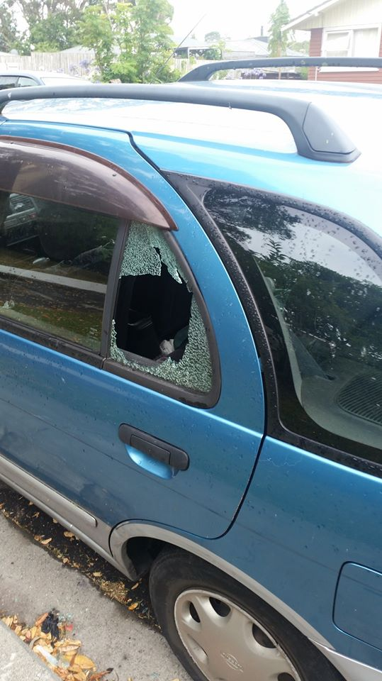
How to Failsafe Your Prayer-life. Part 2.
Despite the greatest care and structure something can still go wrong.

Slide 9
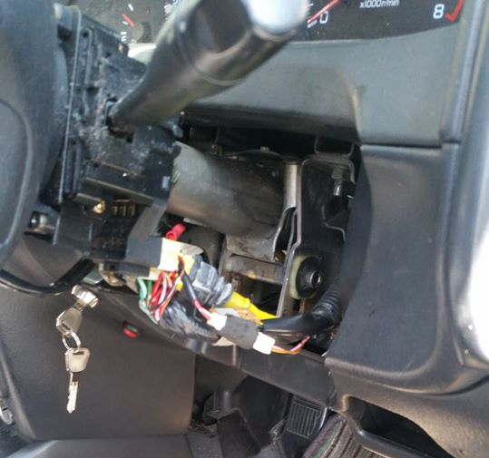
How to Failsafe Your Prayer-life. Part 2.
Despite the greatest care and structure something can still go wrong.

Slide 10
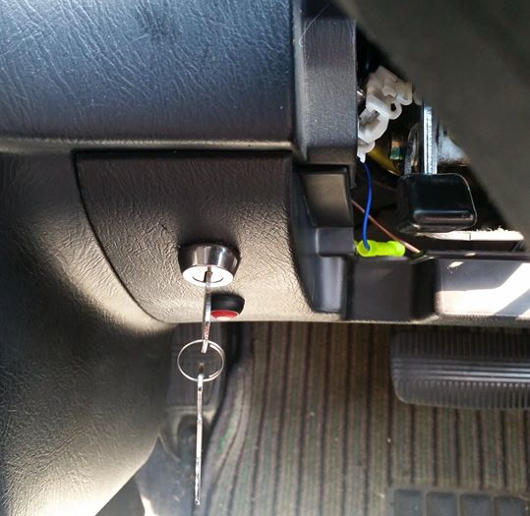
How to Failsafe Your Prayer-life. Part 2.
Despite the greatest care and structure something can still go wrong.

Slide 11
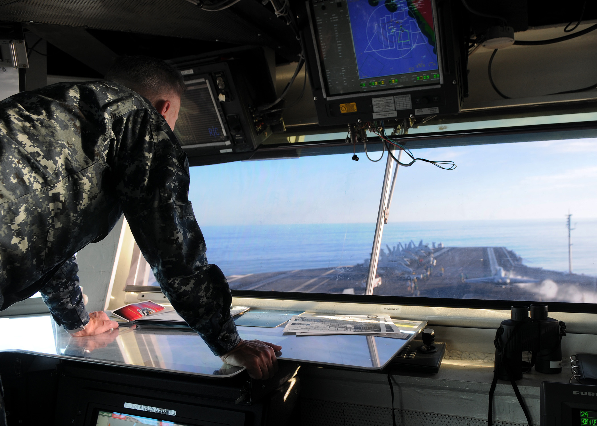
How to Failsafe Your Prayer-life. Part 2.
This is the control room of your spiritual life.

Slide 12
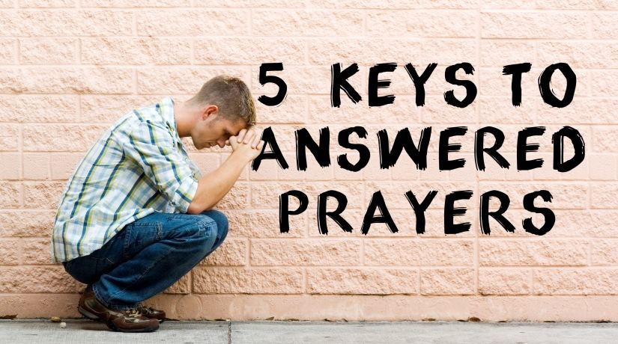
How to Failsafe Your Prayer-life. Part 2.

Slide 13

How to Failsafe Your Prayer-life. Part 2.
1. Be assured—God hears you!
Speak directly to God.
Pour out your heart.
Give godly purpose to the desires of your heart.
Never room for meaningless thoughts or words.
Remember who you are talking to.
Psalm 5:1-2—
Give ear to my words, O Lord;
consider my groaning.
²Give attention to the sound of my cry,
my King and my God,
for to you do I pray. (ESV)

Slide 14
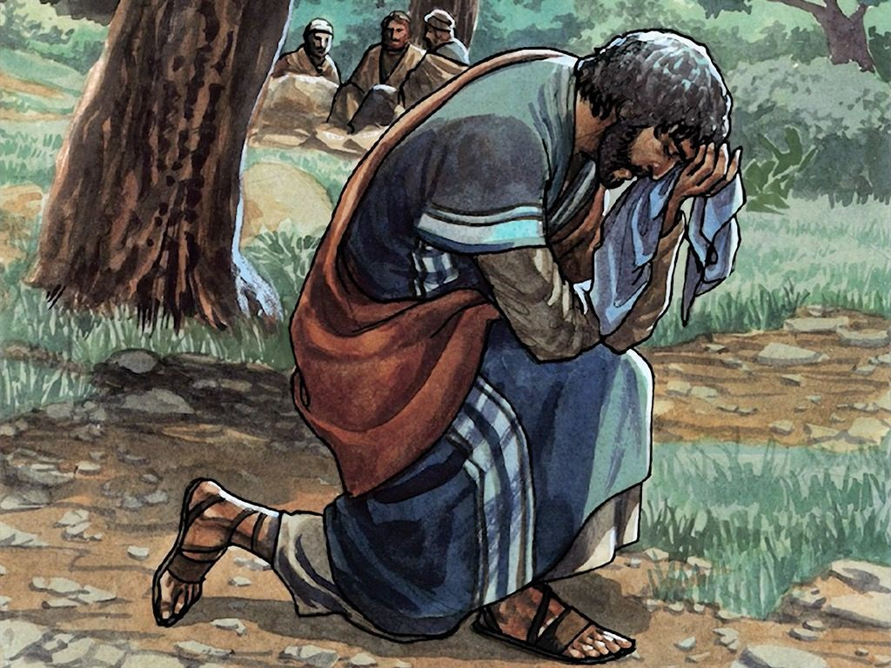
How to Failsafe Your Prayer-life. Part 2.
2. PRAY—
“Thy will be done!”
The very heart of Jesus’ ministry
No way out
Submission to the will of God was Jesus’ only desire.
The joy set before him was our salvation (Heb.12:2).
Matthew 26:39—³⁹And He went a little beyond them, and fell on His face and prayed, saying, “My Father, if it is possible, let this cup pass from Me; yet not as I will, but as You will.” (NASB95)

Slide 15
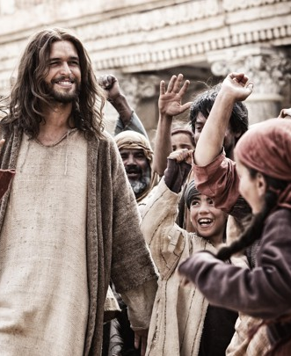
How to Failsafe Your Prayer-life. Part 2.
3. PRAY—
“Asking in Faith.”
Isn’t this too simple?
Don’t kid yourself!
Faithless prayers are too common.
Esp. ones asked with no real expectation of an answer.
What if God presented you with a list of forgotten prayers?
Doubt is an automatic “NO!” device.
James 1:6—⁶But he must ask in faith without any doubting, for the one who doubts is like the surf of the sea, driven and tossed by the wind. (NASB95)

Slide 16
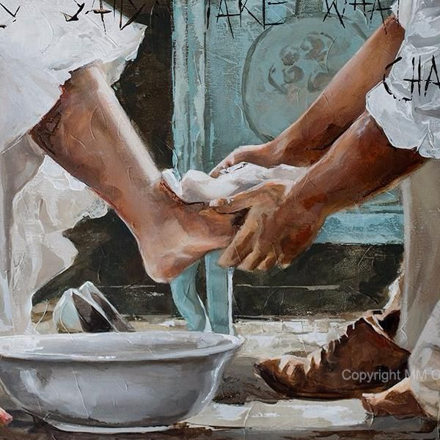
How to Failsafe Your Prayer-life. Part 2.
4. PRAY—
“In Humble Obedience.”
Look to the example of our Lord.
Philippians 2:8—Being found in appearance as a man, He humbled Himself by becoming obedient to the point of death, even death on a cross. (NASB95)
John 13:14-15—¹⁴ If I then, the Lord and the Teacher, washed your feet, you also ought to wash one another’s feet. ¹⁵For I gave you an example that you also should do as I did to you. (NASB95)

Slide 17
How to Failsafe Your Prayer-life. Part 2.
4. PRAY—
“In Humble Obedience.”
Square your faith—Truth!
Clear your conscience—Repent.
Adjust your actions—Change.
Stop pleasing yourselves—
Please the Lord
1 John 3:21-22—²¹ Beloved, if our heart does not condemn us, we have confidence before God; ²²and whatever we ask we receive from Him, because we keep His commandments and do the things that are pleasing in His sight. (NASB95)
John 13:14-15—¹⁴ If I then, the Lord and the Teacher, washed your feet, you also ought to wash one another’s feet. ¹⁵For I gave you an example that you also should do as I did to you. (NASB95)

Slide 18

Go into all the world and preach the Gospel…
—Mark 16:15.
Colossians 4:3—praying at the same time for us as well, that God will open up to us a door for the word, so that we may speak forth the mystery of Christ, for which I have also been imprisoned; (NASB95)
5. Pray—
For open doors

Slide 19
Go into all the world and preach the Gospel…
—Mark 16:15.
Needs are everywhere.
Seek the lost
Encourage the faint hearted
Visit the sick
Give to the needy
Fix something—use your talents.
5. Pray—
For open doors

Slide 20
Go into all the world and preach the Gospel…
—Mark 16:15.
Put your land up.
Isaiah 6:8—Then I heard the voice of the Lord, saying, “Whom shall I send, and who will go for Us?” Then I said, “Here am I. Send me!” (NASB95)
5. Pray—
For open doors

Slide 21
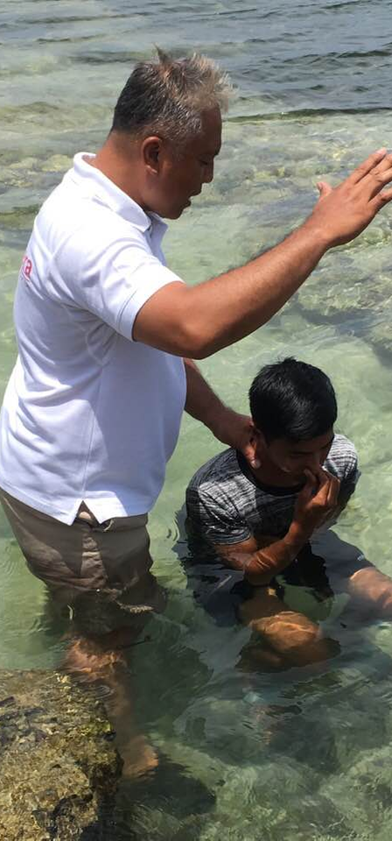
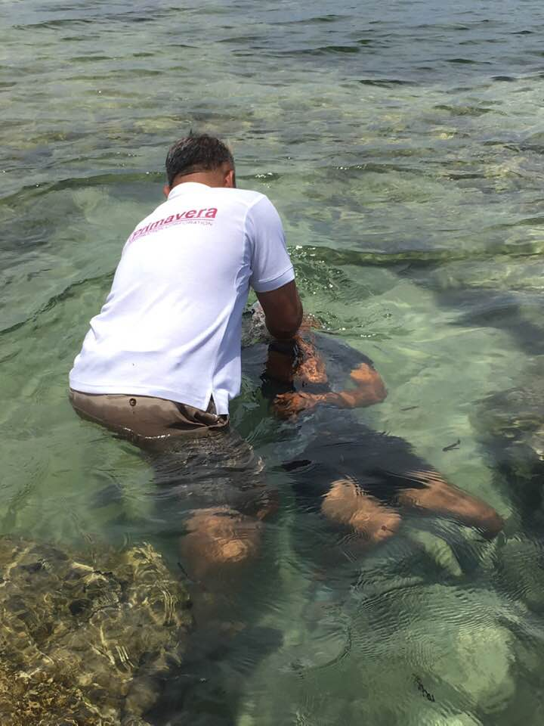
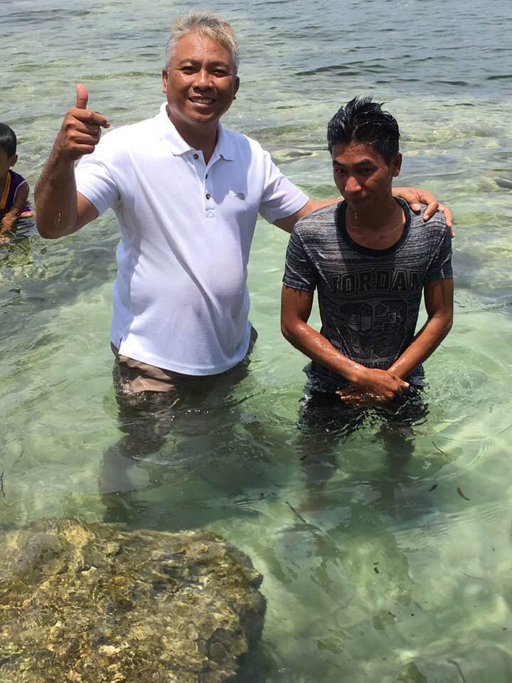
1 Peter 3:21—²¹Corresponding to that, baptism now saves you—not the removal of dirt from the flesh, but an appeal to God for a good conscience—through the resurrection of Jesus Christ, (NASB95)

