Slide 1
Life Under the Sun

Slide 2
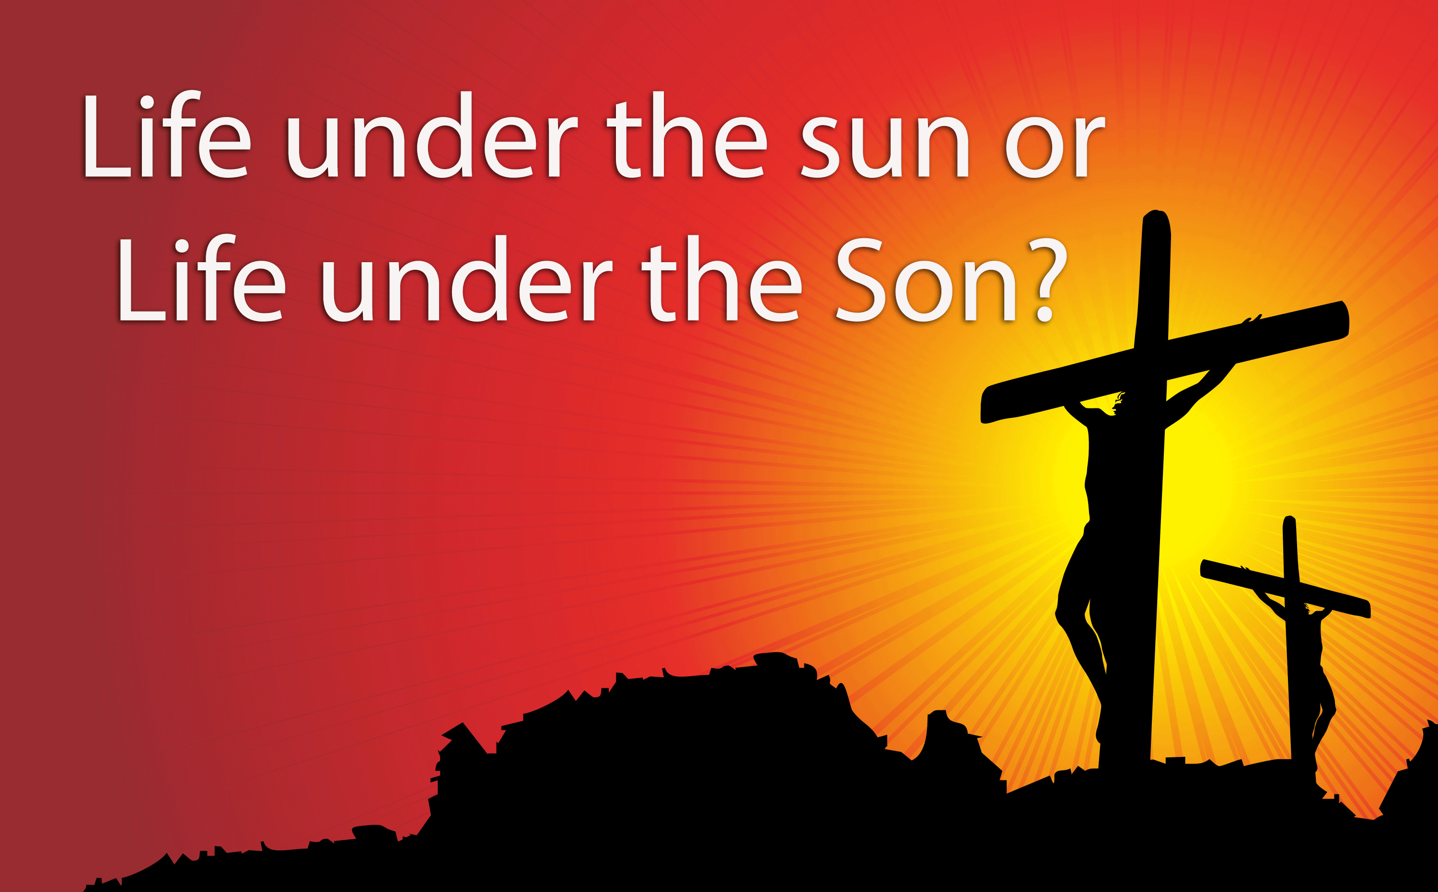
Life Under the Sun.

Slide 3
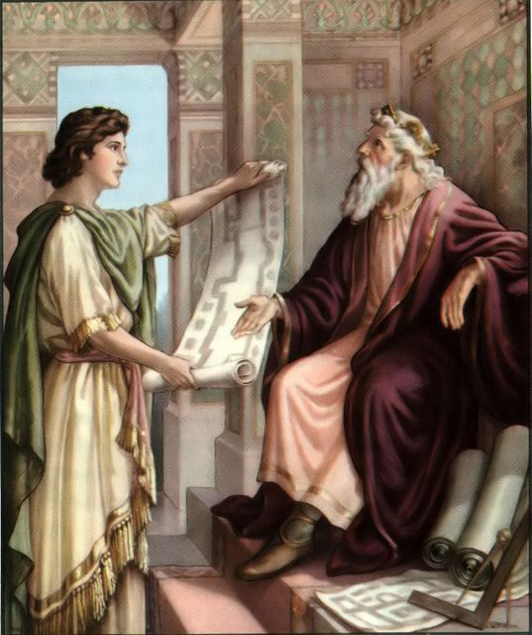
Life Under the Sun.
1. Life as Solomon saw it—The Meaningless of Life
apart from God
Ecclesiastes 1:2
“Vanity of vanities,” says the Preacher,
“Vanity of vanities! All is vanity.”
Solomon was the ‘wisest’ man who ever lived.
Knew it all
He had it all
He saw it all
He tried it all

Slide 4
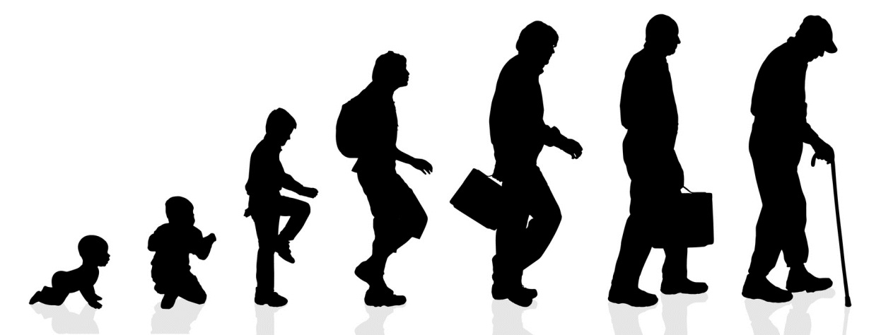
Life Under the Sun.
1. Life as Solomon saw it—Meaningless cycles
Ecclesiastes 1:3ff
v. 3. Meaningless work
v.4. Born and die
v.5. Sunrise after sunrise
v.6 Ceaseless winds
v.7. Ever flowing rivers
v.8 Senses never satisfied
v.9. ‘Nothing new under the sun.”

Slide 5

Life Under the Sun.
1. Life as Solomon saw it—Meaningless cycles
Apart from God and His church:
The daily pursuit of the things of this life, will at best, offer the joys that this life can offer.
Matthew 5:45—
…for He causes His sun to rise on the evil and the good, and sends rain on the righteous and the unrighteous.

Slide 6

Life Under the Sun.
1. Life as Solomon saw it—Meaningless cycles
Apart from God and His church:
But there is much to enjoy in this life.
  Family
  Friends
  Food
  Entertainment
  Satisfying work
  Holidays

Slide 7
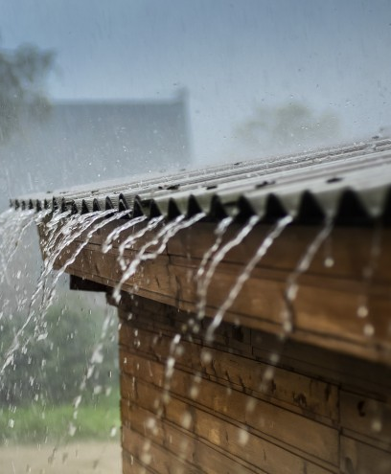
Life Under the Sun.
1. Life as Solomon saw it—Meaningless cycles
Apart from God and His church:
God has been generous and kind to believer and unbeliever alike (Mt.5:45).
Matthew 5:45—
…for He causes His sun to rise on the evil and the good, and sends rain on the righteous and the unrighteous.

Slide 8

Life Under the Sun.
1. Life as Solomon saw it—Meaningless cycles
Apart from God and His church:
But there is also:
  Death
  Hate
  Deception
  Wreckers
  Disappointment
  Danger
Matthew 5:45—
…for He causes His sun to rise on the evil and the good, and sends rain on the righteous and the unrighteous.

Slide 9
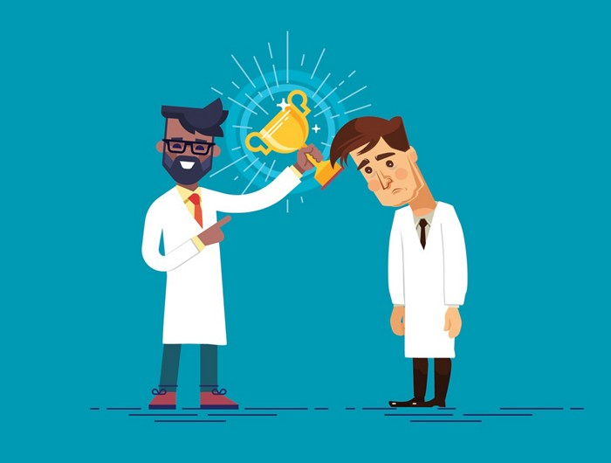
Life Under the Sun.
2. Beware the DEFAULT setting:
Seeing things from a purely worldly perspective is easy.
The devil doesn’t have to work hard for this.
A tinge of envy.
A hint of disrespect.
Small doses of ‘I’m hard done by.’

Slide 10
Life Under the Sun.
2. Beware the DEFAULT setting:
Titus 3:3
³ For we also once were foolish ourselves, disobedient, deceived, enslaved to various lusts and pleasures, spending our life in malice and envy, hateful, hating one another. (NASB95)

Slide 11

Life Under the Sun.
3. This world is not my home—You must be joking!
Destination ‘EARTH.’
Some might say to Christians:
“How many Christians do you see living in caravan parks?”
“You don’t look as if you’re going anywhere.”
“You look very comfortable here, to me.”
“Christians work to pay off debt like everyone else.”

Slide 12
Life Under the Sun.
3. This world is not my home—You must be joking!
Destination ‘EARTH.’
Ecclesiastes 2:4-8—
⁴I enlarged my works:
I built houses for myself,
I planted vineyards for myself;
⁵I made gardens and parks…
⁶I made ponds of water…
⁷I bought male and female slaves…
…flocks and herds…
⁸…silver and gold…
…male and female singers and the pleasures of men—many concubines.

Slide 13
Life Under the Sun.

Slide 14
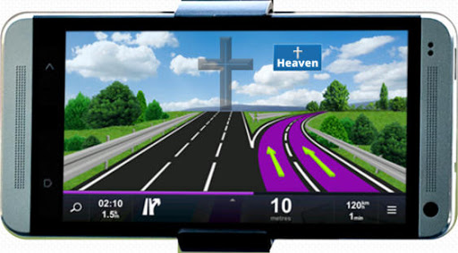

Life Under the Sun.
4. Recalibrating your GPS: Destination ‘Earth.”
Bigger
Brighter
Faster
More
Smarter
Richer
Prettier
Fitter
Healthier

Slide 15
Life Under the Sun.
4. Recalibrating your GPS: Destination ‘HEAVEN.”
We are not made for this earth as it is:
Ecclesiastes 3:11
He has made everything appropriate in its time. He has also set eternity in their heart,… (NASB95)

Slide 16
Life Under the Sun.
4. Recalibrating your GPS: Destination ‘HEAVEN.”
“Divinely Built Homes”:
John 14:1-3—“Do not let your heart be troubled; believe in God, believe also in Me. ²In My Father’s house are many dwelling places; if it were not so, I would have told you; for I go to prepare a place for you. ³If I go and prepare a place for you, I will come again and receive you to Myself, that where I am, there you may be also. (NASB95)

Slide 17
Life Under the Sun.
4. Recalibrating your GPS:
Destination ‘HEAVEN.”
“Eyes up”
Colossians 3:1-2 Therefore if you have been raised up with Christ, keep seeking the things above, where Christ is, seated at the right hand of God. ²Set your mind on the things above, not on the things that are on earth. (NASB95)

Slide 18
Life Under the Sun.
4. Recalibrating your GPS:
Destination ‘HEAVEN.”
“Indestructible – But must be looked to continually”
Hebrews 13:14
¹⁴For here we do not have a lasting city, but we are seeking the city which is to come. (NASB95)

Slide 19
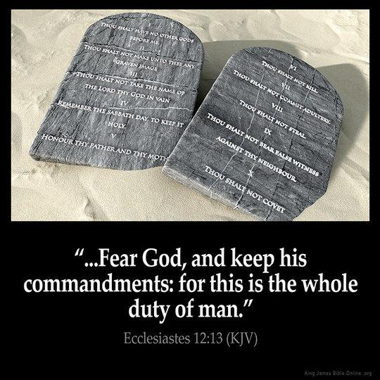
Life Under the Sun.
5. In the mean time: Day-to-Day Life in Christ
Summing up!
We are under orders.
Ecclesiastes 12:13-14
¹³The end of the matter; all has been heard. Fear God and keep his commandments, for this is the whole duty of man. ¹⁴For God will bring every deed into judgment, with every secret thing, whether good or evil. (ESV)

Slide 20
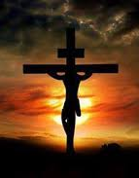
Life Under the Sun.
5. In the mean time: Day-to-Day Life in Christ
Summing up!
This will take us to the right side of judgment.
Ephesians 2:8-10
⁸ For by grace you have been saved through faith; and that not of yourselves, it is the gift of God; ⁹ not as a result of works, so that no one may boast. ¹⁰For we are His workmanship, created in Christ Jesus for good works, which God prepared beforehand so that we would walk in them. (NASB95)

Slide 21

Life Under the Sun.
5. In the mean time: Day-to-Day Life in Christ
Summing up!
Those good works are our works done in faith.
1 John 3:16
¹⁶ We know love by this, that He laid down His life for us; and we ought to lay down our lives for the brethren. (NASB95)

Slide 22
Life Under the Sun.
5. In the mean time: Day-to-Day Life in Christ
Summing up!
Employing talents and opportunities
“The need in front of you!”
The ever present ‘ministry’ (job needing doing).
Special care.
All for the souls of man.

Slide 23
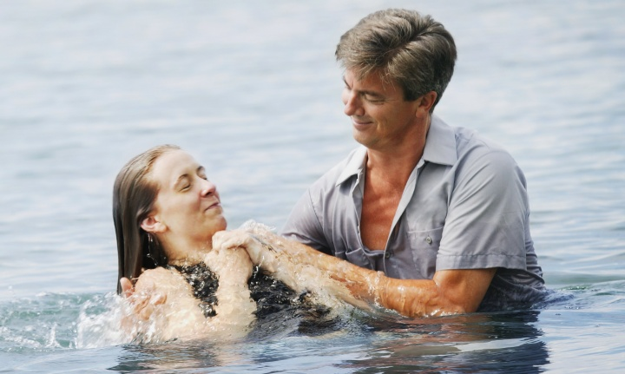
Romans 6:3-4—³Or do you not know that all of us who have been baptized into Christ Jesus have been baptized into His death? ⁴ Therefore we have been buried with Him through baptism into death, so that as Christ was raised from the dead through the glory of the Father, so we too might walk in newness of life. (NASB95)

