Slide 1
“Love is the pathway to holiness.”
1 Thessalonians 3:11-13

Slide 2
Love is the pathway to holiness.
My Point—Lest I miss it!
1 Thessalonians 3:11-13
¹¹Now may our God and Father Himself and Jesus our Lord direct our way to you; ¹²and may the Lord cause you to increase and abound in love for one another, and for all people, just as we also do for you; ¹³so that He may establish your hearts without blame in holiness before our God and Father at the coming of our Lord Jesus with all His saints. (NASB95)
Hebrews 12:14
¹⁴Pursue peace with everyone, and holiness—without it no one will see the Lord. (CSB)

Slide 3
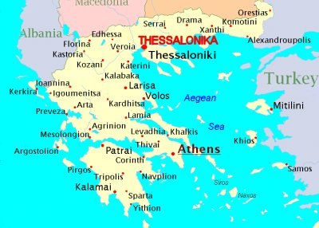
Love is the pathway to holiness.
1 Thessalonians 3:11-13
¹¹Now may our God and Father Himself and Jesus our Lord direct our way to you; ¹²and may the Lord cause you to increase and abound in love for one another, and for all people, just as we also do for you; ¹³so that He may establish your hearts without blame in holiness before our God and Father at the coming of our Lord Jesus with all His saints. (NASB95)

Slide 4
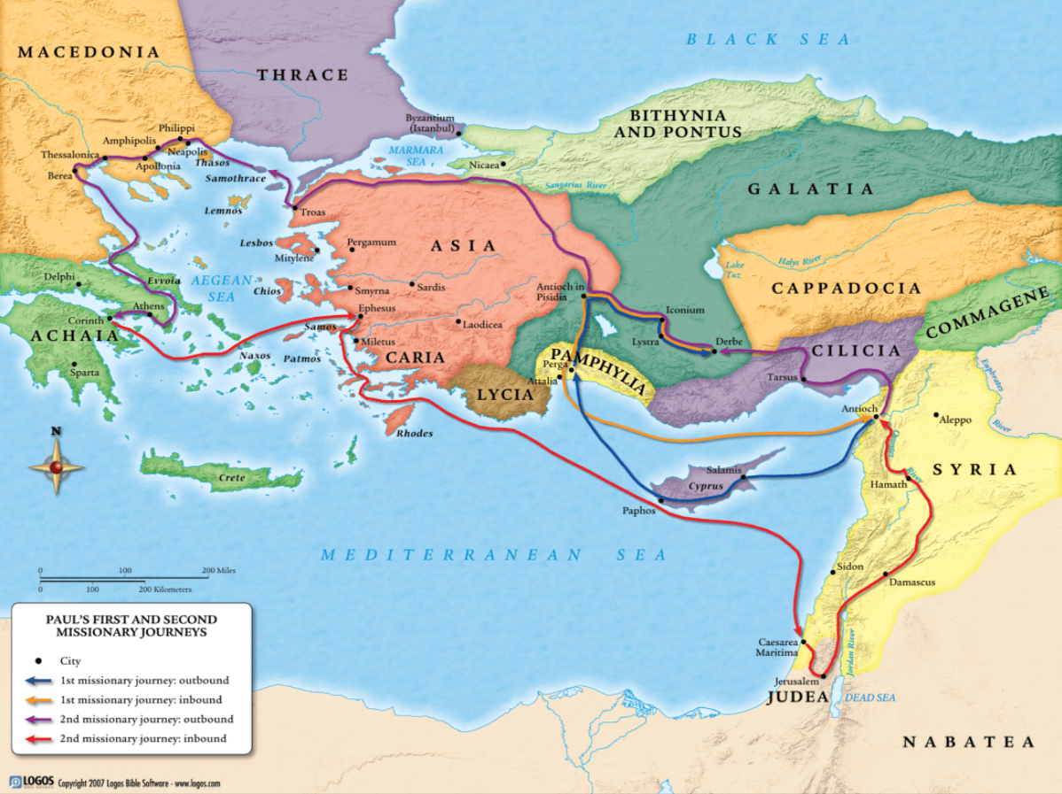
Love is the pathway to holiness.

Slide 5
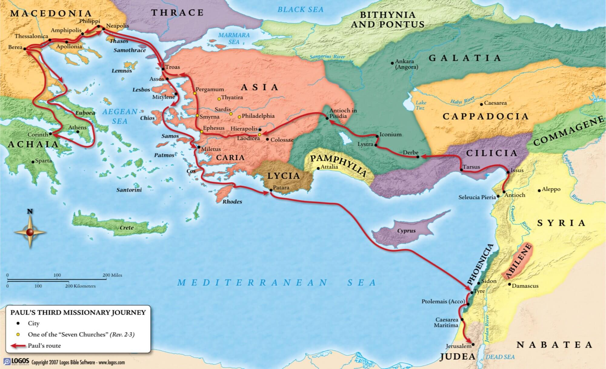
Love is the pathway to holiness.
Paul was not a missionary tourist
1 Thessalonians 3:11-13
¹¹Now may our God and Father Himself and Jesus our Lord direct our way to you; (NASB95)
Paul was coming with a purpose.
Wanted to share God’s blessings
God’s gifts
Mutual edification
He wanted God to be his guide.

Slide 6
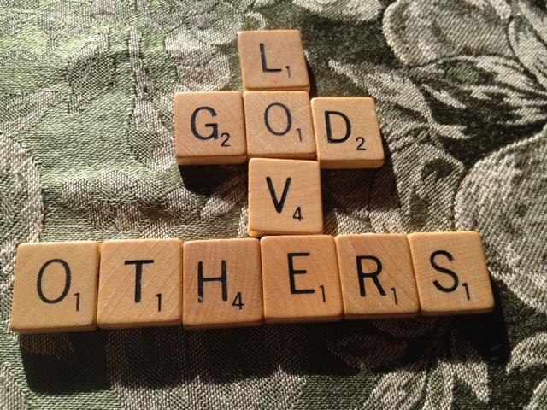

Love is the pathway to holiness.
Paul’s ministry—Love’s Increase!
1 Thessalonians 3:12
¹²and may the Lord cause you to increase and abound in love for one another, and for all people, just as we also do for you; (NASB95)

Slide 7

Love is the pathway to holiness.
Paul’s ministry—Love’s Increase!
God’s Love—It’s Power
1 Thessalonians 3:12
¹²and may the Lord cause you to increase and abound in love for one another, and for all people, just as we also do for you; (NASB95)
1 John 4:9
⁹ God’s love was revealed among us in this way: God sent his one and only Son into the world so that we might live through him. (CSB)

Slide 8

Love is the pathway to holiness.
Paul’s ministry—Love’s Increase!
God’s Love—Demonstrated.
1 Thessalonians 3:12
¹²and may the Lord cause you to increase and abound in love for one another, and for all people, just as we also do for you; (NASB95)
1 John 4:10
¹⁰Love consists in this: not that we loved God, but that he loved us and sent his Son to be the atoning sacrifice for our sins. (CSB)

Slide 9
Love is the pathway to holiness.
Paul’s ministry—Love’s Increase!
God’s Love—It’s Essence
1 Thessalonians 3:12
¹²and may the Lord cause you to increase and abound in love for one another, and for all people, just as we also do for you; (NASB95)
1 John 4:16
¹⁶ And we have come to know and to believe the love that God has for us. God is love, and the one who remains in love remains in God, and God remains in him. (CSB)

Slide 10

Love is the pathway to holiness.
Paul’s ministry—Love’s Purpose!
God’s Love—Makes us Guiltless before God
1 Thessalonians 3:13
¹³so that He may establish your hearts without blame in holiness before our God and Father at the coming of our Lord Jesus with all His saints. (NASB95)
The State of your heart
Established / Strengthened
Blameless
  Satan’s power was in his accusation
  He could point to our guilt
  Jesus disempowered him at the cross
  We are blameless before God through an act of GRACE

Slide 11
Love is the pathway to holiness.
Paul’s ministry—Love’s Purpose!
God’s Love—Makes us Holy before God
1 Thessalonians 3:13
¹³so that He may establish your hearts without blame in holiness before our God and Father at the coming of our Lord Jesus with all His saints. (NASB95)
The State of our Being
Set apart for God
  Be holy as I am holy (1Pet.1:16)
  Holy priesthood (1Pet.2:5)
  Holy nation (1Pet.2:9)
  Regard Christ the Lord as holy (1Pet.3:15)
  Pure
  Clean
  Separate

Slide 12
Love is the pathway to holiness.
Paul’s ministry—Love’s Purpose!
God’s Love—Makes us Holy before God
1 Thessalonians 3:13
¹³so that He may establish your hearts without blame in holiness before our God and Father at the coming of our Lord Jesus with all His saints. (NASB95)
The State of our Conduct
1 Timothy 4:12
Don’t let anyone despise your youth, but set an example for the believers in speech, in conduct, in love, in faith, and in purity. (CSB)

Slide 13
Love is the pathway to holiness.
Paul’s ministry—Love’s Purpose!
God’s Love—Makes us Holy before God
1 Thessalonians 3:13
¹³so that He may establish your hearts without blame in holiness before our God and Father at the coming of our Lord Jesus with all His saints. (NASB95)
The State of our Conduct
1 Timothy 5:1-2
Don’t rebuke an older man, but exhort him as a father, younger men as brothers, ²older women as mothers, and the younger women as sisters with all purity. (CSB)

Slide 14
Love is the pathway to holiness.
Paul’s ministry—Love’s Purpose!
God’s Love—Makes us Holy before God
1 Thessalonians 3:13
¹³so that He may establish your hearts without blame in holiness before our God and Father at the coming of our Lord Jesus with all His saints. (NASB95)
The State of our Conduct
James 4:8
Draw near to God, and he will draw near to you. Cleanse your hands, sinners, and purify your hearts, you double-minded. (CSB)

Slide 15

Love is the pathway to holiness.
Paul’s ministry—Love’s Purpose!
God’s Love—Set a Sinless Saviour
1 Thessalonians 3:13
¹³so that He may establish your hearts without blame in holiness before our God and Father at the coming of our Lord Jesus with all His saints. (NASB95)
The Gift of God
2 Corinthians 5:21
²¹He made the one who did not know sin to be sin for us, so that in him we might become the righteousness of God. (CSB)

Slide 16


Slide 17
