Slide 2

Peace Beyond Comprehension.
In a troubled world

Slide 3
Looking in the wrong places
Distracted by counterfeits
Peace in the midst of tribulation
Harvest of peace
Blessed-peacemakers

Slide 4

1. Seeking peace

Slide 5

Peace Beyond Comprehension.
1. Seeking Peace
Temporary Fixes

Slide 6

Peace Beyond Comprehension.
1. Seeking Peace
A. Temporary Fixes
  1. Looking to Wrong Definitions
    Anything but Jesus

Slide 7

Peace Beyond Comprehension.
1. Seeking Peace
A. Temporary Fixes
  1. Looking to Wrong Definitions
    Anything but Jesus
    Harmony with the universe

Slide 8

Peace Beyond Comprehension.
1. Seeking Peace
A.Temporary Fixes
  1. Looking to Wrong Definitions
    Anything but Jesus
    Harmony with the universe
    One with nature

Slide 9
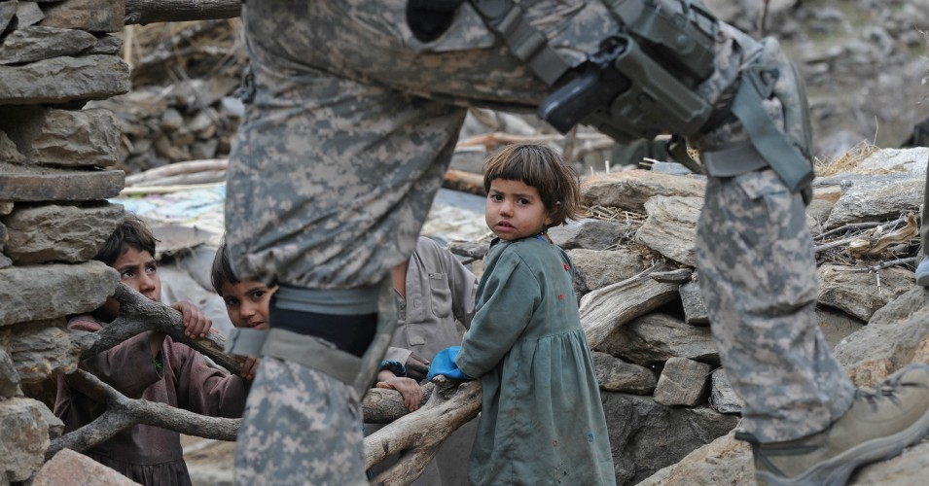

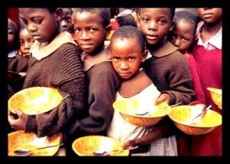
Peace Beyond Comprehension.
1. Seeking Peace
A. Temporary Fixes
  1. Looking to Wrong Definitions
    Anything but Jesus
    Harmony with the universe
    One with nature
    Solving the worlds ills
These are real problems
Praise God for the sacrifice
Peace is not defined by us!

Slide 10
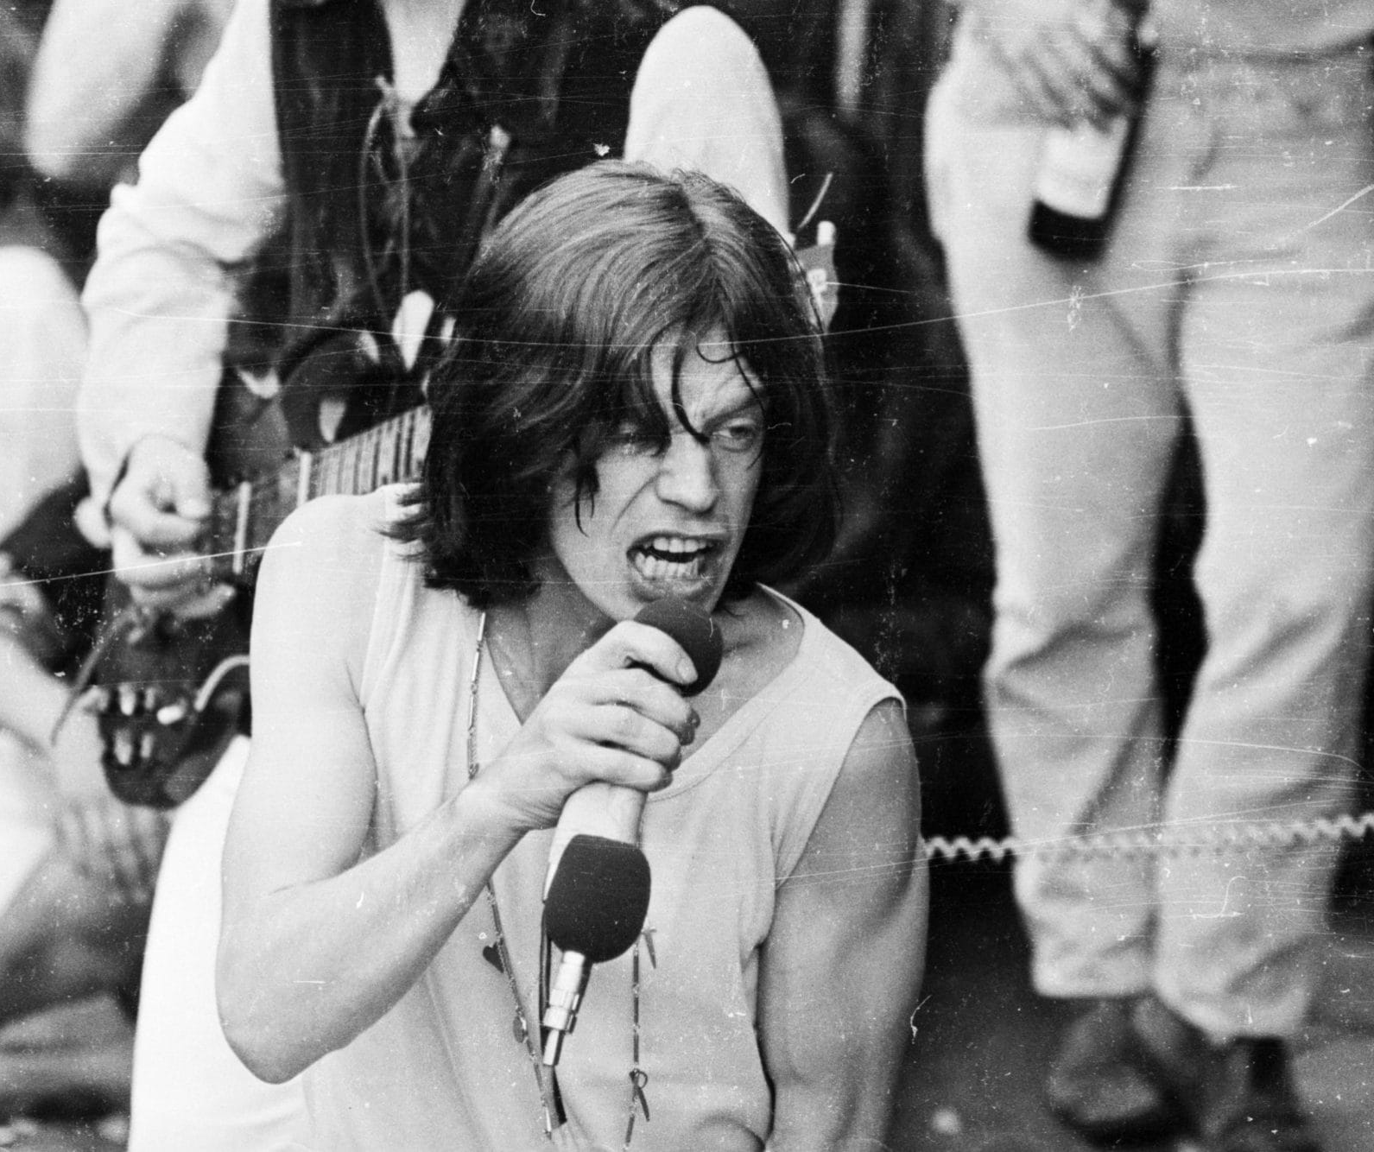
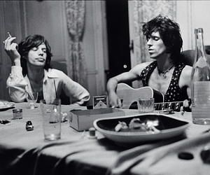

We warned.
This becomes…
Peace Beyond Comprehension.
1. Seeking Peace
A. Temporary Fixes
  2. Looking in Wrong Places

Slide 11
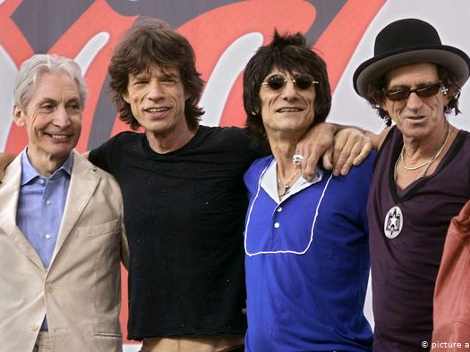
…this!
Peace Beyond Comprehension.

Slide 12

Tragically, this becomes…
Peace Beyond Comprehension.

Slide 13
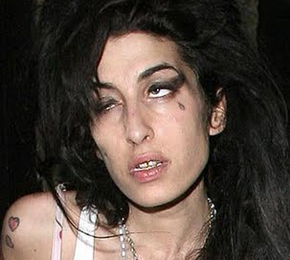
…this!
Peace Beyond Comprehension.

Slide 14
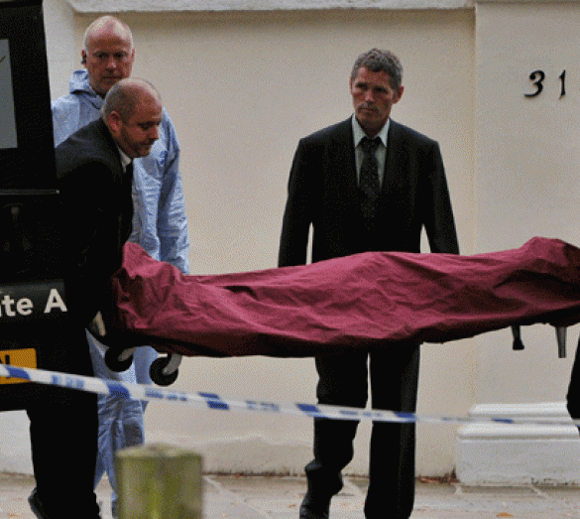
…this!
Amy Jade Winehouse died of accidental alcohol poisoning.
(14 September 1983 – 23 July 2011)
Peace Beyond Comprehension.

Slide 15
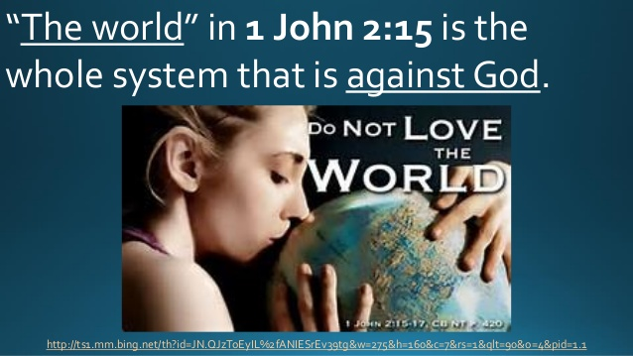
Peace Beyond Comprehension.
1. Seeking Peace
1 John 2:16—
¹⁶ For all that is in the world, the lust of the flesh and the lust of the eyes and the boastful pride of life, is not from the Father, but is from the world. (NASB95)
A. Temporary Fixes
  3. You won’t find it anything here

Slide 16

Peace Beyond Comprehension.
1. Seeking Peace
B. No Quick Fix!
1 Peter 3:10-12—
¹⁰ For,
“The one who desires life, to love and see good days,
Must keep his tongue from evil and his lips from speaking deceit.
¹¹ “He must turn away from evil and do good;
He must seek peace and pursue it.
¹² “For the eyes of the Lord are toward the righteous,
And His ears attend to their prayer,
But the face of the Lord is against those who do evil.” (NASB95)

Slide 17

2. Finding peace

Slide 18
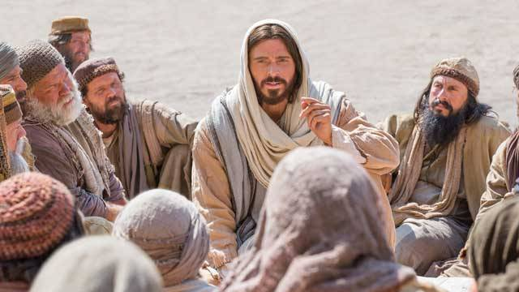
Peace Beyond Comprehension.
2. Finding Peace
A. Only in Jesus
John 16:33—
³³ These things I have spoken to you, so that in Me you may have peace. In the world you have tribulation, but take courage; I have overcome the world.” (NASB95)

Slide 19
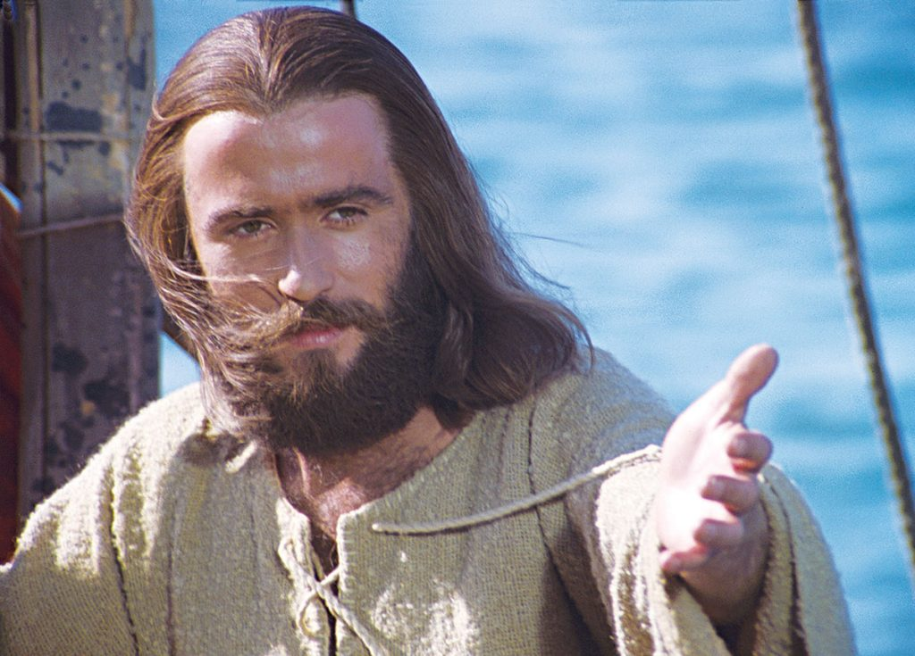
Peace Beyond Comprehension.
2. Finding Peace
B. He calls—You must respond
Matthew 11:28-30—
²⁸ “Come to Me, all who are weary and heavy-laden, and I will give you rest. ²⁹Take My yoke upon you and learn from Me, for I am gentle and humble in heart, and you will find rest for your souls. ³⁰For My yoke is easy and My burden is light.” (NASB95)

Slide 20

Peace Beyond Comprehension.
2. Finding Peace
C. Eternal peace built on an eternal message
Matthew 24:35—
³⁵Heaven and earth will pass away, but My words will not pass away. (NASB95)

Slide 21

3. Keeping peace

Slide 22

Peace Beyond Comprehension.
3. Keeping Peace
A. A new focus
Philippians 4:6-8—
⁶Be anxious for nothing, but in everything by prayer and supplication with thanksgiving let your requests be made known to God. ⁷And the peace of God, which surpasses all comprehension, will guard your hearts and your minds in Christ Jesus.
⁸Finally, brethren, whatever is true, whatever is honourable, whatever is right, whatever is pure, whatever is lovely, whatever is of good repute, if there is any excellence and if anything worthy of praise, dwell on these things. (NASB95)

Slide 23

Peace Beyond Comprehension.
3. Keeping Peace
B. From God
Peace in the love shown by the Father
Peace in the Prince of Peace
Peace in the promises in God’s Word
Peace in the goodness of the church
Peace in wisdom and strength to overcome

Slide 24
Peace Beyond Comprehension.
3. Keeping Peace
C. While here!
Peace through troubled times
Peace through persecution
Peace through abandonment
Peace through temptation
Peace through times of want
Peace through times of lose

Slide 25
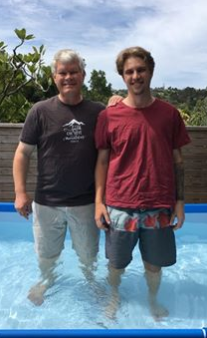
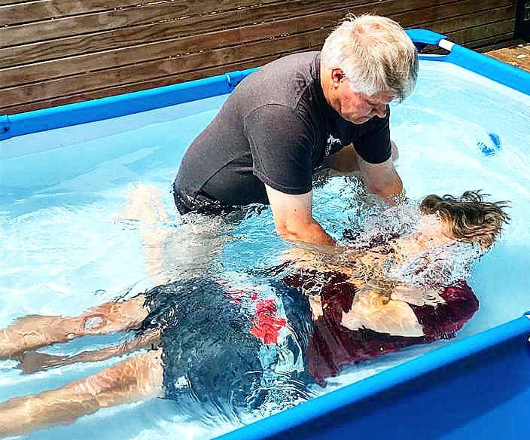
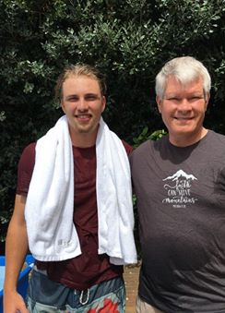
Peace Beyond Comprehension.
In Jesus’ death, burial and resurrection He made a way of peace between God and man—
In baptism we accept that peace!

