Slide 1
“Spiritual Disciplines”
John Staiger
Morningside Church of Christ
Sunday 27 October 2019
AM Sermon

Slide 3
Spiritual Disciplines

Slide 4


Co-operation
And let us…
  All of us
  Without exception
  Together
  Is this you?
Hebrews 10:24-25
²⁴And let us consider how to stir up one another to love and good works, ²⁵not neglecting to meet together, as is the habit of some, but encouraging one another, and all the more as you see the Day drawing near. (ESV)

Slide 5

2. Concentration
Consider how…
  Resources—
    Attentiveness
    Investigation
    Prayer
    Time
    Persistence
    On the job training
    Mentors
Hebrews 10:24-25
²⁴And let us consider how to stir up one another to love and good works, ²⁵not neglecting to meet together, as is the habit of some, but encouraging one another, and all the more as you see the Day drawing near. (ESV)

Slide 6
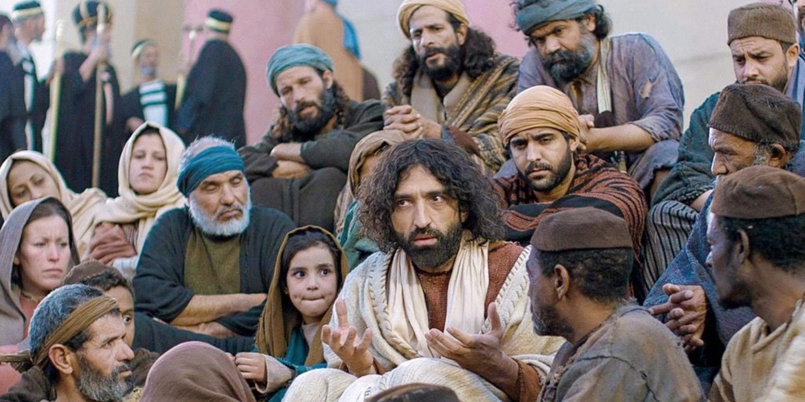
3. Catalyst—Cause Excitement
Stir up one another…
  Excited Christians—Not a common thought.
  Exciting each other
  Not always welcome
  Bring out of spiritual stupor
  “The word of God is living and active…”
  Jesus challenged everyone to change through his teachings, miracles and his death, burial and resurrection.
Hebrews 10:24-25
²⁴And let us consider how to stir up one another to love and good works, ²⁵not neglecting to meet together, as is the habit of some, but encouraging one another, and all the more as you see the Day drawing near. (ESV)

Slide 7

4. Conduct
To love and good works…
  A growing faith is characterised by love and good deeds.
  Hate and indifference bring destruction.
  “Love one another as I have loved you…”
  Luke 6:27—“But I say to you who hear, love your enemies, do good to those who hate you,…”
Hebrews 10:24-25
²⁴And let us consider how to stir up one another to love and good works, ²⁵not neglecting to meet together, as is the habit of some, but encouraging one another, and all the more as you see the Day drawing near. (ESV)

Slide 8
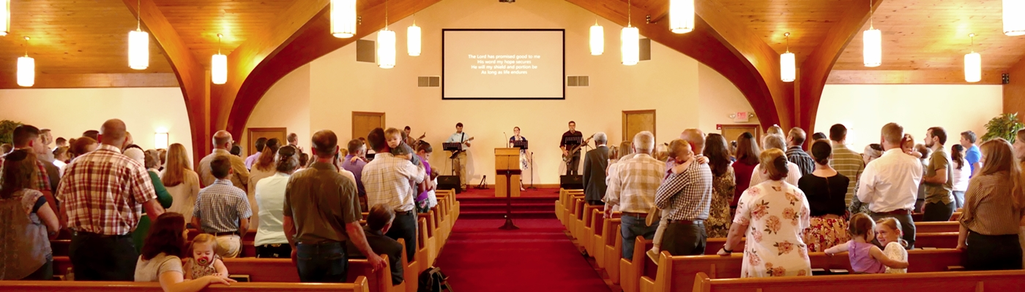
5. Community
Meet together…
  Together we see—
    Family life
    Faith in action
    Know-how shared
    Strength seen and given
    Needs meet
    Weakness helped
  You walk away from this at you spiritual peril—Some are!
Hebrews 10:24-25
²⁴And let us consider how to stir up one another to love and good works, ²⁵not neglecting to meet together, as is the habit of some, but encouraging one another, and all the more as you see the Day drawing near. (ESV)

Slide 9

6. Constant encouragers
Encourage one another…
  Constant Upliftment—
    In prayer
    Praise
    Expressions of joy
    Gentle correction
  Heb.3:13—But encourage one another day after day
  Jesus is coming soon…
Hebrews 10:24-25
²⁴And let us consider how to stir up one another to love and good works, ²⁵not neglecting to meet together, as is the habit of some, but encouraging one another, and all the more as you see the Day drawing near. (ESV)

Slide 10

6. Constant encouragers
Encourage one another…
  Jesus is coming soon
    Unannounced—Like a thief in the night
    Judgement of all
    Wrath to be avoided now
    Glory to share
    Are you ready?
Hebrews 10:24-25
²⁴And let us consider how to stir up one another to love and good works, ²⁵not neglecting to meet together, as is the habit of some, but encouraging one another, and all the more as you see the Day drawing near. (ESV)

Slide 11


