Slide 1
The Church: The Temple of God
Morningside Church of Christ
Sunday 1 December 2019
AM Sermon
John Staiger

Slide 3
The Church:
The Temple of God

Slide 4
The Church: The Temple of God
4 Temples
2 Physical
2 Spiritual

Slide 5
The Church: The Temple of God
4 Temples
2 Physical—Stones from a quarry
2 Spiritual—‘Not made with hands.’

Slide 6
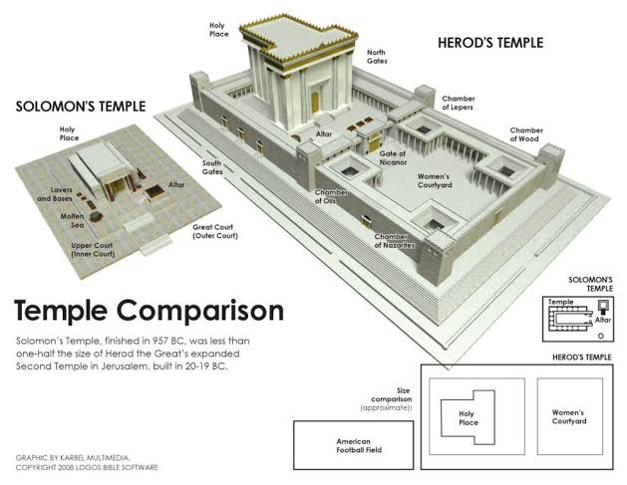
The Church: The Temple of God
4 Temples
2 Physical—Stones from a quarry
  Solomon’s temple (957BC – 586BC)
  Herod’s temple (20BC -70AD)
2 Spiritual—‘Not made with hands.’
  The Church
  Heaven
1 Kings 8:27—²⁷“But will God indeed dwell on the earth? Behold, heaven and the highest heaven cannot contain you; how much less this house that I have built! (ESV)

Slide 7
The Church: The Temple of God
4 Temples
2 Physical—Stones from a quarry
  Solomon’s temple (957BC – 586BC)
  Herod’s temple (20BC -70AD)
2 Spiritual—‘Not made with hands.’
  The Church
  Heaven
Mark 13:2—²And Jesus said to him, “Do you see these great buildings? There will not be left here one stone upon another that will not be thrown down.” (ESV)

Slide 8
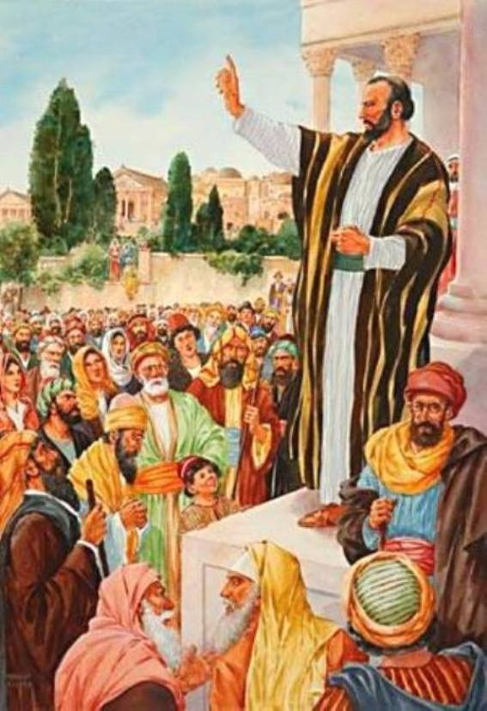
The Church: The Temple of God
4 Temples
2 Spiritual—‘Not made with hands.’
  The Church (Pentecost 30AD - ?)
  Heaven (When Jesus returns)
Matthew 16:18—¹⁸And I tell you, you are Peter, and on this rock I will build my church, and the gates of hell shall not prevail against it. (ESV)

Slide 9
The Church: The Temple of God
4 Temples
To the Church in Philadelphia
Revelation 3:12—¹²The one who conquers, I will make him a pillar in the temple of my God. Never shall he go out of it, and I will write on him the name of my God, and the name of the city of my God, the new Jerusalem, which comes down from my God out of heaven, and my own new name. (ESV)
Revelation 21:22—²²And I saw no temple in the city, for its temple is the Lord God the Almighty and the Lamb. (ESV)
2 Spiritual—‘Not made with hands.’
  The Church (Pentecost 30AD - ?)
  Heaven

Slide 10

The Church: The Temple of God
The Church is ‘The People of God.
The church not an external entity with its various groups, buildings and services.
It is people of like mind—the Mind of Christ.
Never to be spoken of by Christians as: “Them,” or “They,” or “Those...”

Slide 11
The Church: The Temple of God
The Church is ‘The People of God.
The church not an external entity with its various groups, buildings and services.
It is people of like mind—the Mind of Christ.
Never to be spoken of by Christians as: “Them,” or “They,” or “Those...”

Slide 12
The Church: The Temple of God
The Church is ‘The People of God.
The church not an external entity with its various groups, buildings and services.
It is people of like mind—the Mind of Christ.
Never to be spoken of by Christians as: “Them,” or “They,” or “Those...”

Slide 13
The Church: The Temple of God
The Church is ‘The People of God.
The church not an external entity with its various groups, buildings and services.
It is people of like mind—the Mind of Christ.
Never to be spoken of by Christians as: “Them,” or “They,” or “Those...”

Slide 14
The Church: The Temple of God
The world has its own ideas about the church:

Slide 15

The Church: The Temple of God
The world has its own ideas about the church:
  An organisation designed to show people how wrong they are (A judgment organisation)
  That proclaims things they don’t want to hear
  That condemns sins they don’t want to quit
  And that tells them about a future that they don’t want to believe in.

Slide 16

The Church: The Temple of God
The world has its own ideas about the church:
  An organisation designed to show people how wrong they are (A judgment organisation)
  That proclaims things they don’t want to hear
  That condemns sins they don’t want to quit
  And that tells them about a future that they don’t want to believe in.

Slide 17

The Church: The Temple of God
The world has its own ideas about the church:
  An organisation designed to show people how wrong they are (A judgment organisation)
  That proclaims things they don’t want to hear
  That condemns sins they don’t want to quit
  And that tells them about a future that they don’t want to believe in.

Slide 18
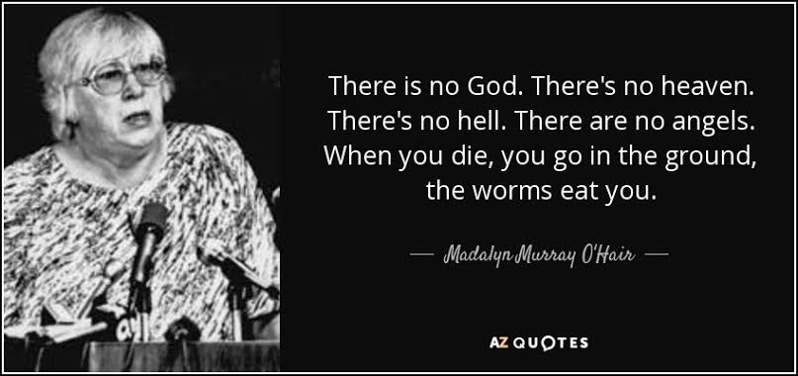
The Church: The Temple of God
The world has its own ideas about the church:
  An organisation designed to show people how wrong they are (A judgment organisation)
  That proclaims things they don’t want to hear
  That condemns sins they don’t want to quit
  And that tells them about a future that they don’t want to believe in.

Slide 19

The Church: The Temple of God
The ‘You is Us!’
1 Corinthians 3:16-17—
¹⁶Do you not know that you are God's temple and that God's Spirit dwells in you?
¹⁷If anyone destroys God's temple, God will destroy him. For God's temple is holy, and you are that temple. (ESV)
We speak of the church in God’s terms:
  God’s temple is the church—us!
  Holy Spirit dwells in God’s temple—us!
  Destroying God’s temple is destroying the church—us!
  Thus, God will destroy those who destroy—us!
  God’s temple is holy—that holy temple is the holy church—us!

Slide 20

The Church: The Temple of God
The ‘You is Us!’
1 Corinthians 3:16-17—
¹⁶Do you not know that you are God's temple and that God's Spirit dwells in you?
¹⁷If anyone destroys God's temple, God will destroy him. For God's temple is holy, and you are that temple. (ESV)
We speak of the church in God’s terms:
  God’s temple is the church—us!
  Holy Spirit dwells in God’s temple—us!
  Destroying God’s temple is destroying the church—us!
  Thus, God will destroy those who destroy—us!
  God’s temple is holy—that holy temple is the holy church—us!

Slide 21
The Church: The Temple of God
The ‘You is Us!’
1 Corinthians 3:16-17—
¹⁶Do you not know that you are God's temple and that God's Spirit dwells in you?
¹⁷If anyone destroys God's temple, God will destroy him. For God's temple is holy, and you are that temple. (ESV)
We speak of the church in God’s terms:
  God’s temple is the church—us!
  Holy Spirit dwells in God’s temple—us!
  Destroying God’s temple is destroying the church—us!
  Thus, God will destroy those who destroy—us!
  God’s temple is holy—that holy temple is the holy church—us!

Slide 22
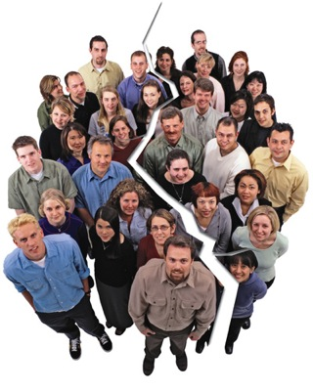
The Church: The Temple of God
The ‘You is Us!’
1 Corinthians 3:16-17—
¹⁶Do you not know that you are God's temple and that God's Spirit dwells in you?
¹⁷If anyone destroys God's temple, God will destroy him. For God's temple is holy, and you are that temple. (ESV)
We speak of the church in God’s terms:
  God’s temple is the church—us!
  Holy Spirit dwells in God’s temple—us!
  Destroying God’s temple is destroying the church—us!
  Thus, God will destroy those who destroy—us!
  God’s temple is holy—that holy temple is the holy church—us!

Slide 23
The Church: The Temple of God
The ‘You is Us!’
1 Corinthians 3:16-17—
¹⁶Do you not know that you are God's temple and that God's Spirit dwells in you?
¹⁷If anyone destroys God's temple, God will destroy him. For God's temple is holy, and you are that temple. (ESV)
We speak of the church in God’s terms:
  God’s temple is the church—us!
  Holy Spirit dwells in God’s temple—us!
  Destroying God’s temple is destroying the church—us!
  Thus, God will destroy those who destroy—us!
  God’s temple is holy—that holy temple is the holy church—us!

Slide 24
The Church: The Temple of God
The ‘You is Us!’
1 Corinthians 3:16-17—
¹⁶Do you not know that you are God's temple and that God's Spirit dwells in you?
¹⁷If anyone destroys God's temple, God will destroy him. For God's temple is holy, and you are that temple. (ESV)
We speak of the church in God’s terms:
  God’s temple is the church—us!
  Holy Spirit dwells in God’s temple—us!
  Destroying God’s temple is destroying the church—us!
  Thus, God will destroy those who destroy—us!
  God’s temple is holy—that holy temple is the holy church—us!

Slide 25
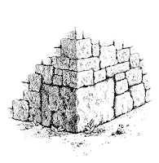
The Church: The Temple of God
Solid Foundation
Ephesians 2:20-22—
²⁰built on the foundation of the apostles and prophets, Christ Jesus himself being the cornerstone, ²¹in whom the whole structure, being joined together, grows into a holy temple in the Lord. ²²In him you also are being built together into a dwelling place for God by the Spirit. (ESV)
Apostles and Prophets
  Foundational
  Witnesses of the resurrection of Christ
  Inspired to preach and write God’s word

Slide 26
The Church: The Temple of God
Solid Foundation
Ephesians 2:20-22—
²⁰built on the foundation of the apostles and prophets, Christ Jesus himself being the cornerstone, ²¹in whom the whole structure, being joined together, grows into a holy temple in the Lord. ²²In him you also are being built together into a dwelling place for God by the Spirit. (ESV)
Jesus Christ
  The rock on which the church is built
  The stone rejected by disbelievers
  Our assurance of Divine construction

Slide 27
The Church: The Temple of God
Solid Foundation
Ephesians 2:20-22—
²⁰built on the foundation of the apostles and prophets, Christ Jesus himself being the cornerstone, ²¹in whom the whole structure, being joined together, grows into a holy temple in the Lord. ²²In him you also are being built together into a dwelling place for God by the Spirit. (ESV)
Holy Temple
  Set apart for God.
  Exclusively His.
  We are ‘Joined together’
  Growing stone by stone
  ‘Dwelling place of God.’
  The Holy Spirit is God’s contractor.

Slide 28
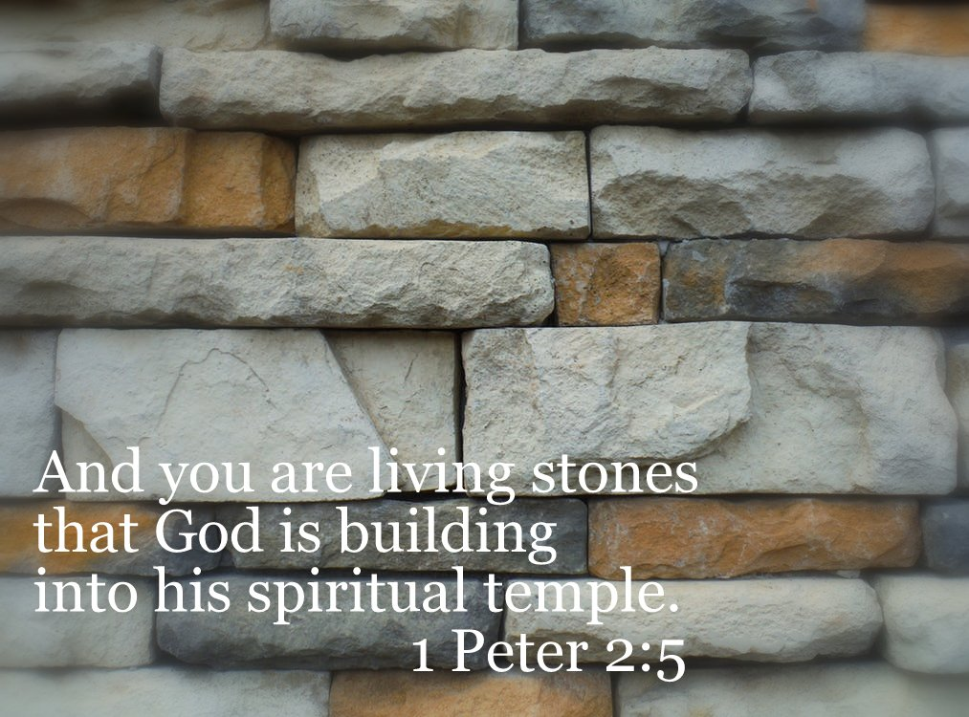
The Church: The Temple of God
The Church: The Temple of God
Living Walls
We are each a piece of the Temple of God.
1 Peter 2:5—
⁵you yourselves like living stones are being built up as a spiritual house, to be a holy priesthood, to offer spiritual sacrifices acceptable to God through Jesus Christ. (ESV)
We are part of the God’s house:
  Living—Dynamic structure
  Built up—Holy Spirit built.
  Priesthood—Serving
  Offering—Sacrifice

Slide 29

The Church: The Temple of God
The Church is not Doomed!
Not ‘Falling apart’
Not ‘Flying to pieces’
Not ‘Being unpicked, stitch-by-stitch.’

Slide 30


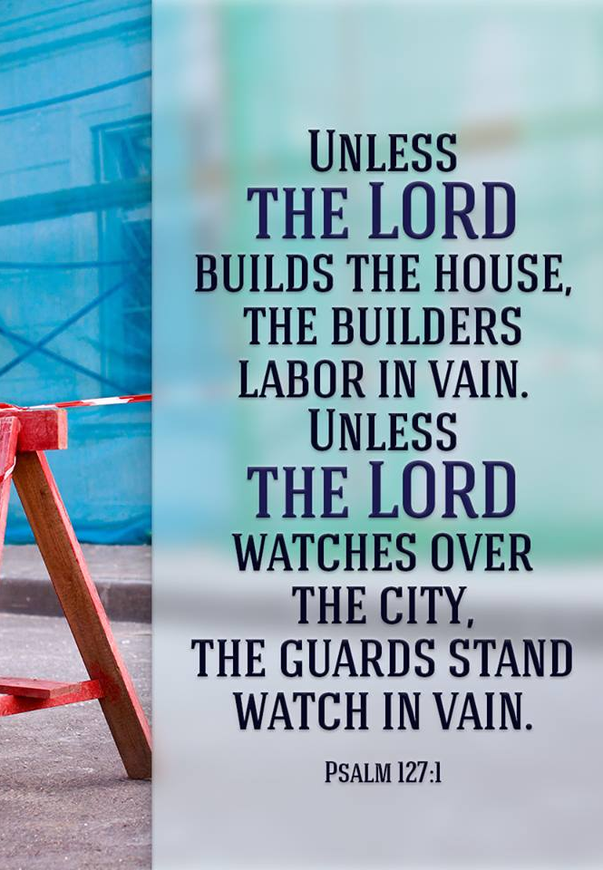
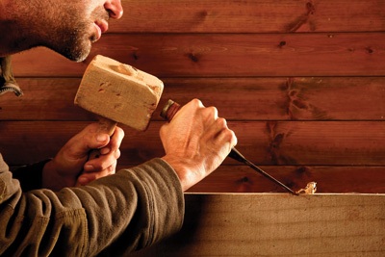
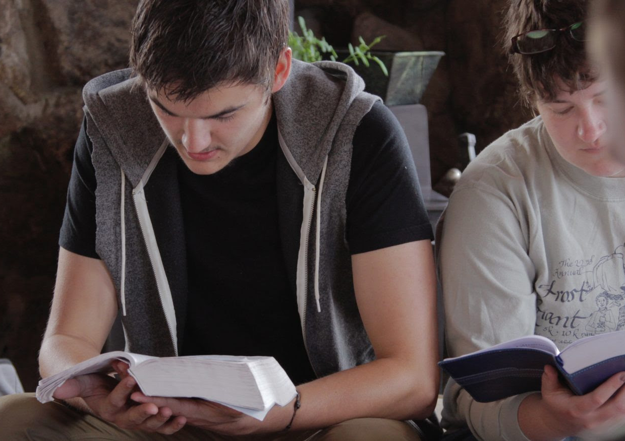
The Church: The Temple of God
It is alive and well on planet Earth—Worshiping, praying, preaching, helping the sick, poor, lonely,..calling all to be a part of the temple of God.

Slide 31
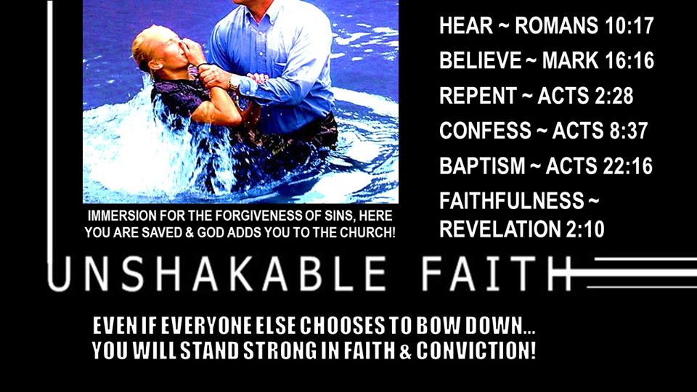
The Church: The Temple of God

