Slide 2


Slide 3

Just in case you didn’t notice…

Slide 4
Christmas is upon us.

Slide 5
It is a nice time of the year…?

Slide 6
It is a nice time of the year…?
YES!

Slide 7
Biblically speaking…?

Slide 8
Biblically speaking…?
A lot of liberties…to say the least!

Slide 9
Does it belong in the of the worship of the saints…?

Slide 10
Does it belong in the of the worship of the saints? NO!

Slide 11
At Home…?

Slide 12
At Home…?
YES!

Slide 13
But a word to the wise.

Slide 14
“If giving gifts to out children is encouraging little more than a selfish spirit, its time to seriously look at the meaning of Christian giving.”

Slide 15
Gifts to our children are teaching moments.
“You are blessed by someone else’s generosity.
But a greater blessing for you is to be generous.”

Slide 16
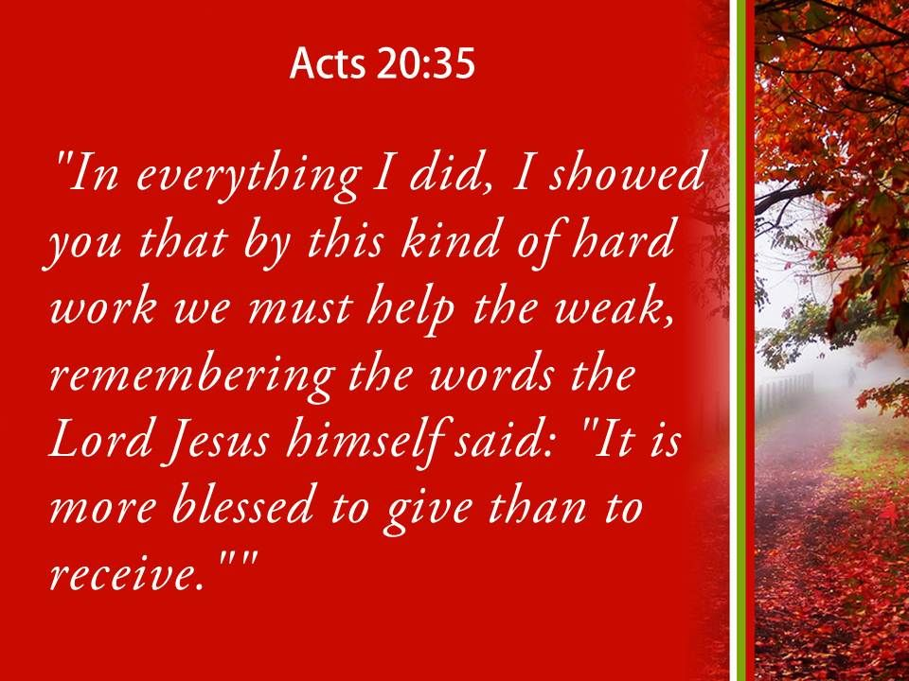

Slide 17

2 Corinthians 8:1-2—Now, brethren, we wish to make known to you the grace of God which has been given in the churches of Macedonia, ²that in a great ordeal of affliction their abundance of joy and their deep poverty overflowed in the wealth of their liberality. (NASB95)

Slide 18
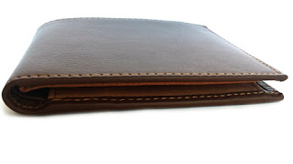
MONEY
  A powerful tool for good—A powerful tool for evil
  Christian giving is about the heart or it ceases to be Christian.
  The journey of giving is from the heart to the wallet, not from the wallet first.
  Selfish giving does not produce a generous spirit.
  Instead a generous spirit will produce eternal results

Slide 19
The Gifts of a Christian cannot be measured in dollars and cents…

Slide 20

SELFLESSNESS AND HUMILITY
Philippians 2:3—³Do nothing from selfish ambition or conceit, but in humility count others more significant than yourselves. (ESV)

Slide 21

PEACE AND MUTUAL UPBUILDING
  It starts in and around the Word of God.
  You can’t SEEK to find Godly PEACE and you can’t UPBUILD in the Lord away from His instruction manual.
Romans 14:19—¹⁹So then let us pursue what makes for peace and for mutual upbuilding. (ESV)

Slide 22


GOD’S WORD
  Give it in print
  Give it electronically
  Live it out before them
  Let it change you
  Challenge you
  Excite you
Hebrews 4:12— For the word of God is living and active and sharper than any two-edged sword, and piercing as far as the division of soul and spirit, of both joints and marrow, and able to judge the thoughts and intentions of the heart. (NASB95)

Slide 23

THAT WHICH IS DUE!
Romans 13:7-8
⁷ Render to all what is due them:
tax to whom tax is due;
custom to whom custom;
fear to whom fear;
honour to whom honour.
⁸Owe nothing to anyone except to love one another;
GOD’S WORD
  Give it in print
  Give it electronically
  Live it out before them
  Let it change you
  Challenge you
  Excite you
Hebrews 4:12— For the word of God is living and active and sharper than any two-edged sword, and piercing as far as the division of soul and spirit, of both joints and marrow, and able to judge the thoughts and intentions of the heart. (NASB95)

Slide 24

THAT WHICH IS DUE!
Proverbs 22:6—
⁶ Train up a child in the way he should go,
Even when he is old he will not depart from it. (NASB95)
GOD’S WORD
  Give it in print
  Give it electronically
  Live it out before them
  Let it change you
  Challenge you
  Excite you
Hebrews 4:12— For the word of God is living and active and sharper than any two-edged sword, and piercing as far as the division of soul and spirit, of both joints and marrow, and able to judge the thoughts and intentions of the heart. (NASB95)

Slide 25
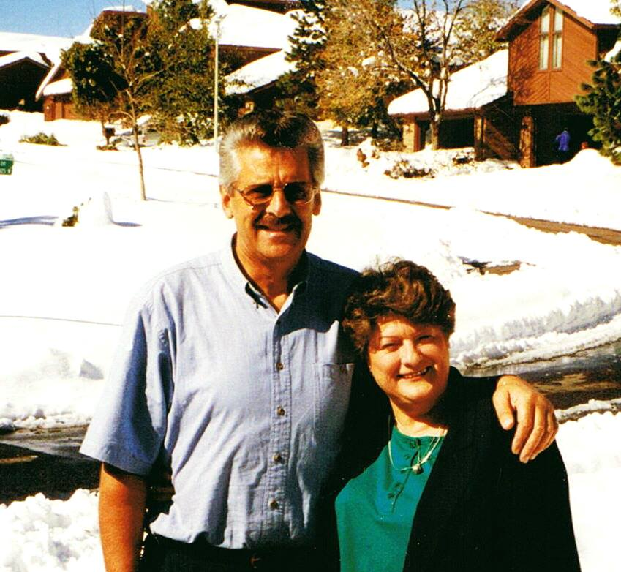
THAT WHICH IS DUE!
Proverbs 22:6—
⁶ Train up a child in the way he should go,
Even when he is old he will not depart from it. (NASB95)
Peter and Joan Craig were God’s gifts to a 16 year old boy who was desperately seeking Jesus.

Slide 26

John 3:16
¹⁶ “For God so loved the world, that He gave His only begotten Son, that whoever believes in Him shall not perish, but have eternal life. (NASB)

Slide 27


