Slide 2
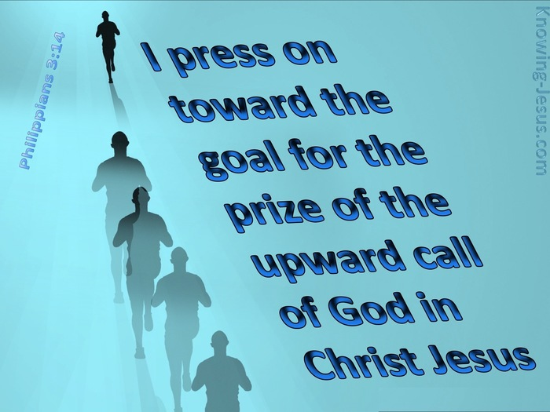
The
Prize!

Slide 3
1. The Command

Slide 4

1. The Command

Slide 5
1. The Command
Mark 16:15-16—
¹⁵And He said to them, “Go into all the world and preach the gospel to all creation. ¹⁶He who has believed and has been baptized shall be saved; but he who has disbelieved shall be condemned. (NASB95)

Slide 6
1. The Command
Matthew 28:19-20
¹⁹Go therefore and make disciples of all the nations, baptizing them in the name of the Father and the Son and the Holy Spirit, ²⁰teaching them to observe all that I commanded you; and lo, I am with you always, even to the end of the age.” (NASB95)

Slide 7

2. The Motivation
Philippians 3:14—
¹⁴ I press on toward the goal for the prize of the upward call of God in Christ Jesus. (NASB95)

Slide 8
2. The Motivation
1 Cor.9:22b—
…so that I may by all means save some. (NASB95)

Slide 9


3. The Strategy
1 Cor.9:24c— Run in such a way that you may win. (NASB95)
The goal is to
WIN THE PRIZE

Slide 10
3. The Strategy
Hebrews 12:1a—Therefore, since we have so great a cloud of witnesses surrounding us,… (NASB95)
Abraham
Isaac
Jacob
David
Rahab…
Strategy 1.
“Look at the winners before you:
“A cloud of witnesses”(Heb.12:1)

Slide 11
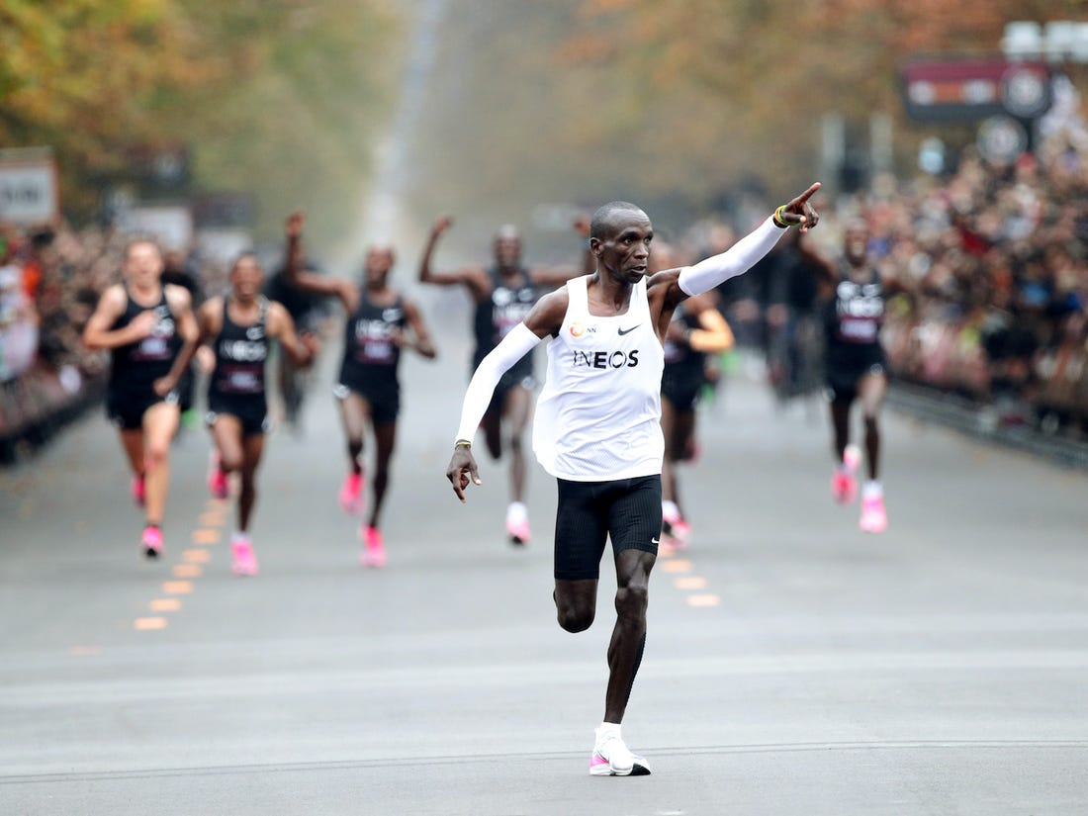
3. The Strategy
Hebrews 12:1b—…let us also lay aside every encumbrance and the sin which so easily entangles us,… (NASB95)
Eliud Kipchoge
Anger
Jealousy
Spite
Lust
Greed
Strategy 2.
Throw away all that slows you down or trips you up!...

Slide 12
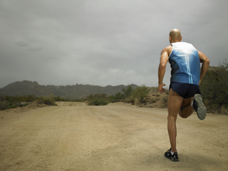
3. The Strategy
Hebrews 12:1—…and let us run with endurance the race that is set before us, (NASB95)
Training—
Self-discipline
Bible
Prayer
Fellowship
Strategy 3.
Keep going…!

Slide 13
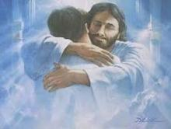
4. The Blessing
Matthew 25:21—His master said to him, ‘Well done, good and faithful slave. You were faithful with a few things, I will put you in charge of many things; enter into the joy of your master.’ (NASB95)
.
2 Timothy 4:7-8—⁷I have fought the good fight, I have finished the course, I have kept the faith; ⁸ in the future there is laid up for me the crown of righteousness, which the Lord, the righteous Judge, will award to me on that day; and not only to me, but also to all who have loved His appearing. (NASB95)

Slide 14

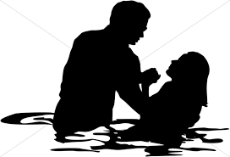
Mark 16:15-16—¹⁵And He said to them, “Go into all the world and preach the gospel to all creation. ¹⁶He who has believed and has been baptized shall be saved; but he who has disbelieved shall be condemned. (NASB95)

