Slide 1
“The Truth about Baptism.”
John Staiger
Morningside Church of Christ
Sunday 24 November 2019
AM Sermon

Slide 2
The Truth about
Baptism

Slide 3

The Truth about Baptism—What?—How?—Why?—Who?
  Adjustments have been made to the Truth
The truth is that Baptism:
  Is a contentious subject
  Causes confusion and division
  Its meaning and method has changed
  Christians would rather not talk about its deeper meaning.

Slide 4
The Truth about Baptism—What?—How?—Why?—Who?
  Adjustments have been made to the Truth
Bible Baptism:
  The simple act of a penitent believer being put under the water to have his/her sins washed away in the name of the Father, and the Son, and the Holy Spirit.
Changes have occurred…

Slide 5
  The Truth about Baptism—What?—How?—Why?—Who?
  Where we are, and where we should be
Today we will look at:
  What?—Definition
  How?—The Mode
  Why?—Reason
  Who?—Candidates

Slide 6
The Truth about Baptism—What?—How?—Why?—Who?
  Where we are, and where we should be
But First:
  Usually when you water something down, you add more water.
  Baptism, ironically is the exception.
  In the Bible the act of baptism began as full immersion for all.
  Tragically, that has changed.
New definitions…

Slide 7

The Truth about Baptism—What?—How?—Why?—Who?
  1. What?—Definition
The Definition
The English word ‘baptism’ is a transliteration of the Koine Greek verb: ‘Baptizo.’
Baptizo means “to dip, immerse, submerge or plunge.”
In simple terms—’to immerse—to put into water and draw out again.’
It was transliterated into English—and still is—to avoid Fear, Confusion and change.

Slide 8

The Truth about Baptism—What?—How?—Why?—Who?
  1. What?—Definition
To avoid:
  Fear
  Confusion and
  Change.
Fear that the believer would question the changes made by the church
That the believers would be Confused by this dishonesty, and
That the believers would call for a Change back to the Biblical mode.

Slide 9
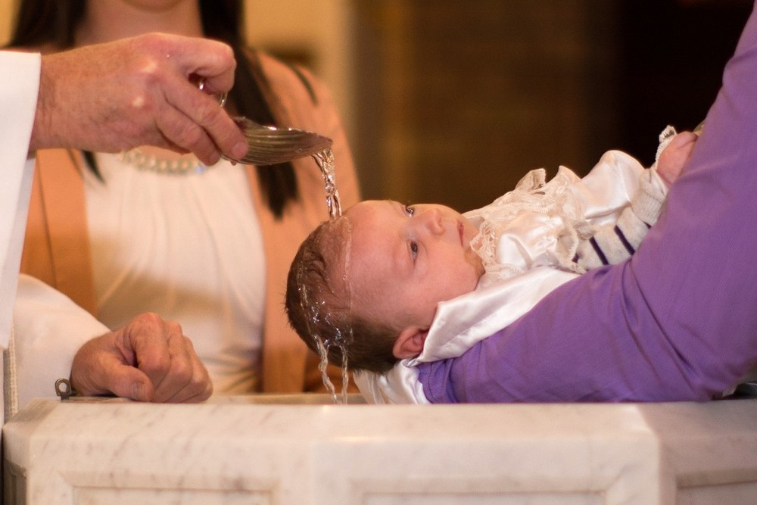
The Truth about Baptism—What?—How?—Why?—Who?
  2. How?—The Mode
The act of Baptism has been made to include two other methods:
  Sprinkling and
  Pouring
Problems…

Slide 10

The Truth about Baptism—What?—How?—Why?—Who?
  2. How?—The Mode
Problems with Sprinkling and Pouring:
  Neither are Biblical baptism
  They are found nowhere in the Bible as examples of Baptism
  They are the traditions of men—made up for convenience.
  You can’t be saved by them.

Slide 11
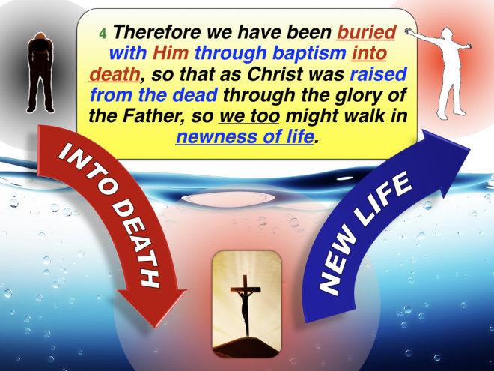
The Truth about Baptism—What?—How?—Why?—Who?
  2. How?—The Mode
A. Baptism is immersion:
  A Burial (Rom.6:4)
  John the Baptist—much water there.
  That’s how it was done–
    Here is water—Philip could have asked for a bottle of water instead.
    The Eunuch understood
    “They both went down into the water.”

Slide 12
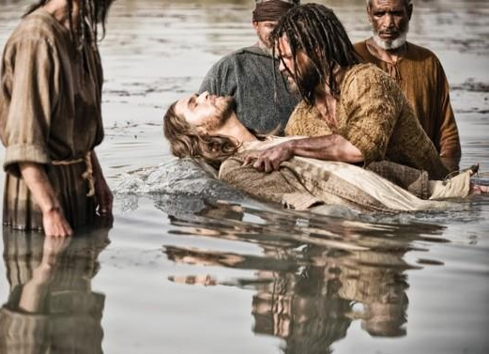
The Truth about Baptism—What?—How?—Why?—Who?
  2. How?—The Mode
A. Baptism is immersion:
  A Burial (Rom.6:4)
  John the Baptist— ‘much water.’ (Jn.3:23)
  That’s how it was done–
    Here is water—Philip could have asked for a bottle of water instead.
    The Eunuch understood
    “They both went down into the water.”
John 3:23—
²³John also was baptizing in Aenon near Salim, because there was much water there; and people were coming and were being baptized— (NASB95)

Slide 13
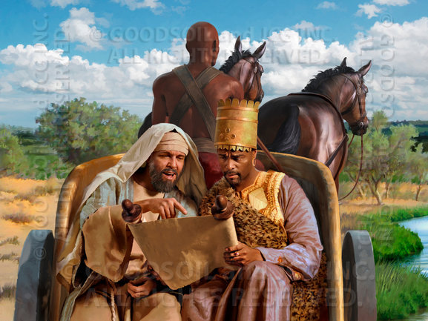
The Truth about Baptism—What?—How?—Why?—Who?
  2. How?—The Mode
A. Baptism is immersion:
  A Burial
  John the Baptist—much water there.
  That’s how it was done– (Acts 8:25-39)
    The Ethiopian Eunuch
    Philip taught him the gospel
    He could have asked for a bottle of water instead.
    The Eunuch understood
    “They both went down into the water.”

Slide 14
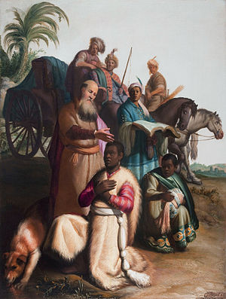
The Truth about Baptism—What?—How?—Why?—Who?
  2. How?—The Mode
A. Baptism is immersion:
  A Burial
  John the Baptist—much water there.
  That’s how it was done– (Acts 8:25-39)
    The Ethiopian Eunuch
    Philip taught him the gospel
    He could have asked for a bottle of water instead.
    The Eunuch understood
    “They both went down into the water.”
Sorry, Mr Rembrandt, this is not how it is written!

Slide 15
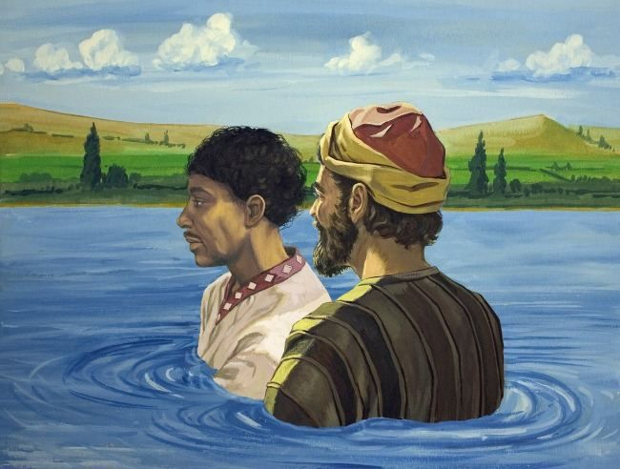
The Truth about Baptism—What?—How?—Why?—Who?
  2. How?—The Mode
A. Baptism is immersion:
  A Burial (Rom.6:4)
  John the Baptist—much water there.
  That’s how it was done– (Acts 8:25-39)
    The Ethiopian Eunuch
    Philip taught him the gospel
    He could have asked for a bottle of water instead.
    The Eunuch understood
    “They both went down into the water.”
Acts 8:38—³⁸And he ordered the chariot to stop; and they both went down into the water, Philip as well as the eunuch, and he baptized him. (NASB95)

Slide 16

The Truth about Baptism—What?—How?—Why?—Who?
  3. Why?—The Reason

Slide 17
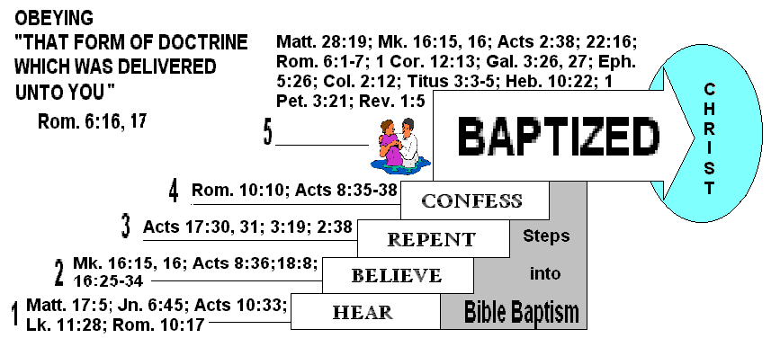
The Truth about Baptism—What?—How?—Why?—Who?
  3. Why?—The Reason
Galatians 3:27—
For all of you who were baptized into Christ have clothed yourselves with Christ. (NASB95)

Slide 18
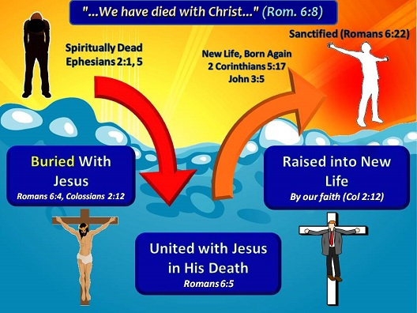
The Truth about Baptism—What?—How?—Why?—Who?
  3. Why?—The Reason
Romans 6:3-4—³Or do you not know that all of us who have been baptized into Christ Jesus have been baptized into His death? ⁴Therefore we have been buried with Him through baptism into death, so that as Christ was raised from the dead through the glory of the Father, so we too might walk in newness of life. (NASB95)

Slide 19

The Truth about Baptism—What?—How?—Why?—Who?
  4. Who?—The Candidate
Not a sinless baby
Not a child who is yet accountable for their actions
Those who are accountable
All sinners who understand what sin is and does
Adult believers
The penitent
Those ready to commit their lives to follow Jesus

Slide 20

The Truth about Baptism—What?—How?—Why?—Who?
As the Bible puts it!
A. Baptism Saves :
1 Peter 3:21
²¹Corresponding to that, baptism now saves you—not the removal of dirt from the flesh, but an appeal to God for a good conscience—through the resurrection of Jesus Christ, (NASB95)

Slide 21

The Truth about Baptism—What?—How?—Why?—Who?
As the Bible puts it!
B. Baptism Saves:
Mark 16:15-16—
¹⁵ And He said to them, “Go into all the world and preach the gospel to all creation. ¹⁶ He who has believed and has been baptized shall be saved; but he who has disbelieved shall be condemned. (NASB95)

