Slide 1
“The Truth about Truth.”
John Staiger
Morningside Church of Christ
Sunday 17 November 2019
AM Sermon

Slide 2
The Truth
About Truth

Slide 3

What is Truth?
In Basic terms—
  It is defined as that which conforms with fact or reality.
  It is genuineness, veracity, or actuality.
  In a word, truth is reality.
  It is how things actually are.

Slide 4
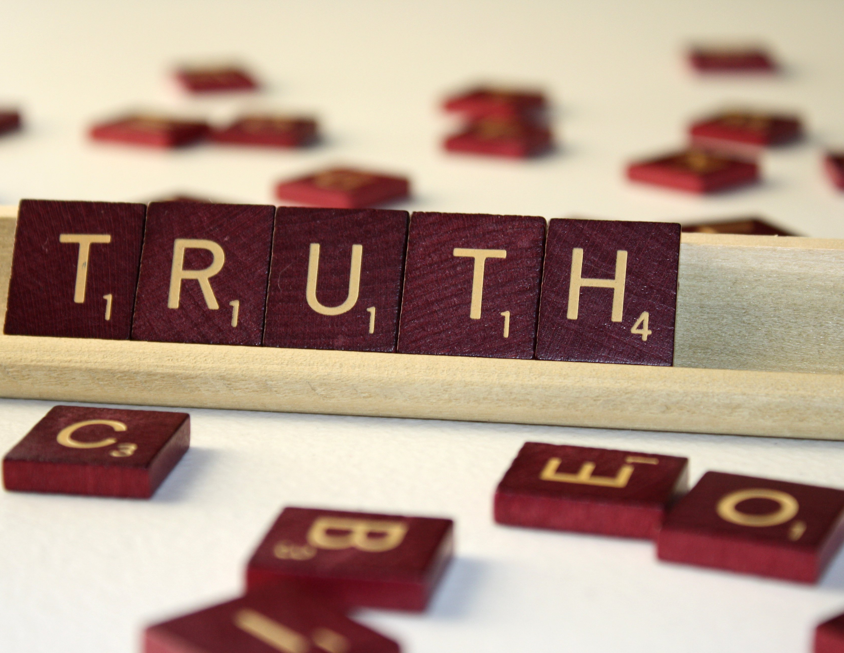
What is Truth?
Theologically, truth is that which is consistent with the mind, will, character, glory, and being of God.
  Truth is the self-disclosure of God Himself.
  It is what it is because God declares it so and made it so.
  All truth must be defined in terms of God, whose very nature is truth.

Slide 5

Truth—As ‘You’ see it!
Your concept of truth—
  1. Exposes your ‘World-view’.
  a) Outcome of chance
  Big-bang
  Evolution
  Aliens
  b) Product of design
  Created in the image of God.
  Adam and Eve

Slide 6
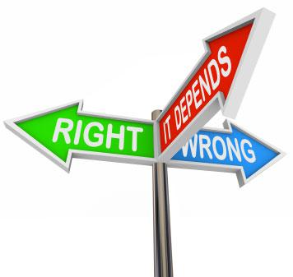
Truth—As ‘You’ see it!
Your concept of truth—
  2. Your moral absolutes
  Man determines right from wrong.
    Via Education / Logic
    Or Life-Experience
  God determines right from wrong.
    Biblical perspective.
    What God says is right.

Slide 7

Truth—As ‘You’ see it!
Your concept of truth—
  3. How is your value compass is calibrated?
  Who determines life and death issues?
  What is Fulfilment
    Success
    Peace of mind
  How should I live?
    Health
    Community
  What do I believe?
    Faith or Fate

Slide 8
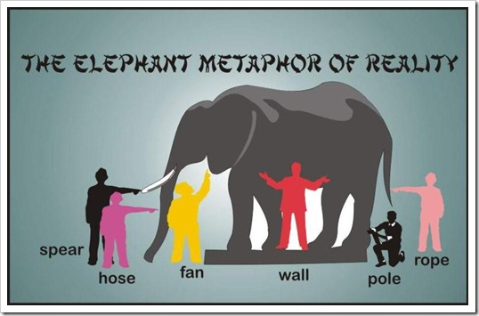
Truth—Problems with Perspective
1. What we ‘feel’ isn’t always the whole truth.
  Past experiences are limited
  Things past don’t always equate to present reality.
  Things change
  We may have been half right or just wrong!

Slide 9
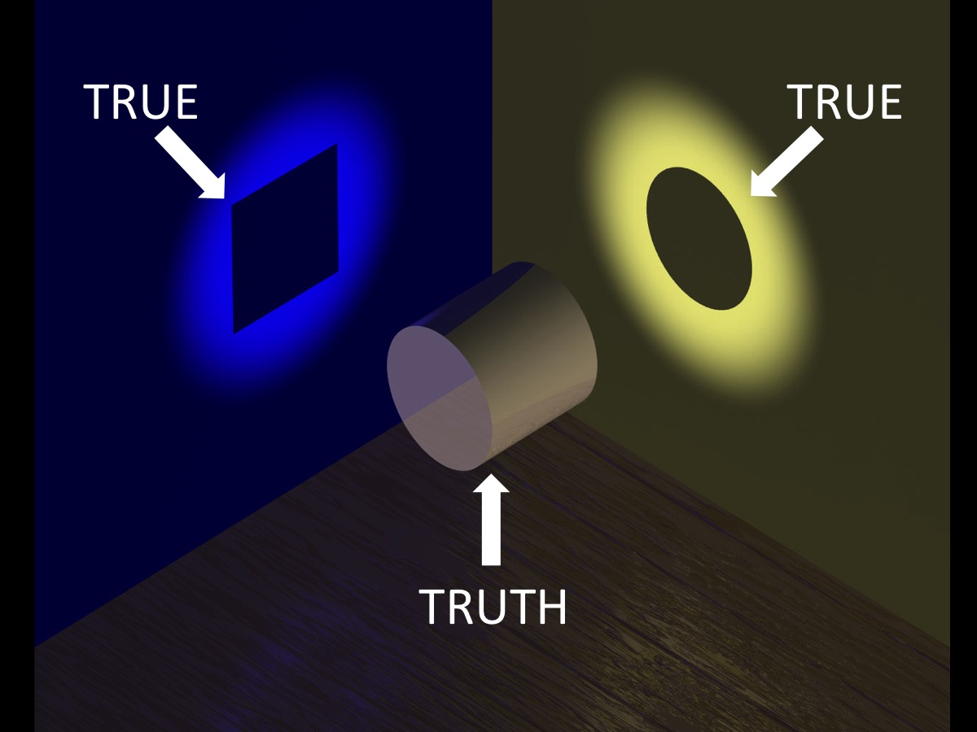
Truth—Problems with Perspective
2. What we ‘see’ isn’t always the whole truth.
  New ‘light’ can help or confuse
  But perception must be taken seriously.
  ‘Connecting the dots’ is the core of learning.

Slide 10

Truth—Problems with Perspective
3. Opinions
  We are intitled to them—until they distraught the facts.
  Points of view that become considered fact.
  …or worse still—Lies to deceive.

Slide 11
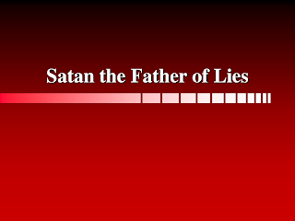
Truth—The Opposition
John 8:44—⁴⁴You are of your father the devil, and your will is to do your father's desires. He was a murderer from the beginning, and does not stand in the truth, because there is no truth in him. When he lies, he speaks out of his own character, for he is a liar and the father of lies. (ESV)

Slide 12
Truth—The Opposition
1. The Liar:
a) Name—
  Devil: "slanderer“
  Satan: “accuser” or “adversary”
b) Title—Father
  Followers: His children
  Desire: To be just like him
  To do as he does
c) Nature—Murderer
  Adam and Eve knew him personally
d) Character—Devoid of Truth
John 8:44—⁴⁴You are of your father the devil, and your will is to do your father's desires. He was a murderer from the beginning, and does not stand in the truth, because there is no truth in him. When he lies, he speaks out of his own character, for he is a liar and the father of lies. (ESV)

Slide 13

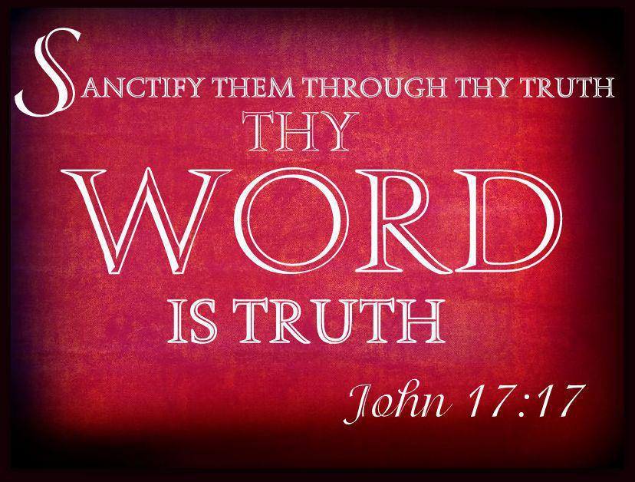
Truth—The Cure!
1. Holiness
  The Word of God is our guide to a holy life in Christ
  Anything else is to be considered a work of the devil
  Jesus claims to be
    “The Way”
    “The Truth”
    “The Life (Jn.14:6)
  This excludes ‘truth’ as defined by everyone else!
John 17:17—
¹⁷Sanctify them in the truth; Your word is truth. (NASB95)

Slide 14

Truth—Shall set you Free (Jn.8:32)
1. Jesus’ listeners didn’t believe that they were slaves of sin, either—
a) “We are Abraham’s descendants and have never yet been enslaved to anyone; how is it that You say, ‘You will become free’?” (NASB95)
Romans 6:16—Do you not know that when you present yourselves to someone as slaves for obedience, you are slaves of the one whom you obey, either of sin resulting in death, or of obedience resulting in righteousness? (NASB95)

Slide 15

John 8:32
³²and you will know the truth, and the truth will set you free.” (ESV)
John 16:13—¹³When the Spirit of truth comes, he will guide you into all the truth,…(ESV)

Slide 16

Truth—Shall set you Free (Jn.8:32)
John 1:14
¹⁴And the Word became flesh and dwelt among us, and we have seen his glory, glory as of the only Son from the Father, full of grace and truth. (ESV)

Slide 17
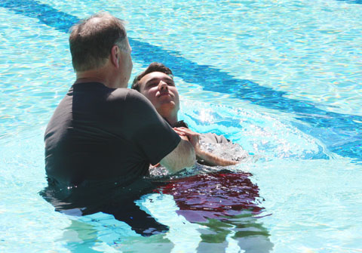
Acts 22:16—¹⁶ Now why do you delay? Get up and be baptized, and wash away your sins, calling on His name.’ (NASB)

